Slide 1

Question Answering Chatbot: A project presentation by: Aditya Goel Wael Abdelkader
SEP 788/789: Neural Networks and Development Tools
Dr. Hamidreza Mahyar

Slide 2
Agenda
Background on chatbots
UML use-case
Data and pre-processing
Model training and evaluation
Challenges and limitations
Conclusion and demo

Slide 3
What is a Chatbot?
Chatbots are a software or computer program that simulates human conversation through text or voice interactions.

Slide 4
Types of Chatbot
Menu/button chatbots
Keyword Recognition chatbots
Rule-Based chatbots
Voice chatbots
Hybrid chatbots
AI chatbots

Slide 5
Types of Chatbot
Retrieval Based
Chatbot

Slide 6
Types of Chatbot
Retrieval Based
Chatbot
Generative Based
Chatbot

Slide 7
Types of Chatbot
Retrieval Based
Chatbot
Generative Based
Chatbot

Slide 8
Types of Chatbot
Retrieval Based
Chatbot
Generative Based
Chatbot
QA Pairs
or
Context (Article)

Slide 9
Types of Chatbot
Retrieval Based
Chatbot
Generative Based
Chatbot
User’s Question
QA Pairs
or
Context (Article)

Slide 10
Types of Chatbot
Retrieval Based
Chatbot
Generative Based
Chatbot
User’s Question
QA Pairs
or
Context (Article)
Model

Slide 11
Types of Chatbot
Retrieval Based
Chatbot
Generative Based
Chatbot
User’s Question
QA Pairs
or
Context (Article)
Model
Chatbot’s Response

Slide 12
Types of Chatbot
Retrieval Based
Chatbot
Generative Based
Chatbot

Slide 13
Types of Chatbot
Retrieval Based
Chatbot
Generative Based
Chatbot
User’s Message
Previous Messages

Slide 14
Types of Chatbot
Retrieval Based
Chatbot
Generative Based
Chatbot
User’s Message
Model
Previous Messages

Slide 15
Types of Chatbot
Retrieval Based
Chatbot
Generative Based
Chatbot
User’s Message
Model
Chatbot’s Response
Previous Messages

Slide 16
What have we used ?

Slide 17
Types of Chatbot
Retrieval Based
Chatbot
User’s Question
QA Pairs
or
Context (Article)
Model
Chatbot’s Response

Slide 18
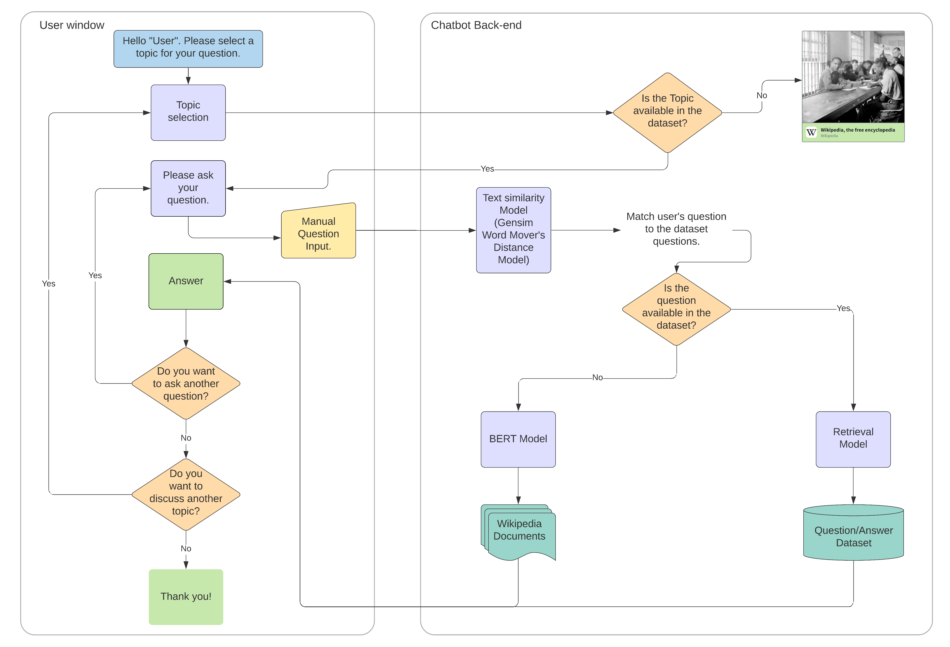
UML use-case diagram

Slide 19
The Dataset
QA Pairs
or
Context (Article)

Slide 20
The Dataset
106 Wikipedia articles.
QA Pairs
or
Context (Article)

Slide 21
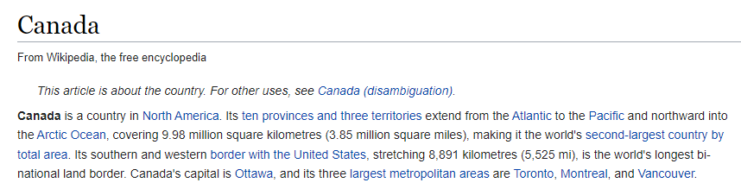
The Dataset
106 Wikipedia articles.
QA Pairs
or
Context (Article)

Slide 22
The Dataset
106 Wikipedia articles.
4000 Question – Answer pairs.
QA Pairs
or
Context (Article)

Slide 23
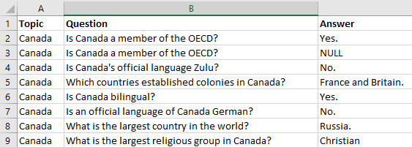
The Dataset
106 Wikipedia articles.
4000 Question – Answer pairs.
An average of 38 QA pairs per article.
QA Pairs
or
Context (Article)

Slide 24
Pre-Processing

Slide 25
Pre-Processing
Only Pre-Process the Questions.
No changes in the Wikipedia Articles.

Slide 26
Pre-Processing
Which countries established colonies in Canada?

Slide 27
Pre-Processing
Which countries established colonies in Canada?

Slide 28
Pre-Processing
Which countries established colonies in Canada?
which country establish colony in canada

Slide 29
Pre-Processing
Which countries established colonies in Canada?
which country establish colony in canada
What did we do ?

Slide 30
Pre-Processing
Which countries established colonies in Canada?
which country establish colony in canada
1. Tokenisation

Slide 31
Pre-Processing
Which countries established colonies in Canada?
which country establish colony in canada
1. Tokenisation

Slide 32
Pre-Processing
Which countries established colonies in Canada?
which country establish colony in canada
2. Lower Casing
1. Tokenisation

Slide 33
Pre-Processing
Which countries established colonies in Canada?
which country establish colony in canada
2. Lower Casing
1. Tokenisation

Slide 34
Pre-Processing
Which countries established colonies in Canada?
which country establish colony in canada
3. Remove Punctuations
1. Tokenisation
2. Lower Casing

Slide 35
Pre-Processing
Which countries established colonies in Canada?
which country establish colony in canada
3. Remove Punctuations
1. Tokenisation
2. Lower Casing

Slide 36
Pre-Processing
Which countries established colonies in Canada?
which country establish colony in canada
4. Lemmatisation
1. Tokenisation
2. Lower Casing
3. Remove Punctuations

Slide 37
Pre-Processing
Which countries established colonies in Canada?
which country establish colony in canada
4. Lemmatisation
1. Tokenisation
2. Lower Casing
3. Remove Punctuations

Slide 38
Pre-Processing
Which countries established colonies in Canada?
which country establish colony in canada
4. Lemmatisation
1. Tokenisation
2. Lower Casing
3. Remove Punctuations

Slide 39
Pre-Processing
Which countries established colonies in Canada?
which country establish colony in canada
4. Lemmatisation
1. Tokenisation
2. Lower Casing
3. Remove Punctuations

Slide 40
Model

Slide 41
User’s Question
Search answer in the QA Dataset
Yes
Retrieve Answer
No
Search answer using BERT Model
Yes
Retrieve Answer
No
Exit

Slide 42
User’s Question
Search answer in the QA Dataset

Slide 43
User’s Question
Search answer in the QA Dataset
How do we search?

Slide 44
User’s Question
Search answer in the QA Dataset
How do we search?
Question-Matching
using
Text – Similarity

Slide 45
User: Largest country in the world?

Slide 46
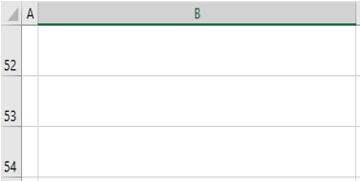
User: Largest country in the world?
Capital of Canada?
Biggest nation on Earth?

Slide 47
User: Largest country in the world?
1.65
Capital of Canada?
Biggest nation on Earth?

Slide 48
User: Largest country in the world?
1.65
Capital of Canada?
Biggest nation on Earth?

Slide 49
User: Largest country in the world?
Capital of Canada?
0.25
Biggest nation on Earth?

Slide 50

User: Largest country in the world?
Capital of Canada?
0.25
Biggest nation on Earth?

Slide 51
How to calculate the Text Similarity Score?

Slide 52
Text Similarity Score
Gensim Library (Link)
a. Word Mover’s Distance

Slide 53
Word Mover’s Distance
1. Computes the “Minimum Travelling Distance”.

Slide 54
Word Mover’s Distance
1. Computes the “Minimum Travelling Distance”.
Text1: Largest country in the world
Text2: Biggest nation on Earth

Slide 55
Word Mover’s Distance
1. Computes the “Minimum Travelling Distance”.
Text1: Largest country in the world
Text2: Biggest nation on Earth
How?

Slide 56
Word Mover’s Distance
1. Computes the “Minimum Travelling Distance”.
Text1: Largest country in the world
Text2: Biggest nation on Earth
How?
Convert Words to Vectors
(Word2Vec)

Slide 57
Word Mover’s Distance
1. Computes the “Minimum Travelling Distance”.
Text1: Largest country in the world
Text2: Biggest nation on Earth
Country
Largest
World

Slide 58
Word Mover’s Distance
1. Computes the “Minimum Travelling Distance”.
Text1: Largest country in the world
Text2: Biggest nation on Earth
Country
Nation
Largest
Biggest
World
Earth

Slide 59
Word Mover’s Distance
1. Computes the “Minimum Travelling Distance”.
Text1: Largest country in the world
Text2: Biggest nation on Earth
Country
Nation
Largest
Biggest
World
Earth

Slide 60
Word Mover’s Distance
If Distance < ɛ
Country
Nation
Largest
Biggest
World
Earth

Slide 61
Word Mover’s Distance
If Distance < ɛ
Country
Nation
Largest
Biggest
World
Earth

Slide 62
Word Mover’s Distance
If Distance < ɛ
We set ɛ = 0.2
Country
Nation
Largest
Biggest
World
Earth

Slide 63
User’s Question
Search answer in the QA Dataset
Yes
Retrieve Answer

Slide 64
User’s Question
Search answer in the QA Dataset
Yes
Retrieve Answer
No

Slide 65
User’s Question
Search answer in the QA Dataset
Yes
Retrieve Answer
No
Search answer using BERT Model

Slide 66
User’s Question
Search answer in the QA Dataset
Yes
Retrieve Answer
No
Search answer using BERT Model
How does BERT search?

Slide 67
BERT
Bidirectional Encoder Representation
from Transformer

Slide 68
BERT
Bidirectional Encoder Representation from Transformer

Slide 69
BERT
Bidirectional Encoder Representation from Transformer
Architecture

Slide 70
BERT
Bidirectional Encoder Representation from Transformer
Architecture
Encoder
Decoder

Slide 71
BERT
Bidirectional Encoder Representation from Transformer
Architecture
that transforms
OUTPUT
Encoder
Decoder
INPUT

Slide 72
BERT
Bidirectional Encoder Representation from Transformer
Architecture
that transforms
One Sequence into another Sequence.
OUTPUT
Encoder
Decoder
INPUT

Slide 73
BERT
Bidirectional Encoder Representation from Transformer
Architecture
that transforms
One Sequence into another Sequence.
I am a student
OUTPUT
Encoder
Decoder
INPUT
Je Suis Etudient

Slide 74
BERT
Bidirectional Encoder Representation from Transformer

Slide 75
BERT
Bidirectional Encoder Representation from Transformer
Encoder
Je
suis
etudient
INPUT
Je Suis Etudient

Slide 76
BERT
Bidirectional Encoder Representation from Transformer
Encoder
Je
suis
etudient
INPUT
Je Suis Etudient

Slide 77
BERT
Bidirectional Encoder Representation from Transformer
Encoder
How Does It Help?
Je
suis
etudient
INPUT
Je Suis Etudient

Slide 78
BERT
Bidirectional Encoder Representation from Transformer
Encoder
How Does It Help?
Understands the context...
Je
suis
etudient
INPUT
Je Suis Etudient

Slide 79
BERT
Bidirectional Encoder Representation from Transformer
Encoder
How Does It Help?
Understands the context...
MUCH MUCH
BETTER
Je
suis
etudient
INPUT
Je Suis Etudient

Slide 80
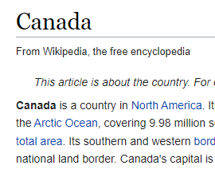
BERT

Slide 81
Where is Canada ?
BERT

Slide 82
Where is Canada ?
BERT
Canada is a country in North America

Slide 83
Limitations

Slide 84
Limitations
BERT was only able to accept 512 tokens at a time.

Slide 85
Limitations
BERT was only able to accept 512 tokens at a time.
Split the Wikipedia article into chunks of 512 tokens.
Implement the method in a loop until a suitable answer is retrieved.

Slide 86
Limitations
Could not find any evaluation metric for BERT.

Slide 87
Limitations
Could not find any evaluation metric for BERT.
Manually checked for 50 random questions on multiple topics.
Found suitable answers for 38 questions.

Slide 88
Limitations
Chatbot is limited to 106 topics only. Outside these topics, users won’t be able to find.

Slide 89
Limitations
Chatbot is limited to 106 topics only. Outside these topics, users won’t be able to find.
In such cases, we are redirecting the user to Wikipedia directly.

Slide 90
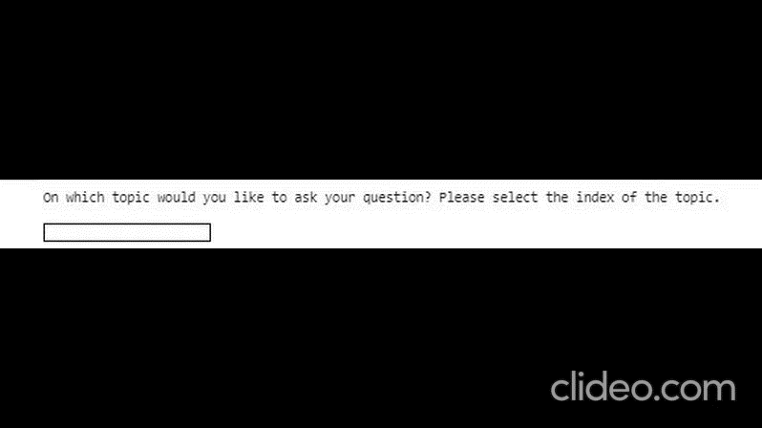
Demo

Slide 91
Select a Topic
0. Abraham Lincoln
Alessandro Volta
Amedeo Avogadro
Anders Celsius
Ant
Antwerp
Arabic Language
7. Bee
8. Beetle
9. Beijing
10. Berlin
11. Blaise Pascal
12. Butterfly
13. Calvin Coolidge
And many more…

