Slide 1


Slide 2
Why Git?

Slide 3
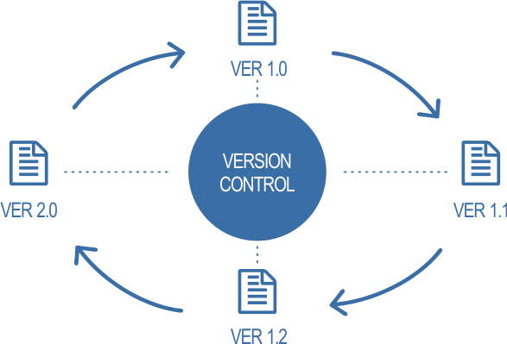

Slide 4
Install Git
https://git-scm.com/downloads

Slide 5
Basics of Linux
1) cd Desktop
takes you to Desktop
2) ls
Displays files and folders in desktop

Slide 6
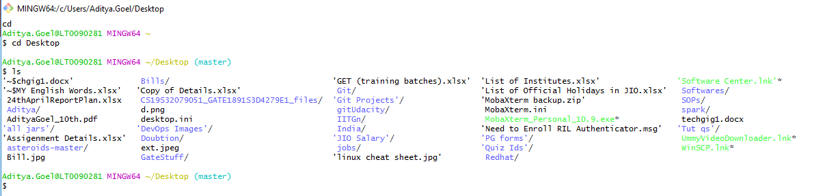

Slide 7
3) mkdir PracticeGit
Creates a folder (Directory) named ‘PrcticeGit’ on Desktop.
4) cd PracticeGit (Recall what this command does)
5) pwd
Gives the current directory on which we are

Slide 8
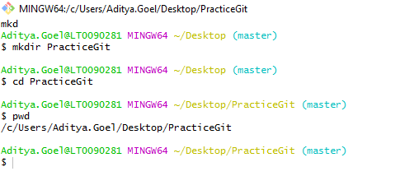

Slide 9
5) vi Biodata.txt
Opens a Text Editor inside the window.
6) To insert data – press “i”
7) To save data – press “esc” followed by “:wq”

Slide 10
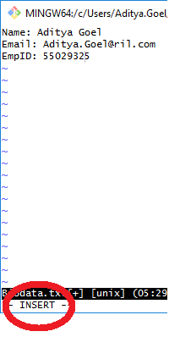
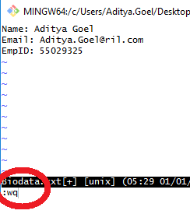

Slide 11
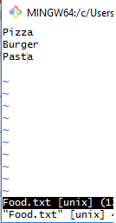
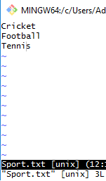
Task
Create 2 similar .txt files. These should be inside “PracticeGit” directory. Name these .txt files as:
Food.txt
Sport.txt

Slide 12
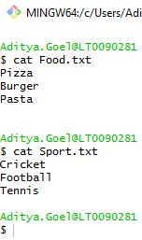
After saving and exiting, write “cat <filename>” to view the contents of the file in read-only mode.

Slide 13
Git Commands

Slide 14

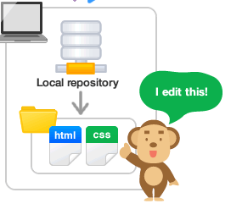
Git Repository
Repository in Git is similar to a folder
in windows. Files are stored inside a repository

Slide 15
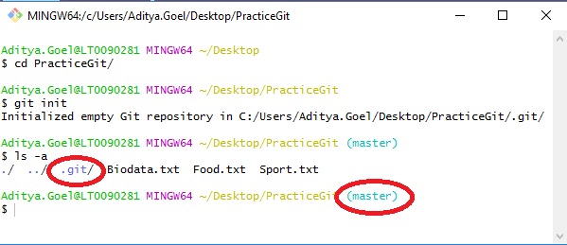
To convert a Folder into a Repository
cd PracticeGit
git init: converts a directory into repository
ls –a: lists all files and also hidden files (those which start with a dot(.))

Slide 16
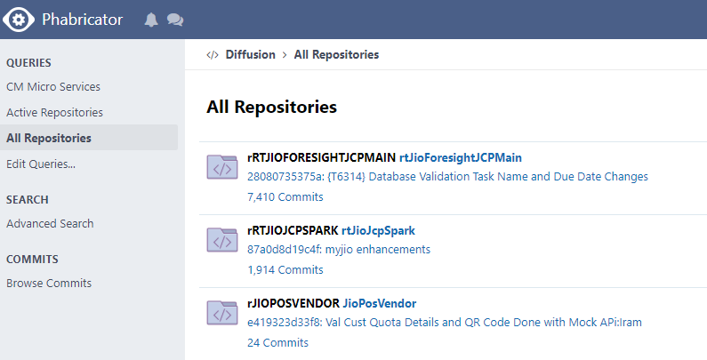

Slide 17
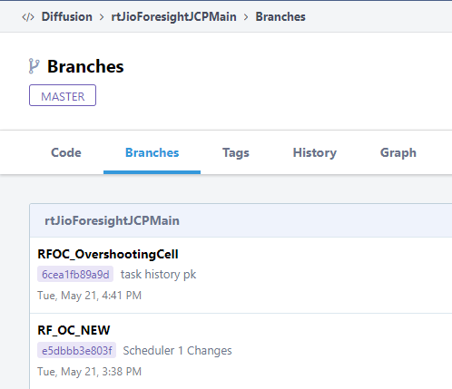
Git Branches
When multiple users work on the same repository, they create their own branches.
Default branch is “master” branch

