Slide 1
IBM Attrition Analytics Dashboard
File created on: 5/20/2026 11:52:10 AM

Slide 6
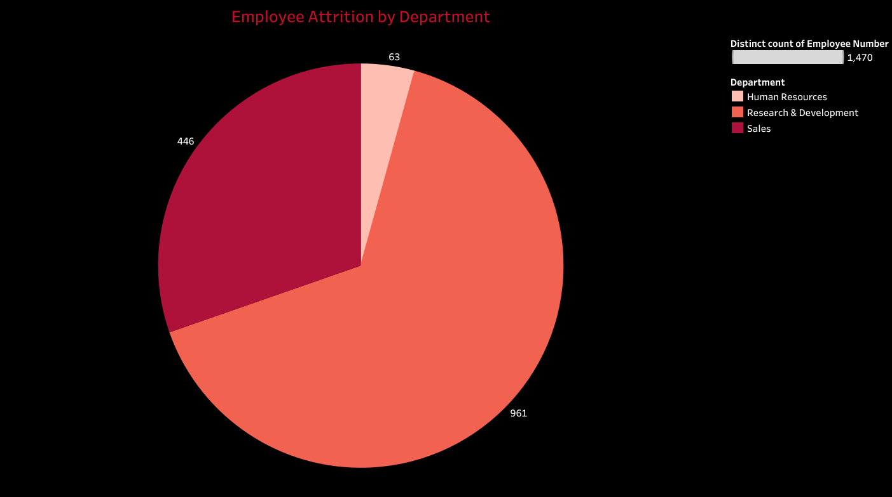

Slide 7
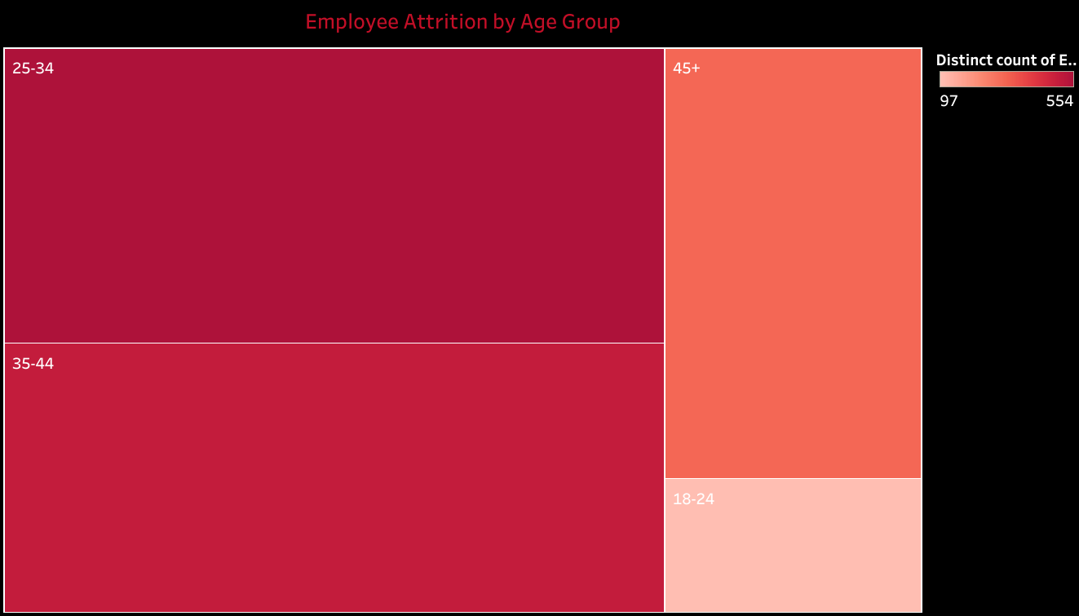

Slide 8
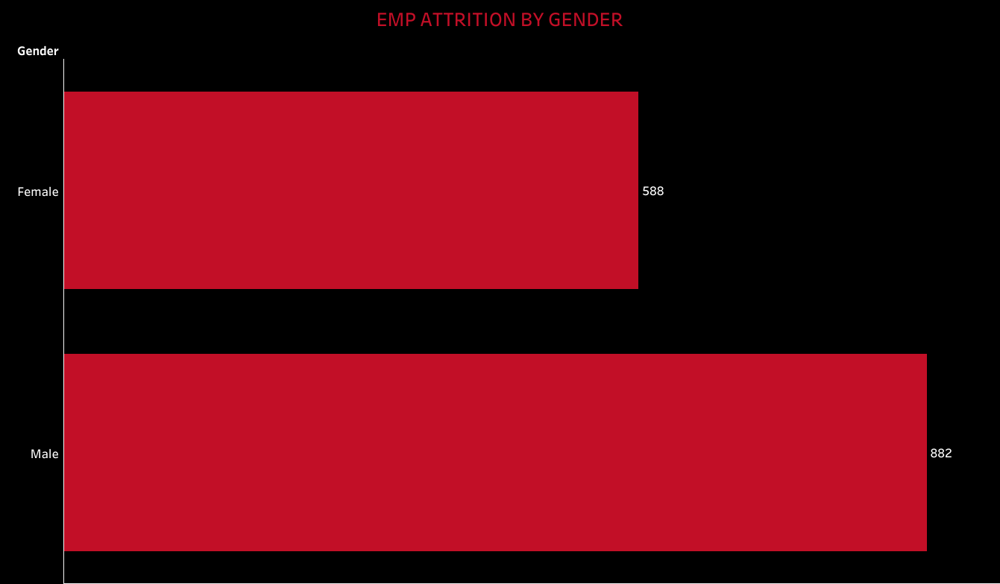

Slide 9
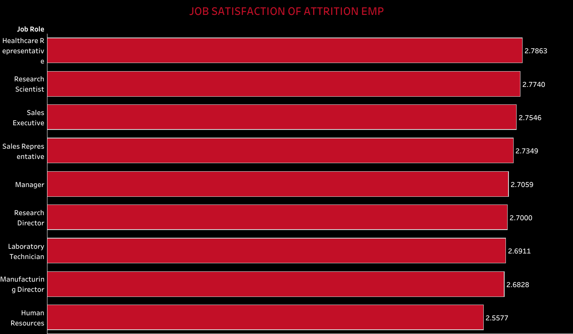

Slide 10
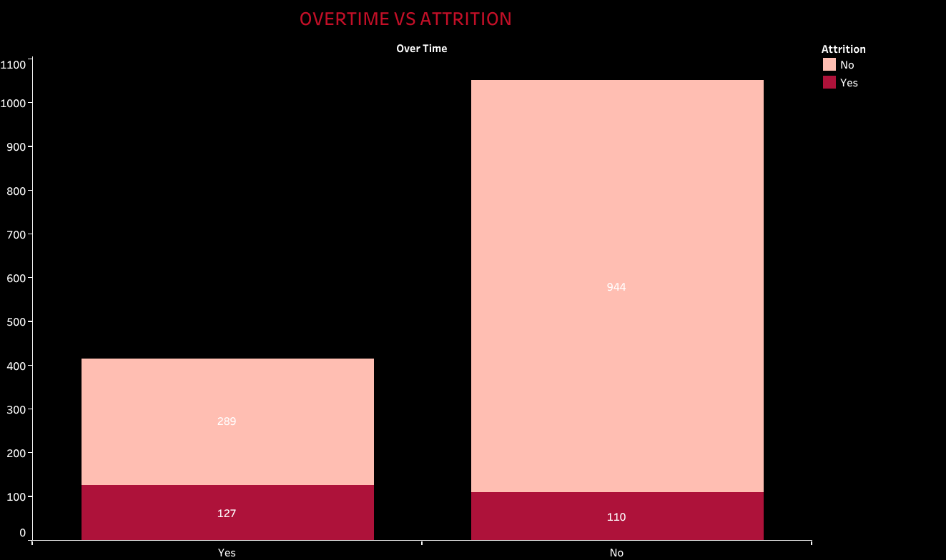

Slide 11
