Slide 1
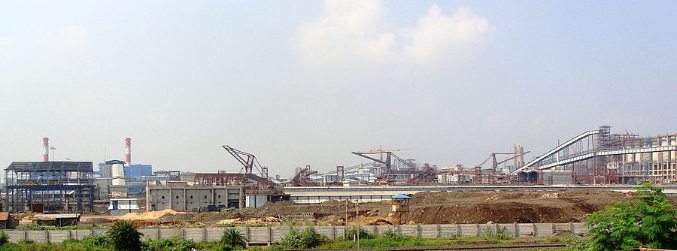

IISCO STEEL PLANT
By – Keshav Mohan

Slide 2
IISCO STEEL PLANT
IISCO Steel Plant of Steel Authority of India Limited is an integrated steel plant located at Burnpur in Asansol, in Asansol subdivision of Paschim Bardhaman district, West Bengal, India.

Slide 3
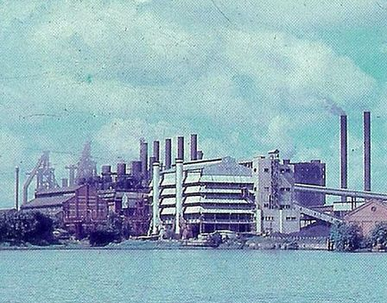
Overview
Established in 1918, the Indian Iron & Steel Company, once the flag ship of the Martin Burn group, was amalgamated with SAIL in 2006 and renamed IISCO Steel Plant.
IISCO Steel Plant of Steel Authority of India at Burnpur has a crude steel production capacity of 2.5 million tones per year.

Slide 4
Modernisation and expansion
The modernization and expansion programmer of IISCO steel plant was completed at a cost of over 16,000 crores. As of 2015, it was the single largest investment in West Bengal till then.
Manmohan Singh, Prime Minister, laid the foundation for the green field modernization and expansion of IISCO Steel Plant at Burnpur on 24 December 2006. Others present on the occasion included Buddhadeb Bhattacharjee, chief minister of West Bengal, Ram Vilas Paswan, union minister for chemicals & fertilizers and steel, and Priya Ranjan Dasmunsi, union minister for information & broadcasting.

Slide 5
Facilities
Coke Ovens : Coke Oven Battery No. 10 has 78 ovens with a height of 4.5 m and COB No. 11 has 74 ovens with a height of 7 m. It has a dry cooling plant using inert gases.
Raw material Handling System : designed to handle 7.56 million tones of raw materials annually,
Sinter Plant: Two sinter machines each with grate area of 204 m²
Blast Furnace: The 4,160 m³ Blast Furnace Kalyani is one of the largest in the country. It uses high blast temperature, oxygen enrichment, high top pressure and pulverized coal injection technology. It was the largest operating blast furnace in the country at the time of its being blown in on 30 November 2014. Prior to this the largest blast furnace was at Rourkela Steel Plant of SAIL with a useful volume of 4,060 m³.
Basic Oxygen Furnace: Three 150-tonne capacity BOFs to produce about 2.55 million tones of liquid steel annually. It is equipped with features like combined blowing and computerized operations.

