Slide 1
Online registration and processing of dairy farmers producing milk and other livestock products Team Treenity Indian Institute of Technology, Ropar, Punjab, India
SIH 2022

Slide 2

PROJECT DESCRIPTION
A mobile application where dairy and poultry farmers can list their dairy and other livestock products at different locations using GPS coordinates.
The app will be available in different languages to increase the target users.
Consumers can directly contact or request the producer for a specific product.
Users/consumers will have an option to rate a particular farm which will contribute to the producer's rating. This will help other consumers estimate the quality of the product of that producer.
Since lack of knowledge is also a significant concern in India, our app will provide helpful tips/suggestions based on scientific research and modern technologies about the maintenance and health of the livestock to increase production.
Our app will also provide a discussion forum for the producers where they can discuss their problems among themselves.

Slide 3
MOTIVATION
India ranks first among the world’s milk producing nations since 1998 and dairying has become an important secondary source of income for millions of rural families and has assumed the most important role in providing employment and income generating opportunities particularly for marginal and women farmers.
Poor accesses to organized markets deprive farmers of proper milk price.
So there is a need to provide them better market linkage.
Improving productivity of farm animals is one of the major challenges. The average annual milk yield of Indian cattle is 1172 kg which is only about 50% of the global average. So our app will provide some modern technology based and scientific based information and tips to the farmers.
Lack of proper data about livestock is also a major problem in India. We wish to solve this problem by collecting data about their livestock from the farmers.

Slide 4
TECHNOLOGY TOOLS USED
Mobile Application :
Frontend : XML
Backend : Kotlin
DATABASE: Google Firebase and Firestore
VERSIONS CONTROL SYSTEM: GIT
IDE: Android Studio

Slide 5
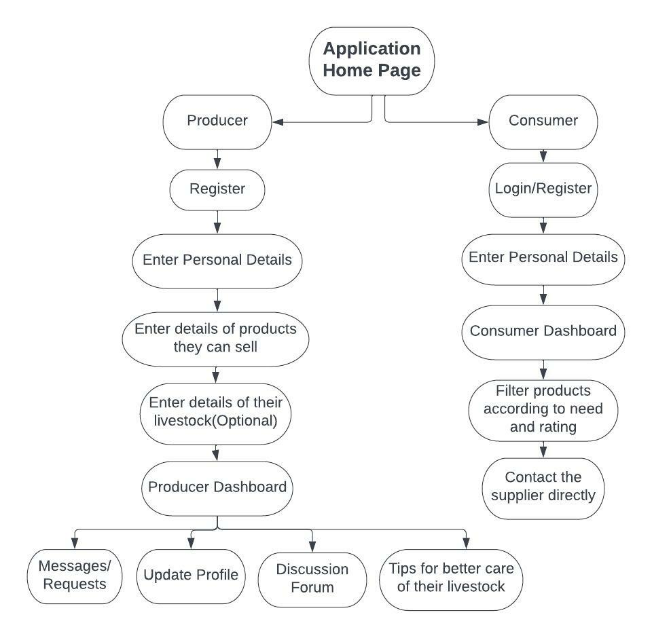
OUTLINE OF OUR APP

Slide 6
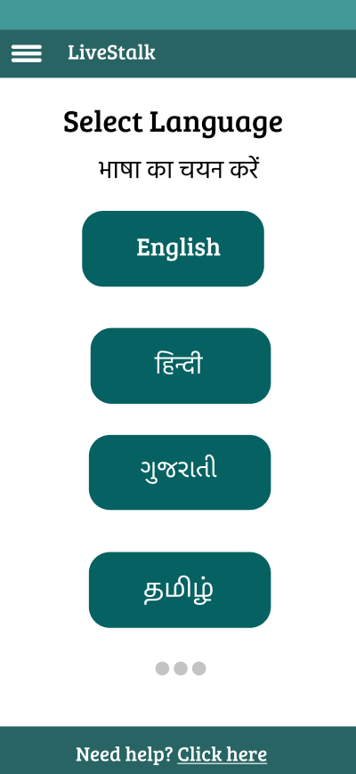
SELECTING LANGUAGE
At this stage, we will display a list of Indian languages.
Producers and consumers can select a language of their choice.
This feature will make our app usable for a diverse audience.

Slide 7
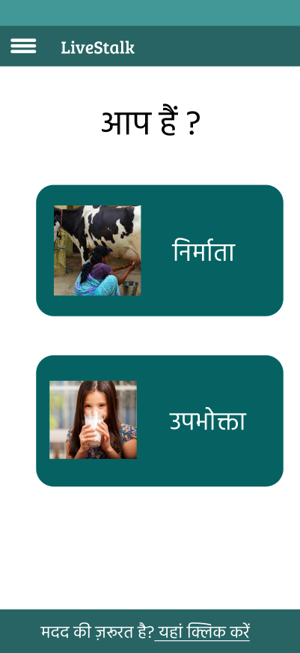
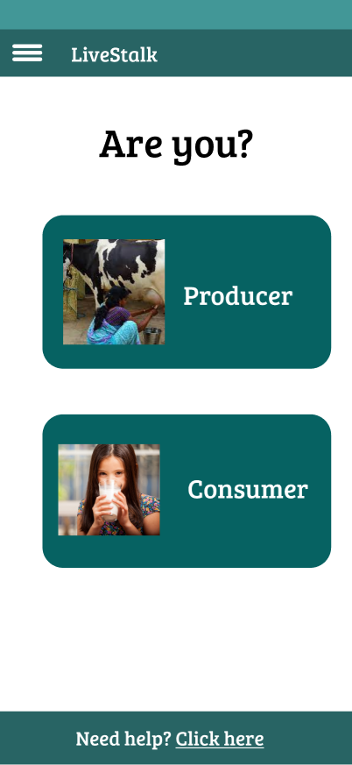
SELECTING USER TYPE
At this stage we will ask the user to select whether they are consumer or producer.
They will be directed to different pages according the option selected.

Slide 8
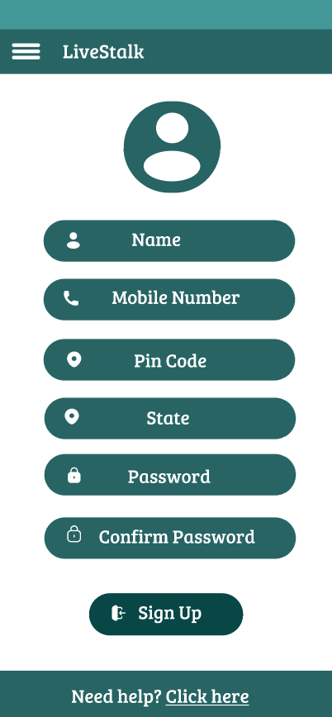
SIGNING UP
At this stage user will be asked make an account on our app.
The users will input their names and mobile numbers. The mobile numbers will be verified by a one time password (OTP).
The user can input their state and pin code or they can select the option of selecting automatically detecting their location.
If the user is consumer, they will be landed on consumer dashboard where they can select the product that they want to buy.
Then they will see the list of the suppliers/producers of the chosen location, where they can sort them according to many different parameters like rating/distance up to which they can supply etc.
They then will directly contact the supplier/producer/farmer for further information.

Slide 9
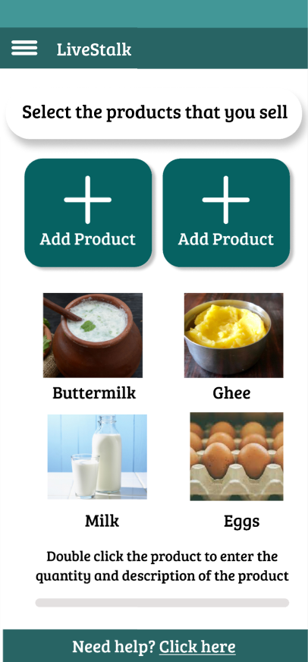
SELECTING THE PRODUCTS
The producers then will select the products from a list of the items, that they want to sell.
Then they will add details about the product such as the price, quantity, distance they can supply to, etc.
Producers can also add image of their product, other special specifications etc.

Slide 10
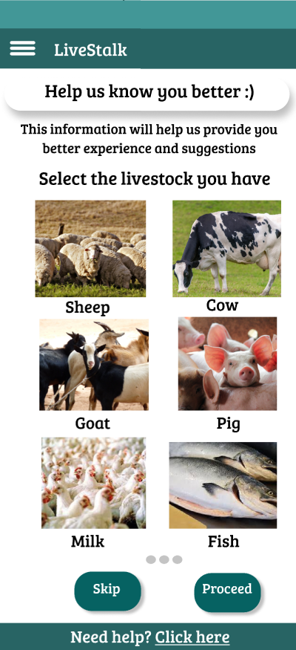
Asking information about their livestock
Our app will have a feature of giving some health and maintenance tips to the producer related to their livestock.
For this, we will ask the them to enter brief information about their livestock on a voluntary basis.
The producers can provide information like the kind of livestock, their count and anything else they want to mention.
Such information will help us provide them better suggestions on how to take best care of their livestock.

Slide 11
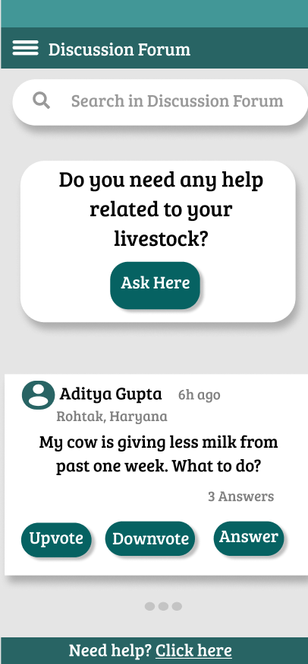
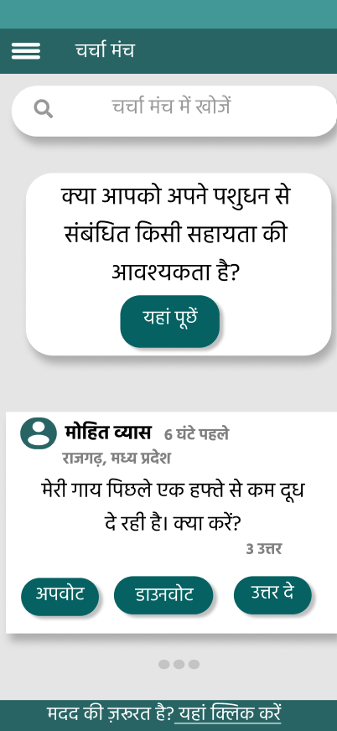
Discussion Forum
Our app will have a public discussion forum where the users can interact with each other.
If any producers is facing any problem, they can post that in this forum and other users can solve that problem based on their experience.
The data collected from this forum can also be used by government to solve the problems that are faced by a large number of producers.
In future, we can also provide some expert based advise by taking a nominal fee from the user.

Slide 12
Business Model
We can introduce a subscription model where users, by paying a nominal fee, can get benefits like expert advice on how to take the best care of their livestock, what diseases and problems are most prominent in their area, and how to prevent those diseases, etc.
The data collected by our app will be a great help in providing the above benefits.

Slide 13


