Slide 1
Team Artemis
Vision : To develop a software with following two features –
a) Land Water Discrimination using SAR imagery
b) Output detected ships as a vector file

Slide 2
Size Invariant Ship Detection
from SAR Images
Team Artemis

Slide 3
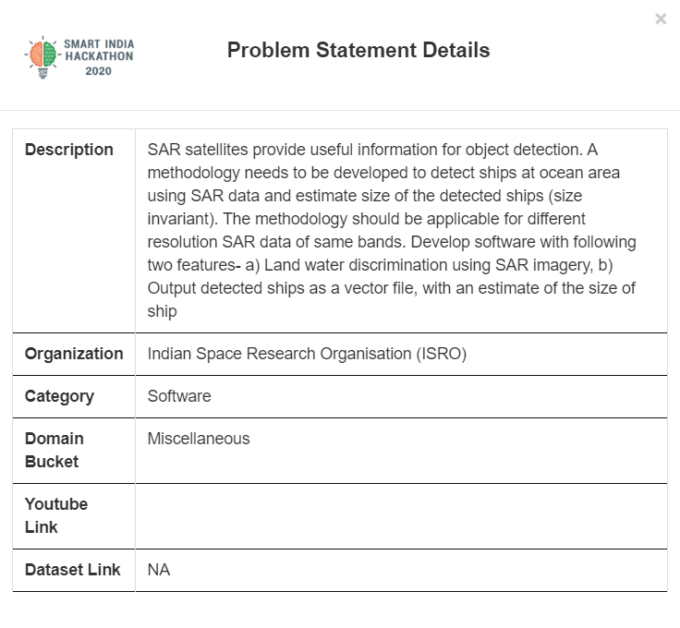
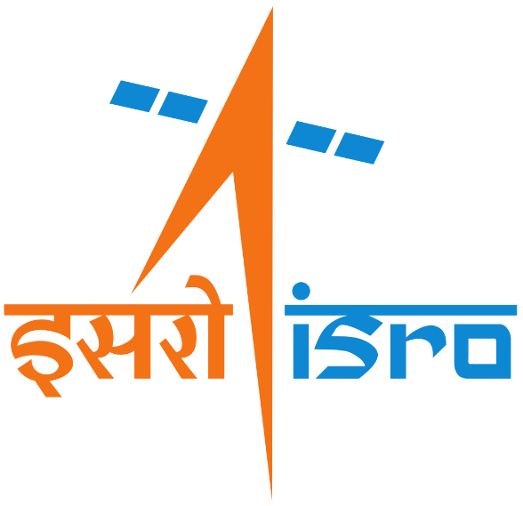
PROBLEM STATEMENT

Slide 4
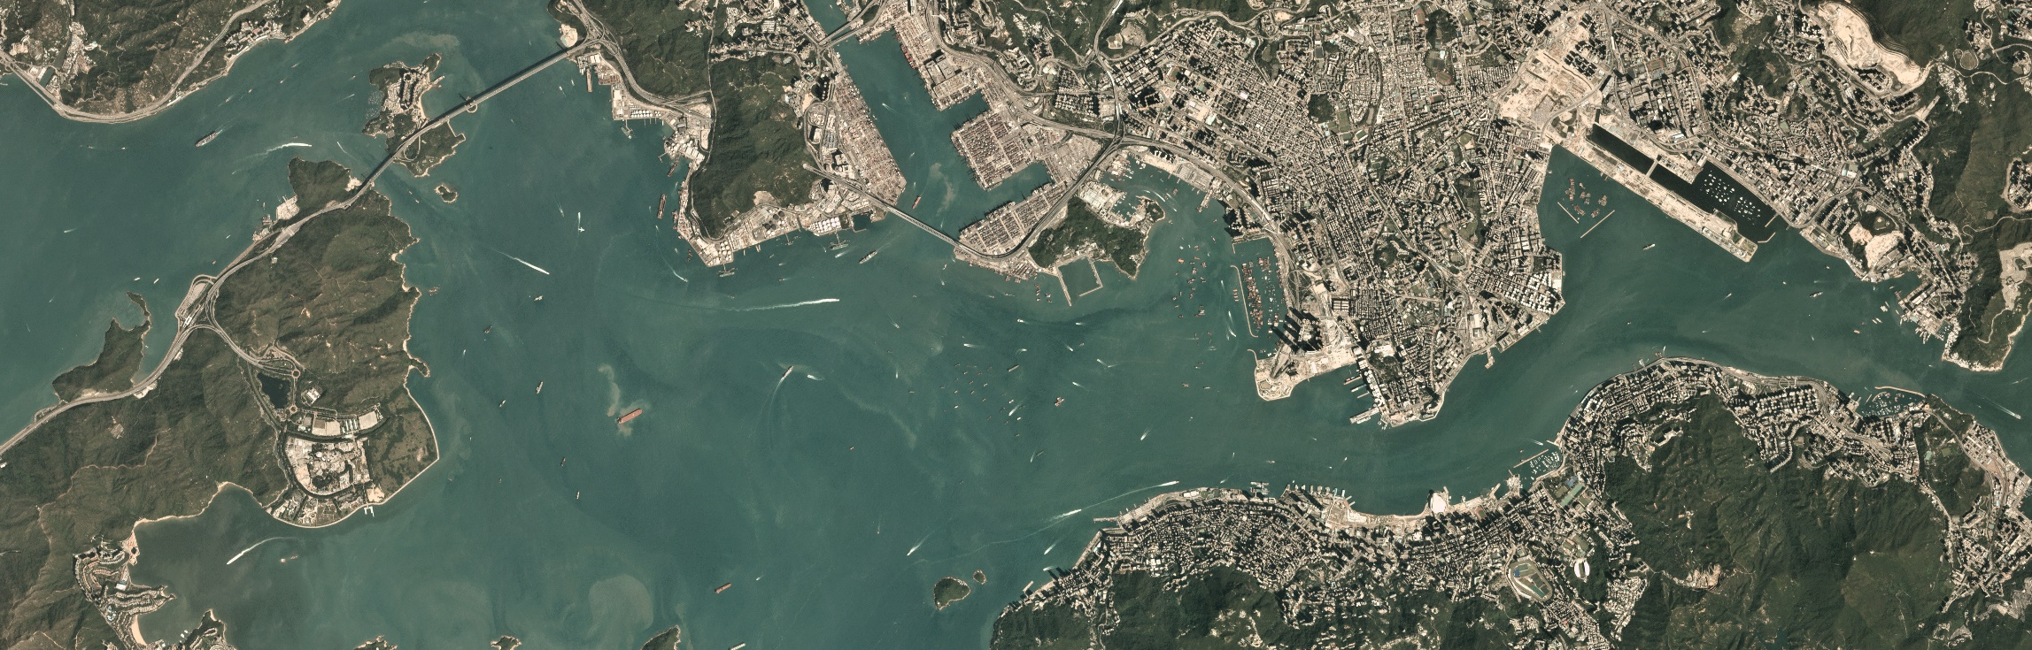
Challenge
Very High Resolution of SAR Satellite Images
8480 pixels
2718 pixels

Slide 5
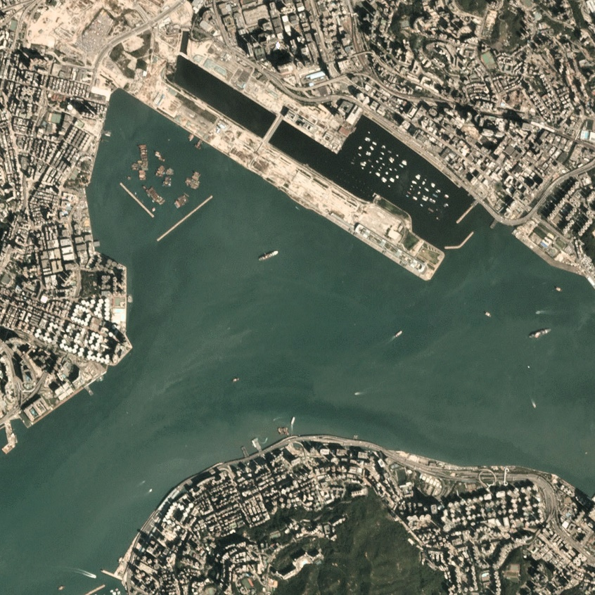
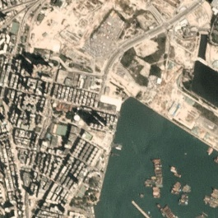
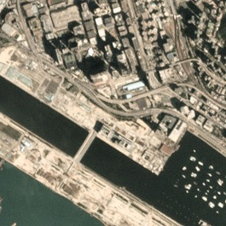
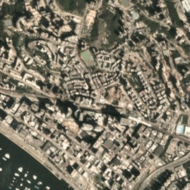
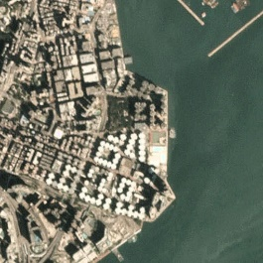
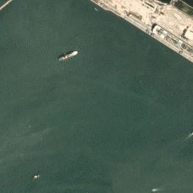
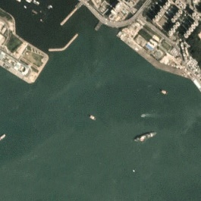
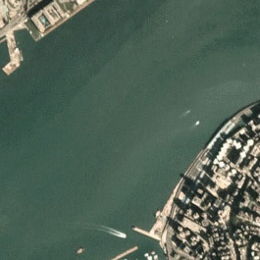
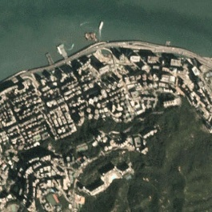
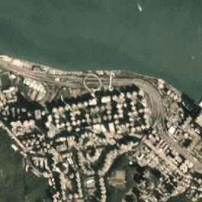
Solution
DATA CHIPPING : Dividing Image into Smaller Images

Slide 6




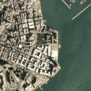
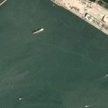



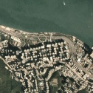
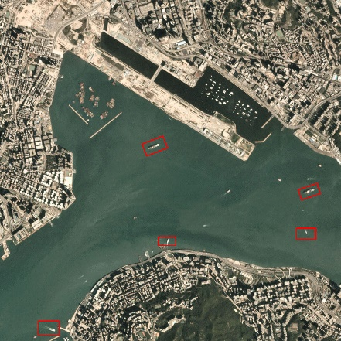


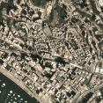
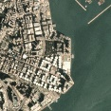
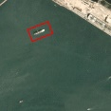
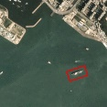
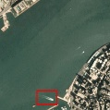
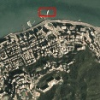
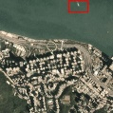
System Architecture
YOLOv3
Model
Chipping
Processing
Output
UnChipping

Slide 7
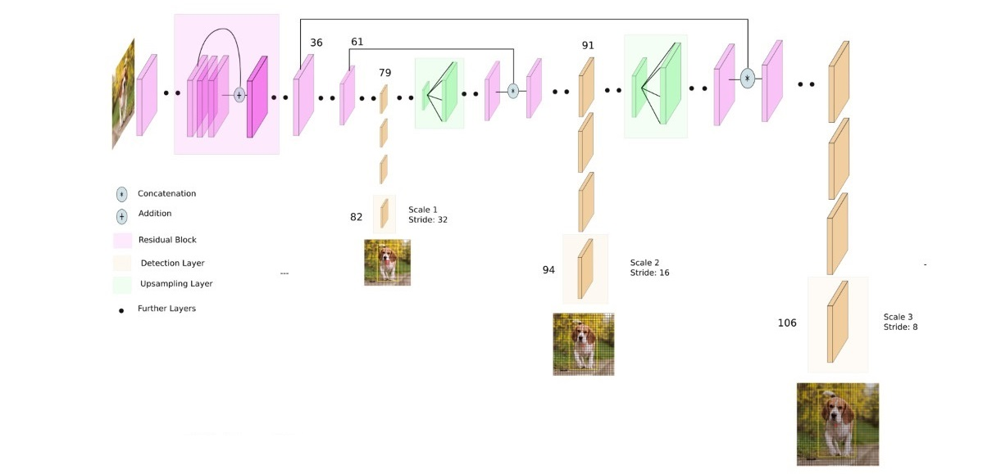
Model : YOLOv3 ARCHITECTURE

Slide 8
Business Model
Opportunities :
Our proposed model tackles the problem statements from ISRO.
This basically is a generalized project which can be used by authorities
for various types of activities like
Maintaining Security
Providing help to lost ship
Locating the ship coordinates
Sources of revenue :
It is a non-revenue generation model.

Slide 9
Competitive Advantages
It is observed that the proposed method greatly improved the accuracy to 95.03%
on the dataset.
Networks Accuracy Time Per Image (ms)
Faster-R-CNN 70.63% 206
YOLOv3 95.05% 25
The YOLOv3 training model had a learning rate of 0.0001 and batch size of 64 and
the total training had 1,500 iterations. We use convolutional weights that are
pre-trained on the ImageNet. Overall, this pre-trained weight is also suitable for SAR
image of ships, which is helpful for the training performance of the network.

Slide 10
SUMMARY
We evaluated the performance of the YOLOv3 deep network architecture to
detect a ship in various scenarios. The experimental results on a basic SAR
image dataset show that the YOLOv3 method outperforms current technologies
in terms of accuracy and performance in near real-time, especially in complex
situations. According to this study, YOLOv3 is very suitable for SAR image ship
detection and its detection speed is 5.8 times faster than faster-R-CNN. From
the experimental results, we can clearly show that the YOLOv3 architecture
has better detection accuracy and speed than the other recent detection
methods on dataset.

Slide 11
Q&A
Q. How does your idea address the problem?
Our idea is to divide the high resolution satellite images into smaller images and then
process it through YOLOv3 deep learning model to detect the ships in the smaller images
and again combine the smaller images to a single high resolution image.
Q. What makes your idea unique?
High Resolution satellite images can't be fed directly to any deep learning model as it leads
the generation of an enormous number of parameters. So, the dividing of high resolution image
into smaller images and then feeding them to the model makes our idea efficient and unique.
Q. What are the geographies, do you think the idea would be suitable for?
Our idea would be suitable for detecting all types of ships(size invariant) for any satellite image
from all the major platforms like Google Earth, PlanetLabs etc.

Slide 12
APPENDIX
https://pjreddie.com/darknet/yolo/
https://timebutt.github.io/static/how-to-train-yolov2-to-detect-custom-objects/
https://www.learnopencv.com/training-yolov3-deep-learning-based-custom-object-detector/
https://towardsdatascience.com/data-science-and-satellite-imagery-985229e1cd2f
Redmon, Joseph and Farhadi, Ali. YOLOv3: An Incremental Improvement., 2018.

