Slide 1

PROGRESS REPORT PRESENTATION
DYNAMIC PRODUCT REVIEW USING SENTIMENT ANALYSIS
BACHELOR OF TECHNOLOGY
in
Computer Science & Engineering
By:-
Guided by:-
Aditya Jayant Gupta(1905080100005)
Aditya Kumar Yadav(1905080100006)
Harsh Prajapati(1905080100035)
4th year, CS41
Dr. Avinash Gupta
(Head of department, CSE)

Slide 2

Introduction
Project Title
This project is titled “Dynamic Product Review Using Sentiment Analysis”
The aim of this project is to identify and analyze the probable sentiments of reviews for given products across shopping platforms and provide a visual representation of the customers’ feelings towards said product

Slide 3
Objective
Generate dynamic product review reports using supervised machine learning
Identify and analyze the sentiments and keywords of reviews for the given products
Create a web application frontend to allow interactive user access
Provide a visual representation of the generated analysis data
To facilitate easier and faster product research for users before making consumer decisions
Future scope:
Create browser extensions for different browsers to enable direct product lookup
Extend support for more shopping platforms

Slide 4
Work Done
50% of the work is done; Modules completed - 2 : Review Analysis Backend, Basic Frontend
Created front end for user interface.
Created scrapers to fetch review data for targeted products from Amazon and Flipkart
Identified and tested various text classification models for sentiment analysis
Prepared the models for sentiment score prediction and review summarization
Created working implementation of chosen keyword extraction model

Slide 5
Work Left
40% work remaining; Backend fine tuning, Middleware API, Hosting.
Combine results from DistillBERT and BERT-base models for better review analysis.
Implement multithreaded workflow for review analysis to speed up batch processing.
Setup hosting and create a middleware API to connect the frontend to review analysis models.

Slide 6
Flow Chart

Slide 7
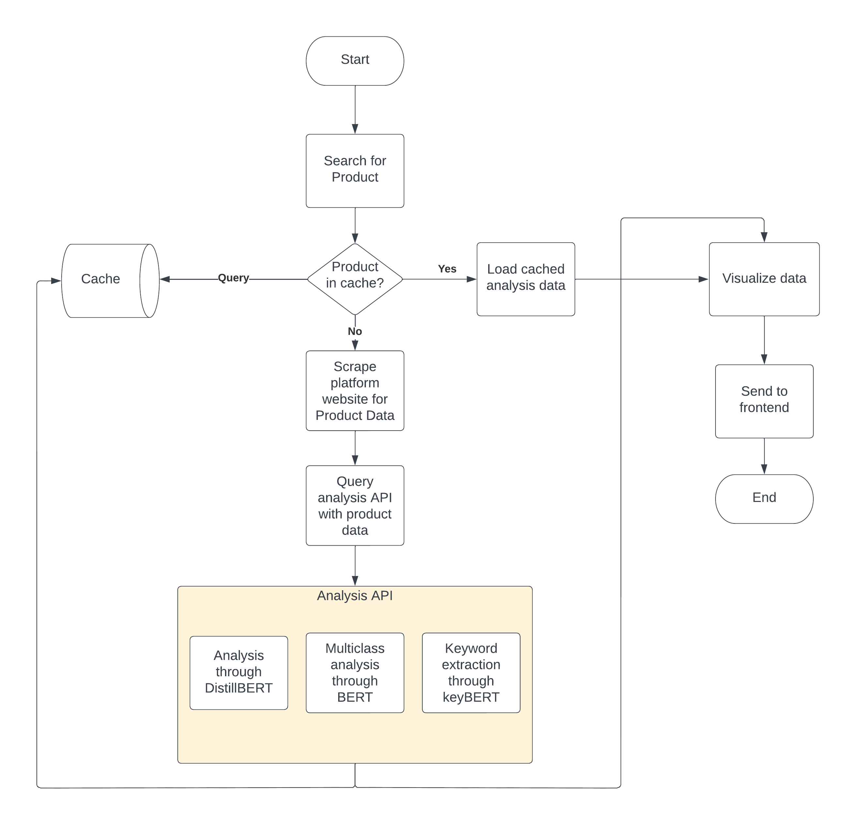
Fig 1: Application general flowchart

Slide 8
References
[1] Fang, X., Zhan, J. Sentiment analysis using product review data. Journal of Big Data 2, 5 (2015). https://doi.org/10.1186/s40537-015-0015-2
[2] NLP and Sentiment analysis by symbl.ai, https://symbl.ai/about
[3] Tamir Bennatan, Conducting Sentiment Analysis on App Reviews to Inform Product Decisions. Hopper, Medium (Jun 13, 2019). https://medium.com/life-at-hopper/conducting-sentiment-analysis-on-app-reviews-to-inform-product-decisions-64fcc71822ed
[4] Atharva Mashalkar, Sentiment Analysis using Logistic Regression and Naive Bayes. TowardsDataScience (Nov 28, 2020). https://towardsdatascience.com/sentiment-analysis-using-logistic-regression-and-naive-bayes-16b806eb4c4b
[5] Thura, T., Na, J.-C., & Khoo, C. S. G. (2010). Aspect-based sentiment analysis of movie reviews on discussion boards. Journal of Information Science, 36(6), 823–848. https://doi.org/10.1177/0165551510388123
[6] Hu Xu, Bing Liu, Lei Shu, Philip S. Yu (2019). BERT Post-Training for Review Reading Comprehension and Aspect-based Sentiment Analysis. https://doi.org/10.48550/arXiv.1904.02232
[7] Federico Pascual, Analyze Sentiment in Product Reviews. MonkeyLearn Blog (Mar 23, 2019). https://monkeylearn.com/blog/sentiment-analysis-of-product-reviews/

Slide 9

THANK YOU

