Slide 1

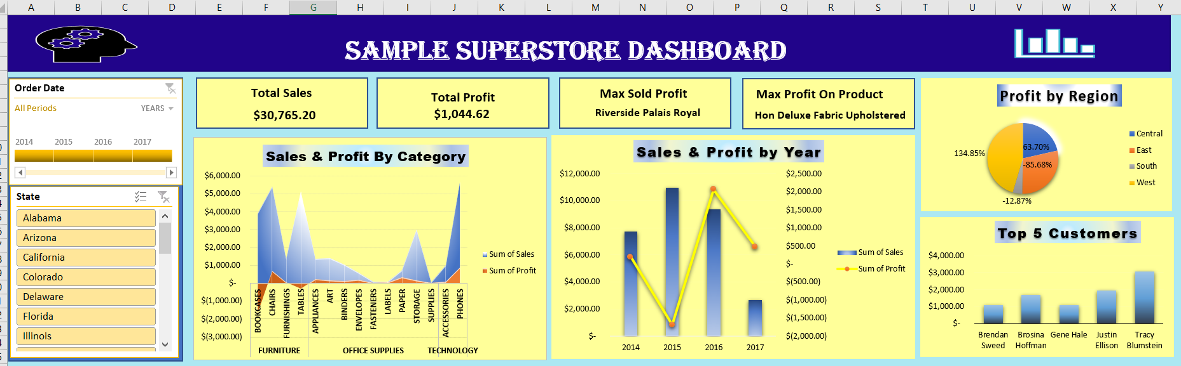
Superstore sales data analysis using Microsoft excel

Slide 2
overview
OBJECTIVE.
DATA PREPROCESSING.
PLOTTING PIVOT CHART
PROFIT BY REGION
TOP 5 CUSTOMER
SALES & PROFIT BY YEAR
SALES & PROFIT BY CATEGORY
DATE AND STATES FILTER USED BY SLIDER
CARDS CREATION
CONCLUSION
RECOMMENDATIONS

Slide 3
objective
A superstore wants to analyze its sales data to identify trends, optimize product offerings, and improve customer satisfaction.
The dashboard aims to offer insights into sales trends, profit margins, and customer behavior, enabling businesses to make informed decisions and optimize their strategies.
Provides a comprehensive overview of sales data, including total sales, profit, and customer information.

Slide 4
DATA PREPROCESSING
Data Cleaning: Handling missing values, removing duplicates, and correcting errors.
Data Transformation: Converting data types, aggregating data, and creating new fields.
Data Filtering: Removing irrelevant data and applying filters for analysis

Slide 5
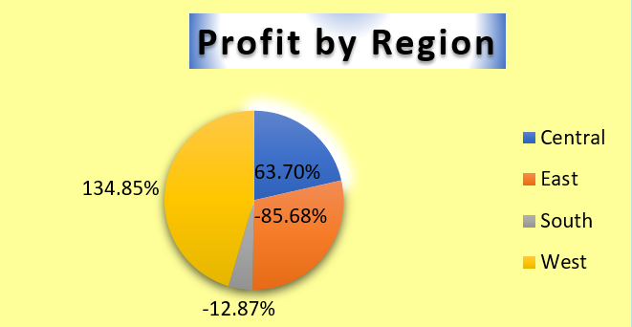
Profit by Region
Analysis: "This graph shows that the Central region is the most profitable, while the South region is the least profitable."

Slide 6
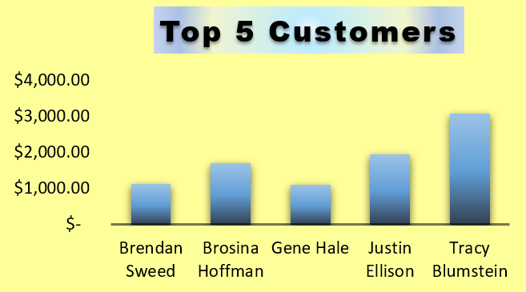
Top 5 Customers
Analysis: "This graph shows the top 5 customers by sales, indicating opportunities to build stronger relationships with these customers."

Slide 7
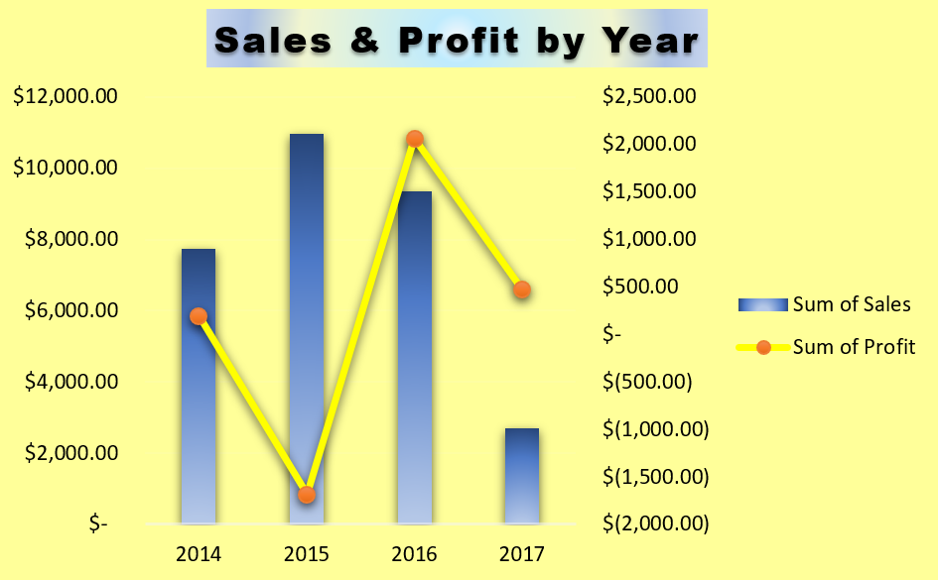
Sales & Profit by Year
"This graph shows a decline in sales and profit over the years, indicating a need to revisit sales strategies."

Slide 8
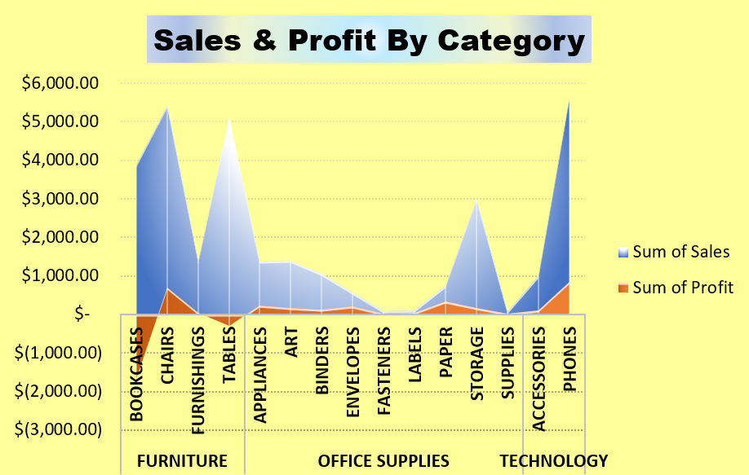
Sales & Profit By Category
Analysis: "This graph shows that furniture is the top-selling category, followed by office supplies and technology."

Slide 9
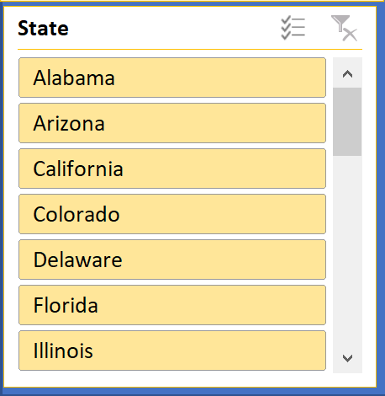
The state filter slider
The state filter Slider is a interactive tool that allows users to select specific states from a list, enabling targeted analysis and insights.

Slide 10
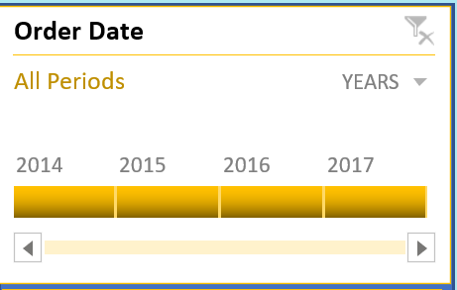
The order date slider
By analyzing the data, we can identify patterns and trends in customer behavior, such as :-
Seasonal fluctuations- Identifying seasonal patterns in sales data
Year-over-year growth- Analyzing sales data over time to assess growth and trends
Peak periods- Identify peak periods when orders are highest. Used to optimize inventory management, staffing, and marketing strategies.
Low periods- Identify low periods when orders are scarce. Help us to plan for slow periods, adjust our pricing strategy, or implement targeted marketing campaigns to boost sales.

Slide 11
THE CARDS CREATED IN DASHBOARD
Total Sales: The total sales amount is $30,765.20, indicating the overall revenue generated.
Total Profit: The total profit is $1,044.62, showing the net earnings after deducting costs from sales.
Max Sold Profit: The product "Riverside Palais Royal" has generated the maximum sold profit, suggesting it is a high-demand or high-margin item.
Max Profit On Product: The product "Hon Deluxe Fabric Upholstered" yields the maximum profit per unit, indicating it might have a higher price point or lower production costs.
These insights help businesses understand their sales performance, identify profitable products, and make informed decisions to optimize their product offerings and pricing strategies.

Slide 12
conclusion
The sample superstore dashboard provides a valuable tool for businesses to analyze sales data, identify trends, and optimize strategies.
By leveraging data visualization and analytics, businesses can gain insights into customer behavior, sales performance, and profit margins, ultimately driving growth and improvement.
The dashboard's interactive features and drill-down capabilities enable users to explore data in detail, making it an essential resource for data-driven decision-making.

Slide 13

recommendations
Focus on high-selling categories like furniture.
Revise sales strategies to improve sales and profit.
Invest in the Central region to maximize profitability.
Build stronger relationships with top customers.

Slide 14


