Slide 1
TRAVEL PLANNER AGENT
CAPSTONE PROJECT
Presented By:
Aditya Hansraj
Ramgarh Engineering Collage
Computer Science and Engineering

Slide 2
OUTLINE
Problem Statement
Proposed System/Solution
System Development Approach (Technology Used)
Algorithm & Deployment
Result (Output Image)
Conclusion
Future Scope
References

Slide 3
Problem Statement
The Challenge - A Travel Planner Agent is an AI-powered assistant that helps users plan trips efficiently and intelligently.
It uses real-time data to suggest destinations, build itineraries, and recommend transport and accommodation options.
By understanding user preferences, budgets, and constraints, it tailors personalized travel plans. Integrated with maps, weather updates, and local guides, it ensures a smooth travel experience. The agent can also manage bookings, alert users to changes, and optimize schedules on the go. This smart assistant transforms complex travel planning into a seamless, enjoyable process.

Slide 4
Proposed Solution
The Travel Planner Agent is an AI-powered assistant designed to make travel planning straightforward and responsive. By leveraging IBM Cloud Lite and IBM Granite services. The solution will consist of the following components:
Suggested Destinations:
Use real-time trends to inspire travelers.
Build Personalized Iteneries:
Analyze user constraints (preferences, budget, flexibility).
Recommend Transport & Accommodation Options:
Aggregate and compare offerings.
Integrate with Maps and Weather Updates:
Ensure suggestions remain relevant and feasible.

Slide 5
Proposed Solution
Provide Local Guides:
Enhance travel experience with attractions, food, and activities.
Manage Bookings:
Automate reservations, monitor changes or cancellations, and provide alerts.
Optimize On-the-Go:
Re-plan and notify users of disruptions or better options when in route.
User Interface:
Accessible via web or mobile interface for continuous interaction.

Slide 6
System Approach
System requirements
User Interface: Web or mobile app for plan input, interaction, and notifications.
Backend: Hosted on IBM Cloud Lite for computation, data aggregation, and storage.
APIs: Integration with mapping, weather, booking, and event data sources.
Security: Secure handling of personal and payment information.

Slide 7
System Approach
Library required to build the model
IBM Granite AI API/SDK
Flask or Node.js (backend)
React or Flutter (frontend)
Requests/Axios for API calls
Pandas/Numpy (data processing, if using Python)
JWT/OAuth (authentication)
Google Maps, OpenWeather, and travel API libraries

Slide 8
Algorithm & Deployment
Algorithm Selection:
AI Model: Leverages IBM Granite large language models for natural language understanding and personalized recommendations.
Optimization: Uses rule-based logic and AI-driven heuristics for itinerary and booking optimization.
Data Handling: Real-time aggregation and filtering using APIs for maps, weather, events, transport, and hotels
Data Input
User preferences (destinations, activities, budget, dates, special needs)
Real-time data (weather, events, availability)
Booking information (flight, hotel, transport APIs)

Slide 9
Algorithm & Deployment
Traning Process
Fine-tune AI models for travel conversation, destination matching, and problem solving based on sample data.
Continuous learning via user feedback and trip rating.Provide a brief overview of the chosen algorithm.
Prediction & Interface
Generate travel plan and push itinerary to user interface.
Continuously monitor for disruptions and offer alternatives instantly.
Deployment
Platform: IBM Cloud Lite, ensuring scalability and reliability.
Access: Deployed as a cloud-based application, accessible via web/mobile.
Monitoring: Performance and accuracy tracked using feedback and analytics modules.

Slide 10
Result
The AI Travel Planner Agent’s effectiveness is demonstrated through:
Model Performance: Improved travel satisfaction and reduced planning time (measured via user ratings, completion rates).
Visualization: Side-by-side comparison of suggested itinerary vs. finalized/booked plan; real-time notification and re-planning in case of change.
User Experience: Smooth, interactive, and responsive interface with automated updates and alerts.

Slide 11
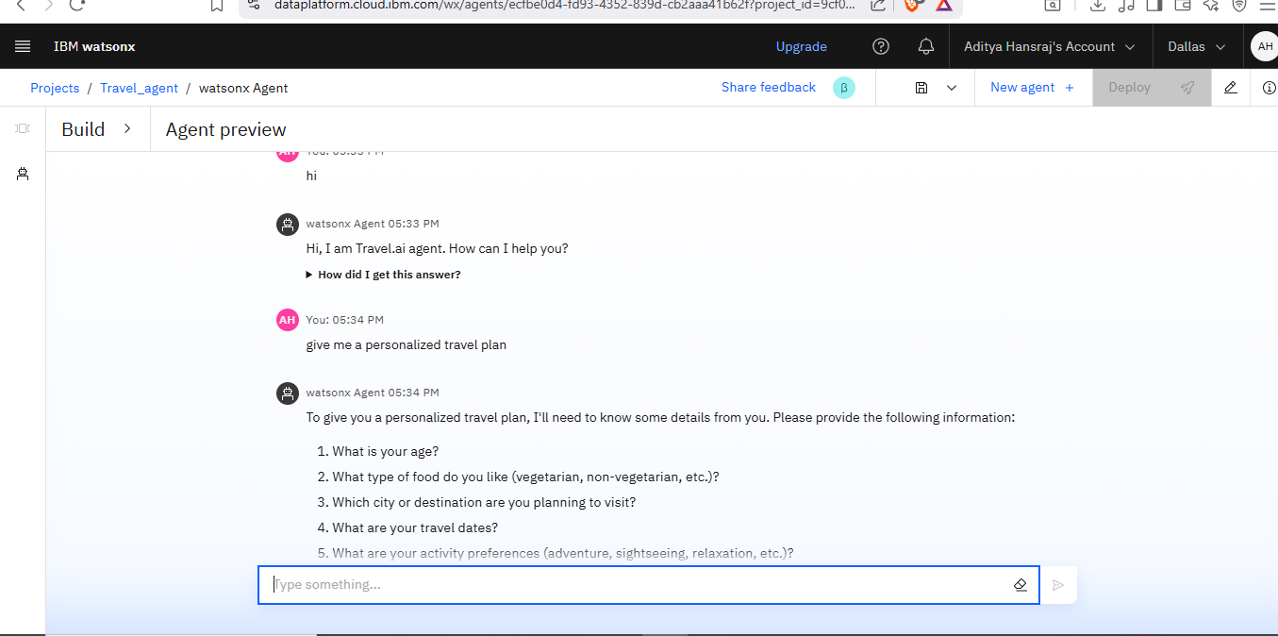
Result

Slide 12
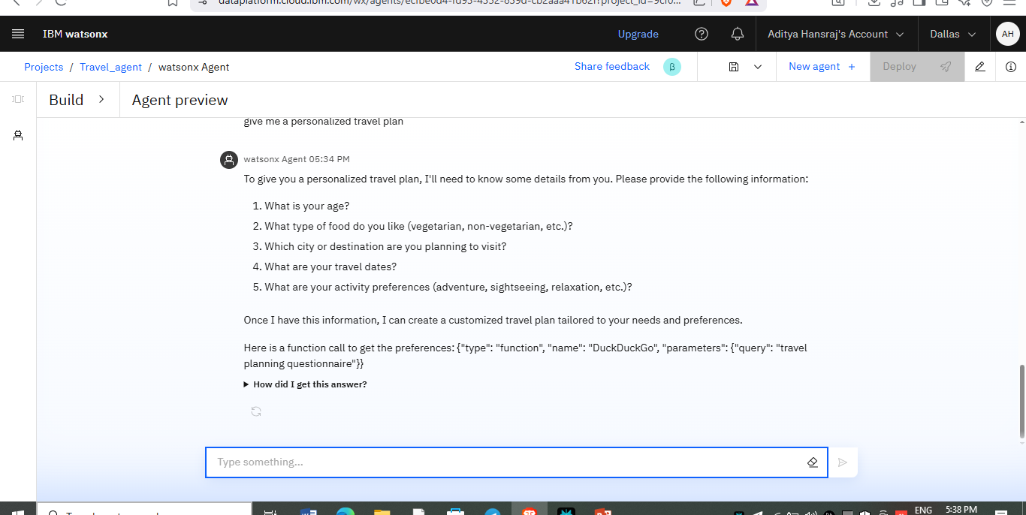
Result

Slide 13
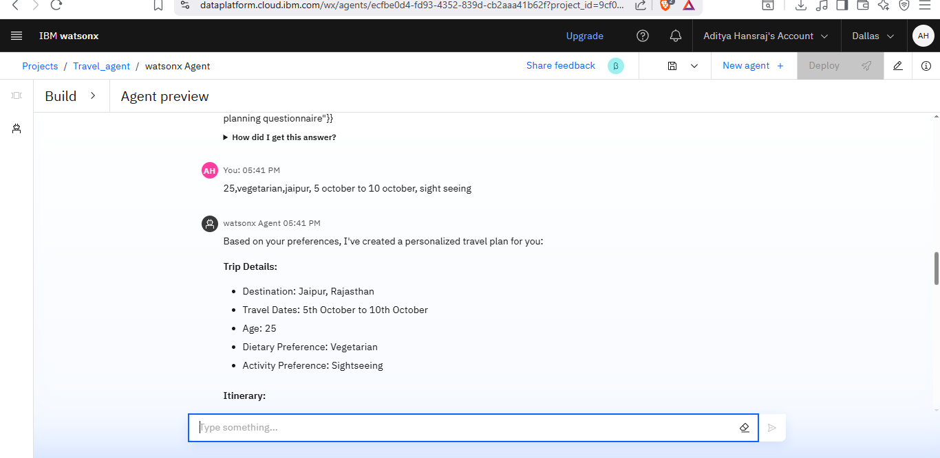
Result

Slide 14
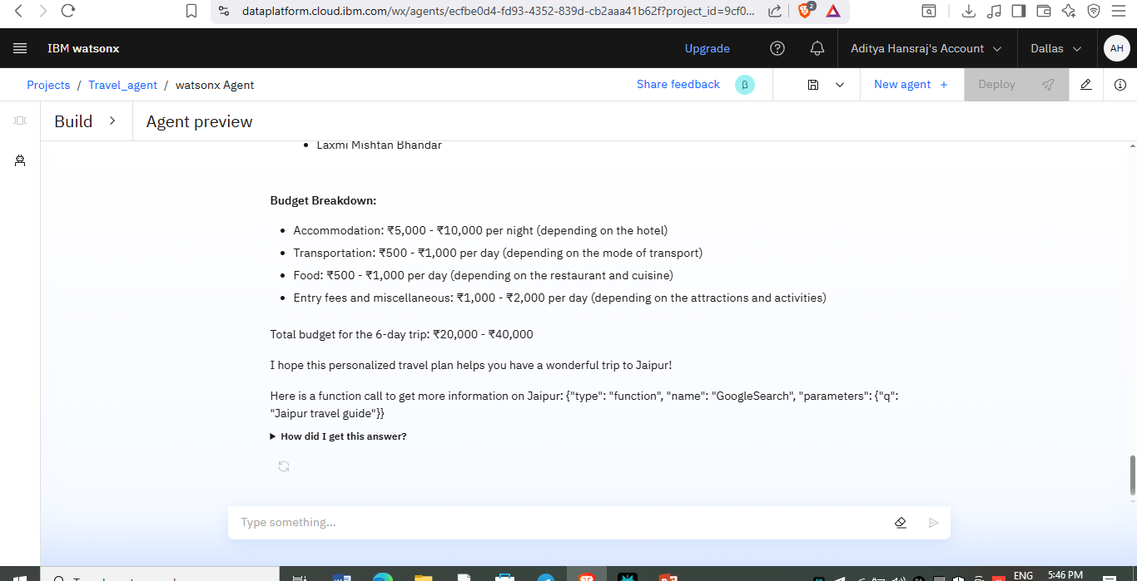
Result

Slide 15
Conclusion
The Travel Planner Agent demonstrates how AI, cloud services, and real-time data integration can transform traditional, manual trip planning into a smart, effortless process. Users benefit from personalized recommendations, dynamic itinerary adjustments, and hassle-free bookings, leading to more enjoyable, stress-free travel experiences. Challenges such as adapting to last-minute changes and integrating diverse data sources were addressed by robust API management and responsive AI logic. Ongoing improvements aim to expand data sources and refine recommendation quality.

Slide 16
Future scope
Enhanced Personalization:
Deeper learning of behavioral patterns, social integration for collaborative travel.
Expanded Data Sources:
Integrate more APIs for niche travel interests (eco-tourism, adventure, etc.).
Multi-modal Interaction:
Voice-based assistants, chatbots.
Smart Travel Wallet:
Manage expenses, loyalty programs, and digital documents.
Regional Expansion:
Adaptation for international languages, currencies, and regulatory contexts.

Slide 17
References
Research on AI-powered travel assistants.
IBM documentation for Cloud Lite and IBM Granite.
Academic papers on recommender systems and itinerary optimization.
Best practices in travel data security and user interface design.

Slide 18
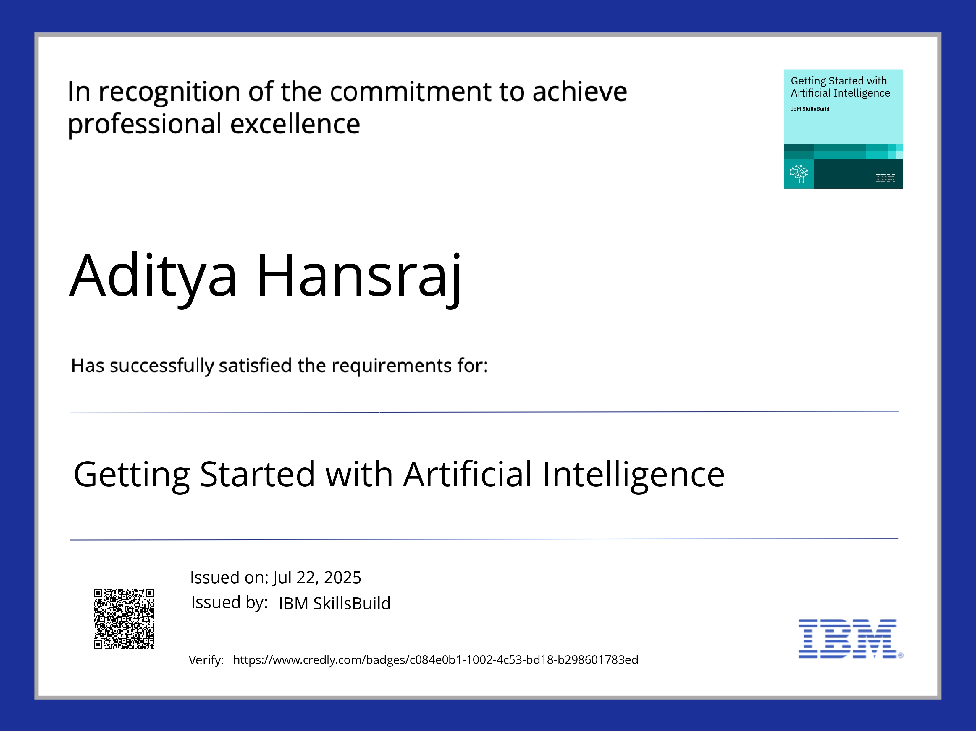
IBM Certifications
Screenshot/ credly certificate( getting started with AI)

Slide 19
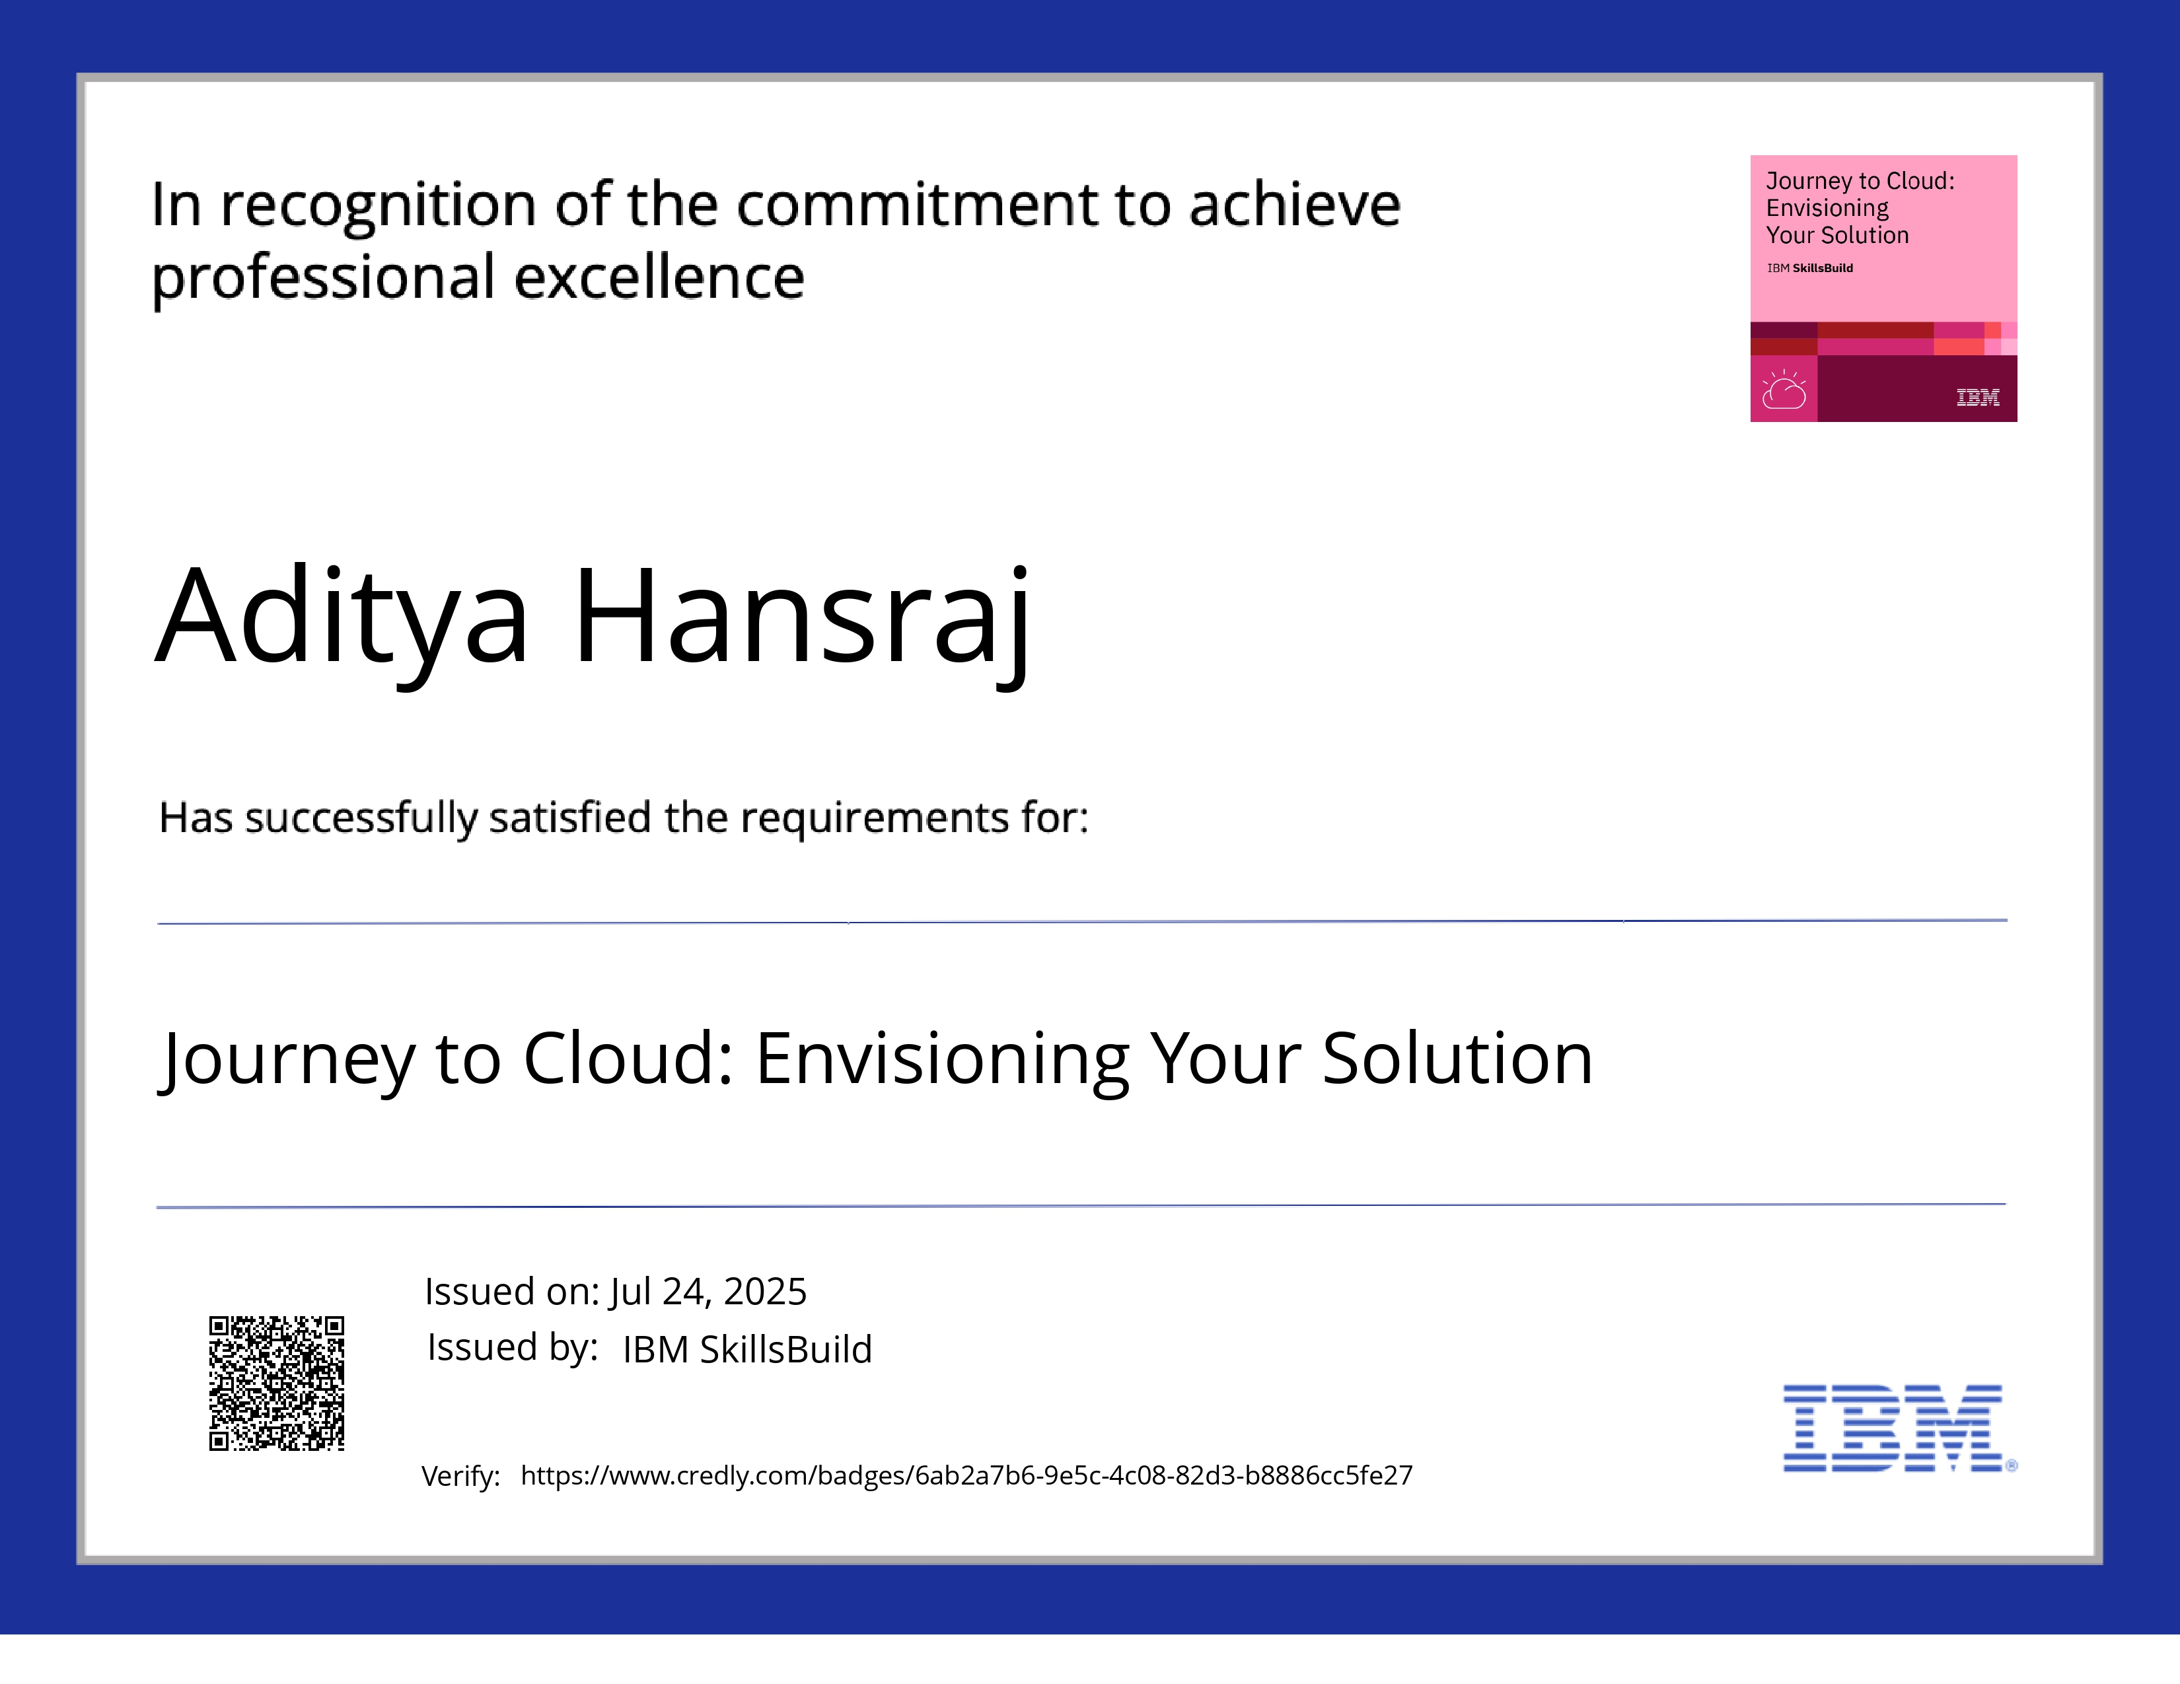
IBM Certifications
Screenshot/ credly certificate( Journey to Cloud)

Slide 20
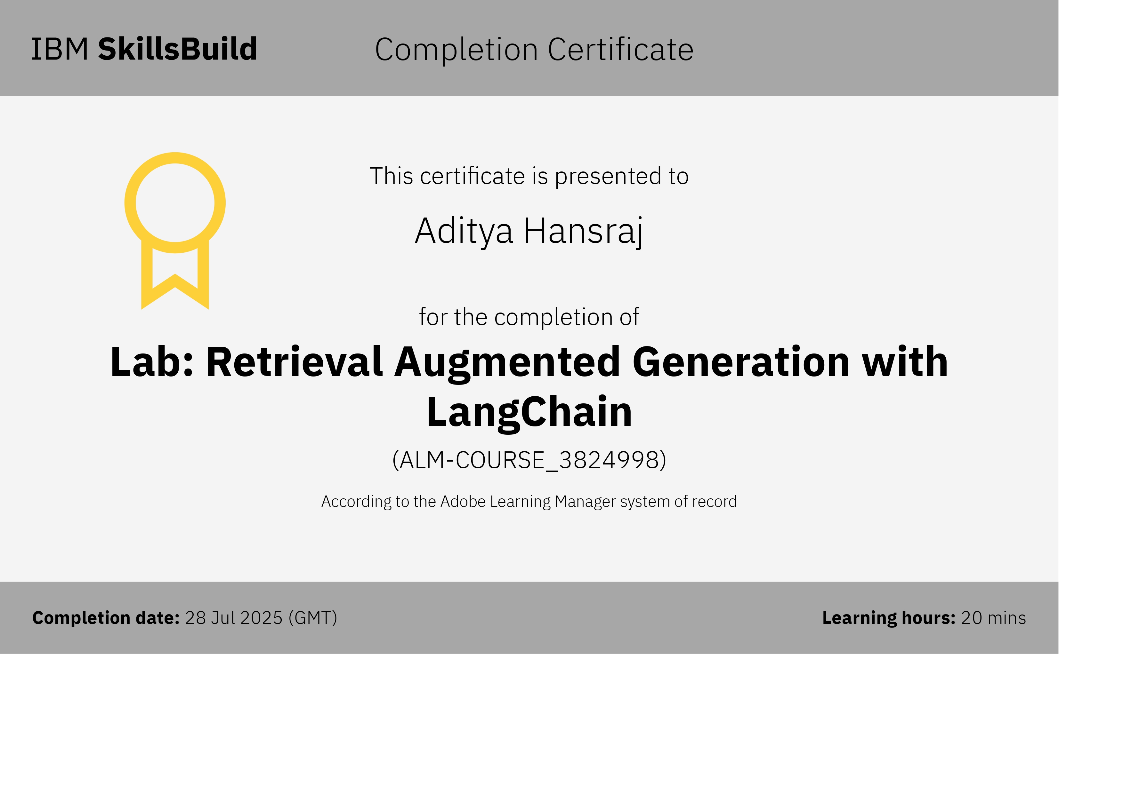
IBM Certifications
Screenshot/ credly certificate( Journey to Cloud)

Slide 21
THANK YOU

