Slide 1
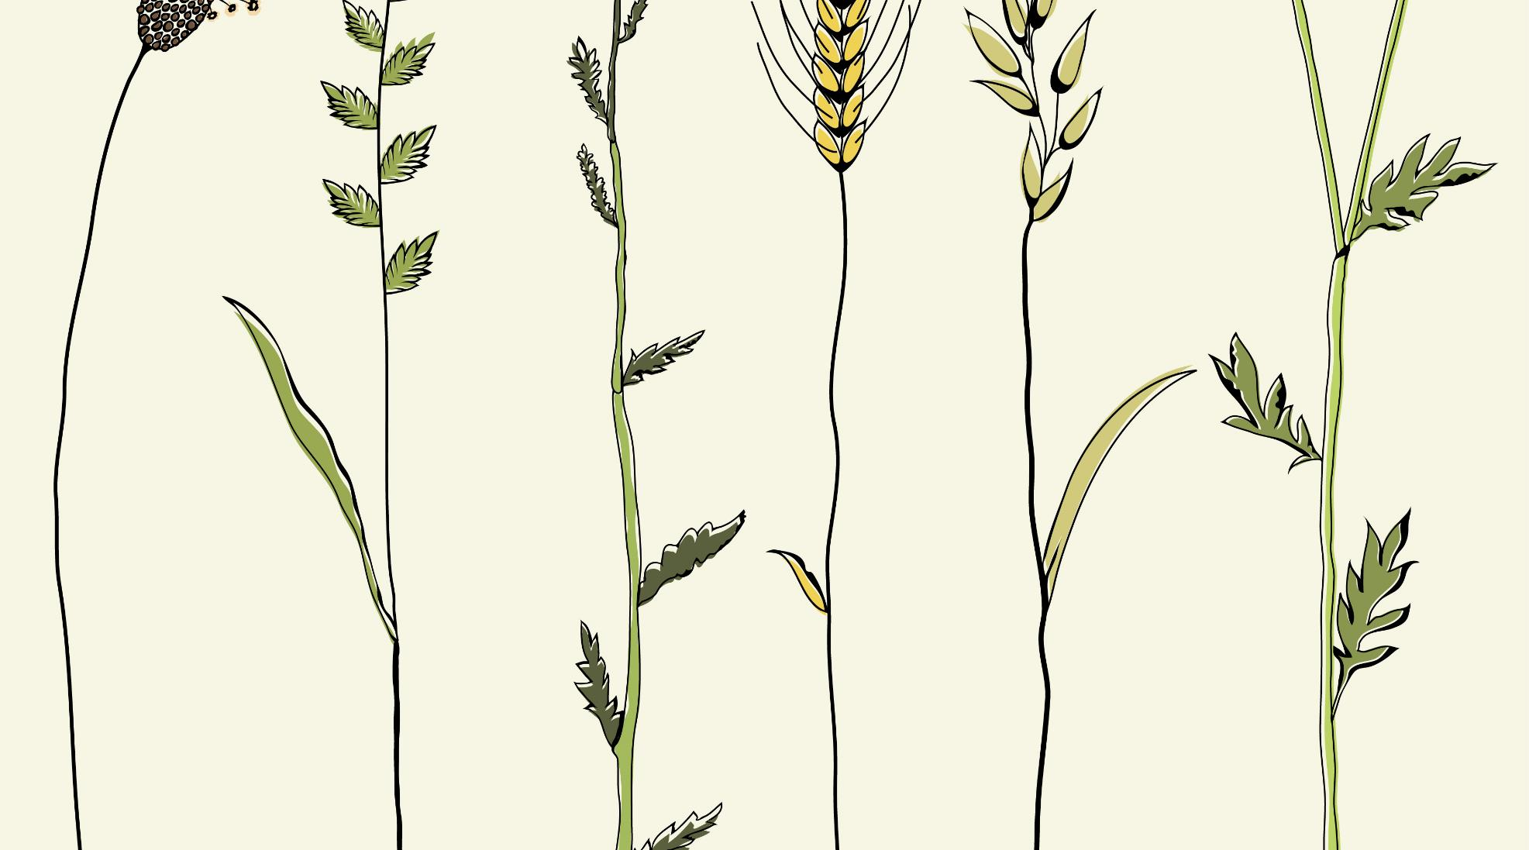
Unicell Simulation
Principles of
Programming
Languages
CS F301
Group – 31
Aditya Hriday Sahu (2020A7PS0144G)
Subramanian V (2020A7PS1371G)
Monit Agrawal (2020A7PS0120G)
Aaryan Marar (2020A7PS0987G)
Yogesh Metukuru (2020A7PS0098G)
Shreyas Santosh Pawar (2019B1A70994G)

Slide 2

The Problem
Many Microbiologists and researchers face issues while implementing efficient and customizable computational simulation of biological systems
Their lack of familiarity with computer programming and object-oriented practices often results in computationally expensive simulations
There is a need of a bio-simulation focused programming language toolset with efficient algorithmic implementations of real-life functionalities for researchers
The scientific community should find it easy to learn and implement biological simulations in this new proposed programming language
The programming language should offer enough flexibility and customizability while setting up the simulation parameters
Issues faced by Biologists and Researchers for simulating biological systems

Slide 3
Merits and Trade-offs
The object-oriented approach is the first and foremost merit in the implementations of our proposed language
Utilization of inheritance, object deletion, ability to keep track of new objects using pointers, and other salient features of object-orientation have enabled us in efficiently simulating lifespan and reproduction
Besides these, specific methods have been implemented on the basis of rigorous microbiological theories which enables the researchers to be less worried about the correctness
The classes and methods developed till now can only simulate unicellular independent organisms, not individual cells of a multicellular organism
Still many methods have not been implemented for simulating complex biochemical processes due to time constraints
Our proposed programming language, while being quite easy to learn, also is quite incomplete

Slide 4
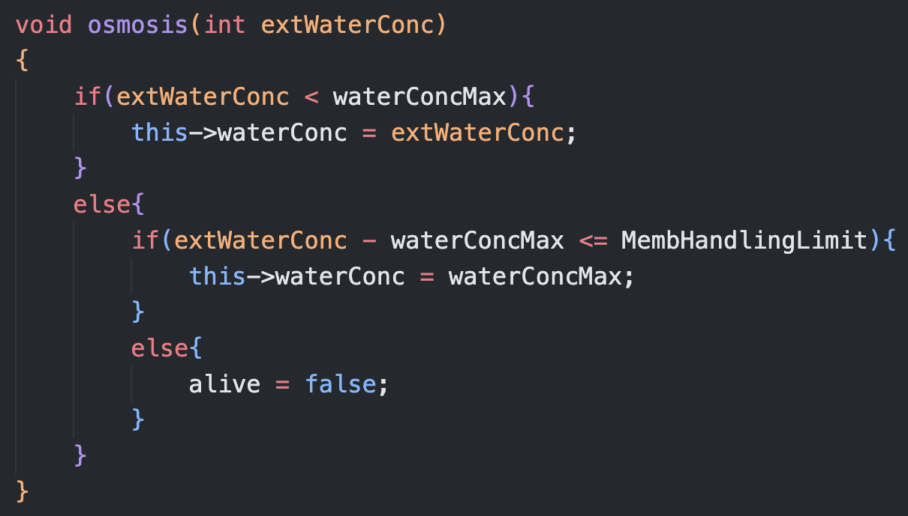
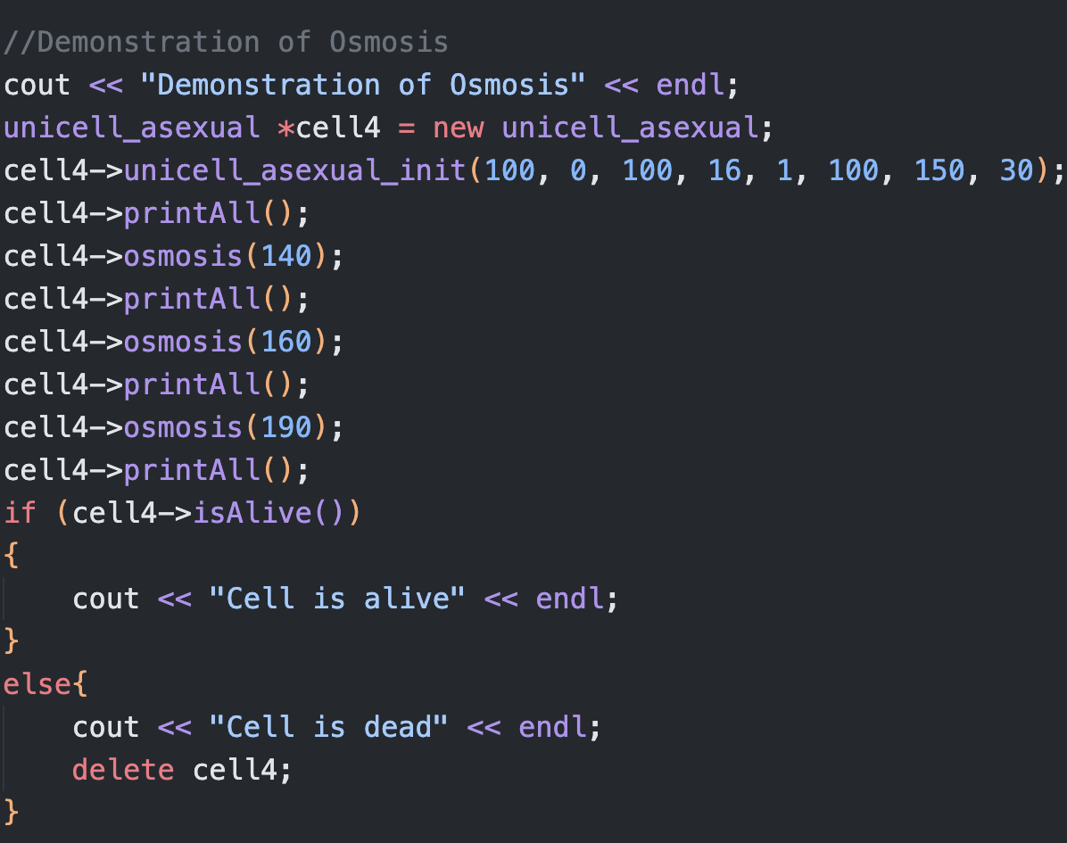
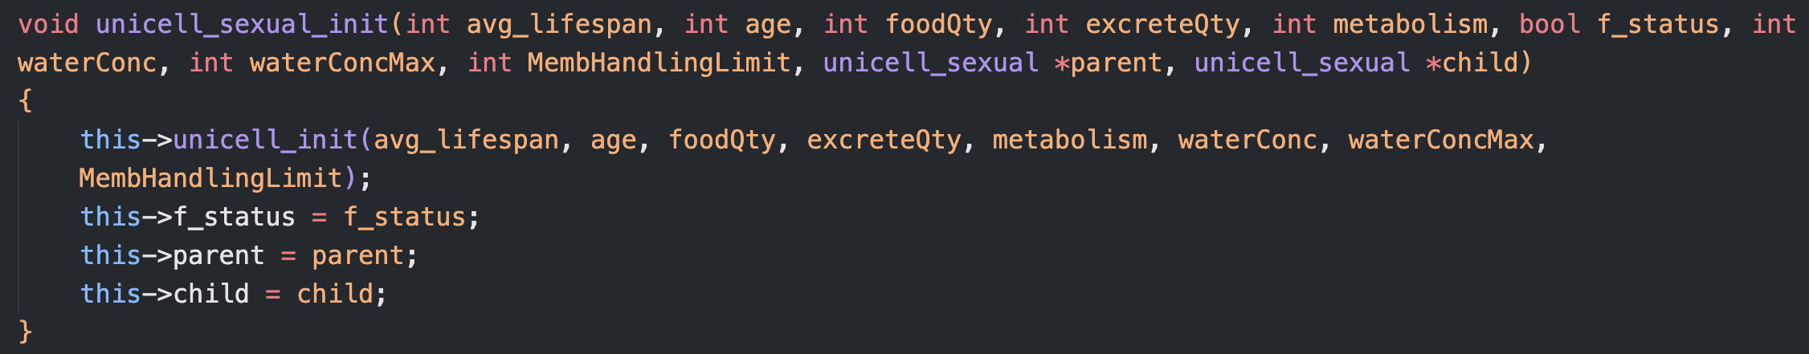
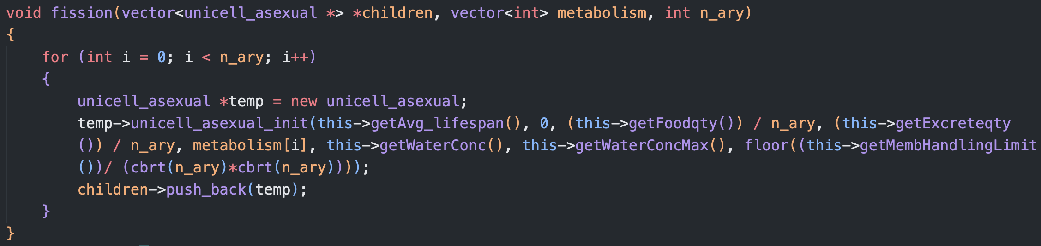
Some Code Snippets!
End-User and Domain
Our user domain mainly includes Microbiology, Pathology, Bacterial Culture Analysis, Pandemic Response Biologists, and Pharmacy
Majority of end-users should be a union of microbiologists, pure science researchers, Medical Students or Doctoral fellows, Medicine professors, and Pathologists

Slide 5




Contribution and Teamwork
Reports and Presentation
Brainstorming
Monit, Aditya, Subramanian
Shreyas, Aditya, Aaryan, Yogesh
Code Implementation
Research
Aditya, Yogesh, Subramanian, Aaryan
Aditya, Monit, Subramanian

