Slide 1
K-D tree and its applications
Shanu Shrivastava (2019202005) Aditya Mohan Gupta (2019201047)

Slide 2
What is a K-D tree ?
K-D trees were invented in 1970s by Jon Bentley.
Name originally meant “3d-trees, 4d-trees, etc” where k
was the # of dimensions.
A k-d tree, or k-dimensional tree, is a data structure used
in computer science for organizing some number of points
in a space with k dimensions. It is a binary search tree
with other constraints imposed on it.
The kd tree is a modification to the BST that allows for
efficient processing of multi-dimensional search keys.

Slide 3
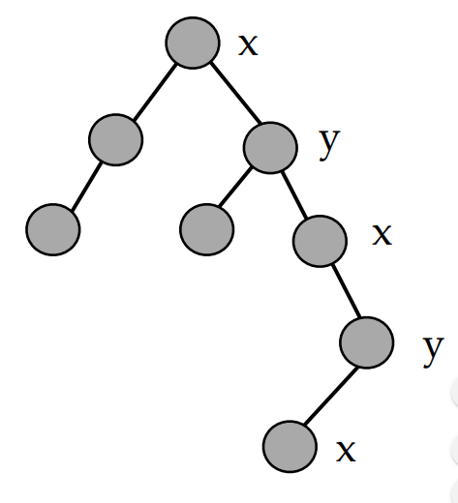
A K-D tree consists of cutting
dimensions along each level,
based upon the number of
dimensions i.e. value of k.
Each node contains a point like
point, P =(x,y).
To, traverse the tree, we need
to compare the node value
with the cutting dimensions,
and accordingly make a move.

Slide 4
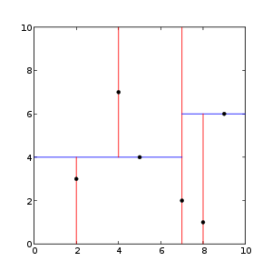
An example of a 2D tree
Each level of a k-d tree splits all children along a specific dimension, using a plane that is perpendicular to the corresponding axis. At the root of the tree all children will be split based on the first dimension(i.e. If less, it will be on the left side and else on the right side, when greater).

Slide 5
Real-world data is often represented in tabular form,
which makes it well-suited to being stored in an Excel
spreadsheet or a database table.
In such a table with n columns, each column can be
viewed as a dimension and each row represents an n-
dimensional point.
Efficient processing of multidimensional data is
challenging.

Slide 6
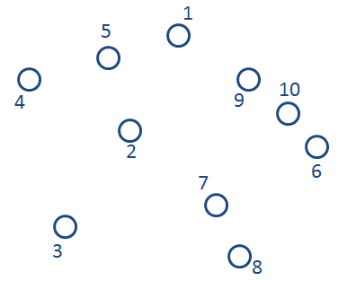
An example of KD tree with K=2 and n = 10, to show space partitioning along each point :

Slide 7
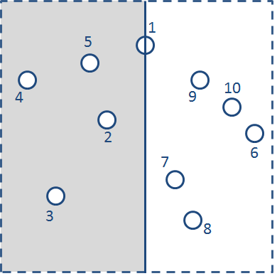
Splitting the space along point 1.(x-dimension)

Slide 8
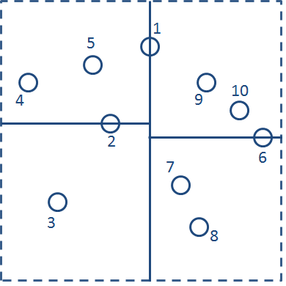
Now, splitting across y dimensions.

Slide 9
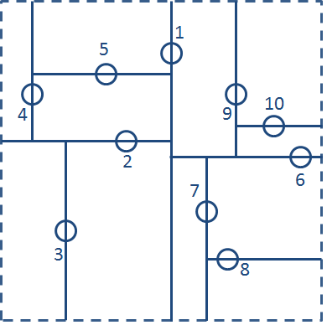
Each of these four quadrants contain just 1 or 2 points. This process of using alternating vertical and horizontal lines to subdivide the set of points can be repeated recursively within each quadrant.

Slide 10
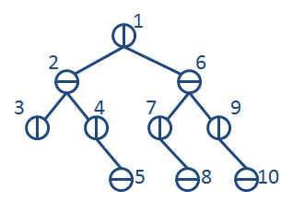
The following is the required K-D tree (K=2,n=10) :

Slide 11
Operations on K-D tree :
Following are the operations performed on K-D trees :
Static K-dimensional data collection
Balancing and Inserting elements
Find min element
Deleting Elements

Slide 12
Static K-dimensional data collection :
Static data is collected for construction of a K-D tree.
The k-d-tree is not designed for changes, and will quickly
lose efficiency.
It relies on the median, and thus any change to the tree
would worst-case propagate through all of the tree.
Thus, we need to collect all the Data beforehand.
Hence, all the data which is to be classified, is collected
and further processing is carried out to build the K-D
tree.

Slide 13
Balancing and Inserting Elements :
Adding elements in a Binary Search tree fashion will
lead to an unbalanced KD tree.
Thus we need to perform balancing in the tree to
ensure that the data points are correctly placed in the
KD tree.
For this, we need to find the median of the data, and at
each iteration and insert in the tree.
This will give us a balanced tree for k –dimensional
data.
Every insert operation divides the space.

Slide 14
An unbalanced K-D Tree :
1,2
2,3
5,1
10,0

Slide 15
Example : Contruction of KD tree for the points :
(50,50),(1,10),(10,30)(35,90),(25,40),(51,75),(55,1),(60,80),(70,70)
Sorting according to x dimension :
(1,10),(10,30),(25,40)(35,90),(50,50),(51,75),(55,1),(60,80),(70,70)
50,50
(50,50)

Slide 16
(1,10),(10,30),(25,40)(35,90),(50,50),(55,1),(70,70),(51,75),(60,80)
50,50
10,30
70,70
(70,70)
(50,50)
(10,30)

Slide 17
(1,10) (10,30) (25,40) (35,90) (50,50) (55,1) (70,70) (51,75) (60,80)
50,50
10,30
70,70
(70,70)
(50,50)
1,10
55,1
(10,30)
(1,10)
(55,1)

Slide 18
(1,10) (10,30) (25,40) (35,90) (50,50) (55,1) (70,70) (51,75) (60,80)
50,50
(51,75)
10,30
70,70
(70,70)
(50,50)
1,10
25,40
55,1
51,75
(25,40)
(10,30)
(1,10)
(55,1)

Slide 19
(1,10) (10,30) (25,40) (35,90) (50,50) (55,1) (70,70) (51,75) (60,80)
50,50
(35,90)
(60,80)
(51,75)
10,30
70,70
(70,70)
(50,50)
1,10
25,40
55,1
51,75
(25,40)
(10,30)
35,90
60,80
(1,10)
(55,1)

Slide 20
Finding Minimum Element :
This is a pre - requisite for deleting elements in the kd tree.
In this operation, we find the minimum data point in a given dimension.
50,50
10,30
70,70
1,10
25,40
55,1
51,75
35,90
60,80

Slide 21
50,50
10,30
70,70
1,10
25,40
55,1
51,75
35,90
60,80
Applying Find Min Operation at x Dimension in K-D tree

Slide 22
Deletion :
If node to be deleted is a leaf node in the KD tree then
we simply delete it.
If the node to be deleted is not a leaf node then we need
to find the replacement node for that particular node.
A replacement node is the minimum node in the same
dimension as that of the node to be deleted.
Searching for replacement node is done by traversing
the suitable part of the KD tree, depending upon its
structure.

Slide 23
Deleting the node P(x,y) = (25,40)
50,50
50,50
10,30
70,70
10,30
70,70
1,10
25,40
55,1
51,75
1,10
35,90
55,1
51,75
35,90
60,80
60,80

Slide 24
Applications of K-D tree :
Nearest neighbor of a point in space :
It aims to find the point in the tree that is nearest to a given input point.
Time Complexity :
Average Case : log n
Worst Case : O(n)

Slide 25
Pseudo Code Nearest Neighbor :
nearest(Node n,Point goal, Node best):
If n is null, return best
If n.distance(goal) <best.distance(goal), best=n
If goal < n (based on cutting dimension)
goodside = n.left
badside=n.right
else
goodside=n.right
badside=n.left
best=nearest(goodside,goal,best)
If bad side can have something useful
best=nearest(badside,goal,best)
return best

Slide 26
50,50
10,30
70,70
1,10
25,40
55,1
51,75
35,90
60,80
Finding the nearest neighbor of the point P(x,y) = (2,7)
Best = (50,50)
Minimum Distance = 64.4438

Slide 27
50,50
10,30
70,70
1,10
25,40
55,1
51,75
35,90
60,80
Finding the nearest neighbor of the point P(x,y) = (2,7)
Best = (10,30)
Minimum Distance = 24.3516

Slide 28
50,50
10,30
70,70
1,10
25,40
55,1
51,75
35,90
60,80
Finding the nearest neighbor of the point P(x,y) = (2,7)
Best = (1,10)
Minimum Distance = 3.16

Slide 29
50,50
10,30
70,70
1,10
25,40
55,1
51,75
35,90
60,80
Finding the nearest neighbor of the point P(x,y) = (2,7)
Best = (1,10)
Minimum Distance = 3.16

Slide 30
50,50
10,30
70,70
1,10
25,40
55,1
51,75
35,90
60,80
Finding the nearest neighbor of the point P(x,y) = (2,7)
Best = (1,10)
Minimum Distance = 3.16

Slide 31
K nearest neighbours :
It returns the k nearest points to a point in space.
It is widely disposable in real-life scenarios since it is non-
parametric, meaning, it does not make any underlying
assumptions about the distribution of data.
The biggest use case of k-NN search might be
Recommender Systems. If you know a user likes a
particular item, then you can recommend similar items
for them. To find similar items, you compare the set of
users who like each item—if a similar set of users like two
different items, then the items themselves are probably
similar!

Slide 32
Pseudocode for K nearest neighbours :
Maintain a min heap(Q) that contains all the visited elements, while traversing the tree to find the nearest neighbours.
while K is not zero
e= extract min(Q)
print e
If e.left not visited
Q.insert(e.left)
For each children t in e.left which is not visited:
Q.insert(t)
if e.right not visited
Q.insert(e.right)
For each children t in e.right which is not visited:
Q.insert(t)
Decrease K

Slide 33
An example of finding K-nearest neighbors of the point P(x, y)=(60,50)
(35,90)
(60,80)
(51,75)
(70,70)
(50,50)
(25,40)
(60,50)
(10,30)
K=1
(1,10)
(55,1)

Slide 34
Nearest neighbour search example

Slide 35
References :
https://en.wikipedia.org/wiki/K-d_tree
http://jcgt.org/published/0004/01/03/paper.pdf#page=17&zoom=100,0,660
http://pointclouds.org/documentation/tutorials/kdtree_search.php
https://www.cs.cmu.edu/~ckingsf/bioinfo-lectures/kdtrees.pdf

