Slide 1
Integration of Phreeqc and its Benchmarking
Earlier, Phreeqc (PhreeqcRM) was integrated into the 2DSoil model and a sequential reaction problem was solved using this conjunctive model
However, this conjunctive model required benchmarking to establish its efficacy
These benchmarking problems covers some specific situations for which analytical solutions are available.
Successful match of the analytical solution with numerical solution leads to benchmarking of a model.
These analytical solutions are comprehensively covered by Van Genuchten 1981
This presentation covers a relevant benchmarking study

Slide 2

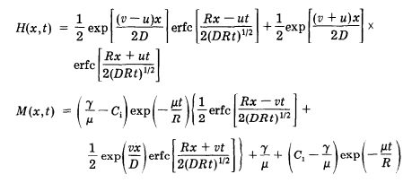
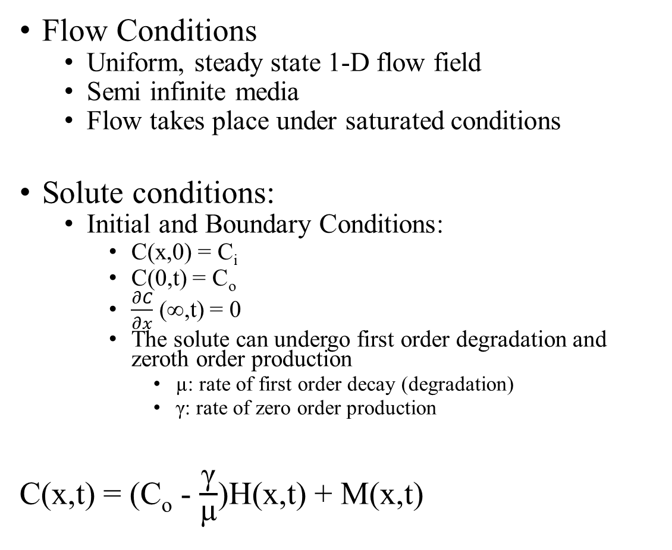

Setup of the Benchmark Problem by Van Genuchten 1981
Flow Conditions
Uniform, steady state 1-D flow field
Semi infinite media
Flow takes place under saturated conditions
Solute conditions:
Initial and Boundary Conditions:
C(x,0) = C_{i}
C(0,t) = C_{o}
$\frac{∂C}{∂x}$ (∞,t) = 0
The solute can undergo first order degradation and zeroth order production
µ: rate of first order decay (degradation)
γ: rate of zero order production
C(x,t) = (C_{o} - $\frac{\text{γ}}{\text{µ}}$)H(x,t) + M(x,t)
x = 0
Flow Direction
x = ∞
Hypothetical 1-D Soil Column

Slide 3
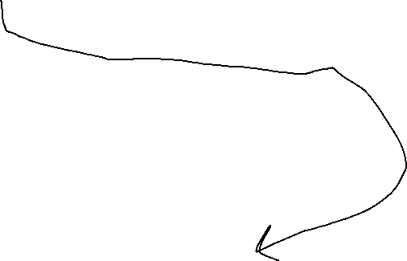
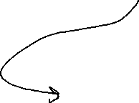

Analytical Solution (Van Genuchten 1981)
C(x,t) = (C_{o} - $\frac{\text{γ}}{\text{µ}}$)H(x, t) + M(x, t) = f(x, t, v, D, R)
I wrote python scripts to calculate the analytical solution

Slide 4
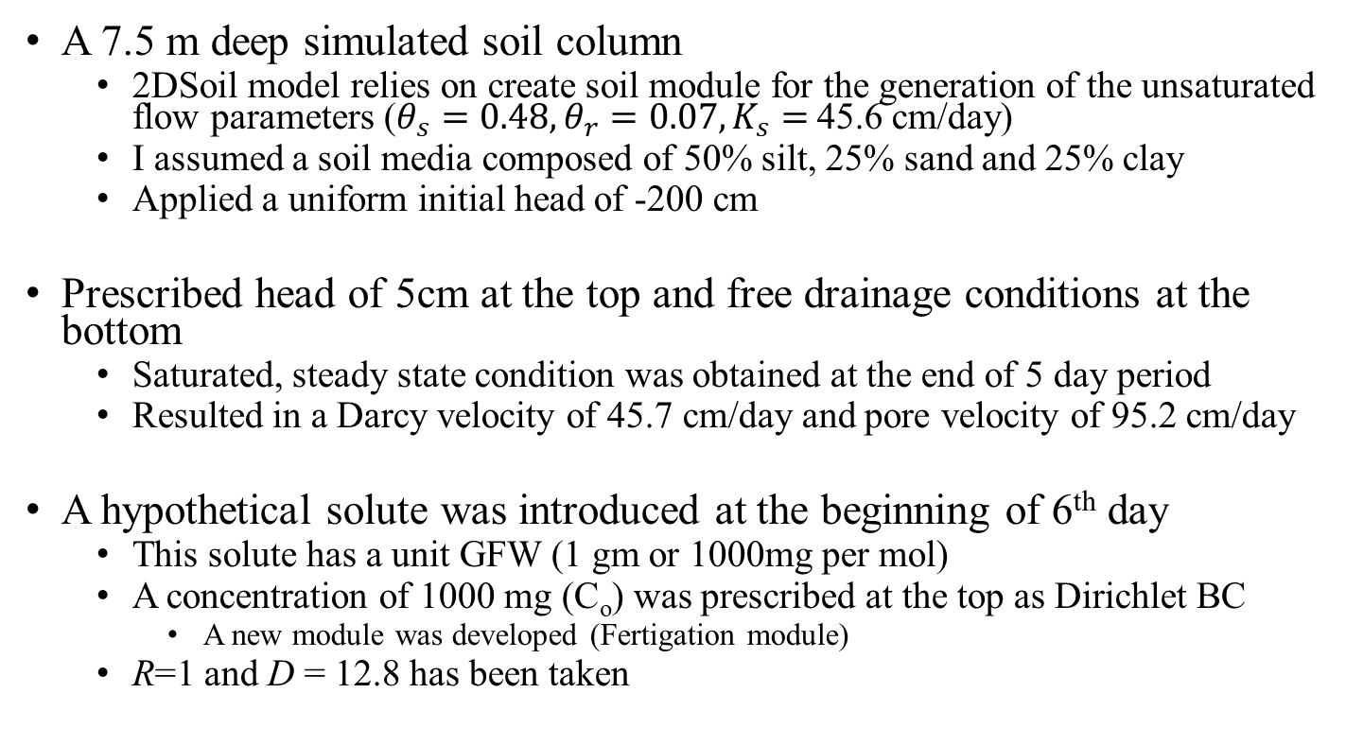
Implementation of Flow and Solute Conditions in the 2DSoil - Phreeqc model
A 7.5 m deep simulated soil column
2DSoil model relies on create soil module for the generation of the unsaturated flow parameters ($θ_{s}=0.48,θ_{r}=0.07,K_{s}=$45.6 cm/day)
I assumed a soil media composed of 50% silt, 25% sand and 25% clay
Applied a uniform initial head of -200 cm
Prescribed head of 5cm at the top and free drainage conditions at the bottom
Saturated, steady state condition was obtained at the end of 5 day period
Resulted in a Darcy velocity of 45.7 cm/day and pore velocity of 95.2 cm/day
A hypothetical solute was introduced at the beginning of 6th day
This solute has a unit GFW (1 gm or 1000mg per mol)
A concentration of 1000 mg (C_{o}) was prescribed at the top as Dirichlet BC
A new module was developed (Fertigation module)
R=1 and D = 12.8 has been taken
x = 0 m
Flow Direction
x = 7.5 m
Simulated Soil Column

Slide 5
Case 1: No Degradation or Production µ = 0 and γ = 0
C_{o} = 1000mg for t >5 days
x = 0 m
Flow Direction
x = 7.5 m
Simulated Soil Column

Slide 6
Case 2: No Degradation or Production µ = 10⁻⁶ mol/sec and γ = 0
C_{o} = 1000mg for t >5 days
x = 0 m
Flow Direction
x = 7.5 m
Simulated Soil Column

Slide 7
Case 1: No Degradation or Production µ = 3*10⁻⁶ mol/sec and γ = 0
C_{o} = 1000mg for t >5 days
x = 0 m
Flow Direction
x = 7.5 m
Simulated Soil Column

Slide 8
Case 1: No Degradation or Production µ = 3*10⁻⁶ mol/sec and γ = 10⁻⁶ mol/sec
C_{o} = 1000mg for t >5 days
x = 0 m
Flow Direction
x = 7.5 m
Simulated Soil Column

Slide 9



What's Next?
Demonstrating the model capabilities in:
Abiotic systems : soil reclamation with ion exchange
Biotic systems : C cycle and N cycle
Some good starting points:

