Slide 1
Verifying the integration of PhreeqcRM with 2DSoil Model by Simulating Cation Exchange In a Soil Column
Presentation Layout:
Introduction
Model Details

Slide 2
Verification Exercise Simulating Cation Exchange In a Soil Column
Geochemical model PhreeqcRM has been coupled with 2DSoil model resulting in an Advective-Dispersive-Reactive Transport (ADRT) model
I have performed a verification exercise to check its performance by simulating a cation exchange problem with 2DSoil-PhreeqcRM and comparing its results against those obtained from the in-built transport module in Phreeqc
This in-built transport module can simulate ADRT under saturated conditions
In this verification exercise, I have simulated cation exchange in a soil column where an infiltrating solution laden with Ca²⁺ cation leads to the replacement of the already existing Na⁺ and K⁺ cations
Same ADRT conditions have been maintained in both simulations
Why Cation Exchange Problem?: Because it is an agriculturally relevant problem as explained later

Slide 3
Verification Exercise Simulating Cation Exchange In a Soil Column
Motivation:
Similar approach has been followed by Jacques and Šimůnek (2005) for verifying the integration of Phreeqc with Hydrus 1D
Scope of Additional Exercises:
Other exercises such as kinetics or redox reactions can also be performed for further verification

Slide 4
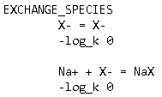


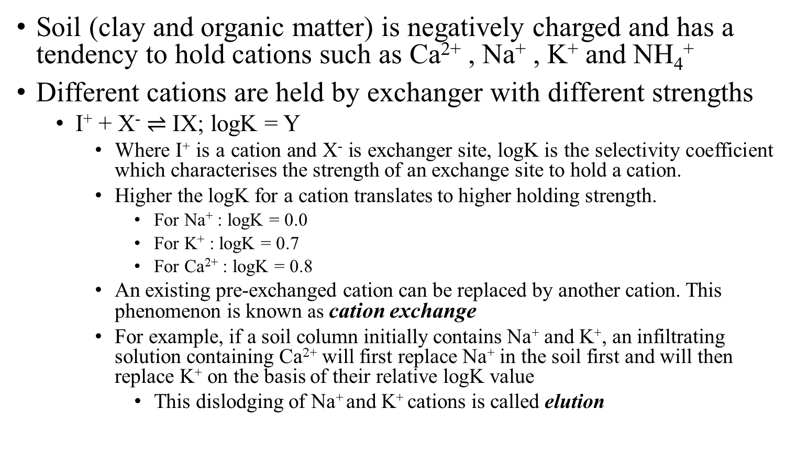
Introduction To Cation Exchange
Soil (clay and organic matter) is negatively charged and has a tendency to hold cations such as Ca²⁺ , Na⁺ , K⁺ and NH₄⁺
Different cations are held by exchanger with different strengths
I⁺ + X⁻ $⇌$ IX; logK = Y
Where I⁺ is a cation and X⁻ is exchanger site, logK is the selectivity coefficient which characterises the strength of an exchange site to hold a cation.
Higher the logK for a cation translates to higher holding strength.
For Na⁺ : logK = 0.0
For K⁺ : logK = 0.7
For Ca²⁺ : logK = 0.8
An existing pre-exchanged cation can be replaced by another cation. This phenomenon is known as cation exchange
For example, if a soil column initially contains Na⁺ and K⁺, an infiltrating solution containing Ca²⁺ will first replace Na⁺ in the soil first and will then replace K⁺ on the basis of their relative logK value
This dislodging of Na⁺ and K⁺ cations is called elution
Excerpts from Phreeqc Database

Slide 5
Model Characteristics (common to both simulations)
Model domain dimensions: A 100cm long soil column
Flow Conditions: 1-D saturated steady state flow
Flow Direction: From top to bottom
Geo-chemical composition and Solute related Boundary Conditions
Each cell/node in the column initially contains 1.1 milli moles of exchanger (X)
Initially, each cell/node has 1.0 mmols Na⁺ , 0.2 mmols K⁺ and 1.2 mmols NO₃⁻ . This is equivalent to 1 mmol of NaNO₃ and 0.2 mmol of KNO₃
Prescribed concentrations at the top surface of the soil column are 0.6 mmols of Ca²⁺ and 1.2 mmols Cl⁻ i.e. 0.6 mmols CaCl₂.
Flow carries Ca²⁺ and Cl⁻ to the lower sections of the soil column leading to the elution of Na⁺ and K⁺

Slide 6
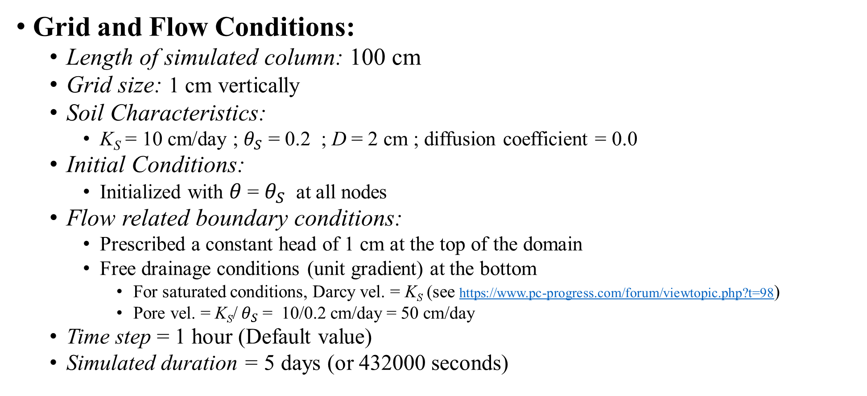
Simulations based on 2DSoil-PhreeqcRM
Grid and Flow Conditions:
Length of simulated column: 100 cm
Grid size: 1 cm vertically
Soil Characteristics:
K_{S} = 10 cm/day ; $θ_{S}$ = 0.2 ; D = 2 cm ; diffusion coefficient = 0.0
Initial Conditions:
Initialized with $θ$= $θ_{S}$ at all nodes
Flow related boundary conditions:
Prescribed a constant head of 1 cm at the top of the domain
Free drainage conditions (unit gradient) at the bottom
For saturated conditions, Darcy vel. = K_{S} (see https://www.pc-progress.com/forum/viewtopic.php?t=98)
Pore vel. = K_{S}/ $θ_{S}$ = 10/0.2 cm/day = 50 cm/day
Time step = 1 hour (Default value)
Simulated duration = 5 days (or 432000 seconds)

Slide 7
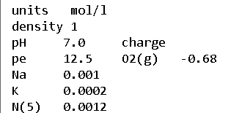
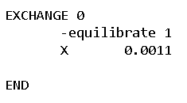
Model Characteristics for 2DSoil-PhreeqcRM
Initialize solute and X concentrations and print outputs
Solute Transport Conditions:
Number of solutes = 5 : Ca²⁺ , Cl⁻ , Na⁺ , K⁺ and NO₃⁻
Prescribed constant solute concentrations at the top most nodes:
Ca²⁺ = 24.0 mg/l (= 0.6 mmol/l; GFW = 40 gm)
Cl⁻ = 42.6 mg/l (= 1.2 mmol/l; GFW = 35.45 gm)
Initial concentrations of Na⁺ , K⁺ and NO₃⁻ are defined by PhreeqcRM input file (refer Figure (a) in the panel on the right)
Solute concentrations were prescribed using fertigation module (added last month to the TF repository)
This module reads the type of solute BC and the prescribed values (VarBS)
fertigation module also prints out the concentrations of solutes in mmols
1.1 millimoles of X is defined for all nodes using cell 0 as initial condition (refer Figure (b) in the panel on the right)
Excerpts from PhreeqcRM input file
(a)
(b)

Slide 8
Model Characteristics for Phreeqc’s Transport Module
Grid and Flow Conditions:
Advective dispersive transport is simulated using a shift based method where water in one cell is shifted to another in a user defined time step
Model domain is composed of 100 cells with each having a length of 1 cm (total length of domain = 1 m)
A single shift equates to downward movement of soil water by 1 cm
Time step calculations
simulated pore velocity in 2DSoil-PhreeqcRM based simulations = 50 cm/day
To obtain similar pore velocity : time step = (Length travelled in a shift)/(Pore Vel)
Time step = 1cm/(50 cm/86400 seconds) = 1728 seconds (28.8 minutes)
Number of Shifts = Simulated duration/ time step = 432000/1728 = 250 shifts
Dispersivity = 2 cm (same as that in 2DSoil-PhreeqcRM based simulations)

Slide 9
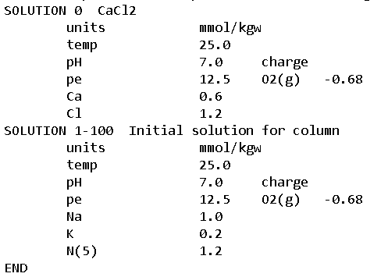
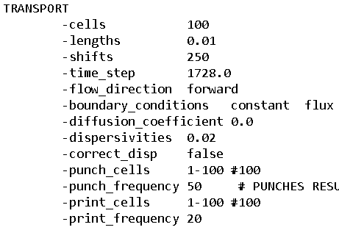
Model Characteristics for Phreeqc’s Transport Module
Initialize solute concentrations and print outputs
Solute Transport Conditions:
Prescribed constant solute concentrations at the top most node (refer Figure (b) in the right panel)
Ca²⁺ = 24.0 mg/l (=0.6 mmol/l)
Cl⁻ = 42.6 mg/l (=1.2 mmol/l)
Initial concentrations of Na⁺ , K⁺ and NO₃⁻ are defined by Phreeqc input file (refer Figure (b) in the right panel)
Solute concentrations were prescribed using fertigation module (added last month to the TF repository)
Solute concentrations are printed out by the fertigation module
Excerpts from PhreeqcRM input file
(a)
(b)

Slide 10
Results
In the next few slides I have presented the following results obtained from 2DSoil-PhreeqcRM and Phreeqc’s in-built transport module:

Slide 11
Comparison of Simulated Concentration Profiles : Ca²⁺ and Na⁺
Ca²⁺
Day 1
Day 2
Day 3
Day 4
Na⁺

Slide 12
Comparison of Simulated Concentration Profiles: Ca²⁺ and K⁺
Ca²⁺
Day 1
Day 2
Day 3
Day 4
K⁺

Slide 13
Comparison of Simulated Concentration Profiles: Cl⁻ and NO₃⁻
Cl⁻
Day 1
Day 2
Day 3
Day 4
NO₃⁻

Slide 14
Discussion of Results
Cation Exchange:
Na⁺ is held weakly by the exchanger due to its lower selectivity coefficient (logK = 0) leading to it being simply flushed out with the flow
K⁺ is held relatively stronger by exchanger in the soil due to a higher selectivity coefficient (logK = 0.7)
This leads to accumulation as it is eluted from the exchanged sites. This accumulation is elucidated by the peaks in the concentration profiles
Anion dynamics:
Both anions and exchange sites are negatively charged and do not interact due to repulsion

Slide 15
Conclusion and scope of additional exercises
Conclusion:
Results obtained from 2DSoil-PhreeqcRM based simulations show good agreement with those obtained from the in-built transport module in Phreeqc
Scope of additional exercises:
Other agro-geochemical scenarios can be simulated
One of them is the simulation of experimental studies conducted at UNL

