Slide 1
Attendance Managment System
Presented By:-
112103048-Shrikant Hamand
112103050- Aditya Ingle

Slide 2
Introduction:-
Attendance Management System:
A program or technology solution designed to automate and simplify the process of tracking and managing attendance records.
It is Most efficient way of taking attendance and maintaining record of students attendance.
It is an online attendance system more effective than the manual paper based attendance process
Our project is done only using python as the subject is based on python only.

Slide 3
System Overview
Python OOPs
MySql
tkinter
OOPS
Used for backend purpose of the project.
For database managment of admins and student
Python library for making frontend of project

Slide 4
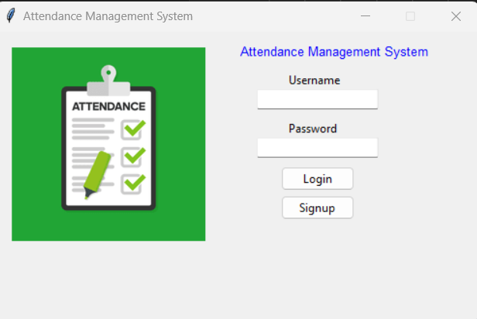
Login Interface
It takes username and password from the user or i can say faculty
Signup button is for the new user
It has attendance image
We also done the error handling that we will see later in ppt

Slide 5
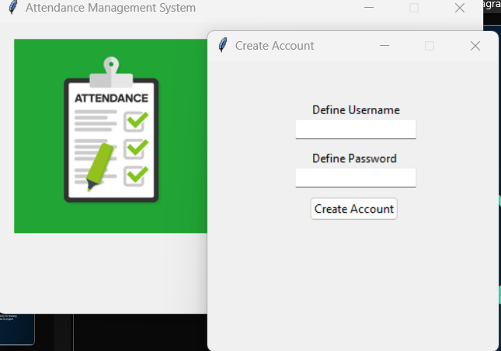
Signup Interface
GOSTUDIO
Signup button is for the new user
It takes username and password and save it to the admins table

Slide 6
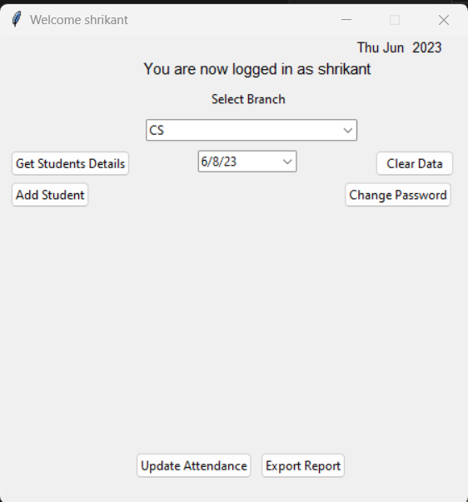
Main Interface
GOSTUDIO
It has buttons like get students details, clear data add student , change password , date, branch , update attendance and export report.
It has label welcome {username}
Select the options we need .

Slide 7
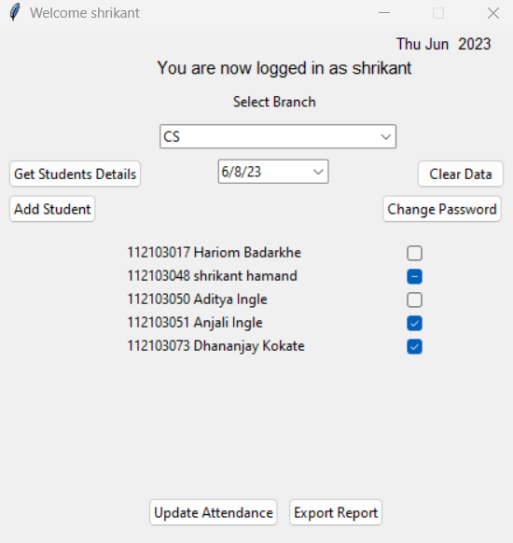
Get Student Details
GOSTUDIO
It fatches the data from data base to mark the attendance of students of selected branch
Clear Data
It clears the data of students fetch from the data base
Update Attendance
It updates the attendence of student of that date mark present and absent in the database

Slide 8
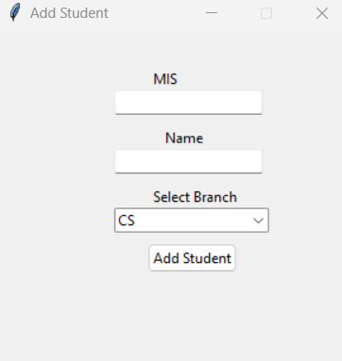
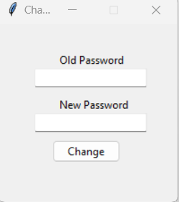
Add Student Interface
GOSTUDIO
Change Password
It takes mis , name and branch of student and add the student in the data base .
To change password of the user it take old password and new password

Slide 9
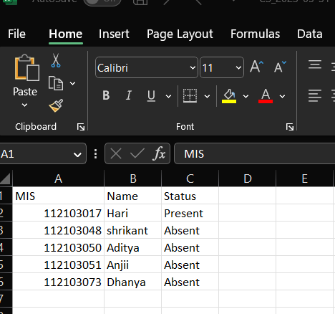
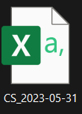
Export Attendance
GOSTUDIO
It export the attendance in csv files and name it as branch_date

Slide 10
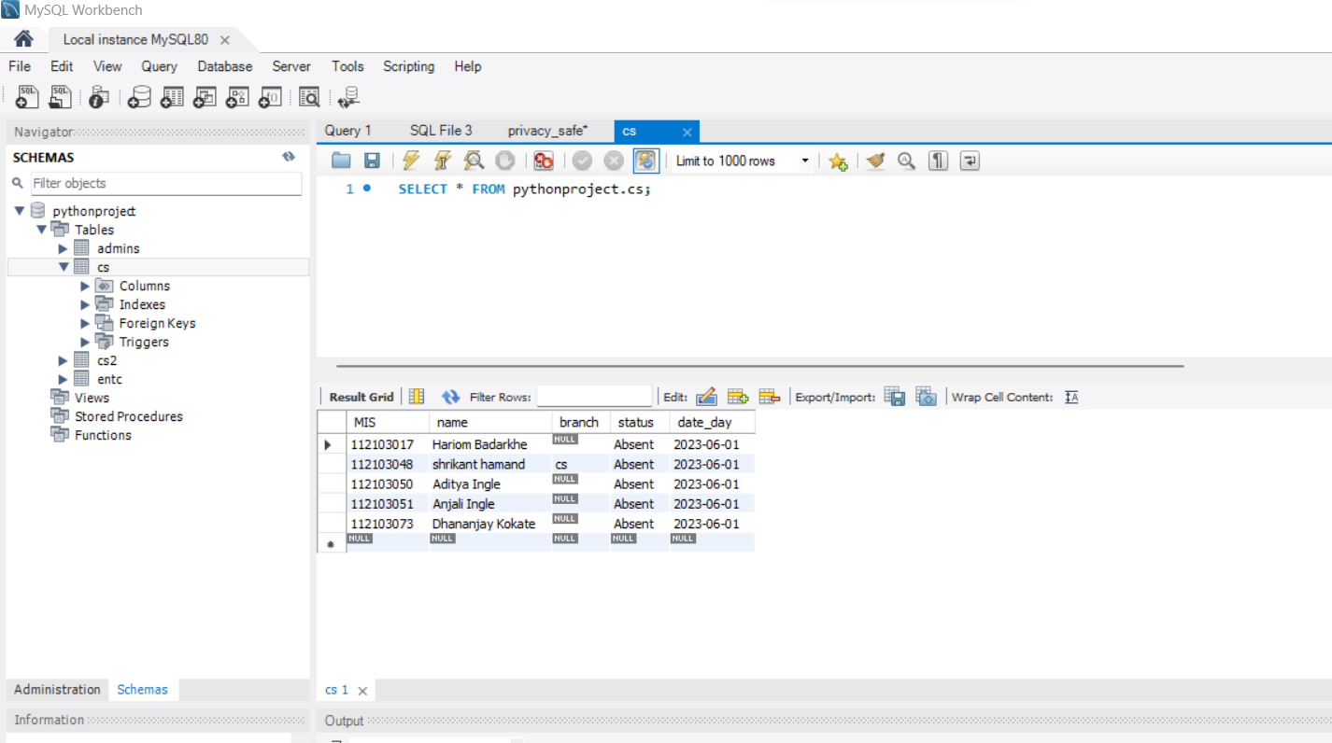
Mysql Database
GOSTUDIO
Admins table to store the data of the user i.e username and password.
Cs, cs2 ,entc, mech are the tables of students of that branch.

Slide 11
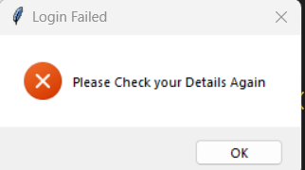
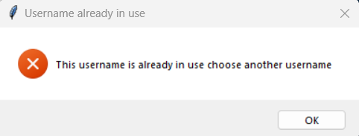
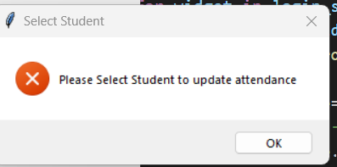
Error Handling
Wrong Login password and Username
If the same username is present in the data base while creating the new user.
To mark or update attendance select the students

Slide 12
Thank You…!!

