Slide 1
IBM University Engagement Project Submission
AI-Based Predictive Maintenance of Industrial Machinery Using Machine Learning and IBM Cloud Lite

Slide 2

Project Title – AI-Based Predictive Maintenance of Industrial Machinery Using Machine Learning and IBM Cloud Lite
Domain of Project – Mechanical Engineering / Industrial IoT / Machine Learning
Student Name | Recent Passport Photo | Email ID | Mobile number [WhatsApp]
ADITYA RAJ CHAUDHARY |  | aditya.inter1010@gmail.com | 6205736083

Slide 3
Problem Statement
Industrial machinery failures cause unexpected downtime, high repair costs and production losses. Traditional maintenance is either reactive (fix after failure) or time-based (fixed schedule), and both are inefficient and costly.
The Challenges:
Class Imbalance – only 3.39% of machines fail
Multiple Failure Types – 5 categories, not just yes/no
No Early Warning – sensor data is not used to predict failures
Explainability Gap – engineers need to know why a failure is predicted
Rare Failures – Random Failures have only 18 examples
Cloud Scalability – must fit IBM Cloud Lite (free tier) limits

Slide 4
Objectives
Predict failures early – detect machine failure before it occurs using real-time sensor data
Classify failure type – Tool Wear, Heat Dissipation, Power, Overstrain or Random
Explain predictions – use SHAP to show which sensor raised the alert
Recommend actions – suggest maintenance steps for the predicted failure type
Integrate IBM Cloud Lite – Watson ML, Cloud Object Storage, Watson NLU and watsonx.ai
Deploy a dashboard – interactive Streamlit app for real-time use by maintenance engineers

Slide 5
Proposed Solution
Data Collection & Analysis – 10,000 sensor records from Kaggle; EDA of failure patterns and class distribution
Feature Engineering – Temperature Differential, Power (Torque × RPM) and Tool Wear Category
ML Model Development – Logistic Regression, Decision Tree, Random Forest and XGBoost for failure detection and type classification
Class Imbalance Handling – SMOTE resampling and class weighting for the 3.39% failure rate
Explainable AI – SHAP shows which sensor triggered each alert
IBM Cloud Integration – Watson ML, Cloud Object Storage, Watson NLU and watsonx.ai Granite
Agentic AI via LangFlow – multi-agent workflow from sensor input to maintenance report
Streamlit Dashboard – 7 pages for live prediction, EDA, model evaluation, SHAP, IBM Cloud status, analytics and log analysis

Slide 6
Technology Used
LangFlow – visual design of the multi-agent maintenance workflow
IBM Granite (ibm-granite-13b-instruct-v2) – language understanding and automatic maintenance reports
IBM Cloud Lite – secure, scalable hosting with Watson ML, Cloud Object Storage and Watson Studio
IBM Watson NLU – extracts keywords, entities and sentiment from maintenance logs to classify the failure type
IBM watsonx.ai – model deployment, LLM report generation and AI governance via REST API
SHAP (Explainable AI) – explains each prediction with real feature-importance values
Scikit-learn + XGBoost – core ML engine: failure detection (F1 = 0.9842) and 6-class failure type classification (F1 = 0.9954), with SMOTE

Slide 7
LangFlow Components Used
Chat Input – accepts maintenance queries as text
Text Input – accepts sensor readings: temperature, RPM, torque, tool wear
Prompt Component – structures sensor data into instructions for the AI
IBM watsonx.ai Agent – generates maintenance insights using IBM Granite
IBM Granite Model – Granite-4.0-8B-Instruct writes reports and explanations
Custom Component (ML Model) – XGBoost / Random Forest failure prediction
Custom Component (SHAP Explainer) – finds the most influential sensors
File Component – loads machine datasets and maintenance records
Chat Output – shows predictions, reports and maintenance advice
Conditional Router – routes by failure category and risk level

Slide 8
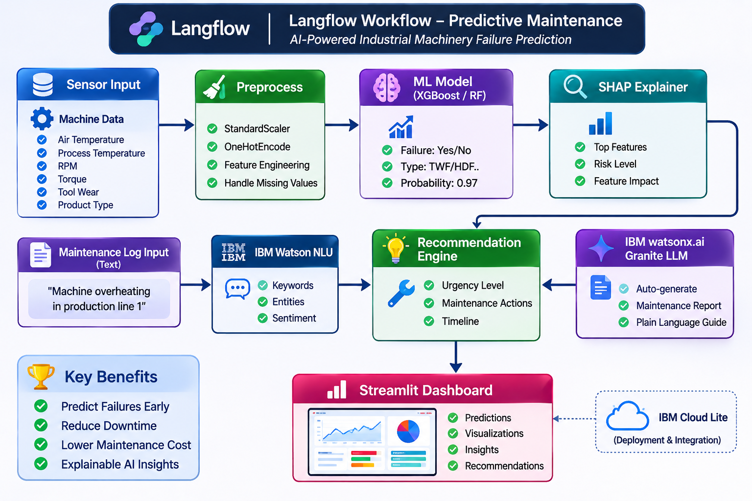
LangFlow Workflow

Slide 9
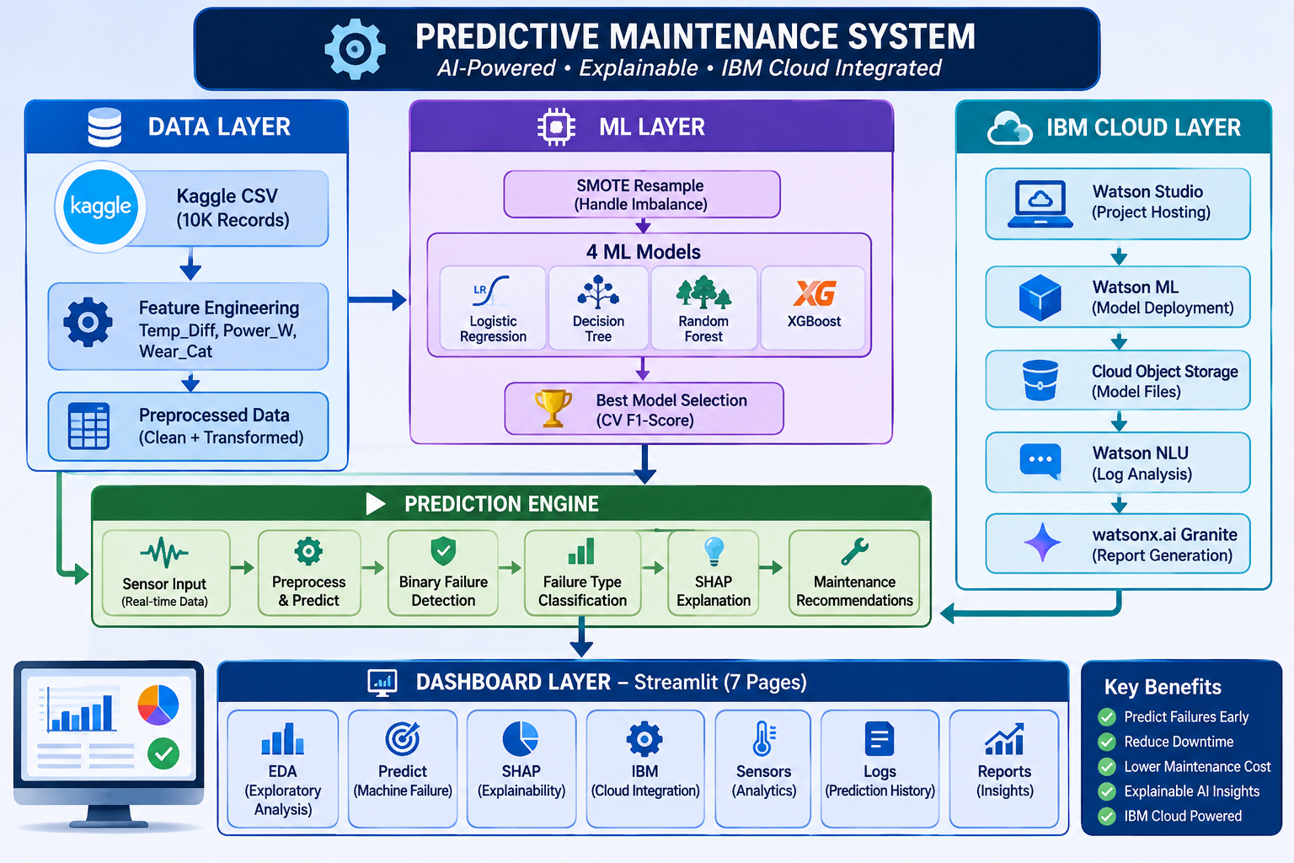
Architecture Blueprint

Slide 10

Role of Agentic AI in the Solution
Agentic AI turns the system from a simple prediction model into an autonomous maintenance assistant, built on IBM watsonx.ai and IBM Granite models.
Specialised agents handle sensor input, failure prediction, SHAP explanation, log analysis and report generation, working together without manual steps.
The agents understand context, such as sensor values and failure risk, and adapt in real time to new readings.
Overall, the system becomes proactive and goal-driven, like a smart digital maintenance engineer.

Slide 11
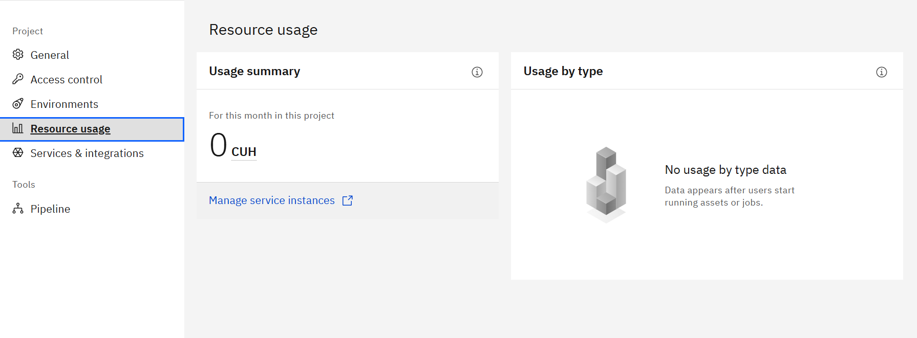
Token Usage
0 tokens are used
After the Prompt

Slide 12
Novelty and Uniqueness
Dual Classification – predicts if a machine will fail and which failure type
IBM Cloud Lite – 5 IBM services, all on the free plan
Log Analyser – Watson NLU extracts failure type and severity from maintenance logs
Report Generation – watsonx.ai Granite writes maintenance reports automatically
Explainable Predictions – SHAP shows which sensor caused the alert
SMOTE + Class Weighting – handles the 3.39% failure rate reliably
Feature Engineering – 3 features based on mechanical engineering principles
7-Page Streamlit Dashboard – prediction, EDA, SHAP, IBM Cloud status and log analysis

Slide 13
GitHub Link
Public GitHub repository:
https://github.com/adityainter1010-svg/AICTE-Predictive-Maintenance-Industrial-Machinery
Repository contents:
app.json file
Problem statement (PDF)
Project presentation (PPTX)
Source code and other project files

Slide 14
Future Scope
Real-Time IoT Integration – live sensor data streaming
Time-Series Forecasting – predict the exact failure time using LSTM
Mobile App – instant alerts for maintenance engineers
Edge Deployment – run the model directly on machine hardware
Digital Twin – virtual copy of the machine for simulation

Slide 15
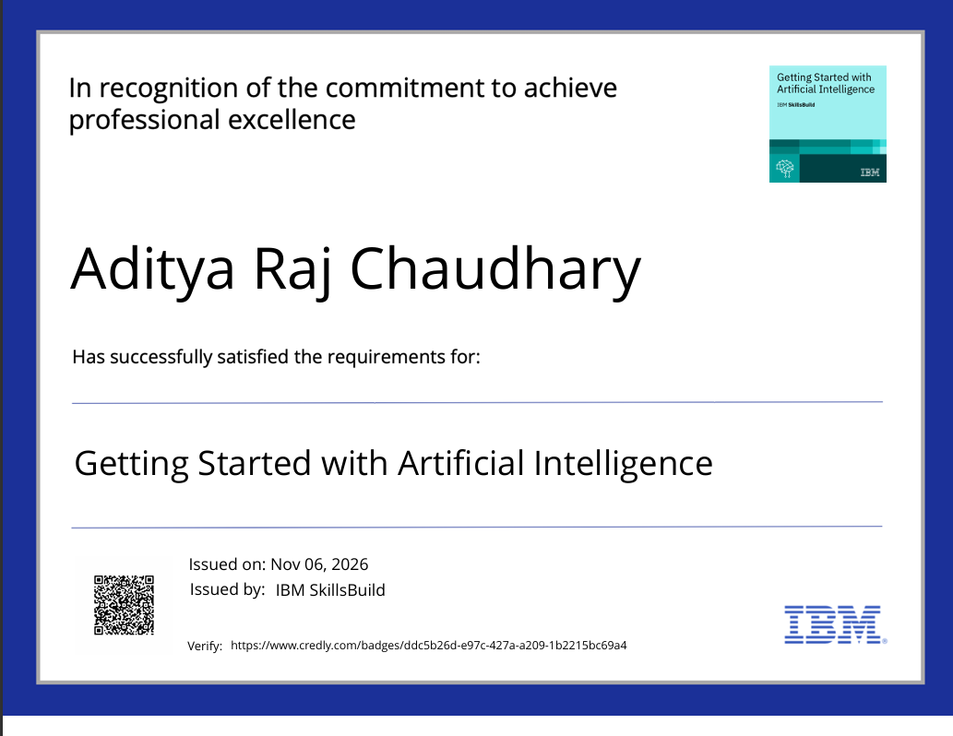
Certificates Earned
IBM SkillsBuild – Getting Started with Artificial Intelligence

Slide 16
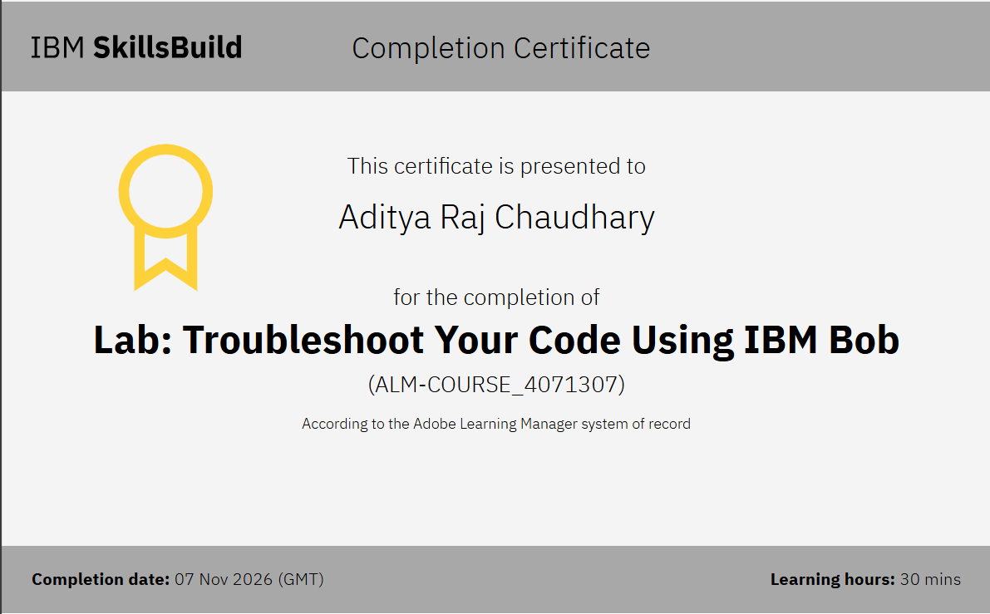
Certificates Earned
IBM SkillsBuild – Lab: Troubleshoot Your Code Using IBM Bob

Slide 17


