Slide 1
JAVA - REMOTE METHOD INVOCATION
Name: Jadhav Aditya Dnyandev
Class: M.Sc(Computer Science)
RollNo: 16
Subject: Web Service
Topic: Java RMI

Slide 2
INTRODUCTION
🠶 The Java Remote Method Invocation (Java RMI) is a Java API that performs remote method invocation, the object-oriented equivalent of remote procedure calls (RPC), with support for direct transfer of serialized Java classes and distributed garbage collection.
🠶 Usage of the term RMI may denote solely the programming interface or may signify both the API and JRMP, IIOP, or another implementation, whereas the term RMI-IIOP specifically denotes the RMI interface delegating most of the functionality to the supporting CORBA implementation.

Slide 3
WHY IT IS NEEDED..??
🠶 Provide user with a “thin client “
🠶Allows good performance on lowed workstations
🠶 Run server on high end hardware
🠶Maximize $ investment over many clients
🠶Server remote from client
🠶 Distributed network object.

Slide 4
WHAT IS NEEDED FOR RMI..??
🠶 Java makes RMI (Remote Method Invocation) fairly easy, but there are some
Extra steps
🠶 To send a message to a remote “server object,”
🠶 The “client object” has to find the object
🠶Do this by looking it up in a registry
🠶 The client object then has to marshal the parameters (prepare them for transmission)
🠶Java requires Serializable parameters
🠶The server object has to unmarshal its parameters, do its computation, and marshal its response
🠶 The client object has to unmarshal the response
🠶 Much of this is done for you by special software

Slide 5
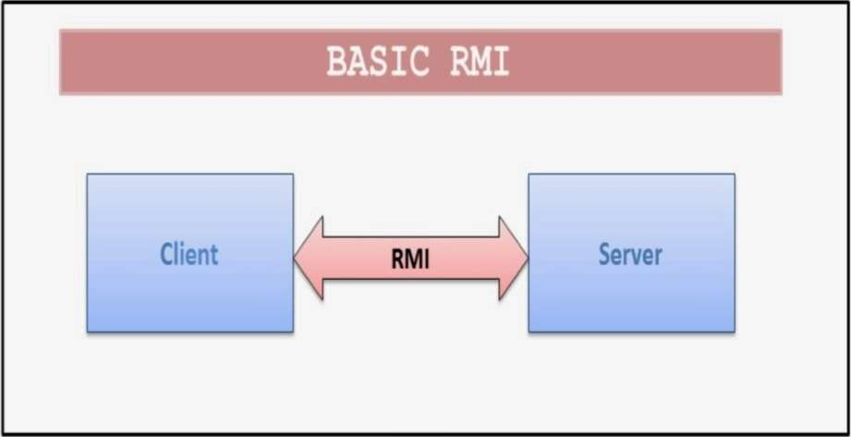
GENERAL FUNCTIONING DIAGRAM
🠶 RMI provides for remote communication between programs written in the JAVA.

Slide 6
RMI ARCHITECTURE
The complete RMI System is divided in 4 layers:
Application Layer
Proxy Layer
Remote Reference Layer
Transport Layer

Slide 7
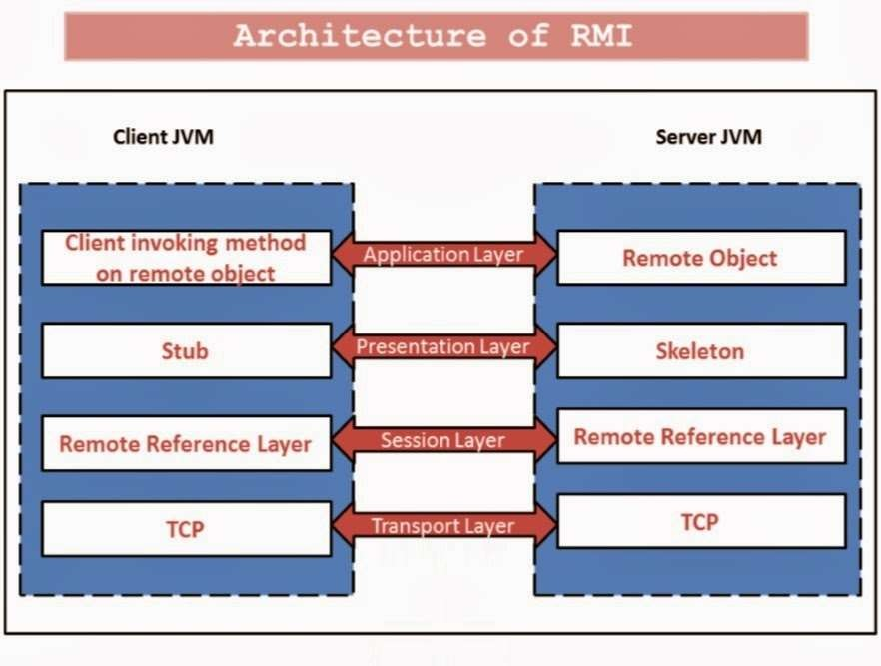

Slide 8
Application Layer : It’s responsible for the actual logic (implementation) of the client and server applications. Generally at the server side class contain implementation logic and also apply the reference to the appropriate object as per per the requirement of the logic in application.
Proxy Layer : It’s also called the “Stub/Skeleton Layer”. A Stub class is a client side proxy handles the remote objects which are getting from the reference. A Skeleton Skeleton class is a server side proxy that set the reference to the objects which are are communicating with the Stub.
Transport Layer : It’s also called the “ Connection Layer”. It is responsible for managing the existing connections and also setting up new connections. So it works works like a link between the RRL on the client side and the RRL on the server side. server side.

Slide 9
4. Remote Reference Layer(RRL) : It is responsible for managing the references made by the client to the remote object on the server so it is available on both JVM(Client JVM(Client and Server). The Client side RRL receives the request for methods from methods from the tub that is transferred into byte stream process called serialization serialization (Marshalling) and then these data are send to the server side RRL.
RRL.
The server side RRL doing reverse process and convert the binary data into object. object. This process is called deserialization or unmarshalling and then sent to the to the Skeleton class.

Slide 10
RMI COMPONENTS
The RMI application contains three components:
RMI Server
RMI Client
RMI Registry

Slide 11
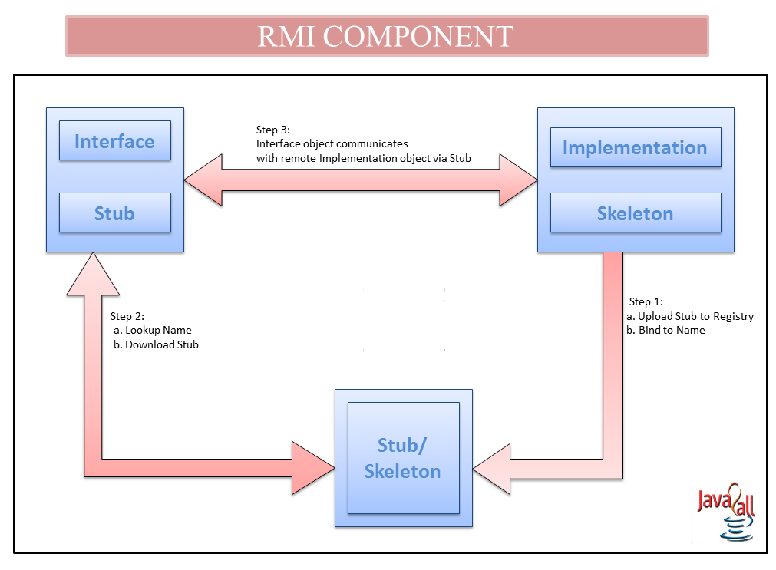

Slide 12
RMI SERVER
🠶 RMI Server contains objects whose methods are to be called remotely. It creates remote objects and applies the reference to these objects in the Registry, after that the Registry registers these objects who are going to be called by client remotely.

Slide 13
RMI CLIENT
🠶 The RMI Client gets the reference of one or more remote objects from the Registry with the help of object name. It can invoke methods on the remote object to access the services of the object as per the requirement of logic in RMI application.
🠶 Once the client gets the reference of remote object, the methods in the
remote object are invoked just like as the methods of a local object.

Slide 14
RMI REGISTRY
🠶 In the Server side of the reference of the object (which is invoked remotely) is applied and after that this reference is set in the RMI registry.
🠶 When the client call the method on this object, its not directly call but it is a call by the reference which is already set in the Registry so it first gets the object from this reference which is available at RMI Registry then after calls the methods as per the requirement of logic in RMI application.

Slide 15
THE FUTURE OF RMI
🠶 Now that it is part of JDK1.1, it is highly unlikely that it will be removed at a later date.
🠶 According to Sun, RMI has not been (and will not be) replaced by Corba
and IIOP.
🠶 According to Java Soft, RMI will be extended in the future with the ability to use IIOP as a transport protocol.

Slide 16
THANK YOU

