Slide 1
Simple Object Access Protocol Messages
NAME: 1) JADHAV ADITYA DNYANDEV
2) SANKET SUNIL GAWADE
CLASS: M.SC(COMPUTER SCIENCE)
ROLLNO: 15, 16
SUBJECT: WEB SERVICE
TOPIC: SOAP MASSEGES

Slide 2
What is SOAP?
SOAP is a lightweight protocol intended for exchanging structured information in a decentralized, distributed environment. SOAP uses XML technologies to define an extensible messaging framework, which provides a message construct that can be exchanged over a variety of underlying protocols. The framework has been designed to be independent of any particular programming model and other implementation-specific semantics.

Slide 3
Simply Put...
SOAP is a way for a program running in one operating system to communicate with a program running in either the same or a different operating system, using HTTP (or any other transport protocol) and XML.

Slide 4
SOAP Messaging Framework
XML-based messaging framework that is
  1) extensible
  2) interoperable
  3) independent
Next we discuss these three characteristics in more detail

Slide 5
Extensible
Simplicity remains one of SOAP's primary design goals
SOAP defines a communication framework that allows for features such as security, routing, and reliability to be added later as layered extensions

Slide 6
Interoperable
SOAP can be used over any transport protocol such as TCP, HTTP, SMTP
SOAP provides an explicit binding today for HTTP

Slide 7
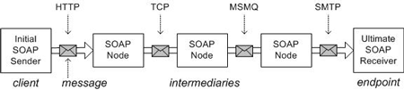
Interoperable Cont…

Slide 8
Independent
SOAP allows for any programming model and is not tied to RPC
SOAP defines a model for processing individual, one-way messages
SOAP also allows for any number of message exchange patterns (MEPs)

Slide 9
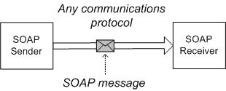
One-Way Message

Slide 10
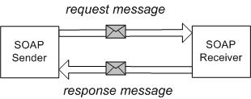
Request/Response

Slide 11
SOAP Message Format
SOAP message consists of three parts:
  SOAP Envelope
  SOAP Header (optional)
  SOAP Body
  From the http://schemas.xmlsoap.org/soap/envelope/ namespace

Slide 12
SOAP Envelope
The SOAP Envelope construct defines an overall framework for expressing what is in a message and who should deal with it.

Slide 13
SOAP Envelope Cont…
The Envelope is the top element of the XML document representing the message.
  The Envelope element is always the root element of a SOAP message.
  The Envelope element contains an optional Header element followed by a mandatory Body element.

Slide 14
SOAP Envelope Code
<soap:Envelope xmlns:soap="http://schemas.xmlsoap.org/soap/envelope/"> <soap:Header> <!-- optional -->
<!-- header blocks go here... -->
</soap:Header>
<soap:Body>
<!-- payload or Fault element goes here... --> </soap:Body>
</soap:Envelope>

Slide 15
SOAP Header
The Header element is a generic container for control information
It may contain any number of elements from any namespace
Header blocks should contain information that influences payload processing
Header is optional

Slide 16
SOAP Header Code
<soap:Header>
<!-- security credentials -->
<s:credentials xmlns:s="urn:examples-org:security"> <username>dave</username> <password>evad</password>
</s:credentials>
</soap:Header>

Slide 17
SOAP Body
The Body element represents the message payload

Slide 18
SOAP Body Code
<soap:Body>
<x:TransferFunds xmlns:x="urn:examples-org:banking"> <from>22-342439</from>
<to>98-283843</to>
<amount>100.00</amount>
</x:TransferFunds>
</soap:Body>

Slide 19
19
Thank You

