Slide 1
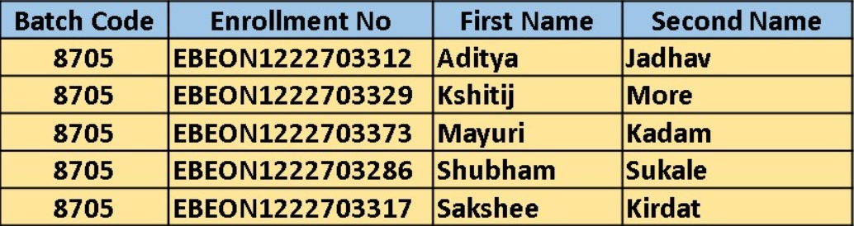
Grocery Delivery Application
Team Leader: Aditya Jadhav
Enrollment No. : EBEON1222703312
Guided by
Varadharajan sir

Slide 2
Grocery Delivery Application
Login Module
Admin Module
Home Page
Add to cart/ Order module
View Products module
Payment module
About us, Contact us

Slide 3
Grocery Delivery Application
1)Login Module:
User Registration
Forgot password
2)Admin Module:
a)Order : 1)View all orders 2)View Pending orders 3)View Delivered Orders
b)Customer :1) View Customer
3)Home page:
a) View all products

Slide 4
Module 1
1)Login Module:
User Registration
Forgot password

Slide 5
Module 2
2)Admin Module:
a)Order : 1)View all orders 2)View Pending orders 3)View Delivered Orders
b)Customer :1) View Customer

Slide 6
Module 3
3)Home page:
a) View all products

Slide 7
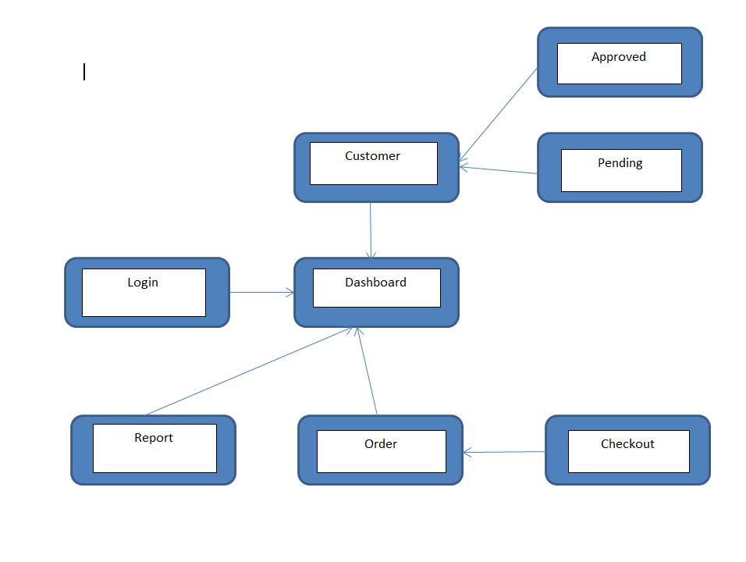
Project overview

Slide 8
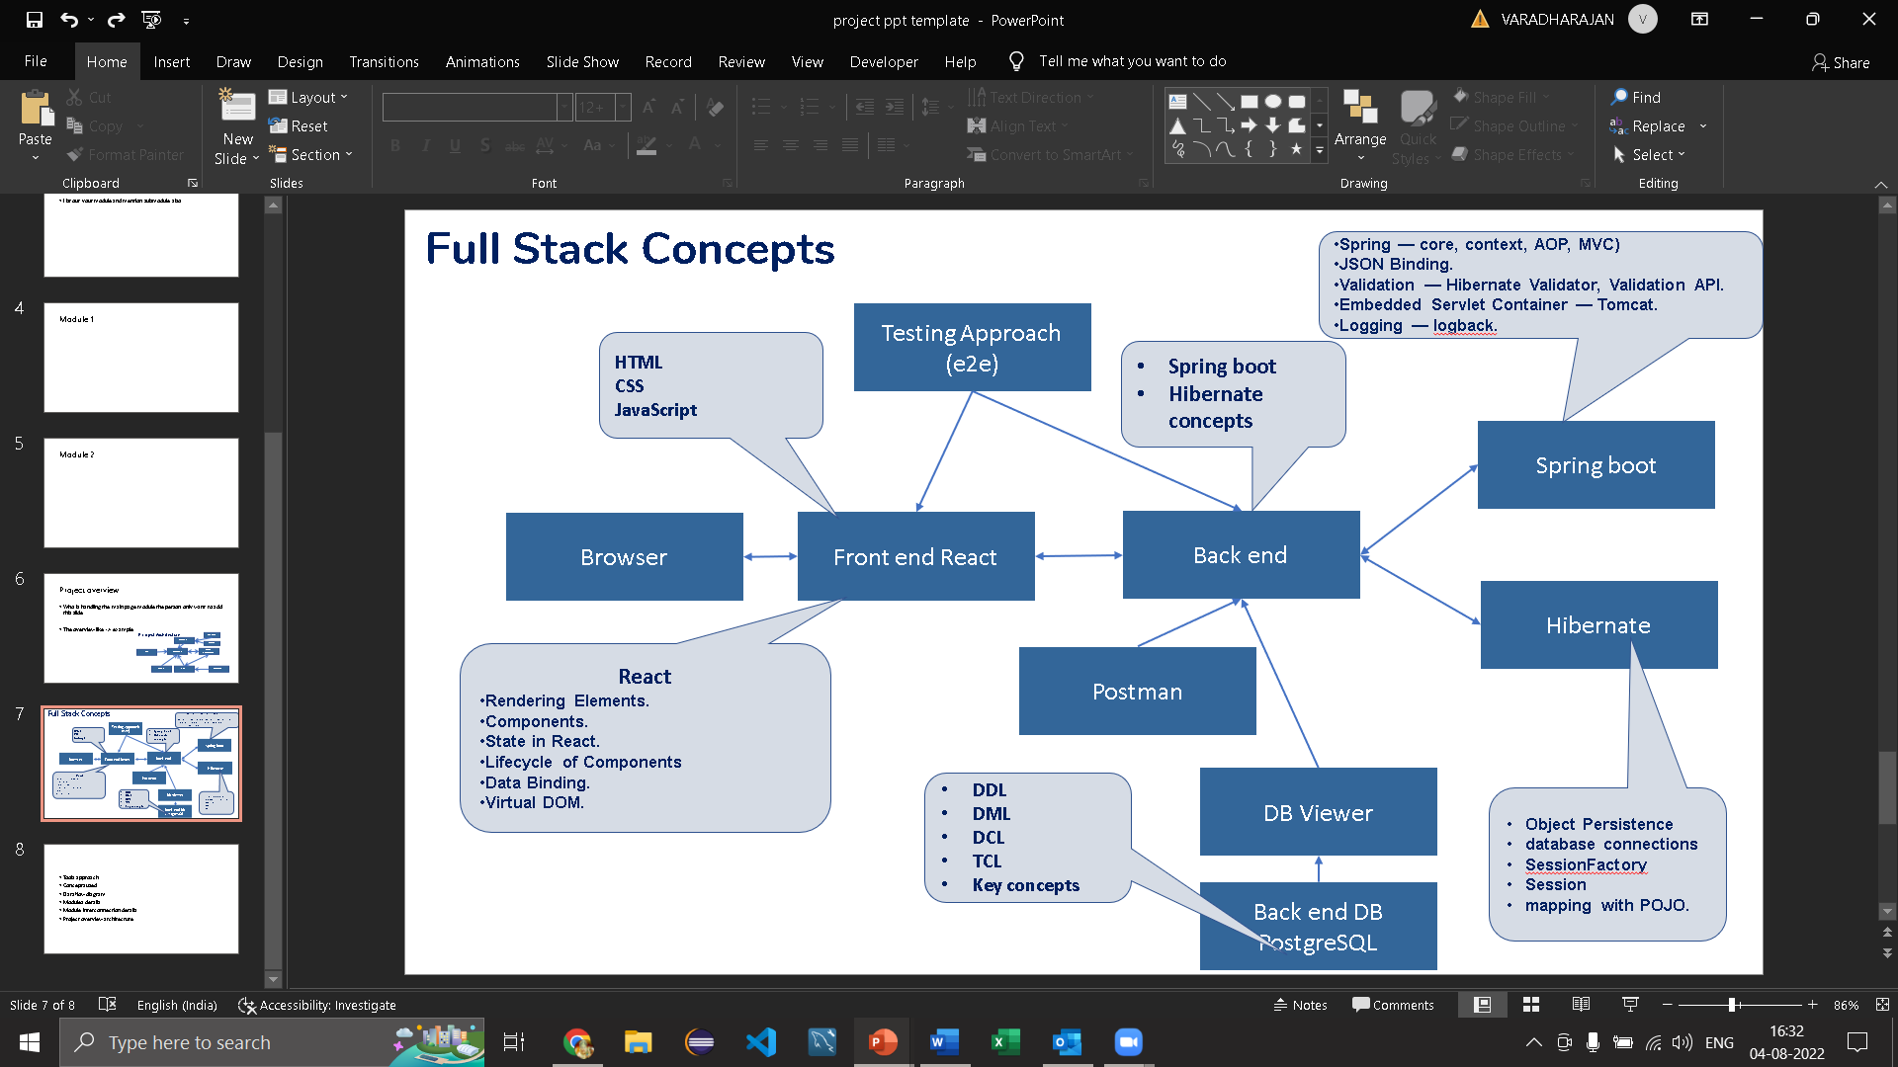
Tech architecture

Slide 9
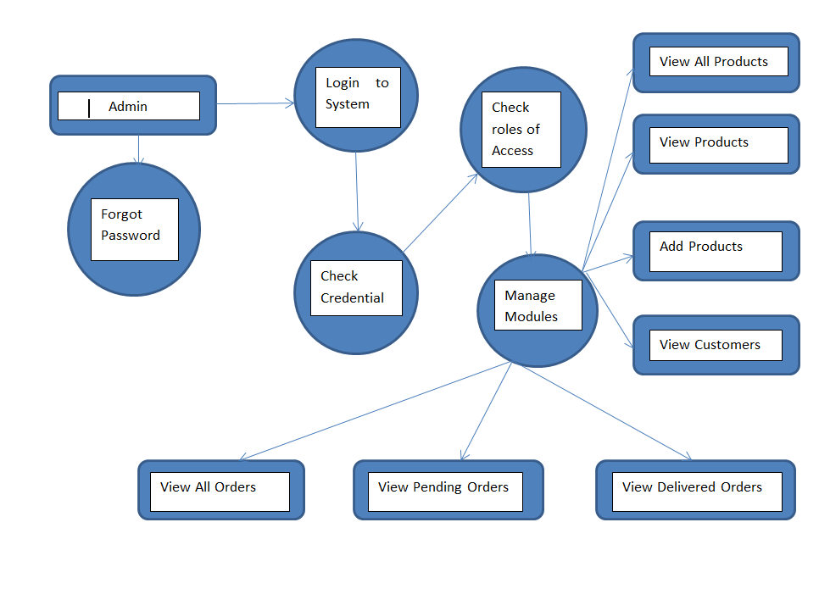
Dataflow diagram

Slide 10
Challenging issues
1) While running project port no. problem
2) wrong dependencies added
3) Changes made in code are not reflected into live project

Slide 11
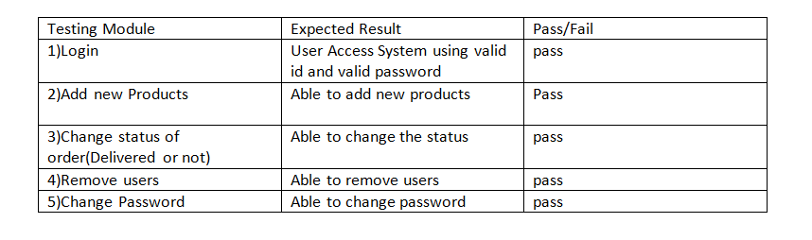
Testing

Slide 12
Future enhancement
Integration with virtual assistants: Integrate the website with virtual assistants like Google Assistant or Amazon Alexa, enabling customers to easily place orders through voice commands.
Smart recommendations: Utilizing data analytics and machine learning techniques to suggest products based on customer’s buying history, browsing history and preferences
Live customer support: Offering live chat support and personalized customer service to ensure customer satisfaction and resolve any issues that may arise.

Slide 13
Conclusion
Online grocery delivery websites are becoming increasingly popular due to their convenience and time-saving features.
This project is made in such a way that it is easy to use/ handle for new users
Person with little technical knowledge can also use/ interact with this project

