Slide 1

Foot365 – A Football Manager for YOU

Slide 2
Introduction
Our objective with this project was to integrate cloud-based services for the football community.
We manage the teams’ schedule, provide them reminders about upcoming games, suggest sports screening recommendations near them, set up SMS reminders on a request basis.
We have also incorporated features such as predictions for the final week of the season as well as live scores for the ongoing matches.

Slide 3
Assumptions
We have implemented our application with the league in consideration to be “English Premier League”
We started building the app with a given set of ideas but now the league has ended. And hence fixtures are not available for the next season, so we are currently assuming the league for 2018/2019 is in play.
During the demonstration, we have simulated already ended games and given data such that live scores can be displayed using this data.
Our predictions for the final week of season assumes that all the matches played in the current season barring the last week are considered.

Slide 4
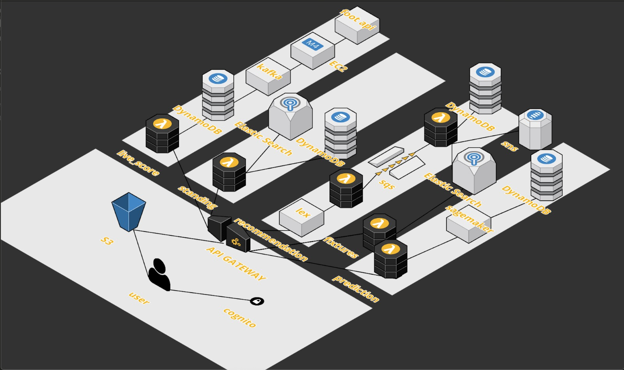
Architecture Diagram

Slide 5
Technology Stack
Front end – HTML, CSS, Bootstrap, JQuery
Back end – Python, Node
AWS Services used – Cognito & IAM for Authentication, Security Management,
S3 for Static Web Hosting, Data Storage,
API Gateway for routing and configuring business logic
Lambda for incorporating modular logic functionality
SQS and SNS for queuing and notification services
Sagemaker for match predictions using ML
EC2 for Kafka (with Apache Avro) for live score update
DynamoDB and ElasticSearch for database & indexing.
Lex for Chatbot application to provide recommendations
Cloudwatch for monitoring, trigger and analytics

Slide 6
External API integrations
FOOTBALL API
Google Places API

Slide 7
Challenges Faced
Security and Session Handling for multiple pages
Simulating live stream logic for Kafka
Machine Learning based complexities
Integration with cloud and merging back-end and front-end logic.
Data Scraping to usable formats within AWS
Adhering to AWS dependencies
Sticking to 100$ limit with Student Plan.

Slide 8
Future Work
Expanding the domain to other Football leagues across the world.
Incorporating fantasy football games for the userbase with Machine Learning techniques.
Including Live Commentary Feature for the ongoing games.
Incorporating FIFA World Cup matches
Exporting our services to games such as EA and PES.

Slide 9
Demo

Slide 10
QUESTIONS?

Slide 11
Thank YOU

