Slide 1

ONLINE MOVIE TICKET BOOKING Web Application using PHP
SIDDHANT PATEL -141112210
VIPANSHU JAIN -141112211
SHUBHAM GUPTA -141112243

Slide 2
CONTENTS
Objectives
Tools and Language used
Features Available
Design of database table
Future Scope of improvement
Conclusion

Slide 3
OBJECTIVE
The main purpose of our online ticket booking system is to
provide another way for the customer to buy cinema
ticket . It is an automatic system .
Goals of our system are:-
To provide anytime anyplace service for the customer.
To minimize the number of staff at the ticket box.
To promote the film on internet.

Slide 4
TOOLS AND LANGUAGE USED
FRONT END
HTML
CSS
JavaScript
BACK END
PHP
APACHE SERVER
STRUCTURED QUERY LANGUAGE

Slide 5
FEATURES AVAILABLE
Register/Sign Up
Login
Explore Movies
Trailors
Online Payment
E-Ticket
ABOUT

Slide 6
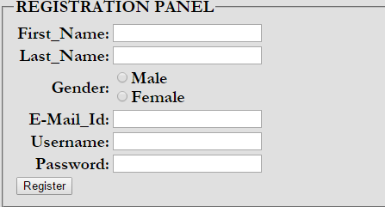
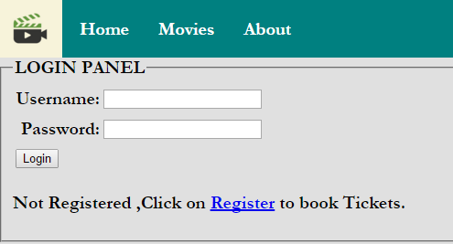
LOGIN AND REGISTRATION

Slide 7
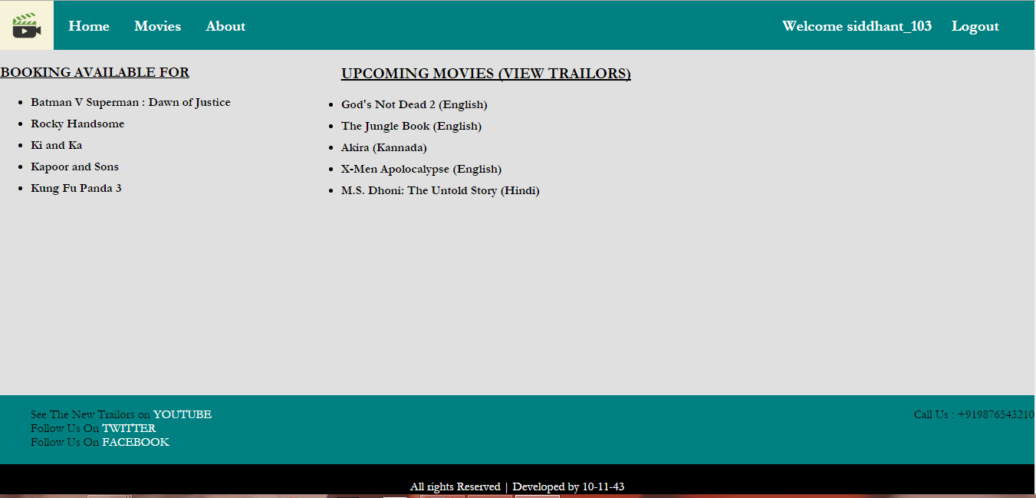
List of Movies

Slide 8
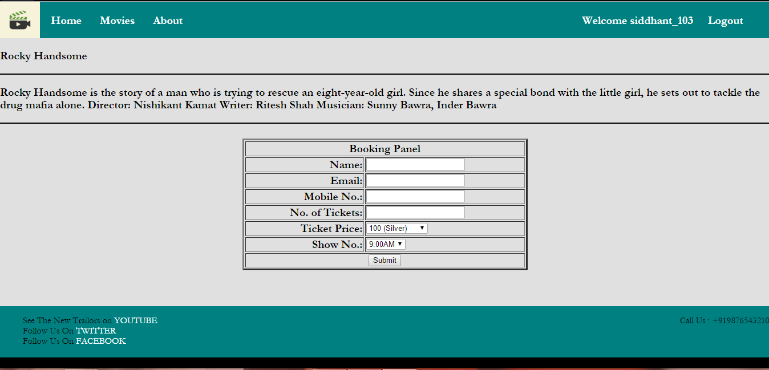
BOOKING PANEL

Slide 9
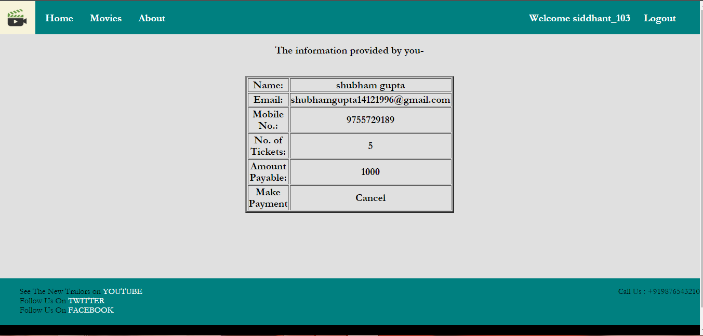
PAYMENT

Slide 10
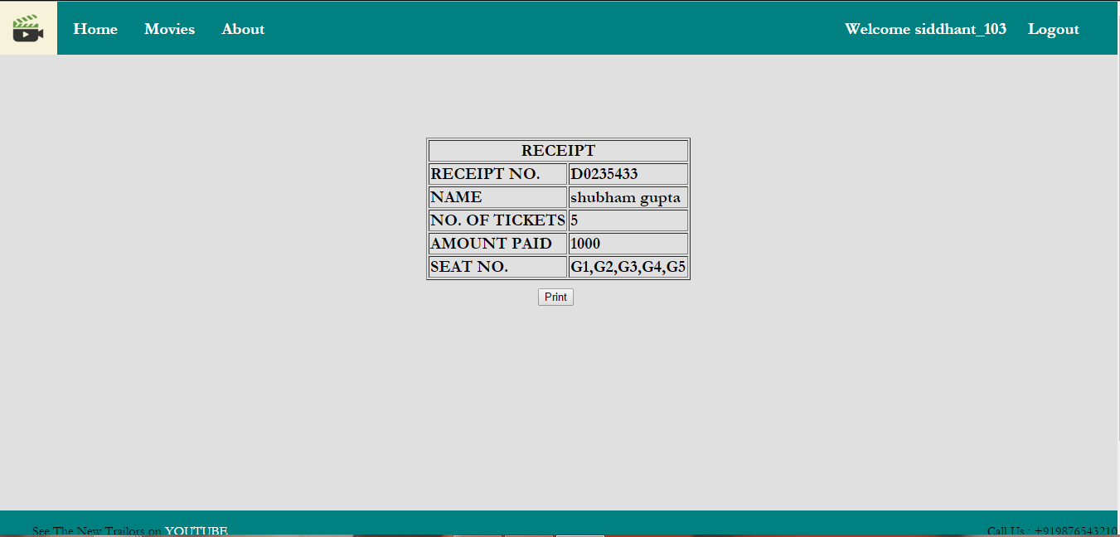
E-TICKET

Slide 11
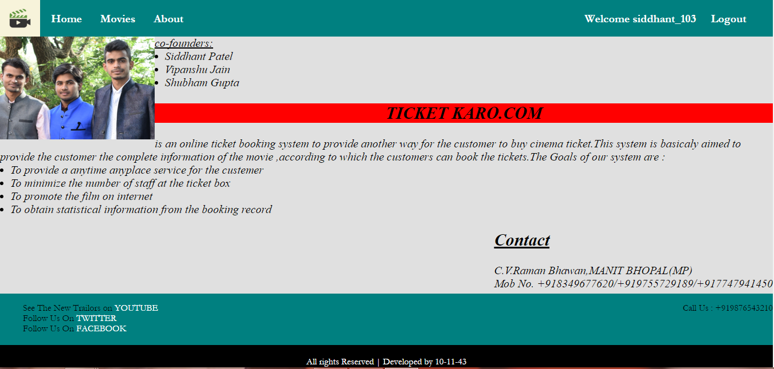
ABOUT

Slide 12
DESIGN OF DATABASE TABLE
The data to be used is stored in various tables .
The database design specifies:
The various tables to be used
Data to store in each table
Format of the fields and their types
We are using database of Apache Server
To create database firstly we start the SQL Server.
Firstly we have created the database ‘SE_Project’ with the user name ‘root’

Slide 13
TABLES IN THE DATABASE
TABLE 1:-
LOGIN_USER:-
Attributes | Data type
Id | int(222)
First name | Varchar(222)
Last name | Varchar(222)
Gender | Varchar(222)
Email | Varchar(222)
username | Varchar(222)
password | Varchar(222)

Slide 14
MORE TABLES:-
Table2:-
Movies:-
Table3:-
Ticket_booking:-
Attributes | Data type
M_id | Int(100)
M_name | Varchar(100)
M_show | Int(100)
M_tickets | Int(11)
M_description | Text
Attributes | Data type
B_id | Int(100)
B_name | Varchar(100)
B_m_name | Varchar(100)
B_show | Int(100)
B_tickets | Int(255)
Mobile_no | Varchar(100)
Emai_id | Varchar(100)

Slide 15
FUTURE SCOPE OF IMPROVEMENT
This project “ONLINE MOVIE TICKET BOOKING” is flexible
enough to meet the requirements of customer . More
features can be added like :-
Allow customers to comment on movies.
SMS notifications.
Online Booking of Purchases of Eatables
More user friendly interface also in small screen devices.

Slide 16
CONCLUSION
This project has been developed successfully and the performance of the system has been found satisfactory.
Use of this interface helps customer in having immediate information about running movies and reserve their seat without wasting their precious time.

