Slide 1

PROGRESS REPORT PRESENTATION
DYNAMIC PRODUCT REVIEW USING SENTIMENT ANALYSIS
BACHELOR OF TECHNOLOGY
in
Computer Science & Engineering
By:-
Guided by:-
Aditya Jayant Gupta(1905080100005)
Aditya Kumar Yadav(1905080100006)
Harsh Prajapati(1905080100035)
4th year, CS41
Dr. Avinash Gupta
(Head of department, CSE)

Slide 2

Introduction
Project Title
This project is titled “Dynamic Product Review Using Sentiment Analysis”
The aim of this project is to identify and analyze the probable sentiments of reviews for given products across shopping platforms and provide a visual representation of the customers’ feelings towards said product

Slide 3
Objective
Generate dynamic product review reports using supervised machine learning
Identify and analyze the sentiments and keywords of reviews for the given products
Create a web application frontend to allow interactive user access
Provide a visual representation of the generated analysis data
To facilitate easier and faster product research for users before making consumer decisions
Future scope:
Create browser extensions for different browsers to enable direct product lookup
Extend support for more shopping platforms

Slide 4
Work Done
70% of the work is done; Modules completed - 2 : Review Analysis Backend, Basic Frontend
Created basic front end for user interface.
Created scrapers to fetch review data for targeted products from Amazon and Flipkart
Implemented sentiment analysis, keyword generation, and summarization of reviews
Improved model performance by 20% through multithreading and caching
Implemented automatic search functionality for available products on other platforms

Slide 5
Work Left
30% work remaining; Better frontend UI, aspect based sentiment analysis
Create better and more engaging frontend UI
Implement aspect based sentiment analysis by processing keywords from reviews and generating feature-based reports

Slide 6
Flow Chart

Slide 7
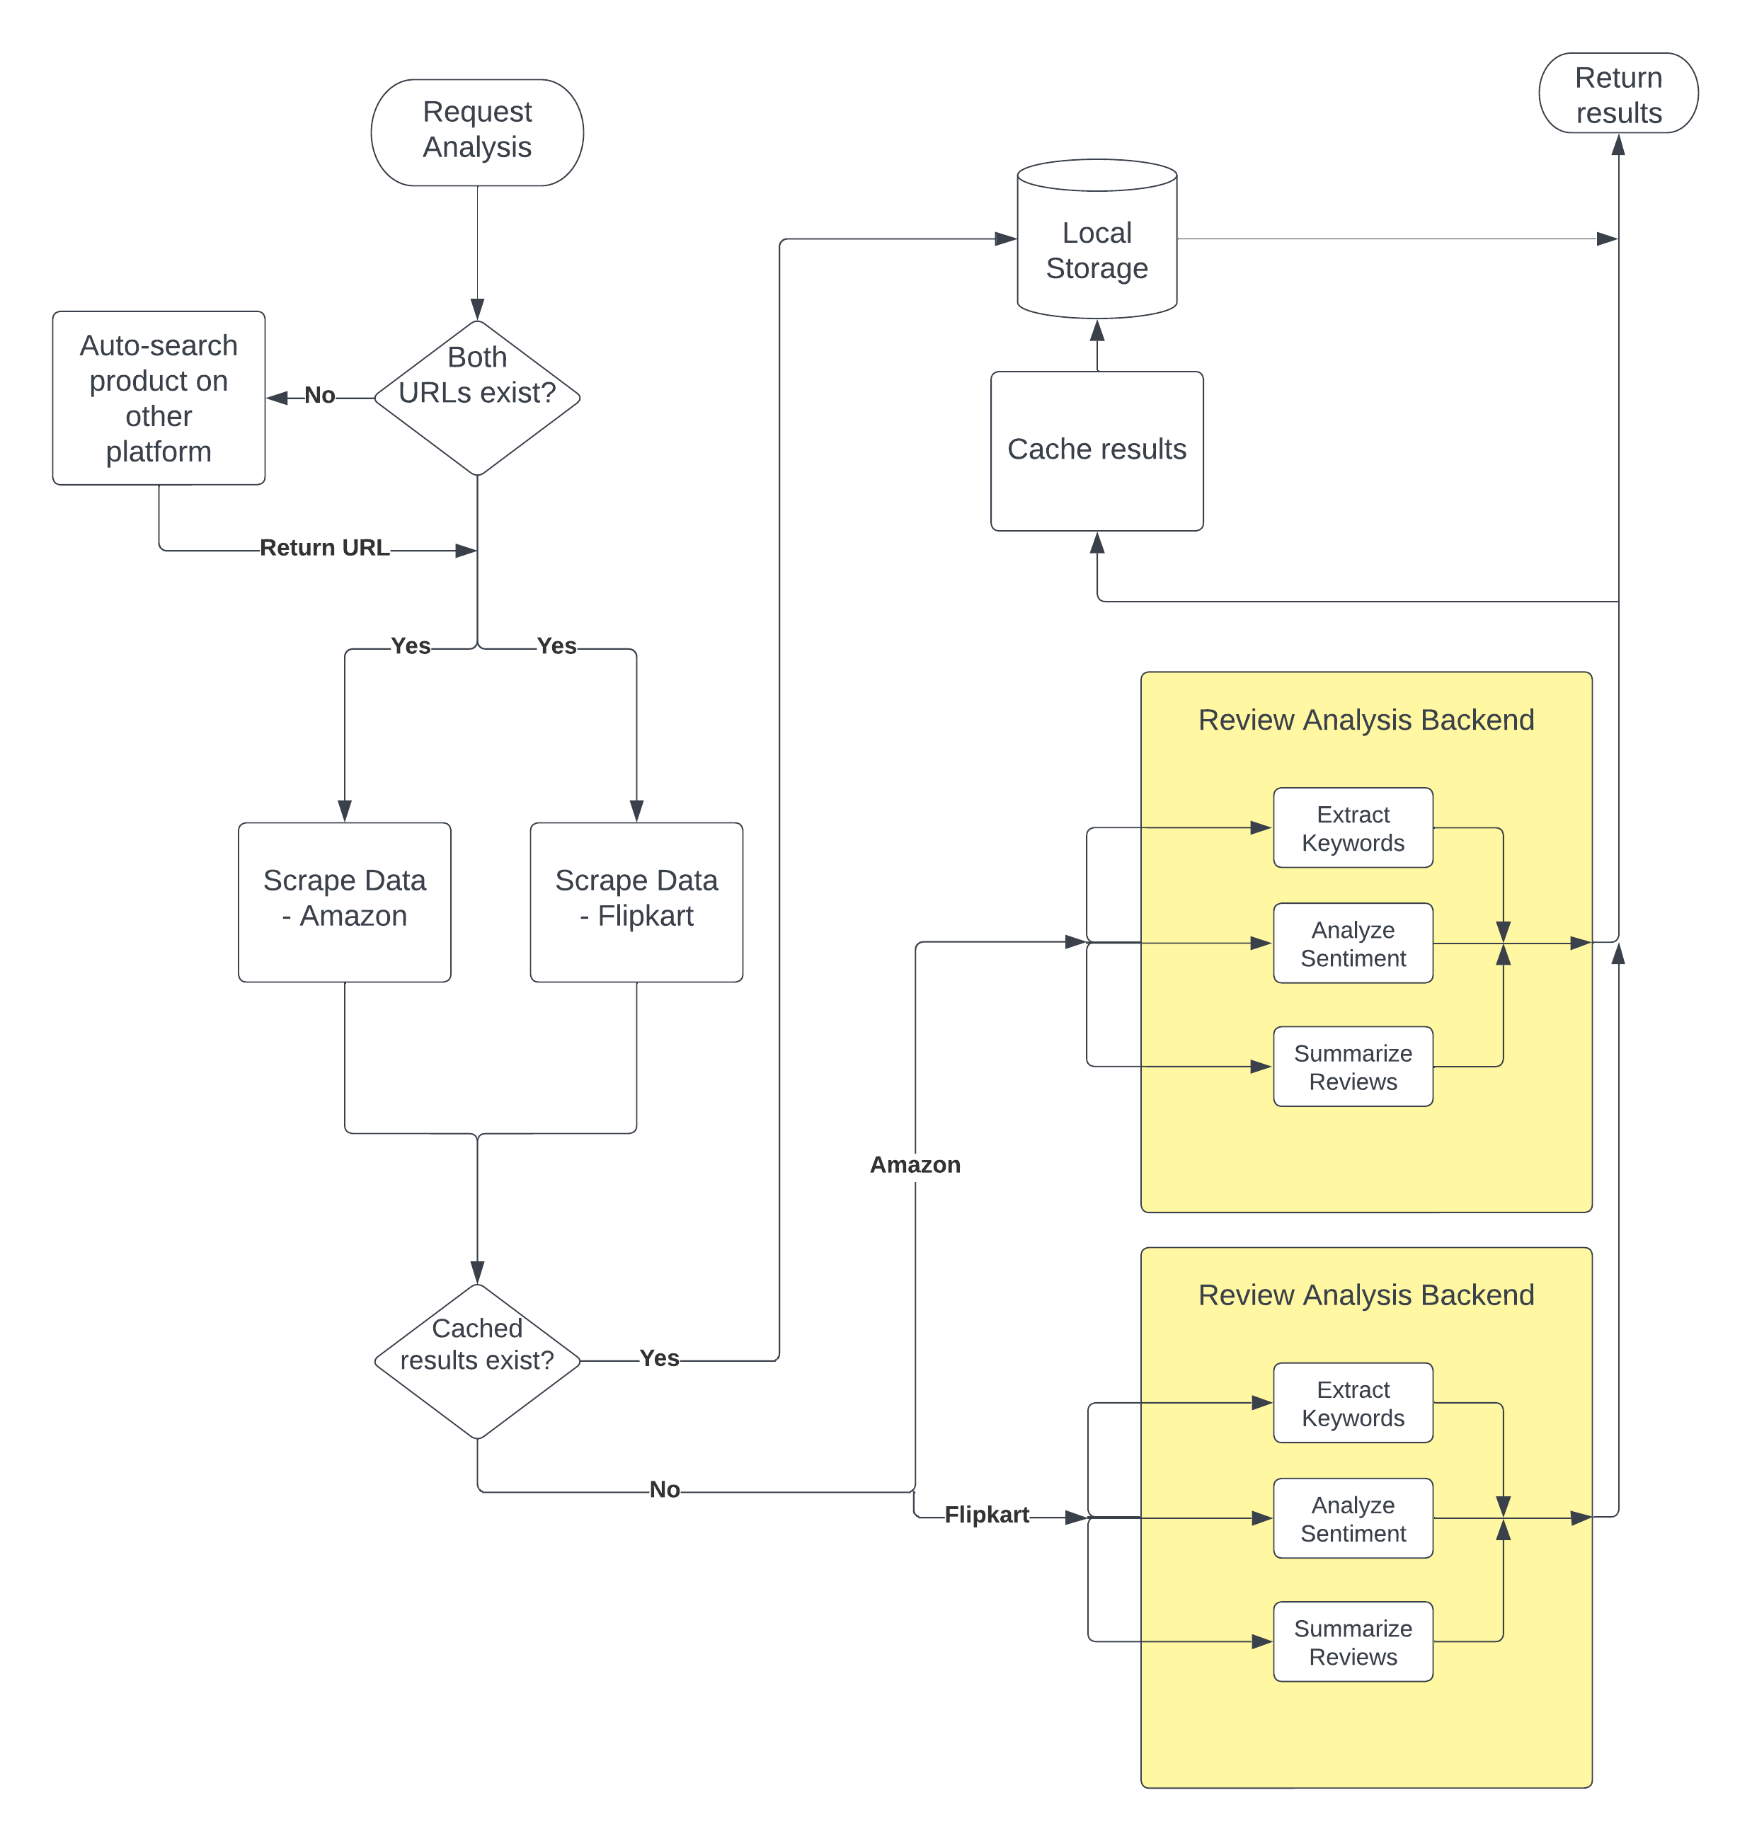
Fig 1: Application general flowchart

Slide 8
References
[1] Fang, X., Zhan, J. Sentiment analysis using product review data. Journal of Big Data 2, 5 (2015). https://doi.org/10.1186/s40537-015-0015-2
[2] NLP and Sentiment analysis by symbl.ai, https://symbl.ai/about
[3] Tamir Bennatan, Conducting Sentiment Analysis on App Reviews to Inform Product Decisions. Hopper, Medium (Jun 13, 2019). https://medium.com/life-at-hopper/conducting-sentiment-analysis-on-app-reviews-to-inform-product-decisions-64fcc71822ed
[4] Atharva Mashalkar, Sentiment Analysis using Logistic Regression and Naive Bayes. TowardsDataScience (Nov 28, 2020). https://towardsdatascience.com/sentiment-analysis-using-logistic-regression-and-naive-bayes-16b806eb4c4b
[5] Thura, T., Na, J.-C., & Khoo, C. S. G. (2010). Aspect-based sentiment analysis of movie reviews on discussion boards. Journal of Information Science, 36(6), 823–848. https://doi.org/10.1177/0165551510388123
[6] Hu Xu, Bing Liu, Lei Shu, Philip S. Yu (2019). BERT Post-Training for Review Reading Comprehension and Aspect-based Sentiment Analysis. https://doi.org/10.48550/arXiv.1904.02232
[7] Federico Pascual, Analyze Sentiment in Product Reviews. MonkeyLearn Blog (Mar 23, 2019). https://monkeylearn.com/blog/sentiment-analysis-of-product-reviews/

Slide 9

THANK YOU

