Slide 1
MOOSE : Matlab Tool for STPA Evaluation - User Guide
Aditya Y Jeppu
Adi.Jeppu28@gmail.com

Slide 2
MOOSE
MOOSE : Matlab Tool for STPA Evaluation
This is a tool developed in Simulink to help analysis of system safety using STPA.
STPA System Theoretic Process Analysis – is a methodology developed at MIT
MIT Partnership for Systems Approaches to Safety and Security (PSASS) http://psas.scripts.mit.edu/home/
http://psas.scripts.mit.edu/home/materials/ The required handbook for the methodology is available here, Accessed 8 Oct 2022

Slide 3
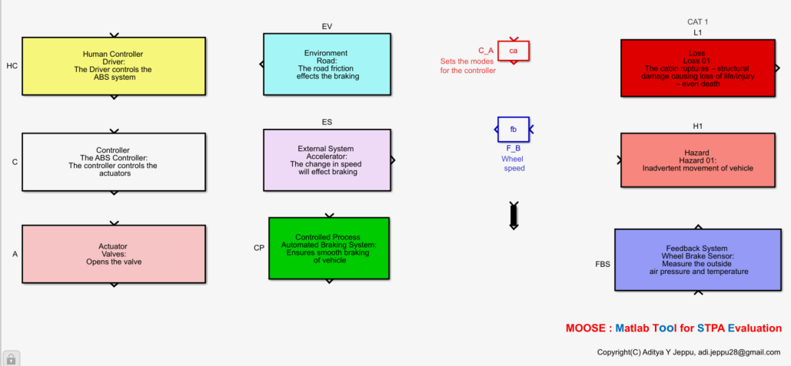
MOOSE files
The STPA library files are in STPA_Library.mdl

Slide 4
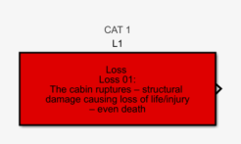
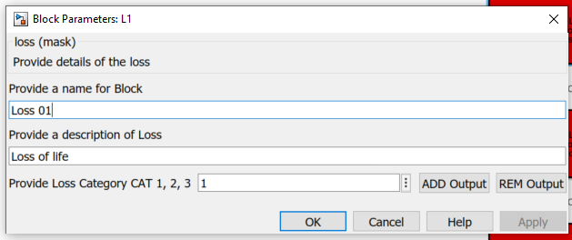
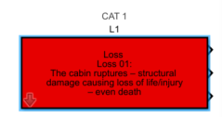
STPA Blocks
The loss block is used to define the loss. It has a name, a description and a category. 1 – is catastrophic.
Open the library. Drag and drop the loss block into a model canvass. The links to the library are automatically removed. Double click on the block to enter the description
Click on ADD Output to add a new output or REM Output to delete an output port

Slide 5
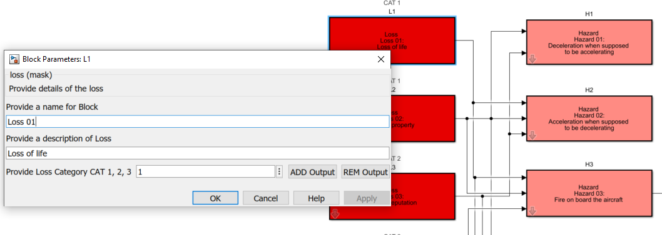
Loss block

Slide 6
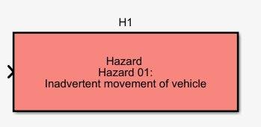
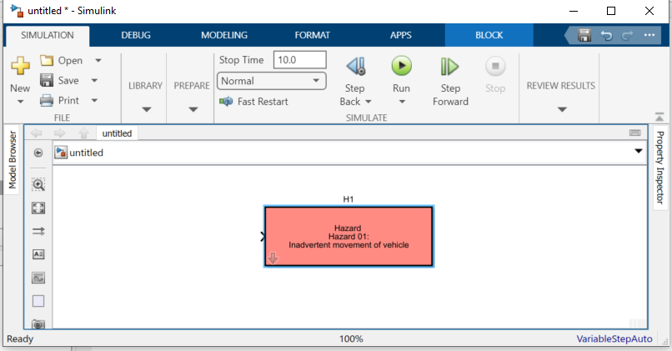
Hazard block
Drag the Hazard block to create the hazard for your system. The Hazards are linked to the losses. Connect the output of the loss to the hazard input. Hazards can have sub hazards, and this can be done by connecting Hazar to another hazard block.

Slide 7
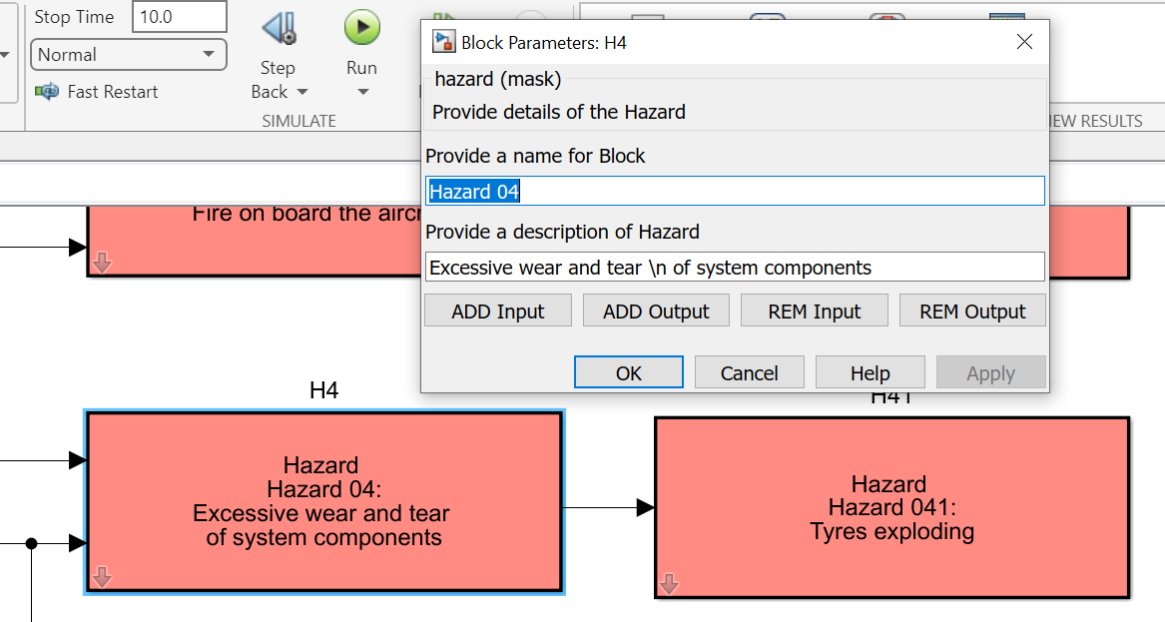
Hazard block
Double click on the Hazard to open the input pane. Give the name - (better to have them numbered). Provide a description. Use the syntax for Hazard as defined in the Handbook. Use the ADD and REM buttons to add and remove inputs to the hazard block. Look at some of the examples with the tool to understand better. “\n” can be used to provide the newline in the description.

Slide 8
STPA – losses and hazards
Create the hazard and looses model for your system.
The file stpa_brake_manage_loss has an example of the losses and hazard in a brake management system.
The next step is to create a table to capture the constrains.
Save the Simulink file with the hazards and the losses.
Run the MATLAB script file analyse_hcs.m
This opens a GUI for file selection. Select your loss model.
A text file stpa_lh.txt is created with a table data.
Put it in a word document to create a table
Type in your constraints in the word document.

Slide 9
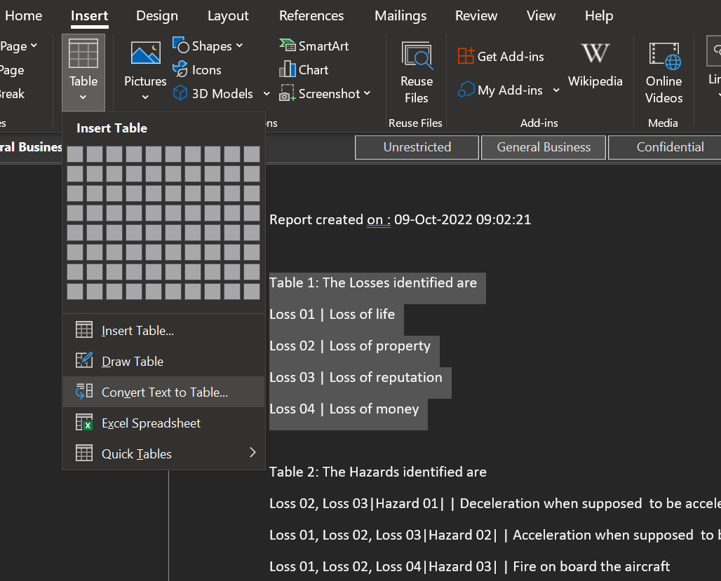
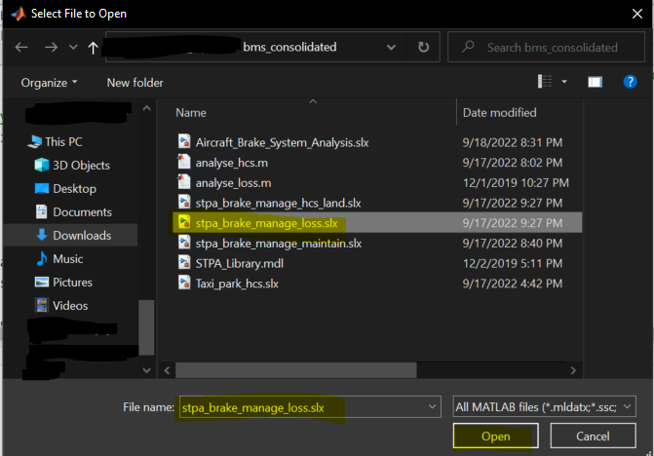
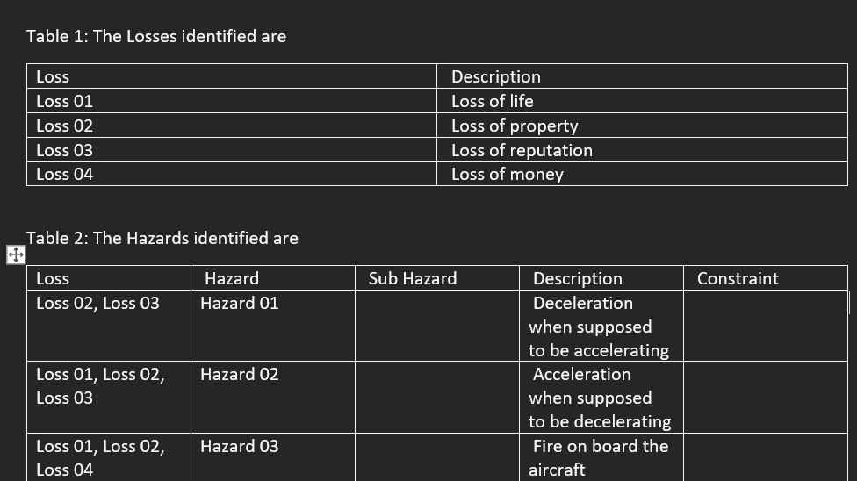
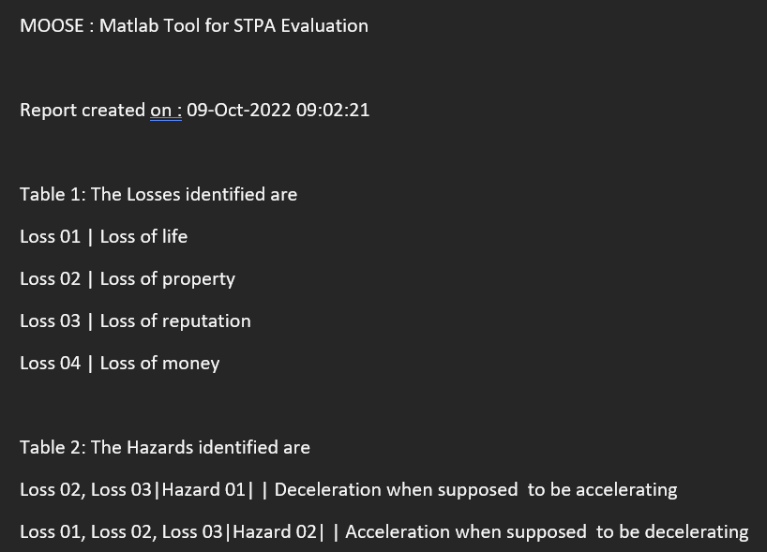
STPA – losses and hazards
Copy the text into word and use the text to table to create a table
Select the loss model
Fill in the constraints
The txt file is created.

Slide 10
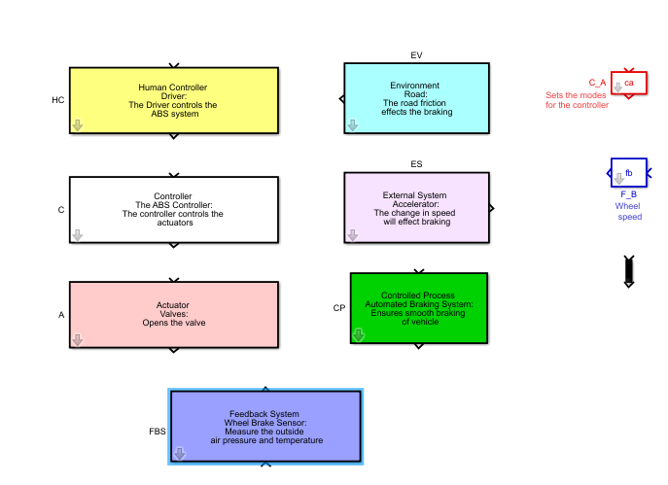
Hierarchical Control Structure (HCS)
The environment that interacts with your system
Use this to represent a human or organization
The other blocks in the STPA library support the building of an HCS.
Use this to represent an electronic or mechanical controller
Use this to represent an actuator that does the actual work
The control actions and feedback
This is a representation of a feedback to the controller like a display panel, alarm etc.
This is the controlled process

Slide 11
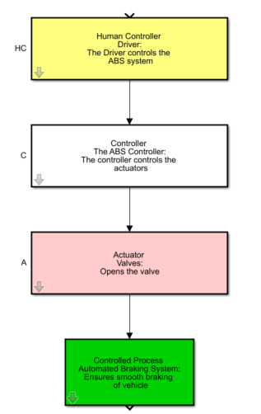
Create the HCS
Start with the human controller – is it required in your analysis. Put this block at the top in a new model that you are creating.
Put the electronic/mechanical/computer controller below it.
Put the actuator is required below that.
Put the process to be analyzed at the bottom

Slide 12
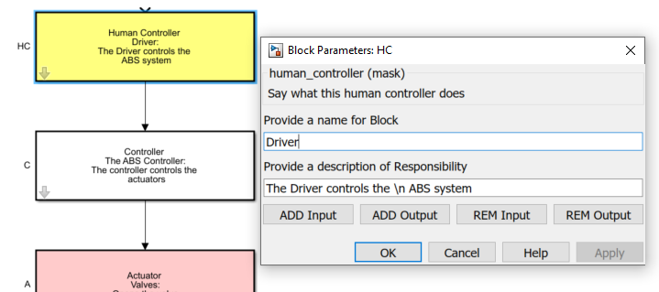
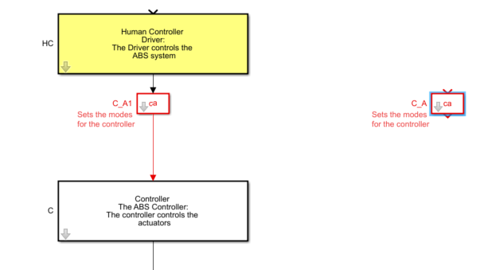
Create the HCS
Double click on the blocks and fill in the descriptions
Add the control actions. Get a CA block and insert it on the line.
Describe the responsibility of the controller and a name. Controller can have many responsibilities. Articulate them here.

Slide 13
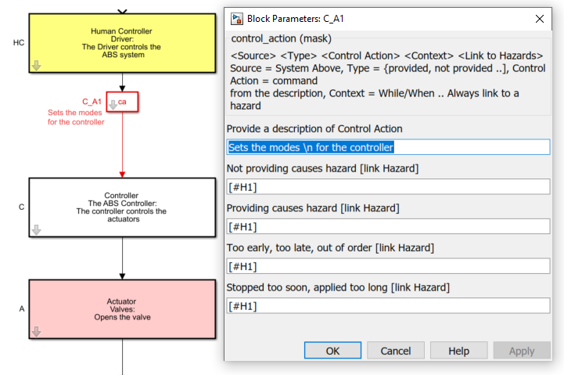
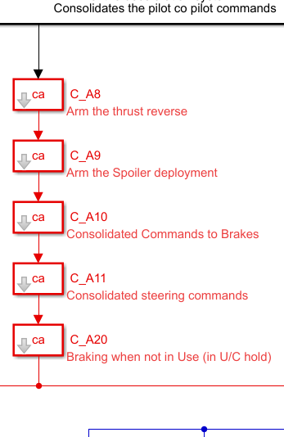
Create the HCS
Describe the control action. There could be many responsibilities attributes to the controller, and these could lead to many CA. Use as many blocks as required. Double click on the CA and describe the CA and the 4 type of UCA with the corresponding hazard numbers. If there are more than one UCA for say “Not providing” use another CA block and retain the CA description the same

Slide 14

Create the HCS
Use the block to create the feedback element.
Use the ADD and REM buttons in the controller and the process to add or remove input and output ports. Look at the example for a typical use of the CA and Feedback blocks
Add the Other System and Environment blocks as need to define the interactions.
The small arrow block can be used to change the color of the line.

Slide 15
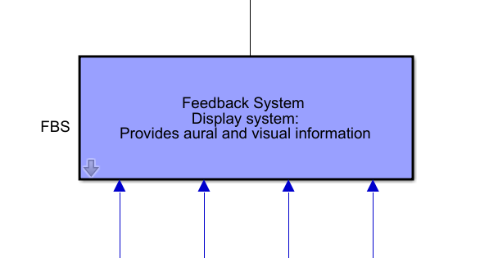
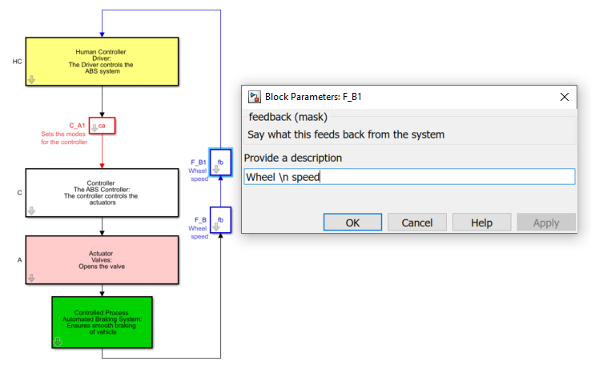
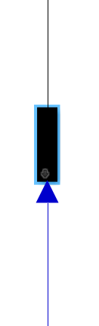
Create the HCS
Use this if there is consolidate unit that is providing feedback
Use physical entities as feedback
This block can change arrow color

Slide 16
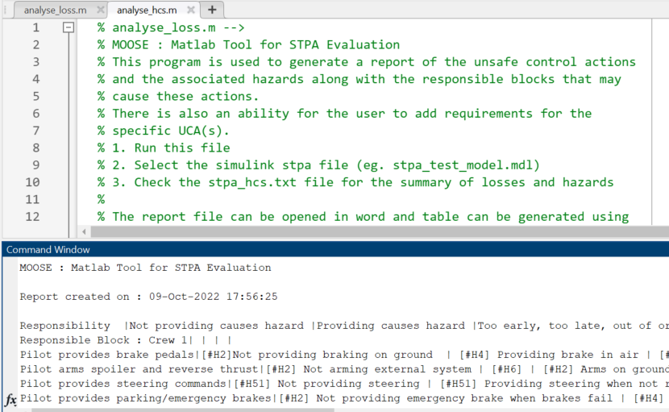
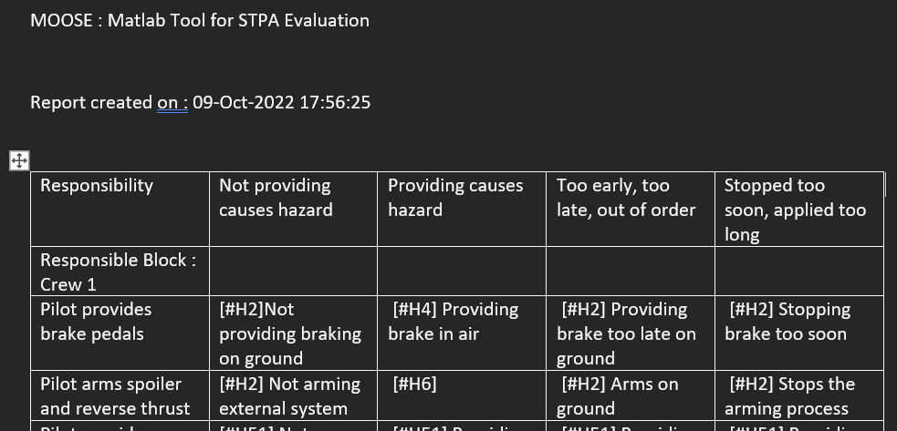
Analyze the HCS
Use analyse_hcs.m to analyse the HCS. The file stpa_hcs.txt has the output. Put in word and make the text to table conversion.

Slide 17
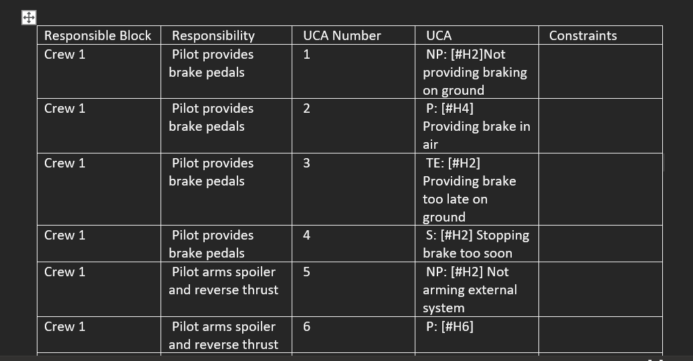
Analyze the HCS
Two tables are created. A UCA table as defined in the Handbook and another with a list of UCA and the blocks with space for constraints.
In the UCA col
NP – Not providing
P – Providing
TE – Too Early / Late
S – Stop / Long

Slide 18
Analyze the HCS
Responsible Block | Responsibility | UCA Number | UCA | Constraints
Wheel brake controller | Providing Brake Pressure | 67 | P: [#H41] Providing in air when in use | TYPE IN THE CONSTRAINTS
Wheel brake controller | Providing Brake Pressure | 68 | TE: [#H41] Providing before touchdown
Nose Wheel Rudder | Providing wheel Turn | 69 | NP: [#H51] Not providing when not on center line
Nose Wheel Rudder | Providing wheel Turn | 70 | P: [#H51] Providing in air (lock)
Nose Wheel Rudder | Providing wheel Turn | 71 | TE: [#H51] Providing out of sync
Nose Wheel Rudder | Providing wheel Turn | 72 | S: [#H51] Applied too long (stuck)
Nose Wheel Rudder | Providing rudder | 73 | NP: [H51] Not providing when not on center line
Nose Wheel Rudder | Providing rudder | 74 | TE: [#H51] Providing out of sync
Nose Wheel Rudder | Providing rudder | 75 | S: [#H51] Applied too long | THIS MODEL HAS 75 UCA IDENTIFIED

