Slide 1

Automatic News Summarization Using NLP
Aditya Kate - 23107126
Tanmay Harmalkar - 23107099
Laxmikant Koli - 23107028
Project Guide
Dr. Avinash Shrivas
Notes:
1

Slide 2
Outline
Abstract
Objectives
Technical Stack
Implementation (Screenshots)
Outcomes
Conclusion
Notes:
2

Slide 3
Abstract
This project develops an NLP-based system to analyze and summarize news articles. It uses methods such as TF-IDF, tokenization, POS tagging, and Named Entity Recognition (NER) to identify important from the text.
A lightweight GRU model is also used to understand words based on their context. The system provides a simple dashboard for viewing summaries and text analysis while using relatively low computing resources.
Notes:
3

Slide 4
Objectives
To build an efficient NLP pipeline that extracts accurate text summaries using statistical methods like TF-IDF.
To deconstruct articles into core linguistic components using POS tagging and Named Entity Recognition.
To resolve word context ambiguities (like "bank") using a targeted GRU machine learning model.
To design a transparent dashboard that visualizes the step-by-step text analysis for the user.
Notes:
4

Slide 5
Technical Stack
Frontend: HTML5, JavaScript (Fetch API), Tailwind CSS
Backend Framework: Python, Flask, Flask-CORS
NLP & Computational Linguistics: NLTK, SpaCy, Scikit-learn
Machine Learning / Deep Learning: TensorFlow / Keras (GRU Recurrent Neural Network)
Data Processing & Visualization: NumPy, Pandas, WordCloud
Dataset: Custom WSD Dataset - 16 labeled contextual sentences
Notes:
5

Slide 6
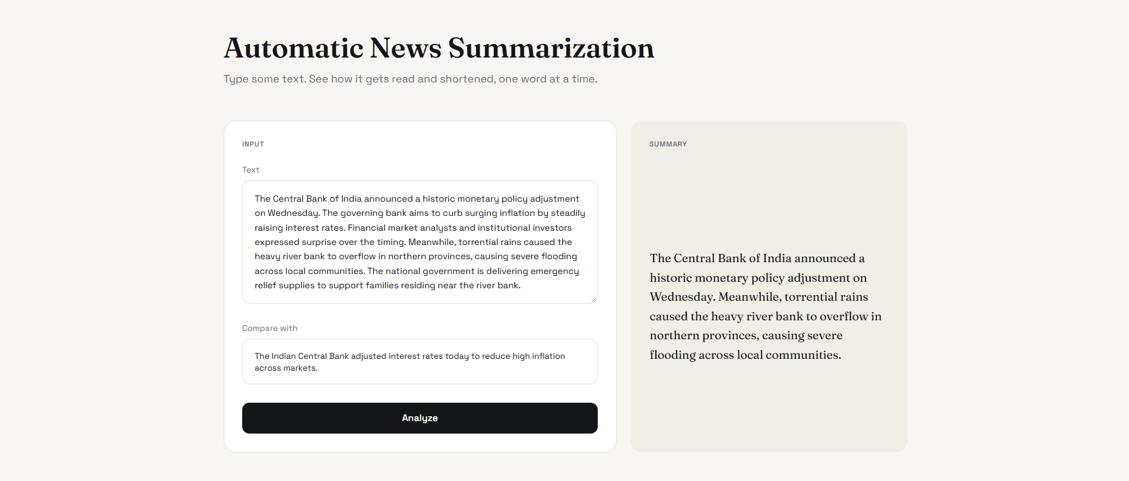
Implementation (Screenshots)
Notes:
6

Slide 7
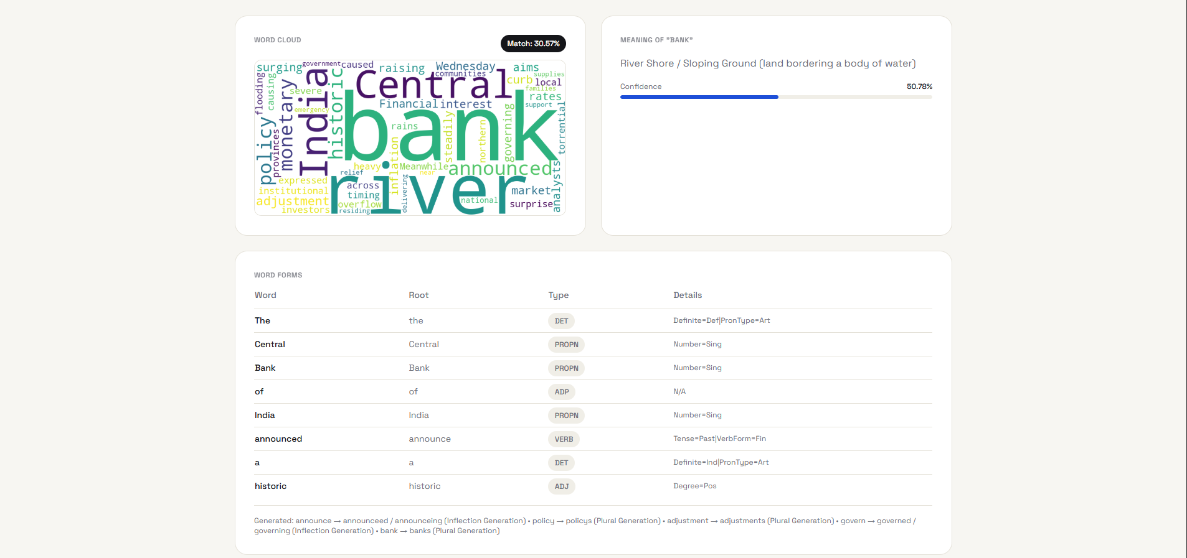
Implementation (Screenshots)
Notes:
7

Slide 8
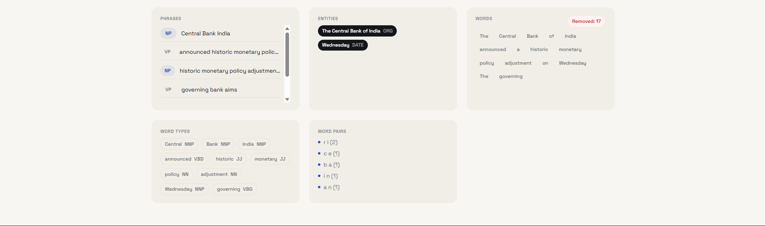
Implementation (Screenshots)
Notes:
8

Slide 9
Outcomes
Extractive Summarization: Creates short and accurate summaries using TF-IDF without generating new information.
Text Analysis: Break the articles into tokens, lemmas, POS tags, chunks, and named entities.
Context-Based Word Meaning: Uses a lightweight GRU model to understand words based on their context, such as ‘bank’ as a riverbank or financial institution.
No External Dataset Required: The system processes user-provided articles directly without relying on an external news dataset. The WSD component uses a small custom, manually curated dataset embedded in the code for training the GRU classifier.
Notes:
9

Slide 10
Thank You...!!
Notes:
10

