Slide 1
Contextualized Weak Supervision for Text Classification
Dheeraj Mekala, Jingbo Shang ACL 2020
Slides by Aditya Joshi
Slides available at: https://github.com/adityajo/talks
17th August, 2020
https://www.aclweb.org/anthology/2020.acl-main.30/

Slide 2
Sectional outline of the paper
Introduction
Overview
Document contextualization
Pseudo-Label and Text Classifier
Seed expansion and disambiguation
Experiments
Related work
Conclusion & Future work
Very non-standard* section titles
* For a typical *ACL paper

Slide 3
Outline
Introduction
Overview
Document contextualization
Pseudo-Label and Text Classifier
Seed expansion and disambiguation
Experiments
Related work
Conclusion & Future work

Slide 4
Weak supervision
Supervision: Labeled supervision
Human annotators manually label each document with a class
Challenges:
Resource-intensive
Domain-specificity can throw off guard
Expert annotators may not be available (say, medical documents)
Can this be done faster? Weak Supervision: Settling for potentially less accurate labels to create large annotated datasets.
Distant supervision (sarcasm detection and emotion classification; ref: Vent)
Crowdsourcing using non-expert annotators (helpful for medical documents?)
Seed words <- the method for weak supervision used in this paper
Suggested reading: https://towardsdatascience.com/snorkel-a-weak-supervision-system-a8943c9b639f

Slide 5
Weak supervision using seed words
Creating an annotated dataset for two-class sentiment classification
Seed Word | Label
#happy | Positive
#sad | Negative
Labeled dataset:
Positive/Negative
Labeled dataset:
Positive/Negative
Twitter-verse
Seed set-based supervision
”Distant” supervision
Seed Word | Label
#happy | Positive
#sad | Negative
#excited | Positive
#sigh | Negative
crying | Negative
awesome | Positive
deadly | Negative
Being stranded in traffic is awesome. #sad #sigh
Seed Word | Label
#happy | Positive
#sad | Negative
Seed Word | Label
#happy | Positive
#sad | Negative
#excited | Positive
#sigh | Negative
Negative
Seed set expansion
‘Twitter-verse’ can potentially be any large unlabeled corpus with text useful to learn the classifier.

Slide 6
Seed set expansion
Seed Word | Label
#happy | Positive
#sad | Negative
#excited | Positive
#sigh | Negative
crying | Negative
awesome | Positive
deadly | Negative
Seed Word | Label
#happy | Positive
#sad | Negative
Seed Word | Label
#happy | Positive
#sad | Negative
#excited | Positive
#sigh | Negative
Both tagged as ‘negative’:
Shane Warne is a deadly spinner.
There are deadly snakes in the forest.
Seed set expansion needs to account for ‘senses of words’ (now known as ‘meaning of words in context’.)
Contextualized Weak Supervision for Text Classification
They propose ‘ConWea’: leverage contextualized representations of word occurrences and seed word information to automatically differentiate multiple interpretations of the same word, and thus create a labeled corpus.

Slide 7
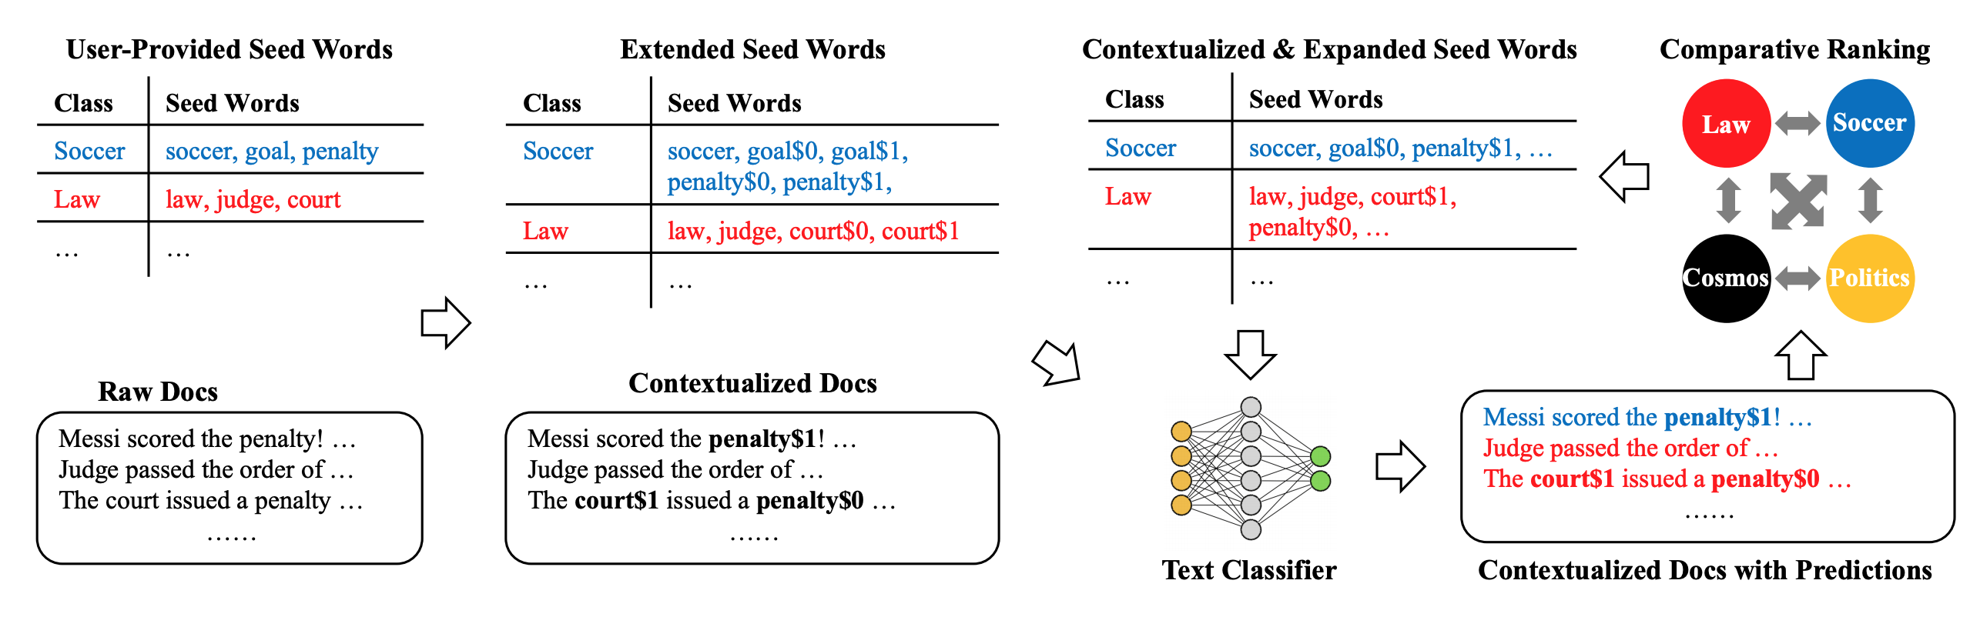
Framework for ConWea & Contributions
Contextualisation
Seed set expansion
“automatically group word occurrences (..) into an adaptive number of interpretations based on contextualized representations and (..) seed information”
“a principled ranking mechanism to identify words that are (..) label-indicative.”
“experiments (..) for both coarse- and fine-grained text classification tasks”

Slide 8
Outline
Introduction
Overview
Document contextualization
Pseudo-Label and Text Classifier
Seed expansion and disambiguation
Experiments
Related work
Conclusion & Future work

Slide 9
Overview
Documents: D = {D1, D2, . . . , Dn}
Classes: C = {C1, C2, . . . , Cm}
Seed words: S = {S1, S2, . . . , Sm}
Objective: Learn a classifier to assign the class label Cj ∈ C to each document Di ∈ D.
Assumptions: Seed “words”, not phrases
Hyper-parameters:
Iterations of seed word expansion: T
(Not mentioned in the paper): Number of initial seed words
(Not mentioned in the paper): k : number of words to be added at the end of every iteration: What is the value? Not mentioned in the paper

Slide 10
Sectional outline of the paper
Introduction
Overview
Document contextualization
Pseudo-Label and Text Classifier
Seed expansion and disambiguation
Experiments
Related work
Conclusion & Future work

Slide 11
Clustering contextualized word vectors
Given a word w, denote all its occurrences as w1, . . . , wn
For each wi, b_wi is the contextualised (BERT) representation of the word
k-means clustering algorithm to generate clusters of representations
Isn’t k is a hyperparameter too?
Number of clusters, k, is selected such that the distance between cluster centres exceeds a threshold τ
K = arg max K {cos(ci , cj ) < τ ∀i, j}
Isn’t τ is a hyperparameter then?
For all seed words s: τ (s) = median({sim(bsi , bsj )|∀i, j})
τ = median({τ (s)|∀s})

Slide 12
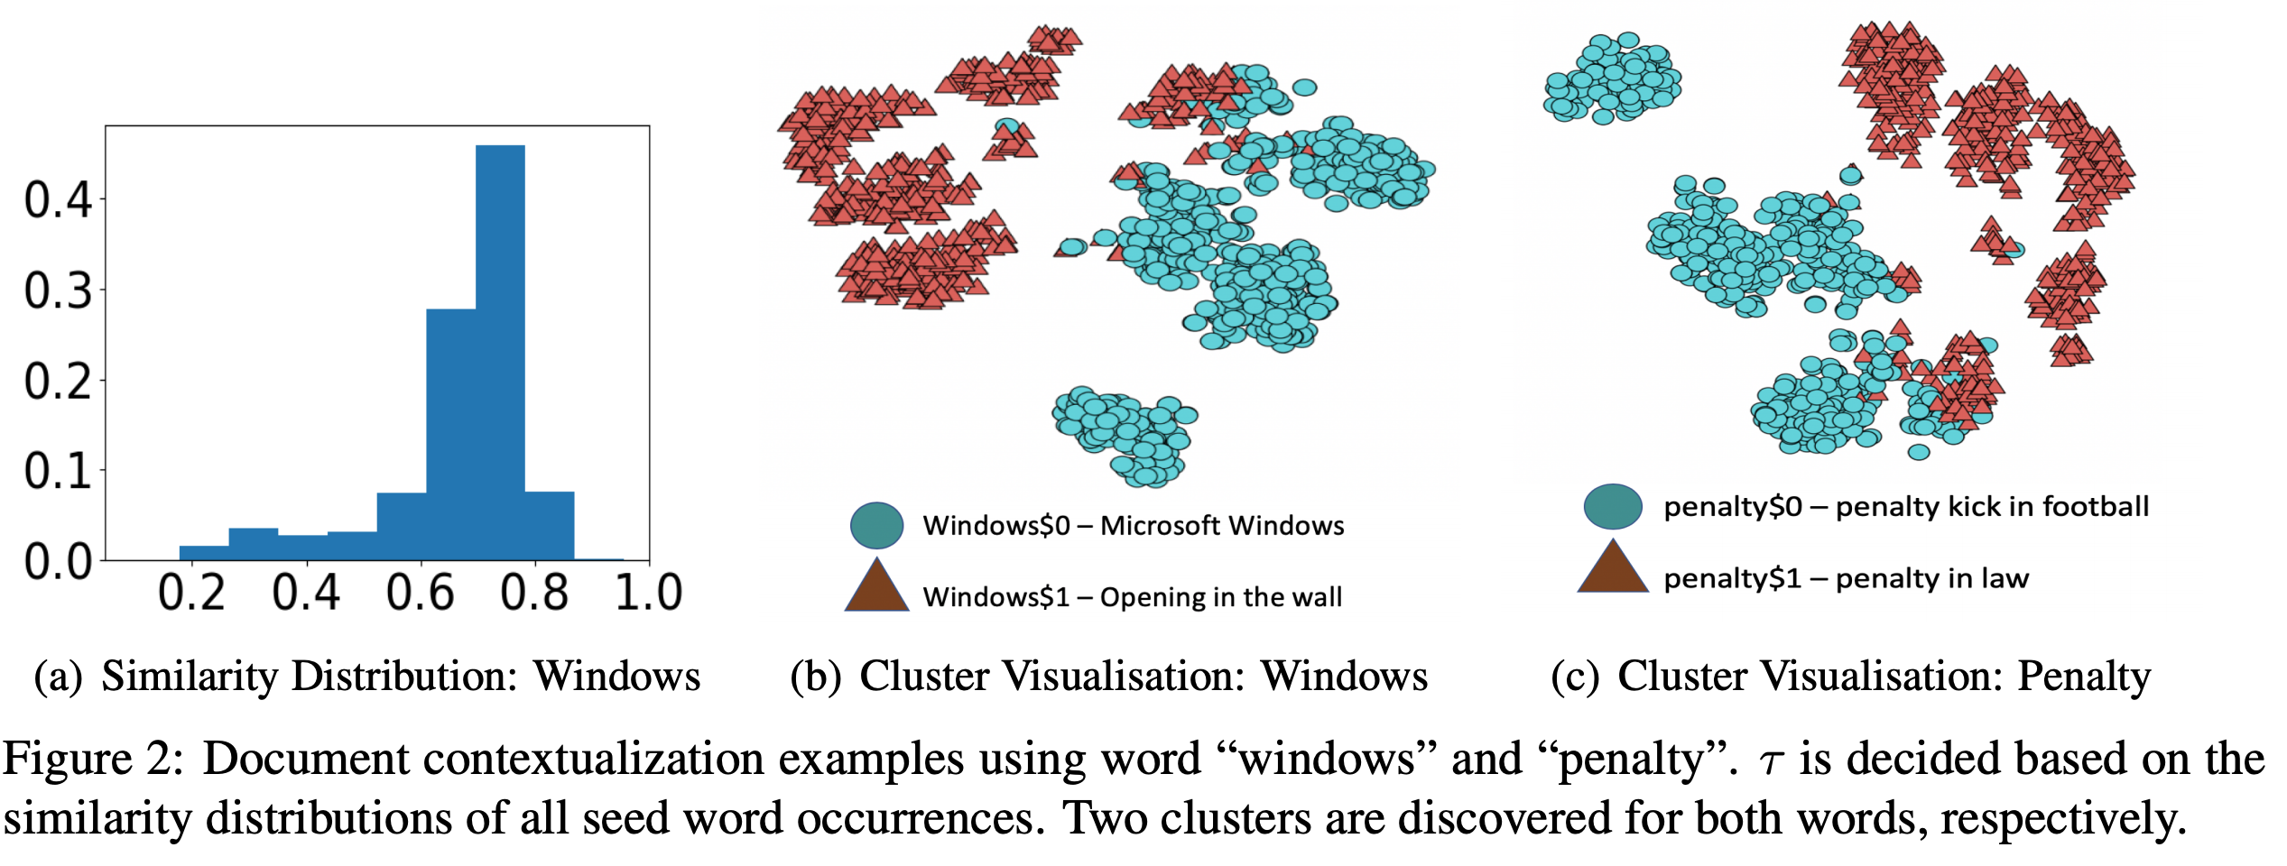
Example

Slide 13
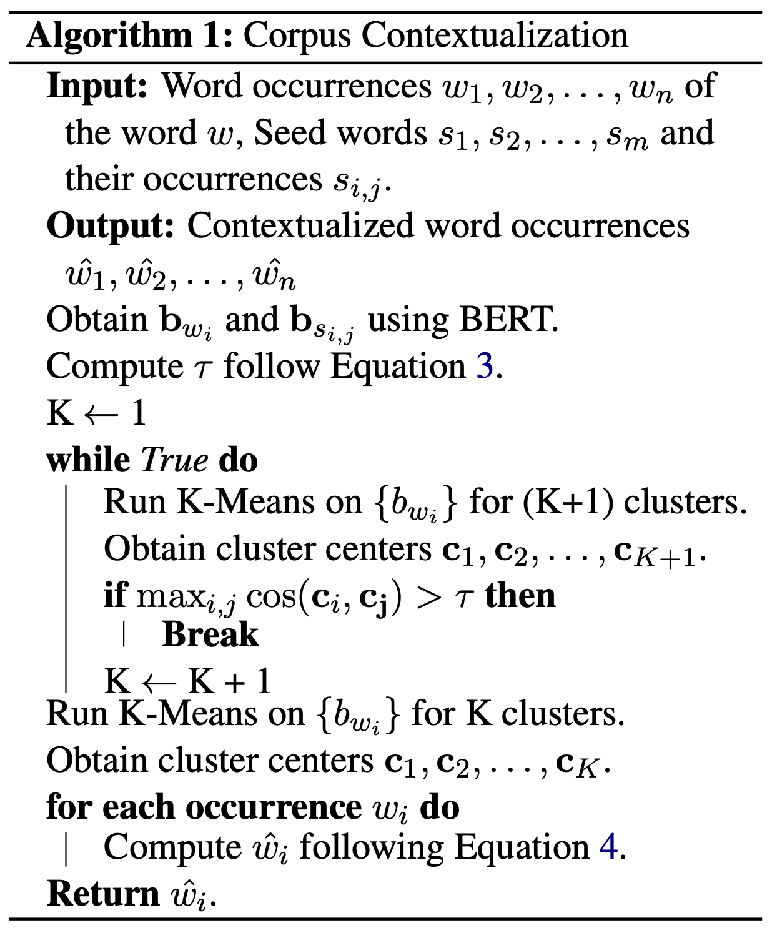
So how are vectors of each word occurrence computed?
Repeat for each unique word in the vocabulary
Compute the threshold based on similarity between seed words
Run k-means so that the similarity between cluster centres exceeds threshold
For each word occurrence of the word,
compute contextualised vector based on:
Assign the vector of the cluster centre to all occurrences of the word in the cluster
wˆi = w if K = 1
w$j∗ otherwise
where j* = argmax {j=1_to_K} cos(bwi , cj )

Slide 14
So far..

Slide 15
Outline
Introduction
Overview
Document contextualization
Pseudo-Label and Text Classifier
Seed expansion and disambiguation
Experiments
Related work
Conclusion & Future work

Slide 16
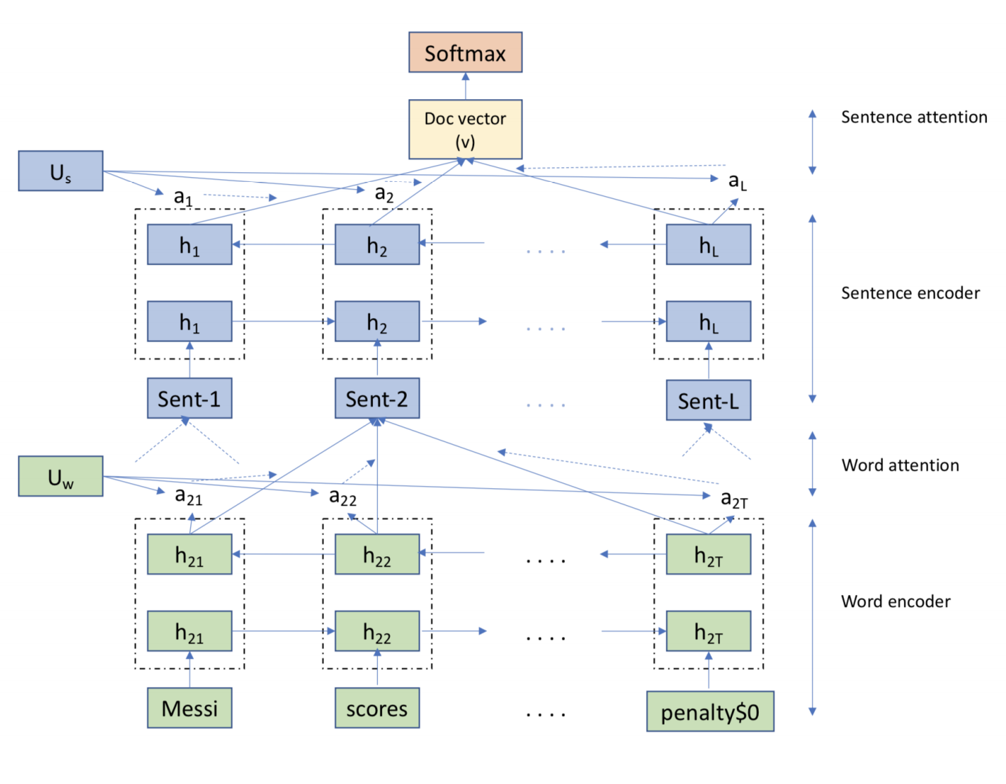
Pseudo-label & Classifier
Pseudo-labels for documents are generated based on contextualised meanings of seed words; max if multiple labels
Classifier: Hierarchical attention network
l(d) = arg max { X i tf(si , d)|∀si ∈ Sl}

Slide 17
Outline
Introduction
Overview
Document contextualization
Pseudo-Label and Text Classifier
Seed expansion and disambiguation
Experiments
Related work
Conclusion & Future work

Slide 18
Scoring how useful a word is for a label
I am reminded of Anton’s discussion on slack.
A word is useful if,
It has a high conditional probability with respect to a label
It has a high TF-IDF – indicating its significance in the dataset
w indicates a contextual meaning of the word: overloaded representation
R(Cj , w) =
[LI(Cj , w) × F(Cj , w) × IDF(w) ] ^{1/3}
LI: Label-indicative
LI(Cj , w) = P(Cj |w)
F: Frequency
F(Cj , w) = tanhfCj (w) fCj
IDF: Inverse-Document frequency
IDF(w) = log (n/fD,w)

Slide 19
Seed disambiguation
“We first consider all possible interpretations of an initial seed word, generate the pseudo-labels, and train a classifier.
Using the classified documents and the ranking function, we rank all possible interpretations of the same initial seed word.
Because the majority occurrences of a seed word are assumed to belong to the user-specified class, the intended interpretation shall be ranked the highest. Therefore, we retain only the top-ranked interpretation of this seed word.”

Slide 20
Framework for ConWea & Contributions

Slide 21
Outline
Introduction
Overview
Document contextualization
Pseudo-Label and Text Classifier
Seed expansion and disambiguation
Experiments
Related work
Conclusion & Future work

Slide 22
Datasets
New York Times Dataset (13,081 documents) labeled with genres (5) (e.g. arts, sports) and fine-grained categories (25) (e.g. dance, music, hockey..)
20News dataset of newsgroup groups (18,846 documents) labeled with groups (6) (e.g. recreation, computers) and fine-grained classes (20) (e.g. graphics, windows, baseball, hockey)
Balanced for fine-grained in 20News; imbalanced otherwise
80-10-10 evaluation

Slide 23
Baselines (from past work)
IR-TF-IDF: Aggregated score over TF-IDF of seed words in a document
Dataless: Vector-based similarity of labels and documents; cosine similarity for classification
Word2Vec: Vector of label is average of its seed words; Document vector is average of words; cosine similarity for classification
Doc2Cube: Label surface name as seed set; learn dimension-aware embeddings
WeSTClass: Generate pseudo-documents using seed set, and trains a classifier based on unlabeled corpus

Slide 24
Baselines (variants of ConWea)
ConWea-NoCon : No contextualization
ConWea—NoSeedExp : No seedset expansion
ConWeaWSD : Contextualisation replaced with WSD using Lesk
HAN-Supervised: As the ceiling performance
Contextualisation
Seed set expansion

Slide 25
Experiment Setup
BERT-base-uncased
5 seed words per class, nominated by 5 experts
T = 10 -- iterations of the expansion algorithm

Slide 26
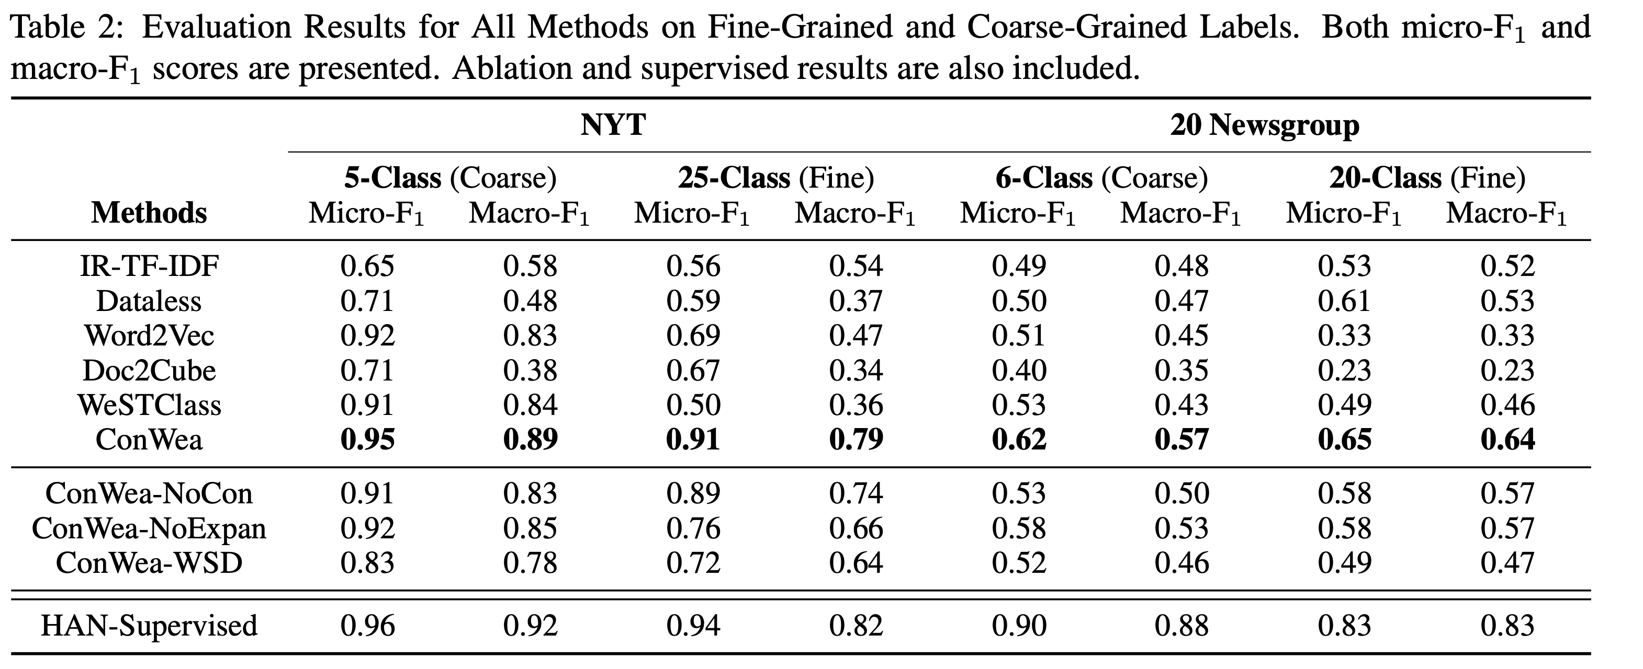
Results

Slide 27
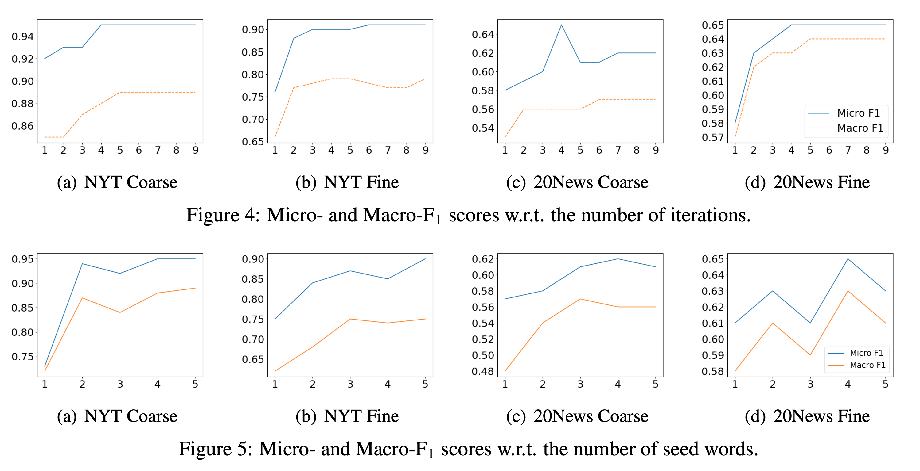
Impact of iterations and seed words

Slide 28
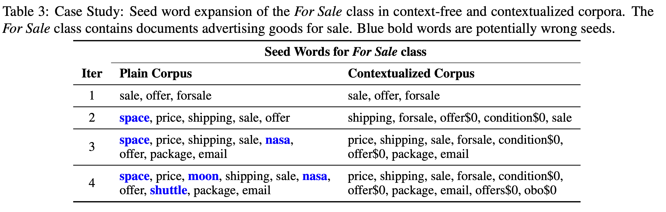
Examples of seed word expansion for class ‘For Sale’ in the newsgroup dataset

Slide 29
Outline
Introduction
Overview
Document contextualization
Pseudo-Label and Text Classifier
Seed expansion and disambiguation
Experiments
Related work
Conclusion & Future work

Slide 30
Related work
The paper describes past work in:
Weak supervision
Word sense disambiguation
Text classification
Contextualised vectors

Slide 31
Outline
Introduction
Overview
Document contextualization
Pseudo-Label and Text Classifier
Seed expansion and disambiguation
Experiments
Related work
Conclusion & Future work

Slide 32
Conclusion & Future work
Our model outperforms previous methods significantly, thereby signifying the superiority of contextualized weak supervision, especially when labels are fine-grained.
Future work:
Hierarchical relationships between classes for seed set expansion
Different text forms such as short text, code-switched text, etc.

