Slide 1
XLNet: Generalized Autoregressive Pretraining for Language Understanding
Yang et al., NeurIPS 2019
Aditya Joshi
9 March 2020
Slides available at: https://github.com/adityajo/talks
Yang, Zhilin*, Zihang Dai*, Yiming Yang, Jaime Carbonell, Russ R. Salakhutdinov, and Quoc V. Le. "XLNet: Generalized autoregressive pretraining for language understanding." In Advances in neural information processing systems, pp. 5754-5764. 2019.

Slide 2
XLNet: Generalized Autoregressive Pretraining for Language Understanding
XLNet:
Generalized:
Autoregressive:
Pretraining:
Language Understanding:

Slide 3
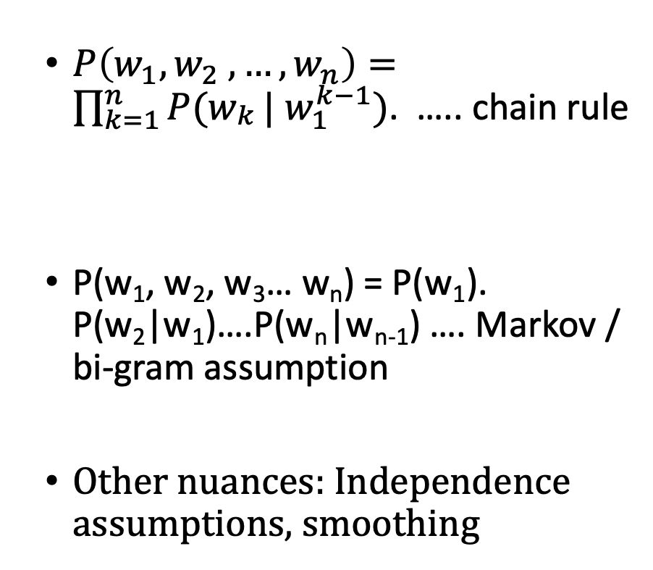
Language modeling: How I first studied it
The year was 2009.
$P\left(w_{1},w_{2} ,…, w_{n}\right)=\prod_{k=1}^{n}{P(w_{\begin{aligned}k \\ \end{aligned}}}| w_{1}^{k−1})$. ….. chain rule
P(w₁, w₂, w₃… w_{n}) = P(w₁). P(w₂|w₁)….P(w_{n}|w_{n-1}) …. Markov / bi-gram assumption
Other nuances: Independence assumptions, smoothing

Slide 4
Language modeling: How I first studied it
$P\left(w_{1},w_{2} ,…, w_{n}\right)=\prod_{k=1}^{n}{P(w_{\begin{aligned}k \\ \end{aligned}}}| w_{1}^{k−1})$. ….. chain rule
P(w₁, w₂, w₃… w_{n}) = P(w₁). P(w₂|w₁)….P(w_{n}|w_{n-1}) …. Markov / bi-gram assumption
Other nuances: Independence assumptions, smoothing
Shareghi et al (2019) compare neural language models with n-gram-based language models on 50 languages
Modification of Kneser-Ney is still the best performing smoothing method
n-gram LMs with Kneser-Ney useful for morphologically rich languages
“Show Some Love to Your n-grams: A Bit of Progress and Stronger n-gram Language Modeling Baselines”, Shareghi et al, NAACL 2019.

Slide 5
Language modeling: How I first studied it
$P\left(w_{1},w_{2} ,…, w_{n}\right)=\prod_{k=1}^{n}{P(w_{\begin{aligned}k \\ \end{aligned}}}| w_{1}^{k−1})$. ….. chain rule
P(w₁, w₂, w₃… w_{n}) = P(w₁). P(w₂|w₁)….P(w_{n}|w_{n-1}) …. Markov / bi-gram assumption
Other nuances: Independence assumptions, smoothing
Shareghi et al (2019) compare neural language models with n-gram-based language models on 50 languages
Modification of Kneser-Ney is still the best performing smoothing method
n-gram LMs with Kneser-Ney useful for morphologically rich languages
Auto-regressive language modeling …. because #yolo
“Show Some Love to Your n-grams: A Bit of Progress and Stronger n-gram Language Modeling Baselines”, Shareghi et al, NAACL 2019.

Slide 6
XLNet: Generalized Autoregressive Pretraining for Language Understanding
XLNet:
Generalized:
Autoregressive: A model that predicts future values based on past values¹
Pretraining:
Language Understanding: Language modeling
1 https://www.investopedia.com/terms/a/autoregressive.asp

Slide 7
What were language models used for?
”Using a large unlabeled dataset”, pre-train language models
And then..
Statistical machine translation: Product of alignment and language model; Fluency
n-gram features in statistical classification (sentiment analysis, etc.)

Slide 8
What are language models used for?
”Using a large unlabeled dataset”, pre-train language models using neural networks
Fine-tune the representations on downstream tasks (sequence generation, sequence labeling, classification)
Enter: BERT

Slide 9
XLNet: Generalized Autoregressive Pretraining for Language Understanding
XLNet:
Generalized:
Autoregressive: A model that predicts future values based on past values¹
Pretraining: Estimate language models from a large corpus, so that they can be fine-tuned for specific downstream tasks
Language Understanding: Language modeling
1 https://www.investopedia.com/terms/a/autoregressive.asp

Slide 10
Language Modeling
Goal: Estimate the probability of a text sequence x = [x1, x2… xT]

Slide 11
Language Modeling
Goal: Estimate the probability of a text sequence x = [x1, x2… xT]
 | Auto-regressive language modeling | Auto-encoding language modeling

Slide 12
Language Modeling
Goal: Estimate the probability of a text sequence x = [x1, x2… xT]
 | Auto-regressive language modeling | Auto-encoding language modeling
Example | N-gram language modeling | Bidirectional Encoder Representation from Transformers (BERT)
Fundamental idea | Estimate the likelihood of the n-th word given a context of sequence of n-1 words | Estimate the likelihood of k masked words in a sequence of length n given a context of n-k words

Slide 13
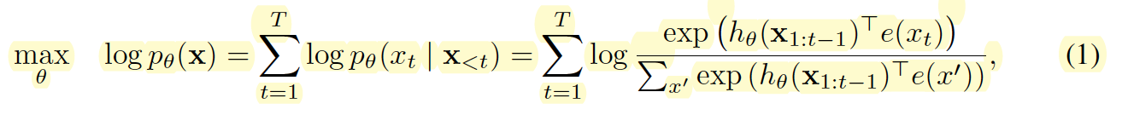
Language Modeling
Goal: Estimate the probability of a text sequence x = [x1, x2… xT]
 | Auto-regressive language modeling | Auto-encoding language modeling
Example | N-gram language modeling | Bidirectional Encoder Representation from Transformers (BERT)
Fundamental idea | Estimate the likelihood of the n-th word given a context of sequence of n-1 words | Estimate the likelihood of k masked words in a sequence of length n given a context of n-k words
Equation | X = x1:t-1 + xt | X^ = x_ with a proportion of tokens masked

Slide 14
Language Modeling
Goal: Estimate the probability of a text sequence x = [x1, x2… xT]
 | Auto-regressive language modeling | Auto-encoding language modeling
Example | N-gram language modeling | Bidirectional Encoder Representation from Transformers (BERT)
Fundamental idea | Estimate the likelihood of the n-th word given a context of sequence of n-1 words | Estimate the likelihood of k masked words in a sequence of length n given a context of n-k words
Equation | X = x1:t-1 + xt | X^ = x_ with a proportion of tokens masked
Density estimation | Explicit | No. Aim to reconstruct original data

Slide 15
Language Modeling
Goal: Estimate the probability of a text sequence x = [x1, x2… xT]
 | Auto-regressive language modeling | Auto-encoding language modeling
Example | N-gram language modeling | Bidirectional Encoder Representation from Transformers (BERT)
Fundamental idea | Estimate the likelihood of the n-th word given a context of sequence of n-1 words | Estimate the likelihood of k masked words in a sequence of length n given a context of n-k words
Equation | X = x1:t-1 + xt | X^ = x_ with a proportion of tokens masked
Density estimation | Explicit | No. Aim to reconstruct original data
Input noise | Does not introduce additional noise | Masked tokens ([MASK]) introduce noise. Downstream data does not contain [MASK]
Context dependency | Models unidirectional context | Models bidirectional context

Slide 16
Language Modeling
Goal: Estimate the probability of a text sequence x = [x1, x2… xT]
 | Auto-regressive language modeling | Auto-encoding language modeling
Example | N-gram language modeling | Bidirectional Encoder Representation from Transformers (BERT)
Fundamental idea | Estimate the likelihood of the n-th word given a context of sequence of n-1 words | Estimate the likelihood of k masked words in a sequence of length n given a context of n-k words
Equation | X = x1:t-1 + xt | X^ = x_ with a proportion of tokens masked
Density estimation | Explicit | No. Aim to reconstruct original data
Input noise | Does not introduce additional noise | Masked tokens ([MASK]) introduce noise. Downstream data does not contain [MASK]
Context dependency | Models unidirectional context | Models bidirectional context
Enter: Orderless language modeling … a.k.a. permutation language modeling

Slide 17
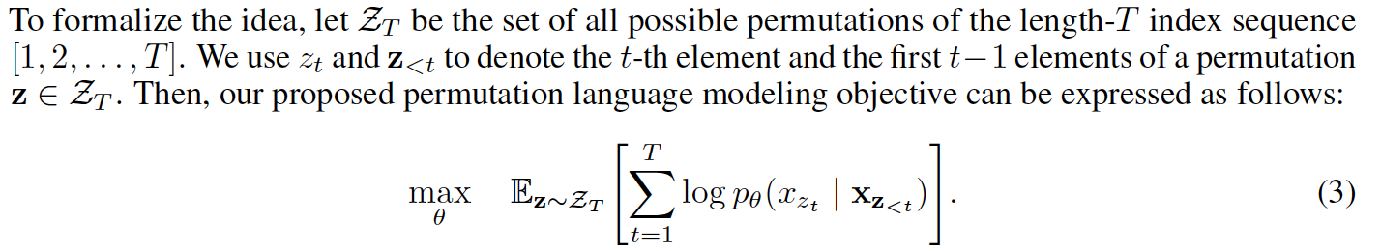
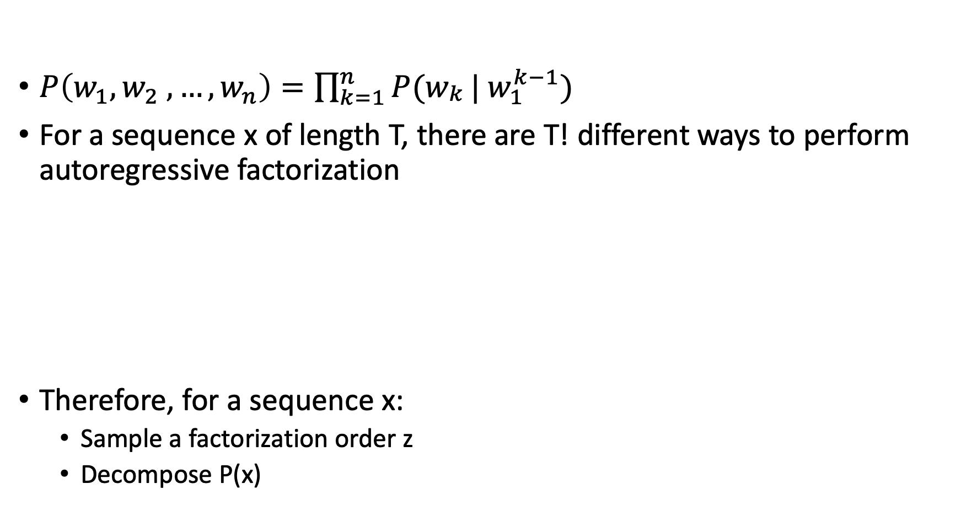
Permutation language modeling
$P\left(w_{1},w_{2} ,…, w_{n}\right)=\prod_{k=1}^{n}{P(w_{\begin{aligned}k \\ \end{aligned}}}| w_{1}^{k−1})$
For a sequence x of length T, there are T! different ways to perform autoregressive factorization
Therefore, for a sequence x:
Sample a factorization order z
Decompose P(x)

Slide 18
Permutation language modeling
$P\left(w_{1},w_{2} ,…, w_{n}\right)=\prod_{k=1}^{n}{P(w_{\begin{aligned}k \\ \end{aligned}}}| w_{1}^{k−1})$
For a sequence x of length T, there are T! different ways to perform autoregressive factorization
Therefore, for a sequence x:
Sample a factorization order z
Decompose P(x)
Only sample the factorization order (i.e., permute the order in which orders will be accounted for). The original sequence order stays when estimating probabilities.

Slide 19
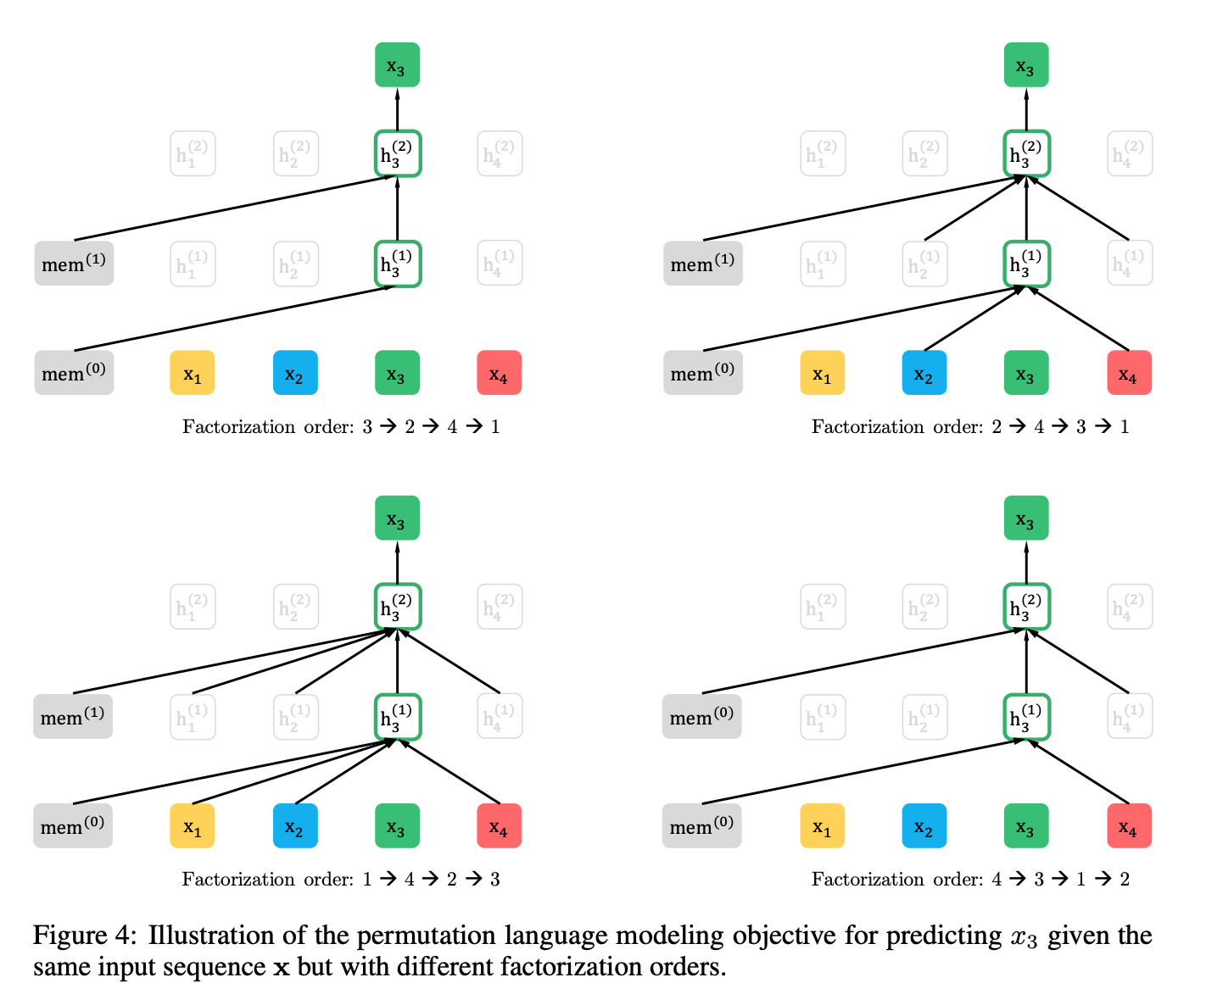
An example of factorisation orders
Please hold your thoughts for ‘mem’ on the left
This Figure is present in the arXiv version, not in the NeurIPS version.

Slide 20
XLNet: Generalized Autoregressive Pretraining for Language Understanding
XLNet:
Generalized: Permutation
Autoregressive: A model that predicts future values based on past values¹
Pretraining: Estimate language models from a large corpus, so that they can be fine-tuned for specific downstream tasks
Language Understanding: Language modeling
We have now covered the first three pages of the paper.
1 https://www.investopedia.com/terms/a/autoregressive.asp

Slide 21
XLNet: Generalized Autoregressive Pretraining for Language Understanding
XLNet:
Generalized: Permutation
Autoregressive: A model that predicts future values based on past values¹
Pretraining: Estimate language models from a large corpus, so that they can be fine-tuned for specific downstream tasks
Language Understanding: Language modeling
XLNet aims to learn conditional distributions for all permutations of tokens in a sequence.
We have now covered the first three pages of the paper.
1 https://www.investopedia.com/terms/a/autoregressive.asp

Slide 22

Architecture

Slide 23
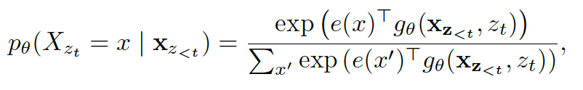
Architecture
re-parameterised as:
zt is the target position.

Slide 24
Architecture
re-parameterised as:
zt is the target position.
So, what is

Slide 25
Architecture
re-parameterised as:
zt is the target position.
So, what is
Some parameterization over h…. We see what it is. And what was h?

Slide 26
Architecture
Recommended reading: https://www.borealisai.com/en/blog/understanding-xlnet/
re-parameterised as:
zt is the target position.
So, what is
Some parameterization over h…. We see what it is. And what was h?

Slide 27
What do we need to satisfy
Requirements:
(1) “to predict the token xzt , the method should only use the position zt and not the content xzt”;
(2) “to predict the other tokens xzj with j > t, the method should also encode the content xzt to provide full contextual information”.
Two-stream self-attention

Slide 28
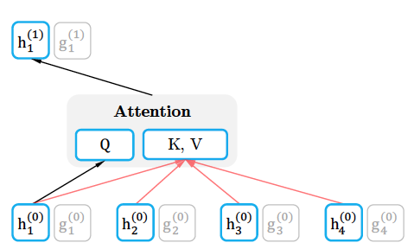
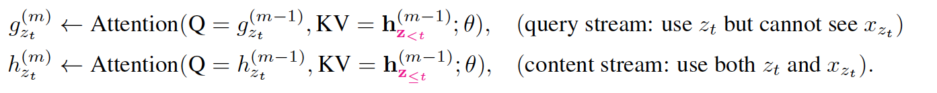
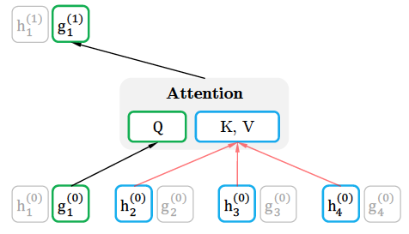
Two streams: Self attention & Query attention
Has access to contextual information and position; but not the word itself
Encodes the context and the word itself

Slide 29
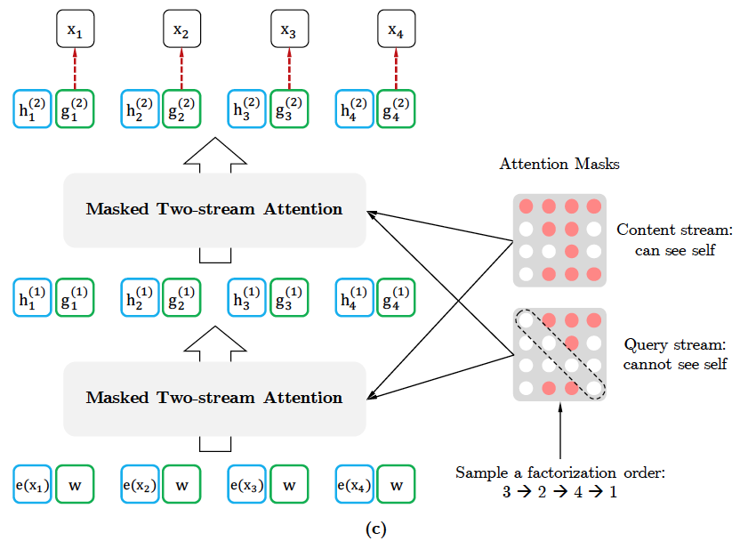
Two-stream attention

Slide 30
Two-stream attention

Slide 31
Two-stream attention
For example:
For a sentence ‘This is a sentence’ with order 3,2,4,1:
Pr(This | *, is+2, a+3, sentence+4) Pr(is | ___, *, a+3, ___) Pr(a | ___, ___, *, ___) Pr(sentence | ___, is+2, a+3, *).
In case of autoregressive LM, the order is : 1, 2, 3, 4

Slide 32
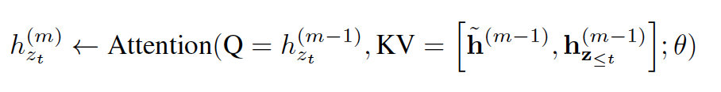
Query attention: Encoding the context and the word
For larger segments, use learned representations of the smaller segments
An Idea from Transformer-XL;
Remember dynamic programming?

Slide 33
Query attention: Encoding the context and the word
For larger segments, use learned representations of the smaller segments
An Idea from Transformer-XL;
Remember dynamic programming?

Slide 34
Modelling multiple segments
For tasks with multiple inputs (say, A & B), XLNet uses an approach similar to BERT: [CLS, A, SEP, B, SEP]
We have now covered the first six pages of the paper. The math part is done. Experimental results ahead.

Slide 35
XLNet: Generalized Autoregressive Pretraining for Language Understanding
XLNet: XL derived from Transformer-XL. ”Net”: Network?
Generalized: Permutation
Autoregressive: A model that predicts future values based on past values¹
Pretraining: Estimate language models from a large corpus, so that they can be fine-tuned for specific downstream tasks
Language Understanding: Language modeling
XLNet aims to learn conditional distributions for all permutations of tokens in a sequence.
We have now covered the first three pages of the paper.
1 https://www.investopedia.com/terms/a/autoregressive.asp

Slide 36
Experiment Setup
BooksCorpus and English Wikipedia (13GB) (as in BERT: “Fair Comparison”)
+ Giga5, ClueWeb 2012-B, CommonCrawl (scalled up)
512 TPU v3 chips for 500K steps; Adam optimizer; batch size of 8192; 5.5 days

Slide 37
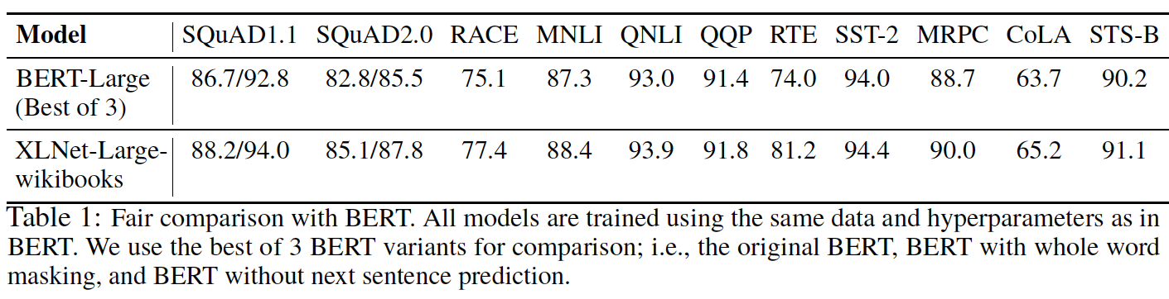
Results: “Fair Comparison”

Slide 38
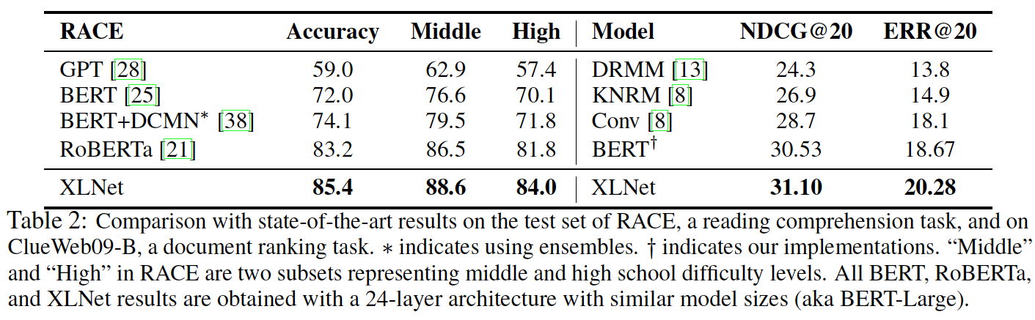
Results: After scaling up (1/3)

Slide 39
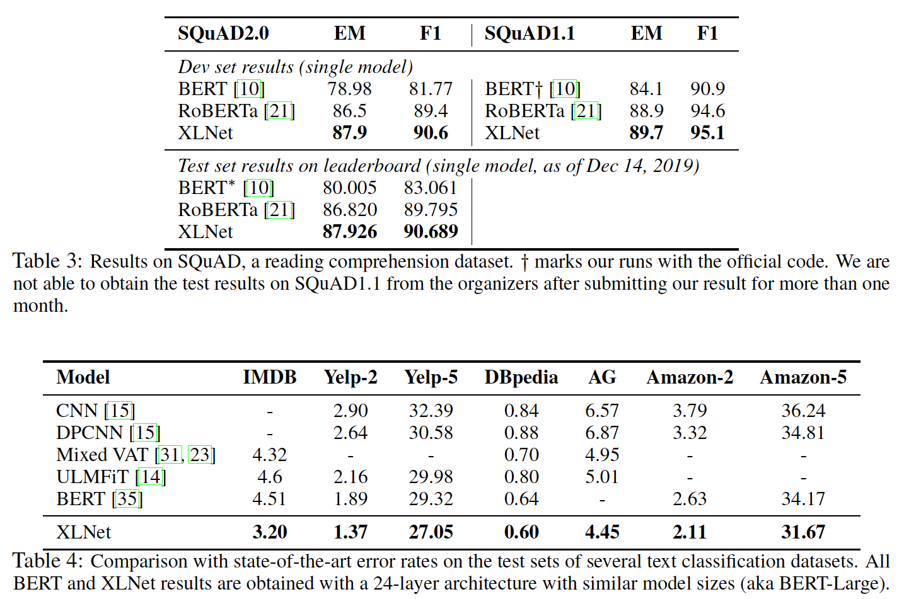
Results: After scaling up (2/3)

Slide 40
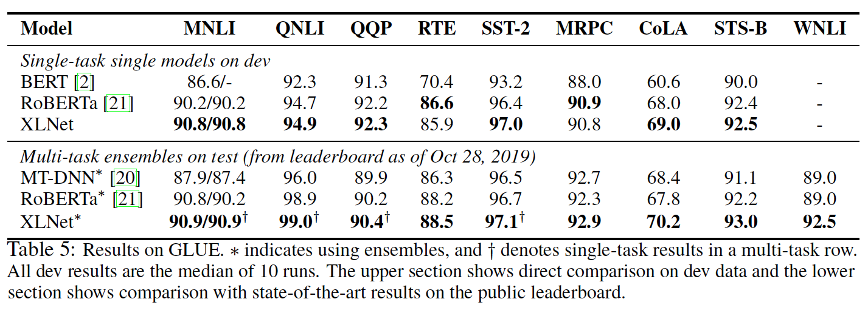
Results: After scaling up (3/3)

Slide 41
Ablation Test
Questions:
Does permutation language modeling objective help?
Does using Transformer-XL help?
Does span-based prediction help?
Does the bidirectional input pipeline help?
Does next-sentence prediction help?

Slide 42
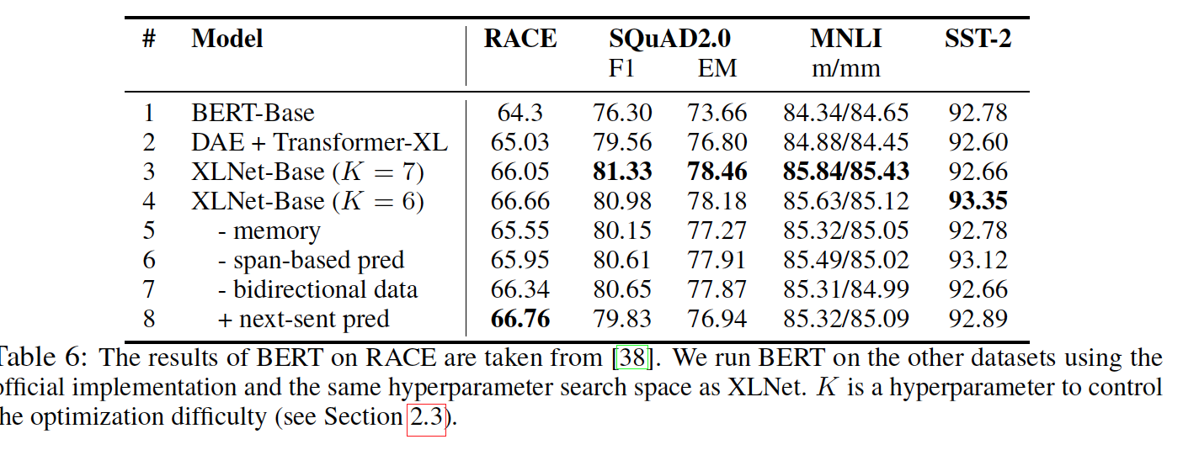
Results: Ablation test

Slide 43
Language Modeling: Let’s revisit this table
Goal: Estimate the probability of a text sequence x = [x1, x2… xT]
 | Auto-regressive language modeling | Auto-encoding language modeling
Example | N-gram language modeling | Bidirectional Encoder Representation from Transformers (BERT)
Fundamental idea | Estimate the likelihood of the n-th word given a context of sequence of n-1 words | Estimate the likelihood of k masked words in a sequence of length n given a context of n-k words
Equation | X = x1:t-1 + xt | X^ = x_ with a proportion of tokens masked
Density estimation | Explicit | No. Aim to reconstruct original data
Input noise | Does not introduce additional noise | Masked tokens ([MASK]) introduce noise. Downstream data does not contain [MASK]
Context dependency | Models unidirectional context | Models bidirectional context

Slide 44
Language Modeling revisited
Goal: Estimate the probability of a text sequence x = [x1, x2… xT]
XLNet
 | Auto-regressive language modeling | Auto-encoding language modeling
Example | N-gram language modeling | Bidirectional Encoder Representation from Transformers (BERT)
Fundamental idea | Estimate the likelihood of the n-th word given a context of sequence of n-1 words | Estimate the likelihood of k masked words in a sequence of length n given a context of n-k words
Equation | X = x1:t-1 + xt | X^ = x_ with a proportion of tokens masked
Density estimation | Explicit | No. Aim to reconstruct original data
Input noise | Does not introduce additional noise | Masked tokens ([MASK]) introduce noise. Downstream data does not contain [MASK]
Context dependency | Models unidirectional context | Models bidirectional context
Uses auto-regression via factorization ordering
Does not introduce masking.
No additional noise
Two-stream attention introduces
bidirectional context

Slide 45
Conclusion
XLNet is a permutation-based language modeling method
Two-stream attention mechanism
Substantial improvement over various tasks

Slide 46
Other observations
'Acknowledgments’ section is longer than ‘Conclusions’
‘Related work’ is a short paragraph in the Introduction
“Text classification tasks such as Yelp and IMDB”
Appendix contains super-helpful illustrations and examples

