Slide 1
Extracting Symptoms and their Status from Clinical Conversations
Based on the paper: Du, Nan, Kai Chen, Anjuli Kannan, Linh Tran, Yuhui Chen, and Izhak Shafran. "Extracting Symptoms and their Status from Clinical Conversations.” ACL 2019.
Slides by Aditya Joshi
@NLP reading group
13th January 2020
Equal contribution by all authors

Slide 2
Outline
Also sections of the paper.
Introduction
Related Work
The Symptom Extraction Task
Models
Empirical evaluations
Analysis

Slide 3
Outline
Introduction
Related Work
The Symptom Extraction Task
Models
Empirical evaluations
Analysis

Slide 4
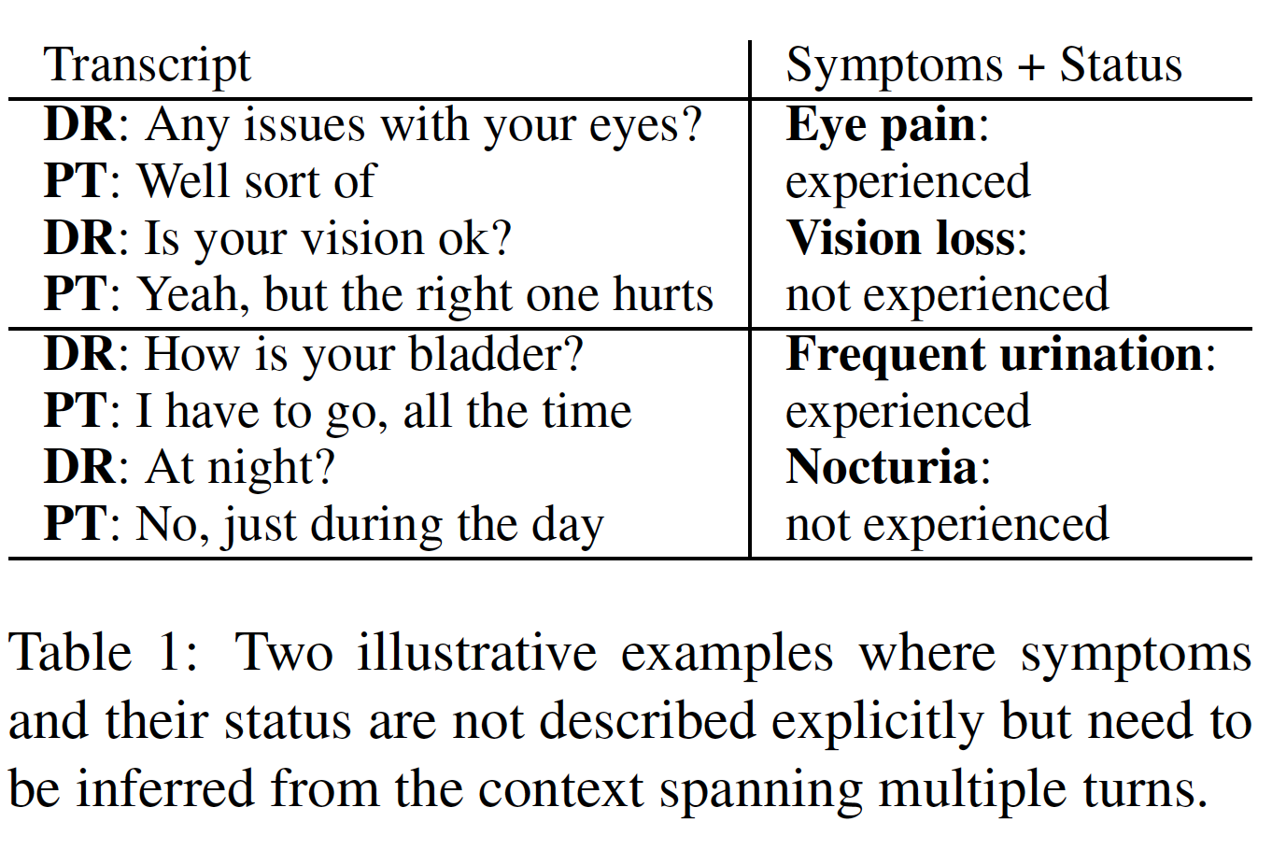
What is the paper about?
Input: Clinical conversations
Outputs:
Symptoms mentioned in the clinical conversations (Symptom labels from a symptom ontology)
Does the patient experience these symptoms or not? (Boolean)

Slide 5
Why is it a useful problem?
Hospitals have ben “coaxed and cajoled into adopting electronic health records”
Led to an ”unforeseen side-effect of placing a disproportionate burden of documentation”
4.5 hours of 11 hour day interacting with clinical documentation systems

Slide 6
Outline
Introduction
Related Work
The Symptom Extraction Task
Models
Empirical evaluations
Analysis

Slide 7
Related work
Information extraction from medical documents
i2b2 challenge (2011):
Discharge summaries: 394Tr+477Te+877Ev
CRF-based methods
Section headings can be useful
Clinical conversations
Two-level model: (Finley et al 2018a)
Classify sentence into sections of a clinical note
Extract relevant phrases

Slide 8
Outline
Introduction
Related Work
The Symptom Extraction Task
Models
Empirical evaluations
Analysis

Slide 9
Corpus
90k de-identified, transcribed clinical conversations
Typically 10 minutes long speech that has been transcribed
Labels:
Symptoms being discussed (Total: 186)
For each symptom, status: does the patient have it or not: Experienced, not experienced, other
Annotation
18 professional scribes
2,950 conversations: (1950 training, 500 dev, 500 test)
5M tokens 615K sentences, 92K labels
Inter-annotator agreement: Cohen’s kappa: 0.4

Slide 10
Evaluation
Unweighted metric:
Given a clinical conversation,
Identify the set of unique symptoms and get their status correct
Weighted metric:
Given a clinical conversation,
Identify the symptoms, weighted according to the number of times they occur
For example, how many times do the specific symptoms get mentioned
in the two examples?

Slide 11
Outline
Introduction
Related Work
The Symptom Extraction Task
Models
Empirical evaluations
Analysis

Slide 12
Models
They develop two models:
(a) Span-attribute tagging model (SA-T) model
(b) Seq2Seq model
And what about status?

Slide 13
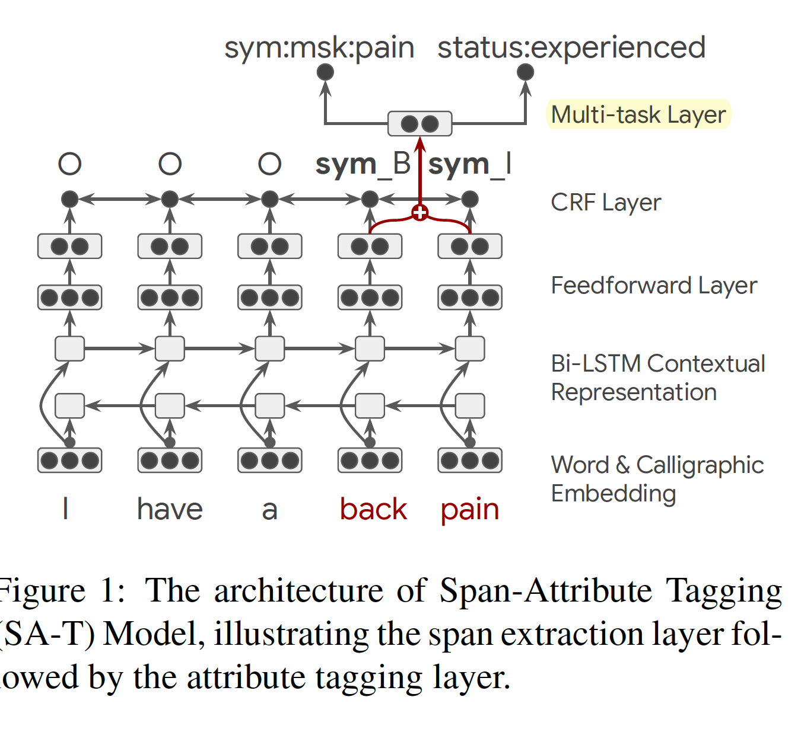
Span-attribute tagging model (SA-T)
Conventional tagging model: Word/char embeddings -> Sequence of bidirectional layers -> CRF to predict BIO tags (3 tags)
Three step model:
CRF layer predicts BIO tags
When something is identified as a span,
Multi-task layer to predict: symptom type (186 labels)
symptom status (3 labels)

Slide 14
Looking closer at the SA-T model
Multi-task layer depends on the internal representation – hopefully capturing context.
This is important because ‘status’ would really depend on words other than those in the span.

Slide 15
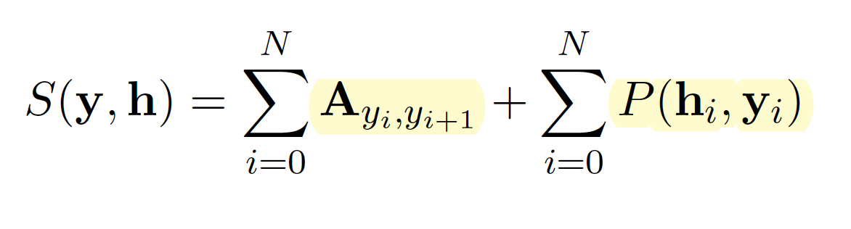
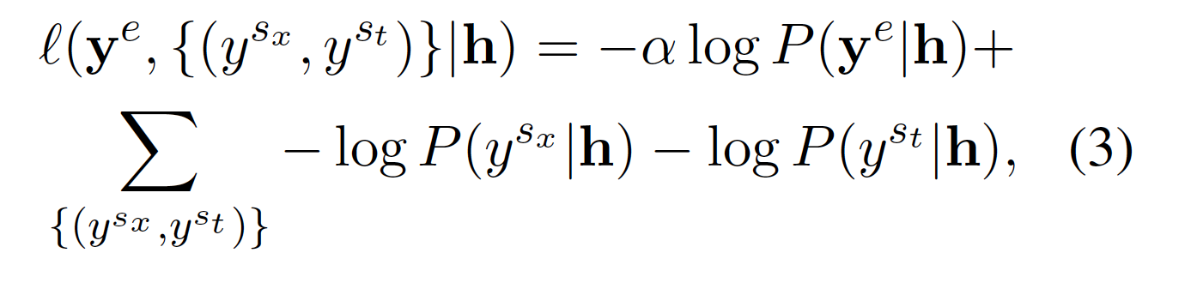
Formulation
x: input (sequence of words)
h : BiLSTM representation (sequence of dense vectors, concatenated)
CRF output is computed in terms of the compatibility function over
Attribute tagging layer: Aggregate pooling (max/sum) of the span identified as a symptom
Then, a multi-tasking layer that assumes independence between status and symptom
Tag sequence
Symptom status
Symptom name

Slide 16
Curriculum learning
The model for locating tags is likely to be unreliable during initial steps of training
So, that would impact the training of the multi-task learning step too.
So how do they get around this problem?
Curriculum learning
Specifically, we provide the classification stage the reference location of the tag from the training data with probability p, and the inferred location of the tag with probability 1 - p. We start the joint multi-task training by setting this probability to 1 and decrease it as training progresses.

Slide 17
Do we see a shortcoming of the SA-T model?
Span, symptom and status identification is at the sentence level.
In a conversation, there may be context across conversation turns.
Doctor: “Do you experience a loss of appetite?” Patient: ”No.”

Slide 18
Therefore… seq2seq model
Input: Chunk of a conversation (k = 5 turns; empirically determined); Output: list of symptoms and their statuses
In seq2seq, the symptom and status are not attached to a subset of words in the text (the way it is done in SA-T)

Slide 19
Seq2Seq
I/O: Input: Sequence of tokens (x), Output: List of symptoms and status (y)
Encoder: Input: x; Output: Encoding h(x)
Decoder: Input: h(x); Output: y … Attention mechanism to attend to different words across conversational turns
LSTM-only encoder-decoder
LSTM+Transformer encoder-decoder
Pre-training using unlabeled data to encode chunks
How is the order of symptoms determined?

Slide 20
Outline
Introduction
Related Work
The Symptom Extraction Task
Models
Empirical evaluations
Analysis

Slide 21
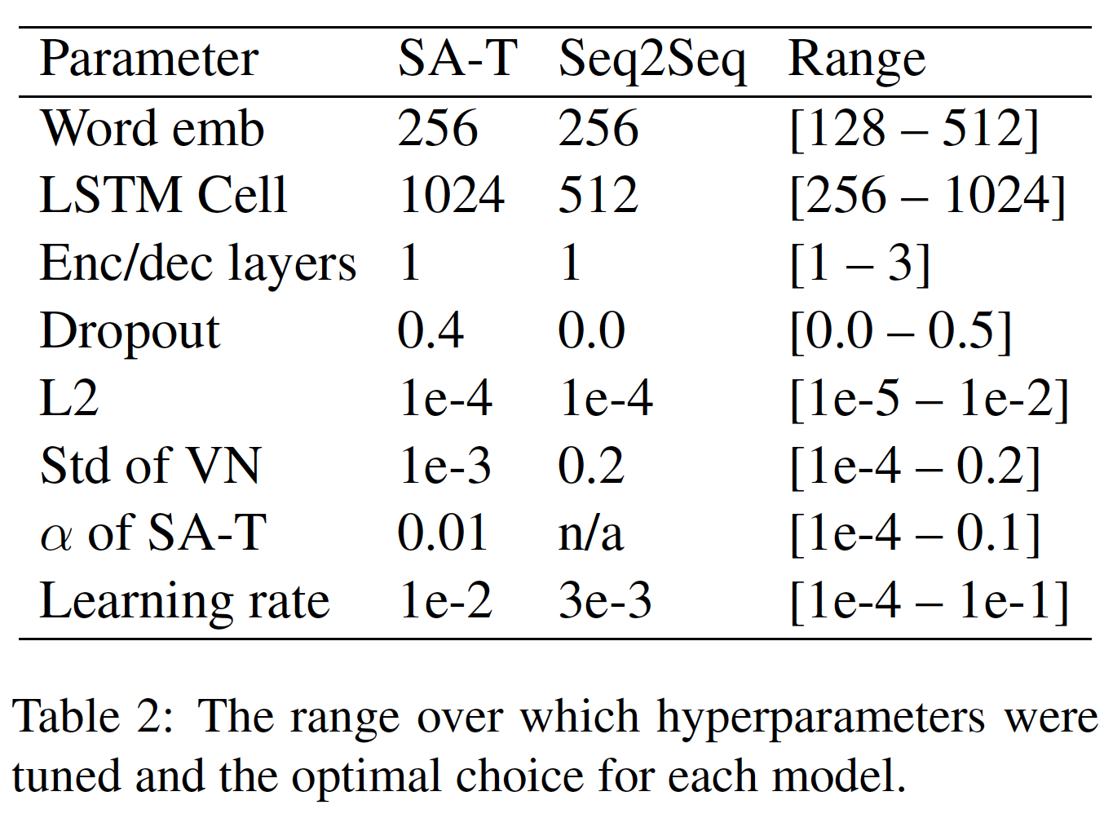
Evaluation
Hyper-parameter tuning on the validation set

Slide 22
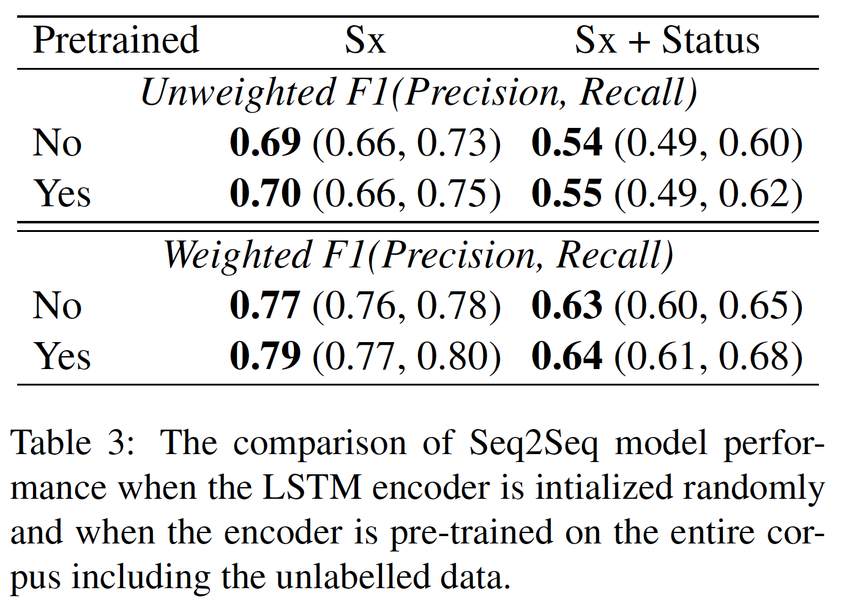
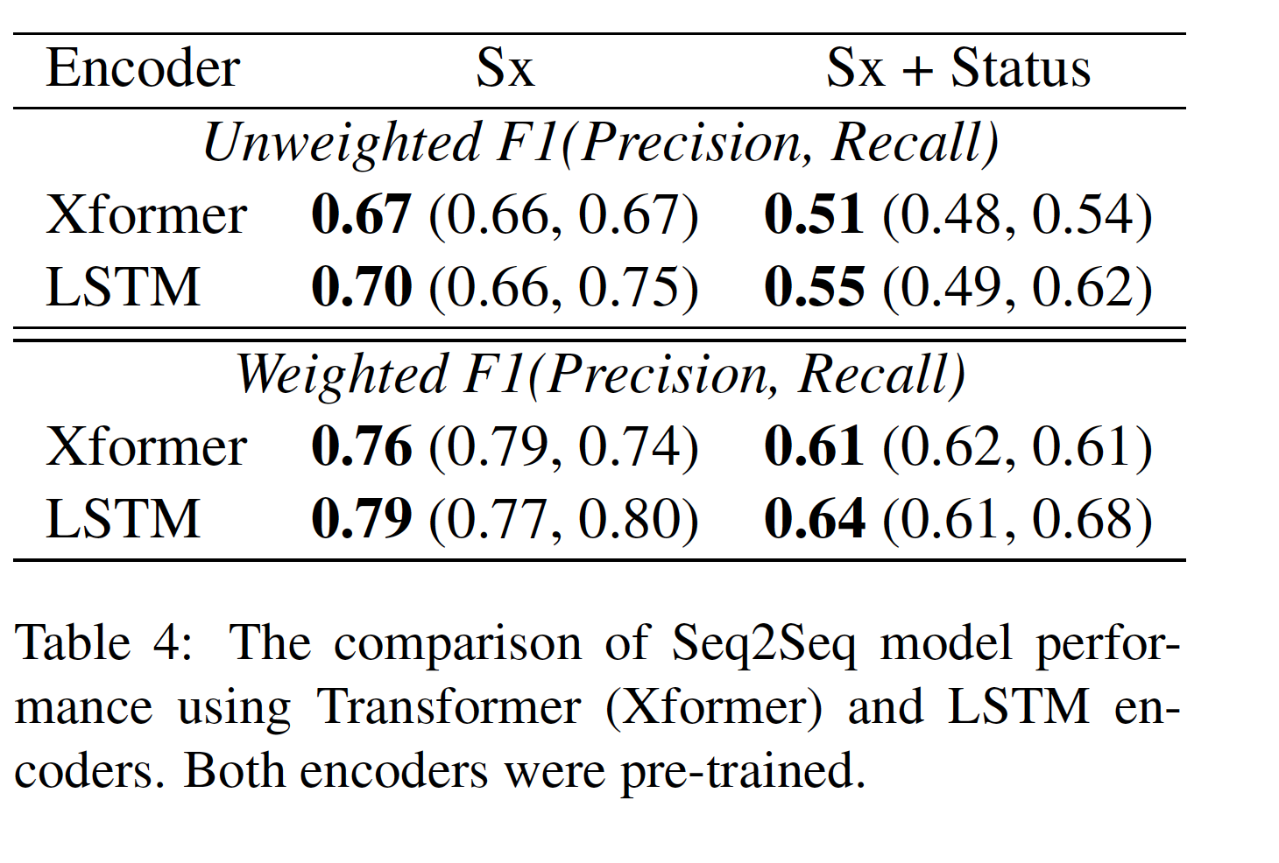
Results: Selecting the encoder for the Seq2Seq model

Slide 23
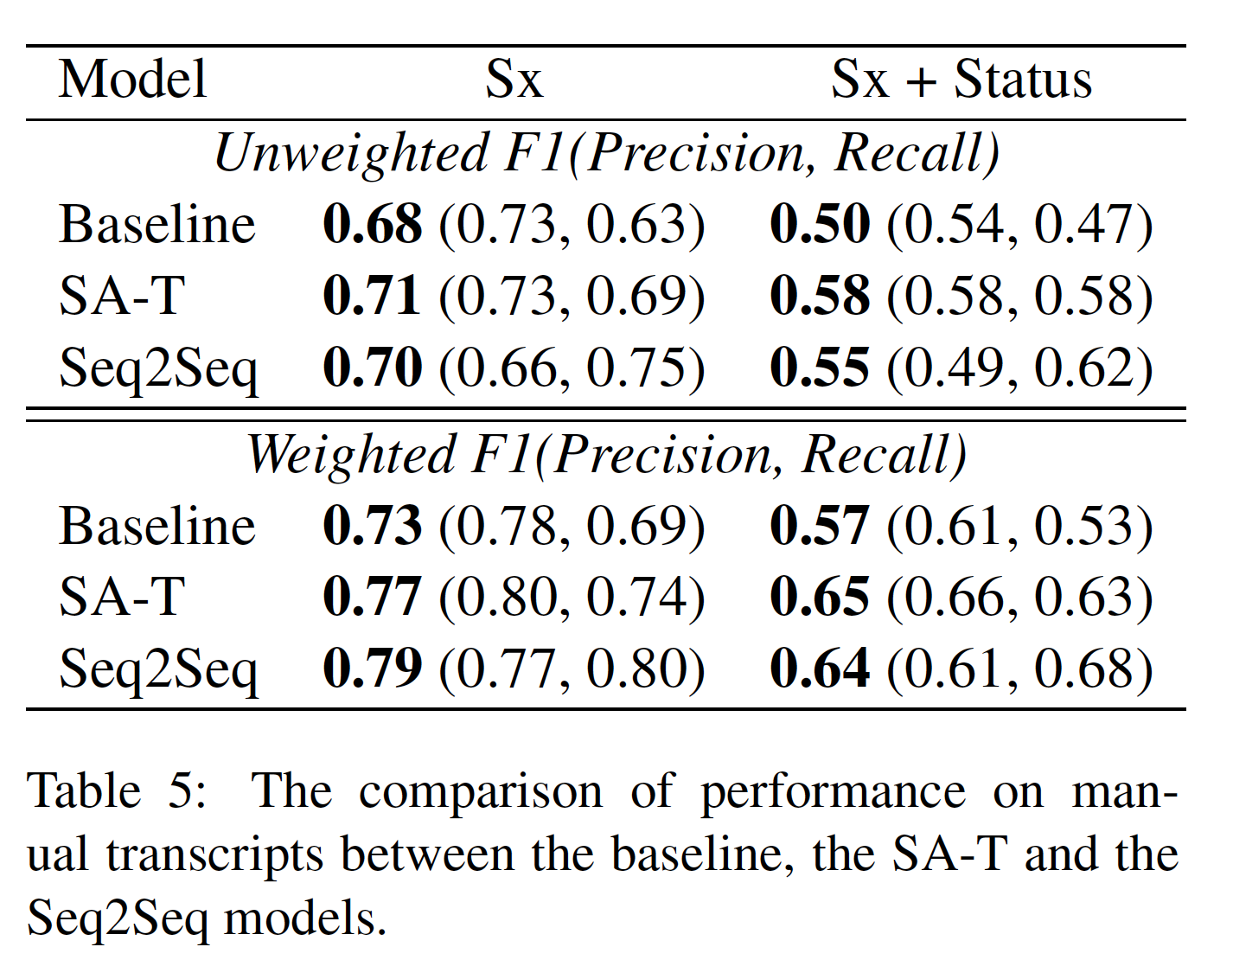
Results: Comparing SA-T, Seq2Seq and baseline
Baseline: BiLSTM; FF Layers; Softmax layer.
Target space: 186 X 3

Slide 24
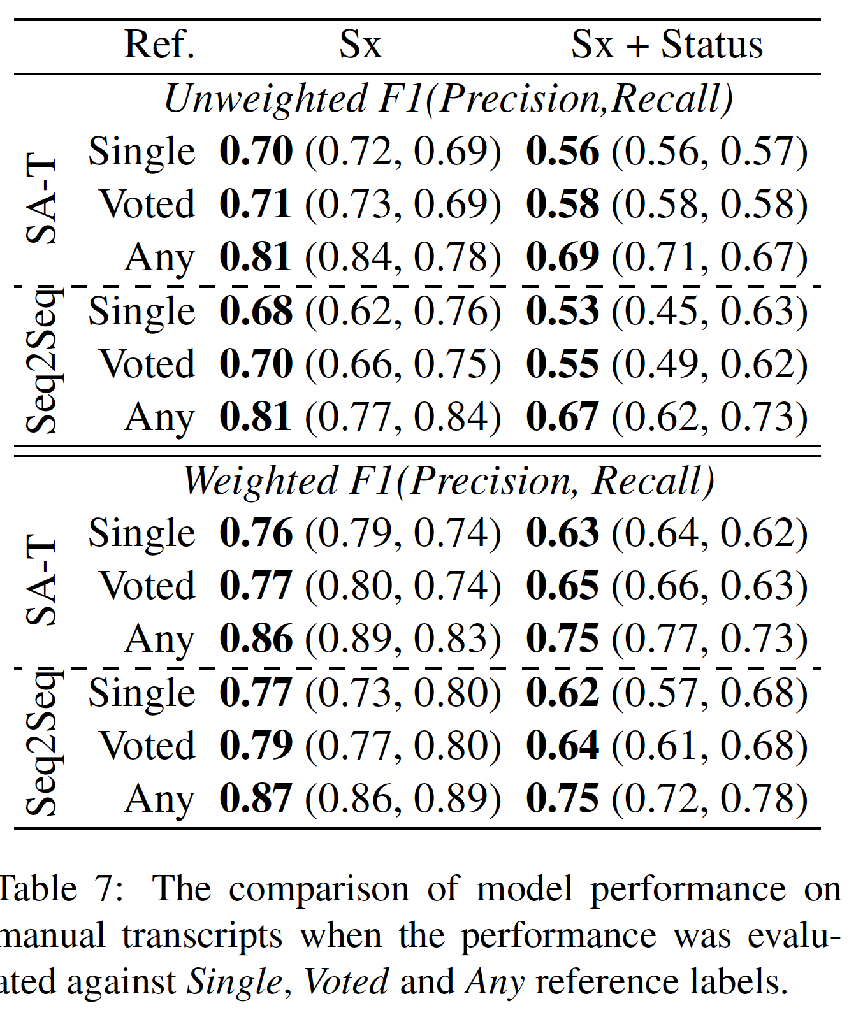
Results: Reference annotations
This section seems to be an effort to arrive at F1s that ‘look good’
OH, but our kappa values were low. So we must
use different combinations of reference annotations.
So we try out three schemes:
Single: Annotation from a random annotator is picked
Voted: Annotation is voted on the basis of how many scribes picked it
Any: Annotation was deemed right if it matched that from any of the scribes

Slide 25
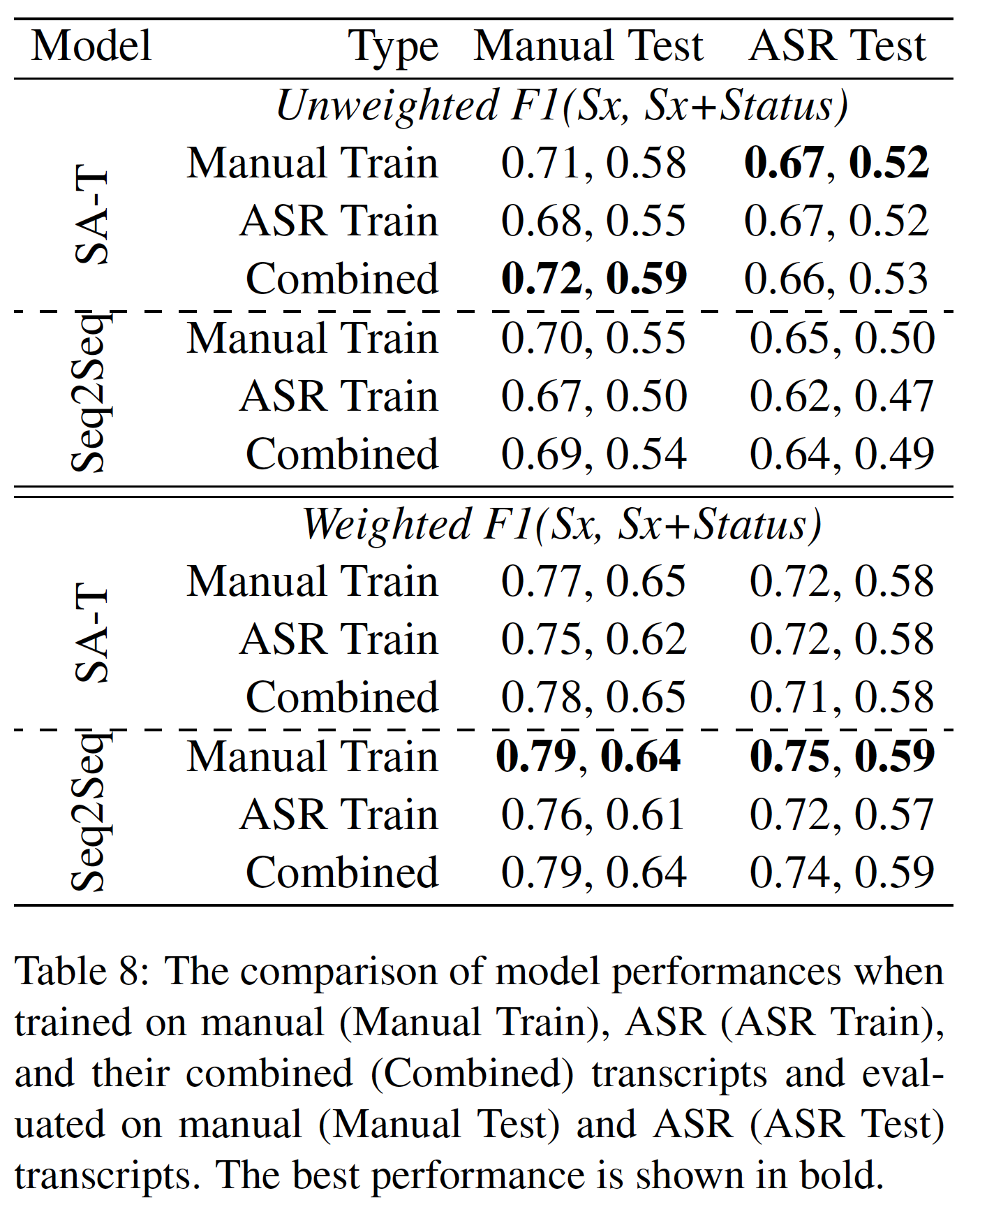
Results: Directly from speech!
If manual transcripts are not available, how well does this model do if the input is an ASR transcript?

Slide 26
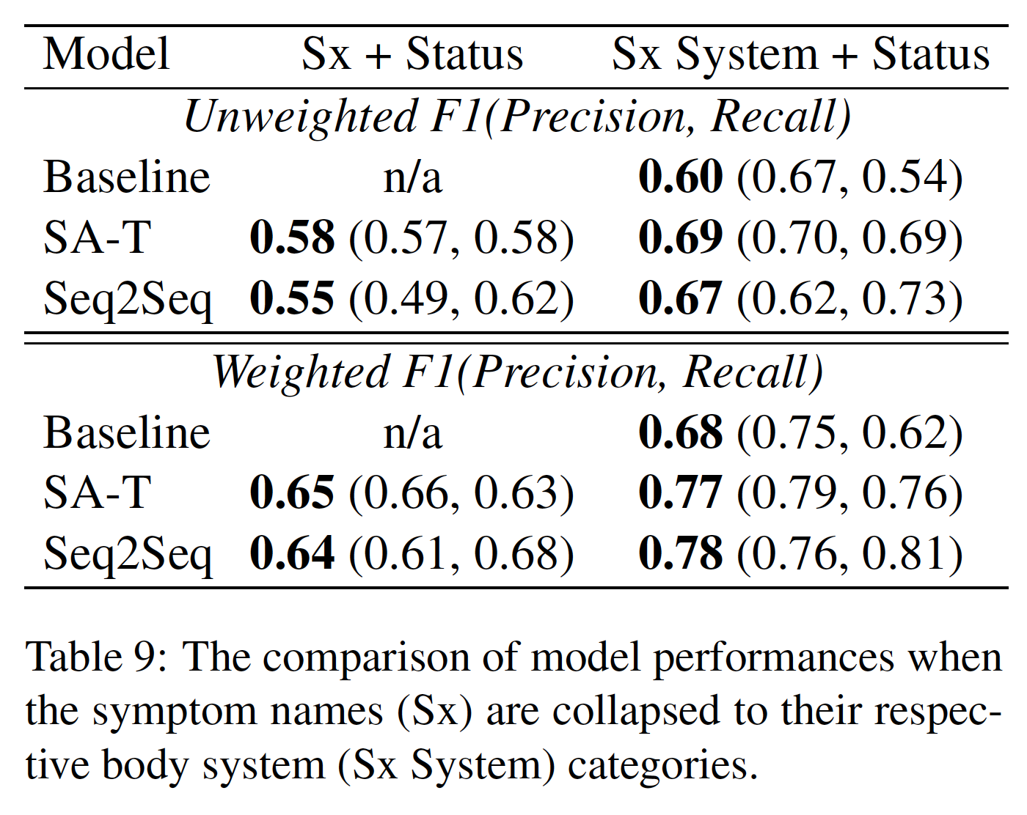
Results: Reducing the space of symptoms
Instead of 186 symptom labels, 14 body systems

Slide 27
Outline
Introduction
Related Work
The Symptom Extraction Task
Models
Empirical evaluations
Analysis

Slide 28
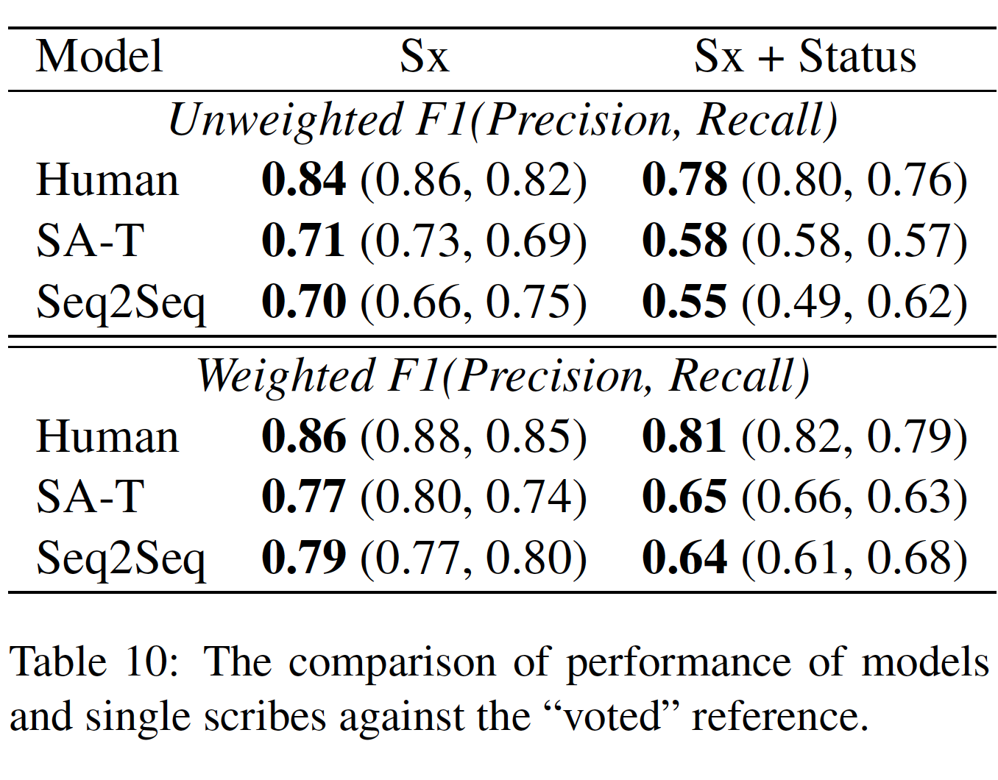
Results: Comparison with humans

Slide 29
Attention weights
DR: How is your sleep?
PT: Well, I have been waking up a lot.
DR: How often would you say?
PT: Several times a night.
DR: That is a lot of waking up!
Table 11: Example of attention from Seq2Seq model,
where words with attention weight of 0.05 or higher are
underlined.
The Error analysis sub-section points to conversations where symptoms are described over multiple conversational turns.

Slide 30
Conclusion
“The performance of our models is significantly better than baseline systems and range from an F-score of 0.5 to 0.8 depending on the condition. When the models are trained on manual transcripts and applied on ASR transcripts, the performance degrades considerably compared to applying them on manual transcripts.”
“Our analysis show that the SA-T model has higher precision while Seq2Seq model has higher recall, thus the two models compliment each other.”
Future work: Can the two be combined?

