Slide 1
Polite Dialogue Generation Without Parallel Data
Tong Niu, Mohit Bansal, Transactions of the Association for Computational Linguistics, Volume 6, 2018.
Slides by Aditya Joshi, for the NLP Reading Group on 25th March, 2019

Slide 2
Abstract
Goal: Fluent, contextually relevant and para-linguistically accurate
Three weakly supervised models
Late fusion model (Fusion)
Label fine-tuning model (LFT)
Reinforcement learning model (Polite-RL)
Two retrieval-based, polite dialogue model baselines
X, Y, X: Utterance by X & Y -→ Response by X

Slide 3
Introduction
Engaging, convincing and trustworthy conversational agents
Amazon echo encouraging kids to be rude, parents worried
Politeness versus rudeness: a paralinguistic style axis
Parallel data may not be available to train translation-style systems
Therefore, they present weakly supervised models
Datasets:
Stanford Politeness Corpus (Wikipedia and stack exchange requests)
MovieTriples dialogue corpus (IMSDB)

Slide 4
Introduction: Three models
Fusion: Response generation decoder fused with language model trained on polite utterances
LFT: Politeness score is prepended to the utterance. Each step of the generation computes this score, and ensures it is above a value.
Polite-RL: A politeness score is computed for the decoder output, and the value acts as a reward for the RL formulation.
State-of-the-art politeness classifier combined with a seq2seq dialogue model.

Slide 5
Introduction: Key Result
Fusion and the retrieval models increase the politeness level but have poorer dialogue quality.
LFT and Polite-RL models fully produce polite responses without sacrificing dialogue coherence and relevance.

Slide 6
Related Work
Xu et al. (2012), Jhamtani et al. (2017) | Translation model: Modern language to Shakespearean style
Kikuchi et al. (2016) | Control the output length for summarisation; similar to the LFT model
(Hu et al., 2017; Shen et al., 2017; Zhao et al., 2017; Fu et al., 2018) | Variational autoencoders for generation
Sennrich et al. (2016a) | Annotation of training data with stylistic metrics such as number of formal words, etc.
Dong et al. (2015) and Luong et al. (2016) | Multilingual NMT using multi-task learning

Slide 7
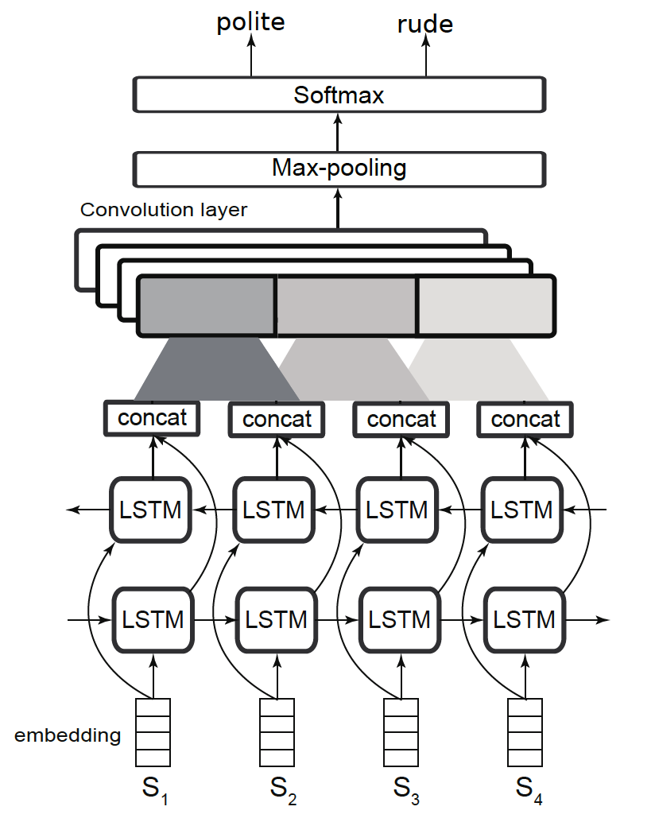
Politeness Classification Model

Slide 8
Polite-Style Dialogue Models: Baseline
(Bahadanau et al 2015):
2-layer bi-directional LSTM-RNN encoder to encode the conversation history turns
4-layer LSTM-RNN decoder to generate the response
Additive attention from the output of the encoder is applied to the last layer of the decoder.

Slide 9
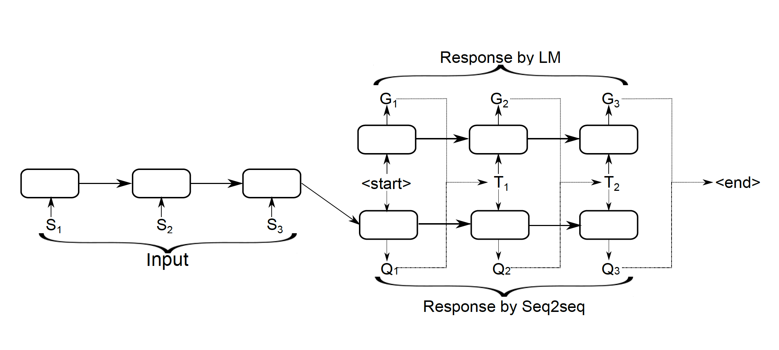

Polite-Style Dialogue Models: Fusion

Slide 10
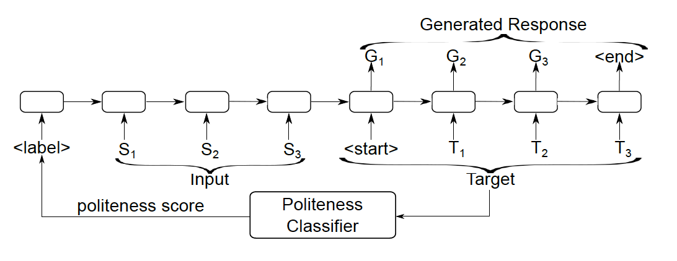
Polite-style Dialogue Models: LFT
Specifically, we add to the vocabulary a single politeness label and attach with it a trainable word embedding, just like what we would do to a normal token. Then, the way we make it continuous is by scaling its embedding vector with the (intended) politeness score of the target sequence. During training,
this score is obtained by feeding the ground-truth
target sequence (response). during test time, we are
free to scale the prepended politeness label with different
scores of our choice
Thus, the LFT model is able to simultaneously
produce polite, neutral and rude responses depending
on the prepended label, similar to recent multilabel,
multi-space, and zero-shot machine translation
work

Slide 11
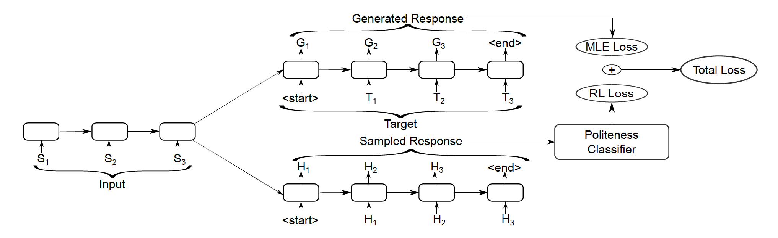
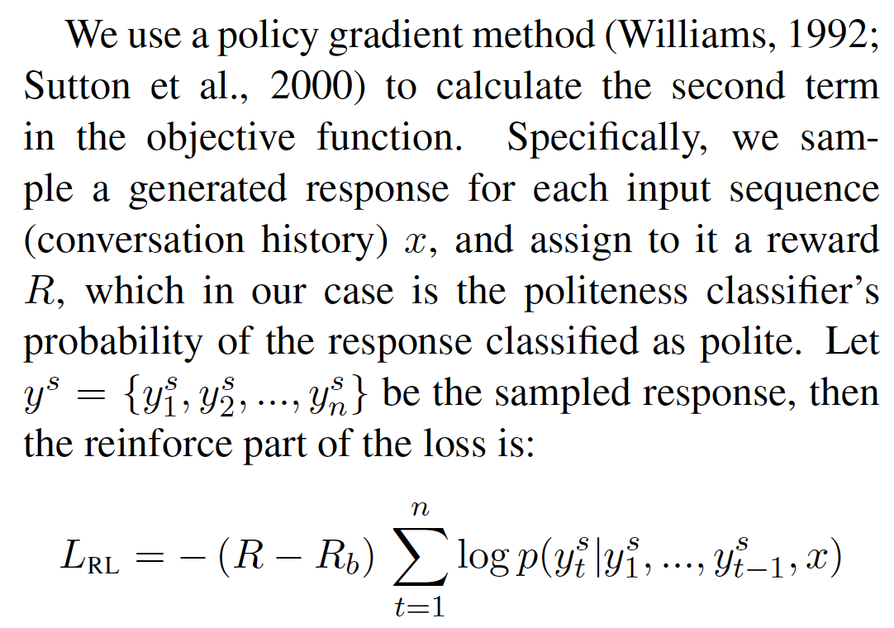
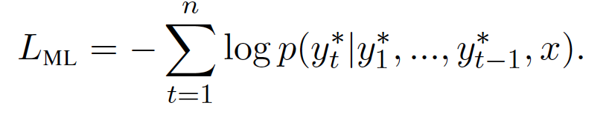

Polite-style Dialogue Models: Polite-RL
The first term is the traditional maximum likelihood loss (LML), which we refer to as the teacher forcing part. The other one is the reinforcement learning loss (LRL) based on politeness scores, which we refer to as the reinforce part.

Slide 12
Baselines
Baseline 1: TF-IDF Similarity with source utterance Y
Baseline 2: Return one out of 10 randomly known polite responses

Slide 13
Datasets
Based on scores from human annotators, these requests are labeled with either Polite or Rude, with each class equally consisting of 1,089 requests for the Wikipedia domain and 1,651 requests for the Stack Exchange domain.
MovieTriples dialogue corpus (Serban et al., 2016), which contains 245K conversations extracted from IMSDB movie scripts in X-Y-X triplet-utterance format, where X and Y correspond to two movie characters (and the model’s task is to generate the last response).

Slide 14
Human Evaluation
Context, with six outputs (seq2seq base model, three models and two baseline models)
300 randomly selected test instances
Rate each output on: dialogue quality and politeness evaluations
Score each output
Also, Likert scale (where each score value has a descriptive string)

Slide 15
Automatic evaluation
BLEU matched with the source transcript
Do not draw any conclusions from these values due to issues with BLEU

Slide 16
Experiment Setup
word2vec embeddings
Pre-train seq2seq model on a subtitle corpus
Empirically determine parameters

Slide 17
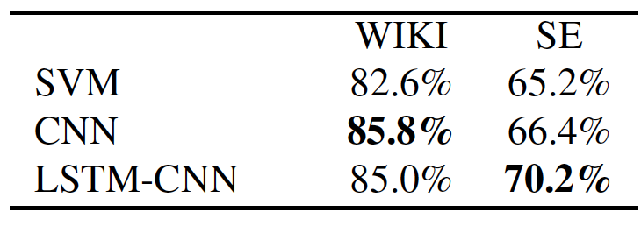
Results: Politeness classifier

Slide 18
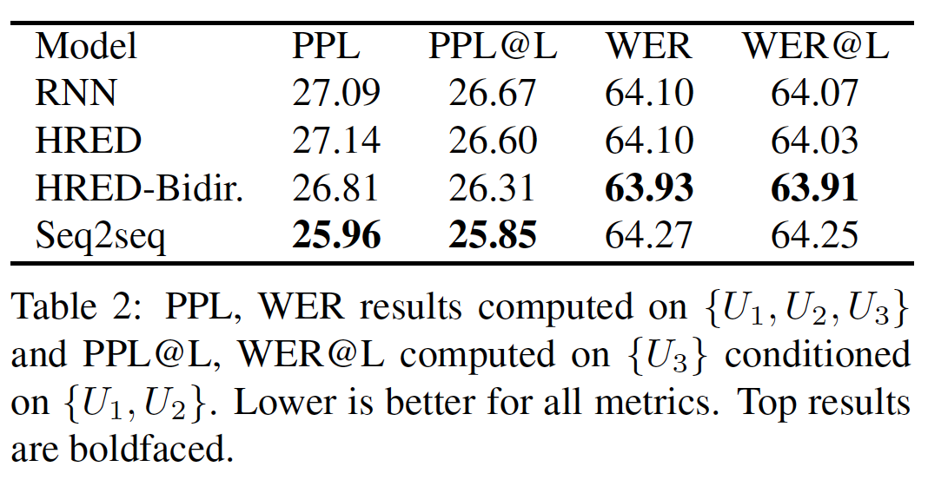
Results: Base model

Slide 19
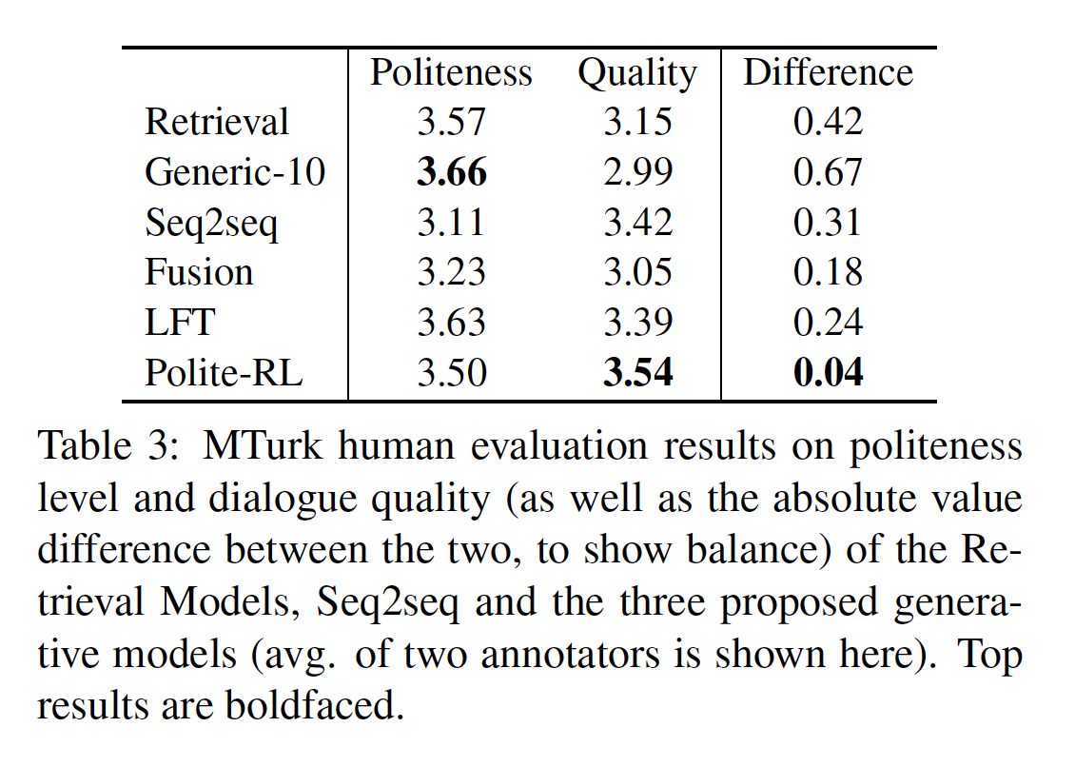
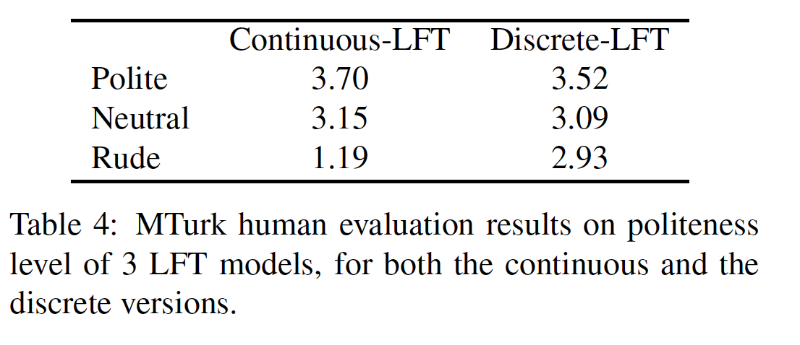
Results: Human Evaluation
stratified categories in the case of
Discrete-LFT

Slide 20
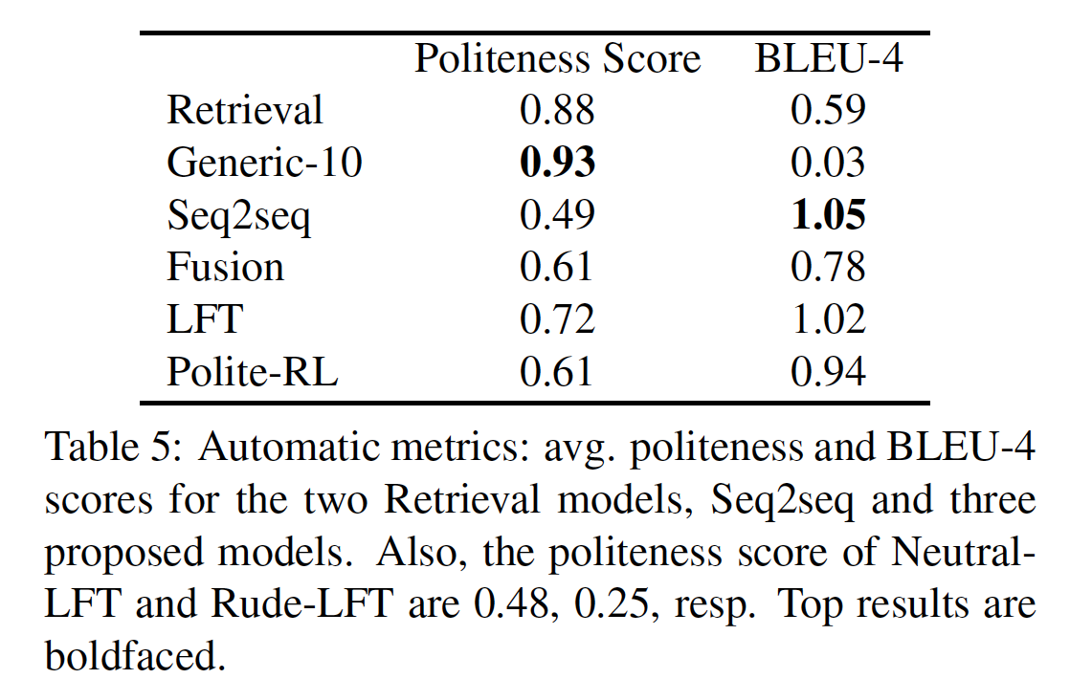
Results: Automatic Evaluation

Slide 21
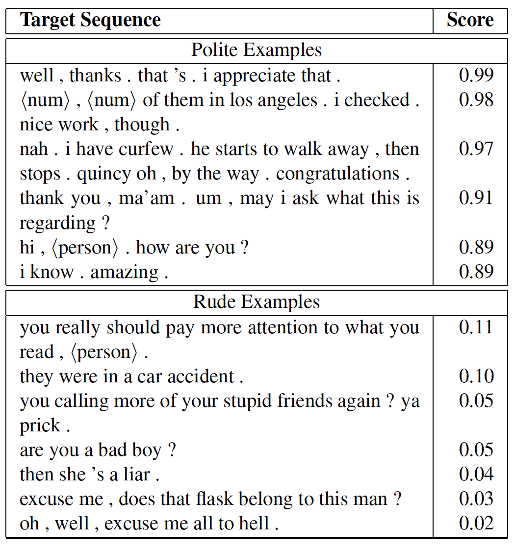
Analysis of the polite classifier output

Slide 22
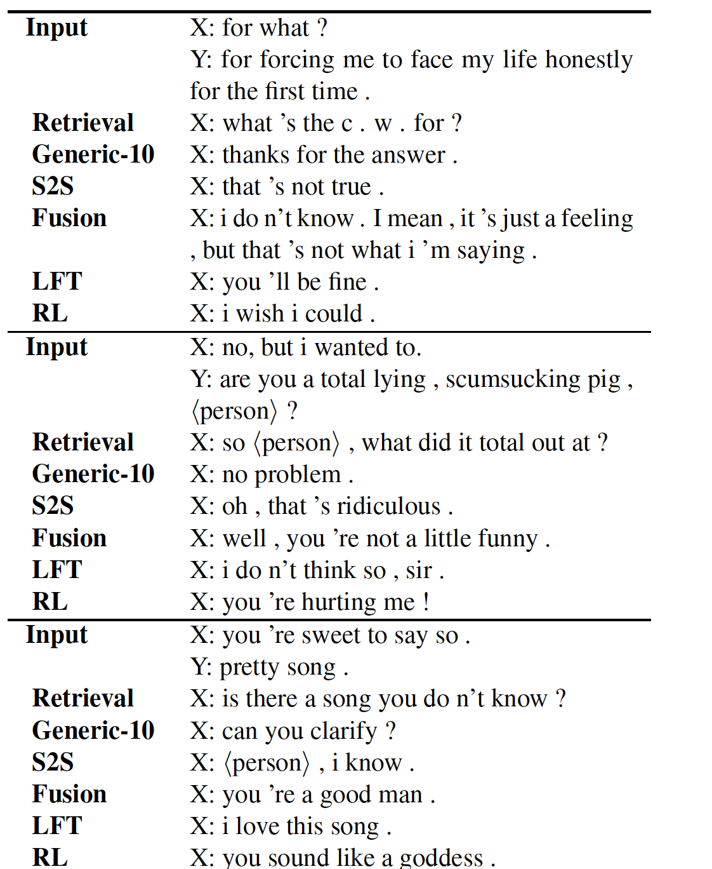
Analysis of the system output

Slide 23
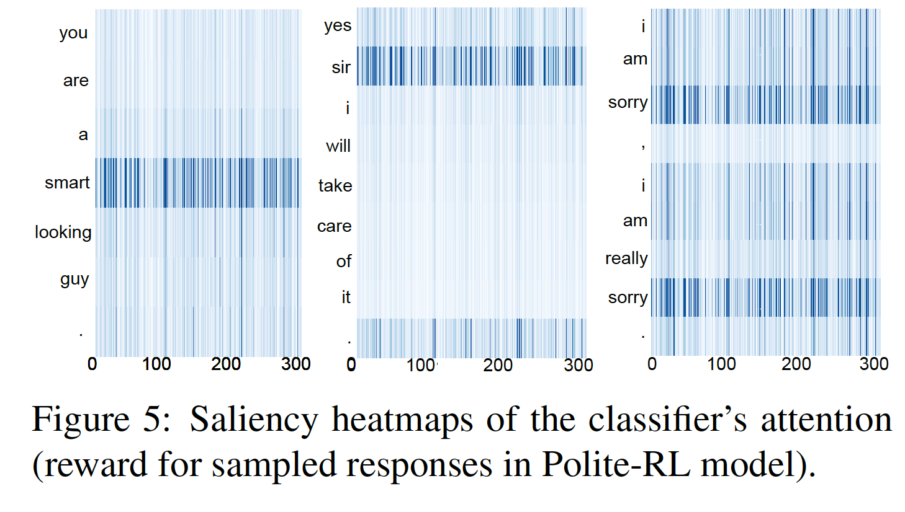
Heat maps
Fig. 5 shows three such
heatmaps that correspond to the magnitudes of the
derivative in absolute value with respect to each dimension.
The figures clearly show that the classifier
has learned to identify multiple politeness strategies,
e.g., “smart” (deference), “sir” (polite address), and
the two “sorry”s (apologizing).

Slide 24
Conclusion
Three models for polite dialogue generation
Their models have better values of quality parameters
Can be generalized to other personality traits

