Slide 1
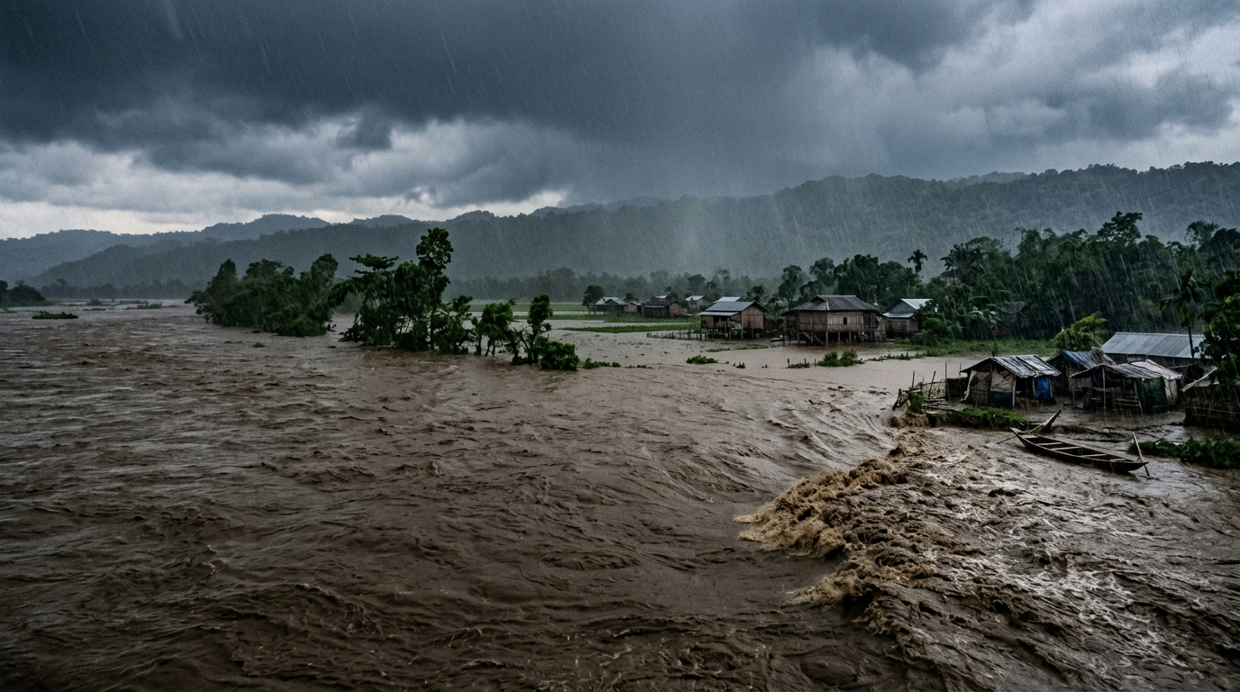
FINAL YEAR MAJOR PROJECT PRESENTATION • SESSION 2026–2027
Flash Flood Early Warning, Rescuer Assistance,
and Safe Evacuation Routing System
Helping communities reach government relief shelters safely and assisting rescue teams before roads are cut off
STUDENT INVESTIGATORS:
[Undergraduate Major Project Student Group / Candidate Names & Roll Numbers]
Department of Computer Science & Engineering
Project Guide: [Faculty Project Guide / Supervisor, Department of Computer Science & Engineering]
Target Focus Area: Brahmaputra & Barak River Basin (Assam)

Slide 2
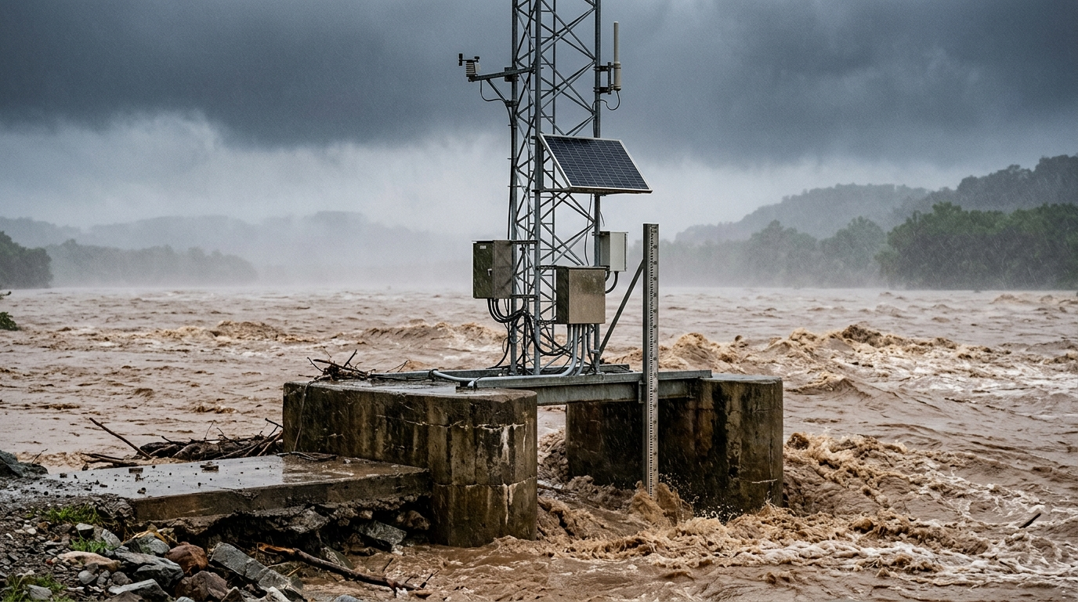
THE PROBLEM
WHAT GOES WRONG DURING FLASH FLOODS?
1. Water Rises Fast Without Enough Warning
Heavy rain in the hills causes rivers to rise rapidly. Because water moves so quickly, people living downstream often don't get warned in time to pack essential belongings and evacuate safely.
2. Ground Sensors Often Break in Severe Storms
River gauges installed on riverbanks are easily damaged or washed away by floating logs, mud, and fast currents. When the sensors break, officials lose real-time visibility right when they need it most.
3. People and Rescuers Get Trapped on Flooded Roads
Standard maps and GPS apps only look at normal traffic. During floods, they direct people onto low roads and bridges that are already underwater. Meanwhile, rescue teams don't know which roads are cut off until they get stuck.

Slide 3
OUR SOLUTION
HOW OUR SYSTEM SOLVES THESE PROBLEMS
STEP 1: SENSORS & BACKUP
Reads ground river gauges every 15 minutes. If a ground sensor gets damaged, the system automatically uses satellite radar from orbit to keep measuring water height.
STEP 2: FLOOD PREDICTION
Calculates how fast water is moving downstream from upstream rain. This gives downstream towns 2 to 2.5 hours of advance warning before water crests.
STEP 3: MAPPING FLOODED ROADS
Compares rising water levels with local road maps to determine exactly which streets will be underwater and how deep the water will be.
STEP 4: ALERTS & SAFE ROUTES
Sends automated SMS in local languages and guides residents along dry roads to open government shelters, while helping rescue teams deploy in advance.
CORE GOAL: Predict where water will rise, alert people immediately, and guide both citizens and rescue teams to safe ground before catastrophe happens.

Slide 4
STEP 1: SENSOR BACKUP
WHAT HAPPENS WHEN GROUND SENSORS BREAK?
THE SENSOR PROBLEM ON THE GROUND
• River Gauges Break Easily
Ground sensors are placed right in the river channel. Fast-moving water, floating tree trunks, and thick silt often knock them out completely.
• Power & Signal Outages
Severe storms knock down electricity poles and mobile network towers, stopping ground data from reaching disaster headquarters.
• Missing Data Causes Warning Delays
In most standard flood systems, if the ground sensor goes offline, the software simply stops working and leaves officials guessing.
HOW SATELLITE RADAR SOLVES THIS
✔ Automatic Detection
Our software checks for incoming sensor readings every 15 minutes. If no data arrives, it switches over to satellite radar data automatically.
✔ Sees Through Rain & Storm Clouds
Regular satellite cameras cannot see through monsoon clouds. We use radar satellites (Sentinel-3) which shoot radar pulses through heavy rain and measure river height directly.
✔ Completely Safe in Space
Because the satellite is in orbit, ground floods, broken power lines, and damaged roads cannot affect it. The system keeps running no matter how bad the storm is.

Slide 5
STEP 2: FLOOD PREDICTION
PREDICTING WATER LEVEL TO GAIN 2+ HOURS OF LEAD TIME
1. Tracking Flood Water Speed Downstream
When heavy rain falls in upstream hills, the flood wave takes time to travel downstream (about 5 meters per second). By calculating this speed, our system gives towns downstream 2 to 2.5 hours of advance notice before the water level peaks.
2. Checking Soil Wetness (Saturation)
Dry soil absorbs rain like a sponge. But when soil is already completely soaked from days of rain, 90%+ of any new rain immediately runs off into rivers. The system checks soil wetness so it knows when a flash flood is likely.
3. Keeping Predictions Realistic
Pure computer algorithms sometimes make wild, impossible guesses when unusual storms hit. We constrain the prediction with basic physics (how much water the river channel can physically hold) so predictions remain reliable.
WHY A 2-HOUR LEAD TIME MATTERS:
In most flash floods, people get caught because water enters homes without any warning. Having even 2 hours of advance notice is enough time for families to get to high ground and for rescue teams to reach vulnerable spots.

Slide 6
STEP 3: MAPPING FLOODED ROADS
FINDING OUT WHICH ROADS WILL BE UNDERWATER
HOW THE SYSTEM CHECKS EVERY ROAD
• Step 1: Digital Elevation Map
The system uses terrain height maps to see which parts of the town are on high ground and which streets sit in low dips.
• Step 2: Predicted River Height
It brings in the predicted river water level from Step 2.
• Step 3: Road Map Overlay
It overlays local road maps (from OpenStreetMap) on top of the water map to calculate estimated water depth on every single street segment.
CLASSIFYING ROADS FOR SAFETY
■ Dry Roads (Under 5 cm)
Completely safe. Normal walking and passenger cars allowed.
■ Shallow Water (5 cm to 15 cm)
Walking is hazardous for elderly/children. Small cars must take caution.
■ Dangerous Flooded Roads (15 cm to 80 cm)
Blocked for pedestrians and ordinary cars (engines will stall). Only high-clearance rescue trucks can pass.
■ Deep Flood (Over 80 cm)
Completely impassable. Roads are closed to all vehicles. Only rescue boats can enter.

Slide 7
STEP 4: EARLY WARNING
SENDING ALERTS DIRECTLY TO PEOPLE WITHOUT DELAY
AUTOMATIC ALERTS: NO WAITING FOR MANUAL APPROVAL
In many past floods, official warnings were delayed for hours because of manual paperwork and phone chains. Our software sends out alerts automatically the moment water rise and rainfall speed cross safety limits, ensuring warnings go out even in the middle of the night.
1. SMS in Local Languages
Sends text messages directly to mobile phones in local languages (Assamese, Bengali, Hindi, English, etc.). Works on ordinary keypad phones without needing internet.
2. Public Loudspeakers & Sirens
Triggers loud audio sirens and clear spoken voice messages at bus stands, train stations, and village centers so people hear the warning immediately.
3. Government Disaster Dashboard
Updates local authorities and district response officials with a clear map showing exactly which streets and neighborhoods are in danger.

Slide 8
RESCUER ASSISTANCE
HELPING RESCUERS REACH PEOPLE BEFORE ROADS GET CUT OFF
THE PROBLEM FOR EMERGENCY TEAMS
• Rescuers Are Often Called Too Late
Emergency teams (like NDRF or local police) usually find out about trapped people only after water has already cut off the road.
• Villages Become Inaccessible Islands
Low-lying areas often have only one main road connecting them. Once that road goes under 1 meter of water, regular trucks cannot enter.
• Rescuers Risk Getting Stuck Themselves
Without knowing where water is rising fastest, rescue vehicles can easily drive into washed-out roads and get trapped.
HOW OUR SYSTEM HELPS RESCUERS
✔ Identifies Cut-Off Zones in Advance
Because the system predicts water height 2 hours early, it alerts rescue teams to which neighborhoods will lose road access before the water actually arrives.
✔ Move Boats & Supplies Before Roads Close
Rescuers are advised to move motorized rescue boats, medical kits, and relief supplies into position while access roads are still dry.
✔ Special Routes for High-Clearance Trucks
Rescue trucks can safely drive through shallow water up to 80 cm deep. The system provides special routes for rescue trucks so they take the shortest path to stranded people.

Slide 9
SAFE EVACUATION
GUIDING PEOPLE ALONG DRY ROADS TO AVOID DROWNING TRAPS
Walking Citizens / Families
MAX SAFE WATER DEPTH: < 15 CM (ANKLE DEPTH)
Fast-moving water as shallow as 15 cm can easily knock down children and adults. The system directs people walking on foot strictly along high, dry ridges and completely avoids flooded streets.
Family Cars & Motorcycles
MAX SAFE WATER DEPTH: < 30 CM
Water deeper than 30 cm will enter car exhaust pipes and air intakes, causing engines to die and leaving families stranded. The system routes passenger vehicles around dips and low culverts.
Emergency Rescue Trucks
MAX SAFE WATER DEPTH: UP TO 80 CM
Heavy NDRF 4x4 trucks have high ground clearance and can wade through shallow flooded sections. This lets rescue teams take direct paths to reach trapped people quickly.
HOW DYNAMIC ROUTING SAVES LIVES:
Regular map apps calculate the shortest path, which often leads straight into a flooded underpass. Our system constantly checks water levels on every road: if water rises on a street, that street is instantly blocked, and evacuees are guided onto safe alternative roads.

Slide 10
RELIEF SHELTERS
MAKING SURE PEOPLE REACH SAFE, OPEN GOVERNMENT SHELTERS
WHICH SHELTERS ARE ACTUALLY SAFE?
✔ Built on High Ground
Not every school or community building is safe. The system only directs people to registered shelters that are built on high ground, well above the highest expected water level.
✔ Must Have a Dry Access Road
A shelter on a hill is useless if the road leading up to it is under 1 meter of water. The system verifies that at least one dry approach road remains open before directing people there.
✔ Official Government Registry
Uses verified shelters from district disaster authorities so people know where food, clean water, and medical aid will be waiting.
PREVENTING SHELTER OVERCROWDING
• Live Bed Capacity Tracking
The system monitors how full each government shelter is in real-time (for example: Guwahati 72%, Tezpur 65%, Dhubri 88%, Silchar 30%).
• Automatic Diversion at 85% Full
If a relief center gets close to full (reaching 85% occupancy), the system automatically starts routing new evacuees to the next nearest open shelter.
• No One Gets Turned Away
This stops families from walking through rain and storm only to find that the shelter doors are full and locked. It balances crowds smoothly across all available centers.

Slide 11
SYSTEM NOVELTY
HOW OUR SYSTEM DIFFERS FROM EXISTING DISASTER TOOLS
1. Continuous Satellite Radar Failover
GROUND GAUGE VULNERABILITY FIXED
Existing river monitoring depends on physical gauges that break or lose power during storms. Our system provides automated failover to Sentinel-3 SAR radar altimetry, penetrating storm clouds directly from orbit without ground equipment.
2. Street-Level Depth-Aware Routing
SOLVES COMMERCIAL GPS BLINDNESS
Standard GPS apps (Google Maps) only route by traffic speed and frequently direct drivers into flooded dips. Our system calculates estimated water depth on every road segment and strictly steers evacuees along verified dry routes.
3. Proactive Rescuer Staging & Shelters
FROM REACTIVE CALLS TO ADVANCE ACTION
Current rescue teams are dispatched after access roads are submerged. Our system flags single-access villages 2 hours before cutoff to pre-stage boats, and dynamically routes families to open shelters with dry access roads.
SUMMARY OF NOVEL CONTRIBUTION:
Instead of treating river monitoring, road mapping, and rescue logistics as isolated problems, our framework integrates them into a single automated pipeline: spaceborne sensor backup + street water depth mapping + depth-constrained evacuation navigation.

Slide 12
CONCLUSION
SUMMARY OF WHAT WE BUILT AND NEXT STEPS
WHAT OUR SYSTEM ACHIEVES
✔ Predicts 2+ Hours Early
Gives residents and emergency managers valuable advance time before floodwaters peak.
✔ Works Even If Sensors Break
Switches automatically to satellite radar if river gauges get washed away.
✔ Protects Rescuers & Families
Keeps citizens out of dangerous water and helps rescue teams move before roads submerge.
✔ Guides to Safe Government Shelters
Directs evacuees only to elevated shelters with open beds and dry access roads.
PRACTICAL NEXT STEPS
• Integration with State Disaster Portals
Connecting the automatic alert pipeline directly with local State Disaster Management Authority SMS portals.
• Deploying Low-Cost Water Sensors
Testing small, solar-powered water level sensors on smaller streams that currently have no government monitoring.
• Field Trials with Local Communities
Conducting evacuation drills in flood-prone blocks to ensure families and rescue teams find the mobile interface easy to use.
THANK YOU • QUESTIONS & DISCUSSION
Undergraduate Major Project Research Group | Department of Computer Science & Engineering

