Slide 1
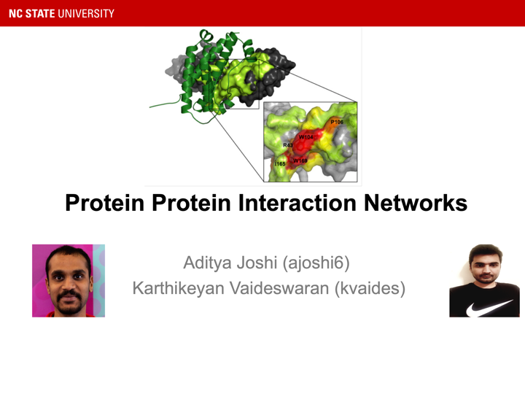

Slide 2
What are proteins??
Large, complex molecules.
Eg. Enzymes, antibodies, 4EP1.
Do not function in isolation.
Mutation in proteins causes diseases.
Interactions can explain molecular basis which can help study prevention, diagnosis and treatment.
Notes:
1. Molecules that perform most of the essential tasks and required for the structure, function, and regulation of the body’s tissues and organs.
3. They interact with one another to perform cellular and metabolic processes.

Slide 3
Protein-Protein Interactions (PPI)
Physical interactions between proteins.
Interactome - totality of all PPIs.
Aberrations might lead to diseases.
Eg. Congenital heart disease, Alzheimer’s
Notes:
1. Electrostatic forces, chemical reactions, covalent bonds, interaction with water.
2. Wrt. cell, organism or subset of any study.

Slide 4
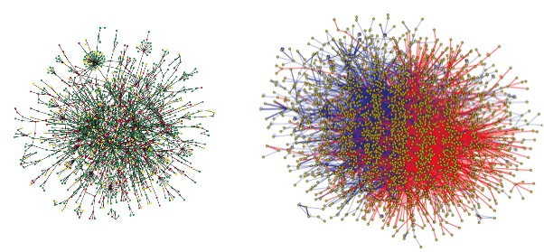
PPI Networks (PPINs)
Mathematical representations of the interactions.
Undirected graph : Nodes represent interacting proteins and Edges represent the interaction.
Experimental identification of PPIs:
Biophysical Methods (X Ray Crystallography)
Automated High Throughput Methods (Y2H-widely used)

Slide 5
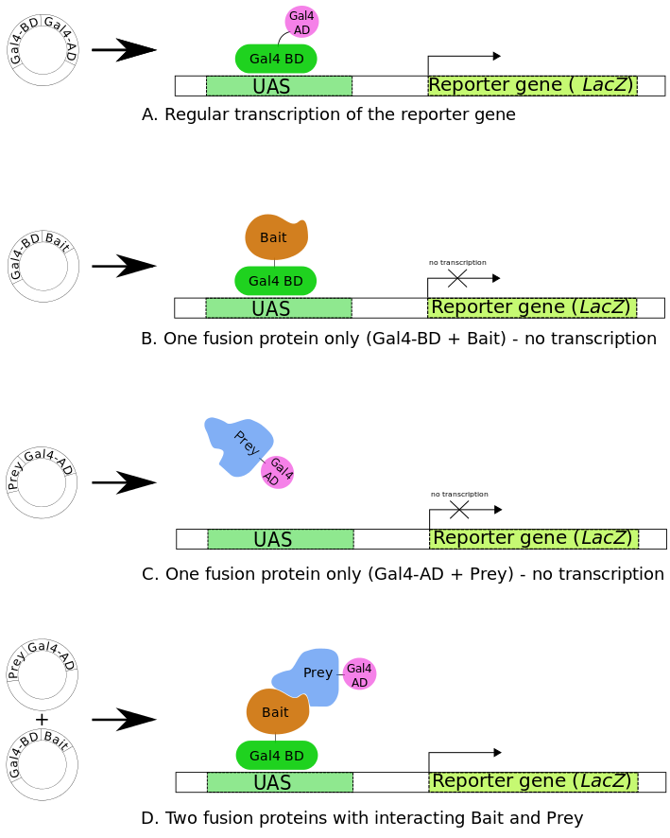
Yeast Two-Hybrid (Y2H)
Binding of transcription factor to an upstream activating sequence leading to activation of downstream reporter gene.
By Anna - Own work, CC BY-SA 3.0, https://commons.wikimedia.org/w/index.php?curid=2890233
Notes:
Transcription factor - Protein controlling rate of transcription of genetic information from DNA to RNA.
Transcription - copying of a particular sequence of DNA to RNA.
Upstream and downstream - relative positioning of genetic code in DNA or RNA.
Upstream Activating Sequence - DNA sequence regulating the transcription rate in neighbouring genes.
Reporter Gene - Gene attached to another regulatory gene under study (eg. bacteria, plants etc.)
Pic -
The Gal4 transcription factor gene produces a two-domain protein (BD and AD) essential for transcription of the reporter gene (LacZ).
The BD is the domain responsible for binding to the UAS and the AD is the domain responsible for the activation of transcription.
When Gal4 interacts with bait and prey separately, there is no activation on the reporter gene (LacZ).
However, when Gal4 interacts with the fusion of bait-prey, there is transcription on Lacz.

Slide 6
Properties of PPINs
Small World Effect
Scale Free Networks
Transitivity

Slide 7
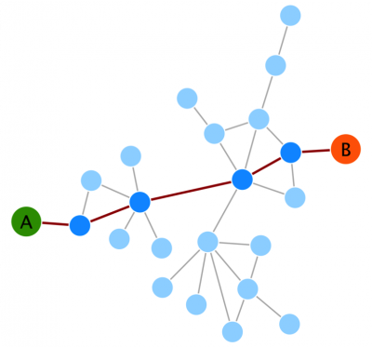
Small World Effect
Protein-protein interaction networks show a small world effect : There is great connectivity between proteins.The network’s diameter is small no matter how big the network is.
Biological consequences :It allows for an efficient and quick flow of signals within the network.
If the network is so tightly connected, why don't perturbations in a single gene or protein have dramatic consequences for the network?
Biological systems are extremely robust to cope with a relatively high amount of perturbations in single genes/proteins. How ? Another important property : Scale Free Network

Slide 8
Scale Free Networks
Protein-protein interaction networks are scale-free networks which means that the majority of nodes (proteins) in these networks have only a few connections to other nodes, whereas some nodes (hubs) are connected to many other nodes in the network (High degree). This property has some major biological implications :
Stability
If failure / infection occur at random, and the vast majority of proteins are those with a small degree of connectivity, hence the likelihood that a hub would be affected is small.
If a hub-failure occurs, the network will generally not lose its connectedness, due to the presence of other hubs.
Vulnerable to targeted attack
If we lose a few major hubs from the network, the network is turned into a set of rather isolated graphs.
Hubs proteins are enriched with essential/lethal genes.Many cancer-linked proteins are hub proteins.

Slide 9
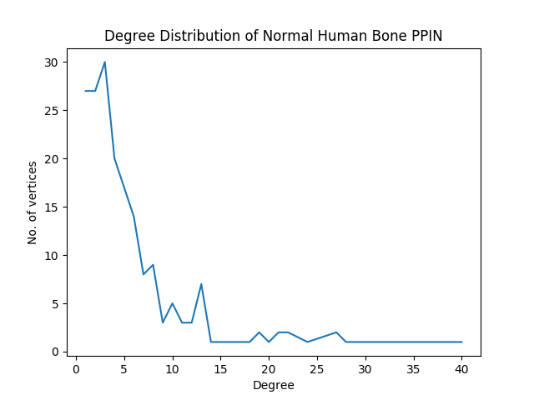
Degree Distribution in PPIN

Slide 10
Transitivity
The transitivity or clustering coefficient of a network is a measure of the tendency of the nodes to cluster together. High transitivity means that the network contains communities or groups of nodes that are densely connected internally. “the friends of my friends are my friends”
In Biology these communities or clusters reflect functional modules and protein complexes
Protein complexes can be considered a type of module in which proteins are interacting with each other in a stable manner

Slide 11
Applications of PPINs
Study Virus Pathogenesis (Epstein-Barr Virus Pathogenesis)
Cancer Detection

Slide 12
EBV Pathogenesis
EBV (Epstein-Barr Virus ) is a member of the herpesvirus family and one of the most common human viruses.(~95 % Adults infected in USA)
We took the dataset of EBV-Human PPI and processed it using Cytoscape for visualization.

Slide 13
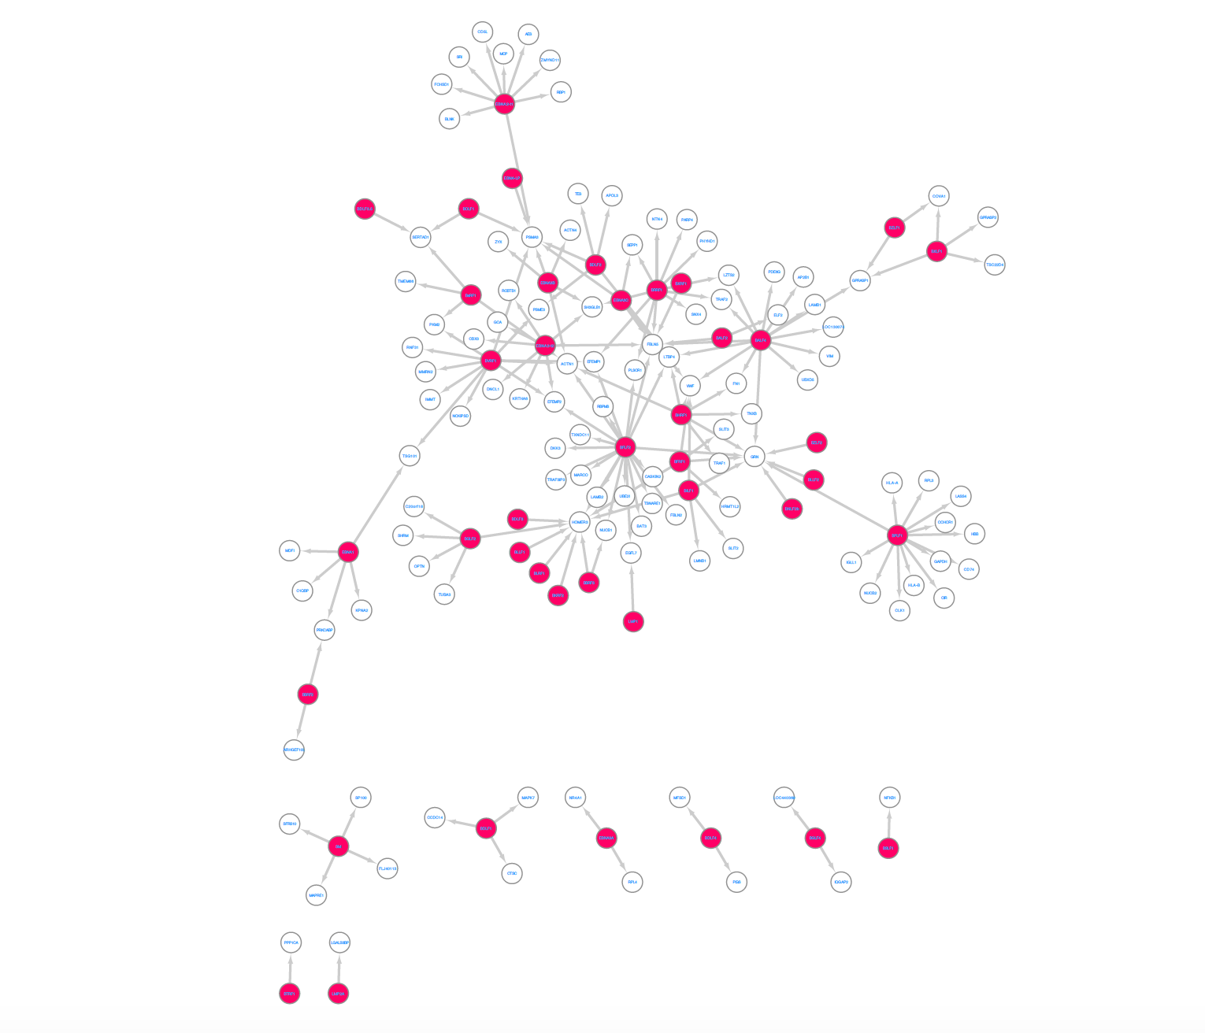
EBV Pathogenesis
*Red Nodes : EBV Proteins

Slide 14
EBV Pathogenesis
There were 112 Human and 40 EBV Unique proteins
Total Edges : 173
24 multi targeted human proteins (interact with >1 EBV)
Multi Targeted human proteins are crucial for Virus Life Cycle metabolism and thus can be used for further analysis.(ET-HPs : EBV Targeted Human Proteins)

Slide 15
EBV Pathogenesis
The average degree of ET-HPs(~15) significantly larger than other human proteins(~6) and thus are hub proteins.
EBV targets ET-HPs as they are key for human metabolism and are highly interconnected to maximize efficiency of biological processes. This choice of proteins is best for virus so that it can hijack host metabolism and use it for its own survival.

Slide 16
Cancer Detection
In cancer genomic mutations result in alteration of PPINs.
Hence study of molecular interactions is beneficial to have an insight on regular and cancerous patterns.
We studied structural differences between normal and cancerous protein interactions in Bone tissue by using various graph theoretical concepts and parameters.

Slide 17
Experiment
Collected raw dataset for proteins found in human bone tissue.
Preprocessed the raw data to identify the interacting proteins in Normal and Cancerous Bone tissues.
Transformed the processed data to construct PPIN graph (using Python)
Computed various graph parameters to figure out the distinguishing factors betwen normal and cancerous bone PPINs

Slide 18
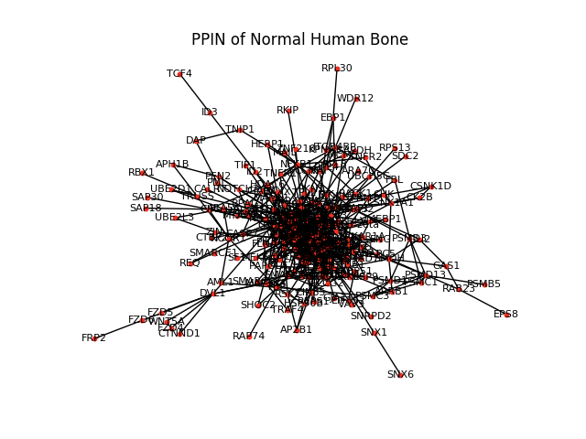
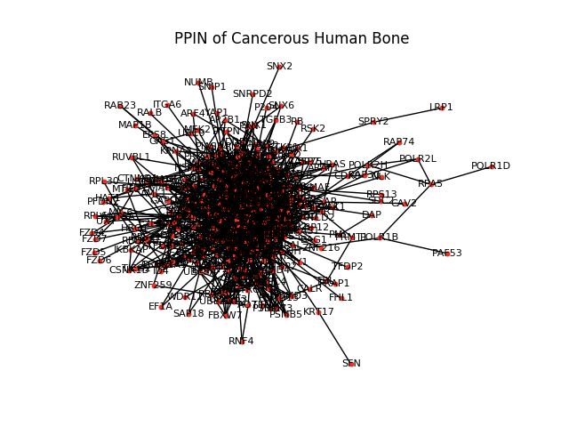
Results

Slide 19
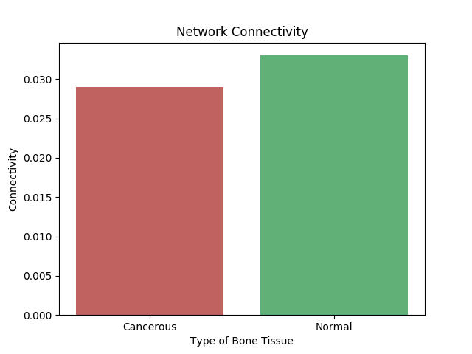
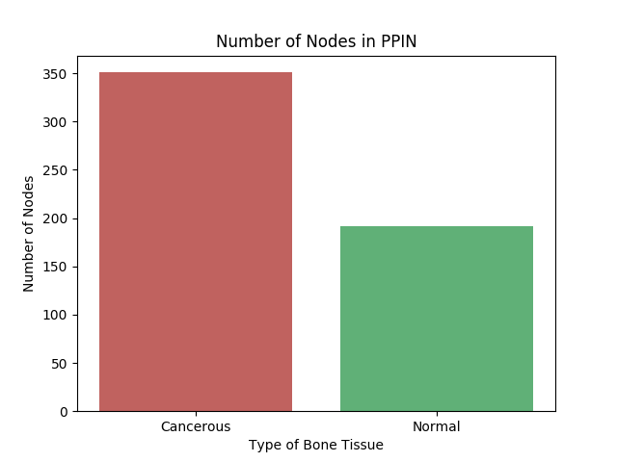
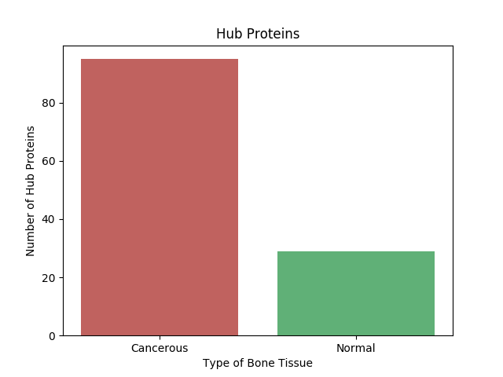


Slide 20
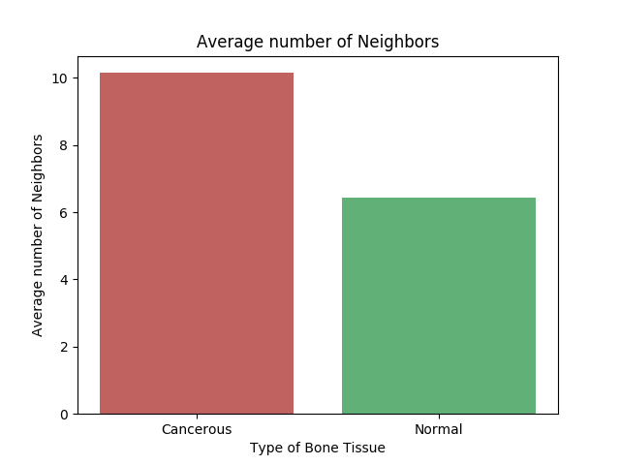
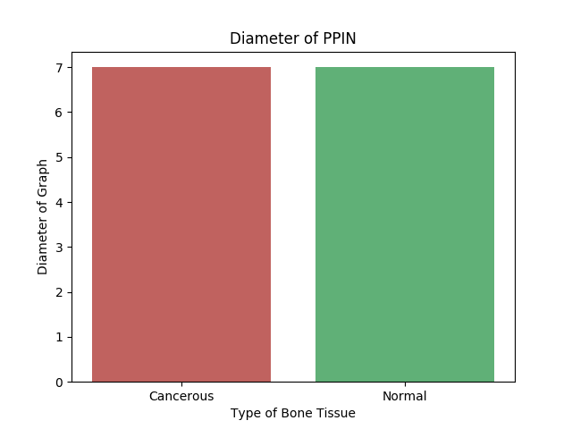
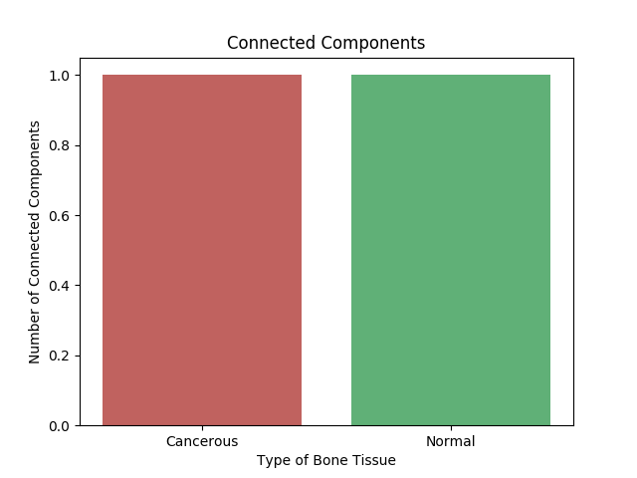
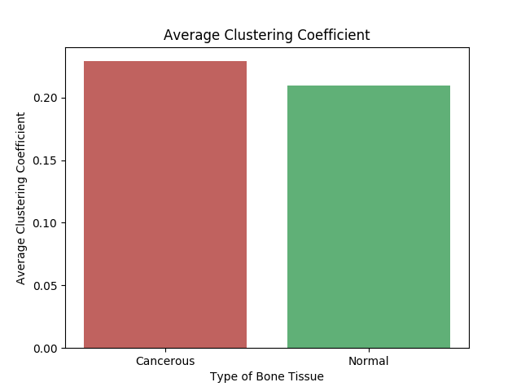

Slide 21
Hub Proteins (Degree Centrality)
Normal Bone | Cancer Bone
SMAD3 - 40 | STAT1 - 66
FYN - 38 | FYN - 63
ERK1 - 32 | SMAD3 -63
HDAC1 - 35 | STAT5B - 50
RELA - 28 | ERK1 - 50

Slide 22
Betweenness Centrality (Key Proteins)
Normal Bone | Cancer Bone
HDAC1 - 0.1426 | SMAD3 - 0.0936
CTNNB1 - 0.1329 | FYN - 0.0703
SMAD3 - 0.1323 | HDAC1 - 0.0630
FYN - 0.1201 | CTNNB1 - 0.0601
ERK1 - 0.0993 | STAT5B - 0.0561

Slide 23
Closeness Centrality (Key Proteins)
Normal Bone | Cancer Bone
4EBP1 - 0.3026 | 4EBP1 - 0.3196
AKT1 - 0.3797 | AKT1 - 0.3954
CCND1 - 0.3827 | CCND1 - 0.3867
14-3-3-zeta - 0.3485 | MAPK14 - 0.4156
CSNK1A1 - 0.3046 | TFDP1 - 0.2829

Slide 24
Conclusion
Cancerous bone’s PPINs are more denser than that of normal bone’s.
Cancerous networks have significantly more edges and more nodes than normal networks. This concurs with the fact that more and more proteins get expressed in cancerous tissues due to genetic mutations and there is a multifold increase in their interactions.
The clustering coefficient was also found higher in cancerous tissues than in normal tissues and so was the average number of neighbours
The high degree proteins(hub) were also significantly higher in cancerous networks. This may be attributed to the growth of cancer tumor where rapid and uncontrollable cell division leads to expression of more proteins which is undesirable.
Therefore these parameters can be used as distinguishing factors for cancerous and normal bone tissues and can be used as a way to detect cancer to some degree
The proteins having higher centrality measures are important from the therapeutic point of view. These proteins lie on signal transduction path and control the information flow.Thus these proteins are important proteins in signalling pathways and can be used as new drug targets for research in advanced cancer treatments

Slide 25
References
Protein-protein interaction networks.
Changes in protein interaction networks between normal and cancer conditions: Total chaos or ordered disorder?
Protein interactions and disease.
Dataset.

