Slide 1
Eventchart_KB
3

Slide 2

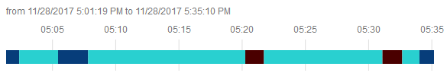
Documentation of Widget – EventChart_KB
Widget Name
Eventchart KB
<Widget Short Description>
Input (ideal)
No additional input for bar chart
One Infotable column which can have up to x different values/categories. (The categorization is done via state formatting, or as different SeriesStyles)
Another column of the infotable can be used as timeline
Widget Intention
The eventchart in Thingworx OOTB can be used with a flag to show data changes.
In the Knorr Bremse Scenario the data changes are not the most important thing, but more the timefrime until the next data change. This functionality is OOTB not available. (in the POC this was achieved creating a lot of events, which was performance critical)
Input (implemented)
Dependencies
The functionality is based on Visavail https://github.com/flrs/visavail
Used Pictures
Example of Output
widget icon
Visualization of shifts
Order-Numbers from SAP
Machine-Status
OK/NOK timeframe of machine
Comments
The x-axis needs to be formated as timestamp

Slide 3
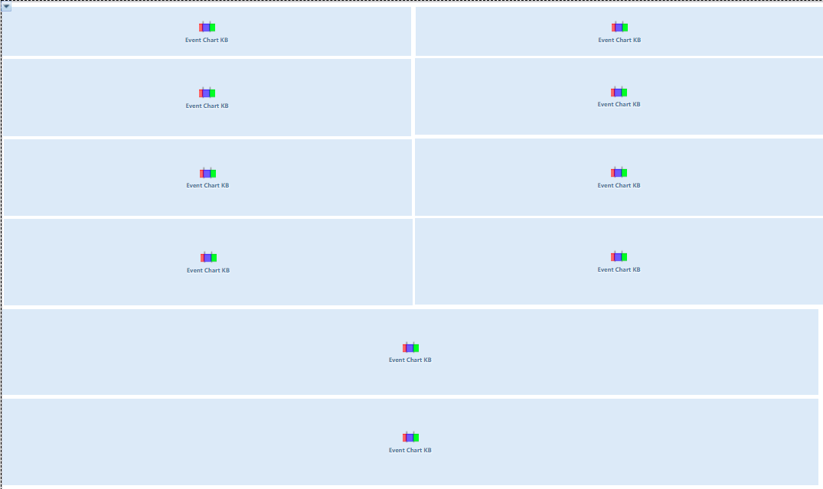
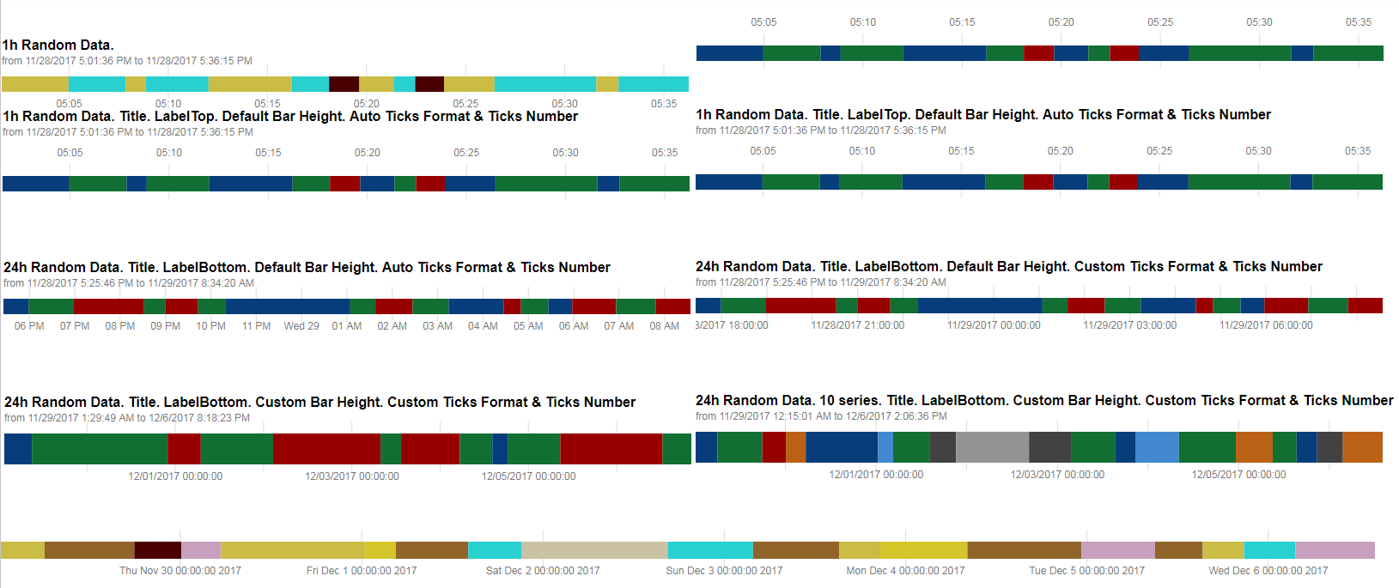
Implementation Example EventChartKB 0.0.104
IDE:
Comments to Version 0.0.114:
By customer:
Chart sollte in der Breite und Höhe Responsive sein
Label-Position lässt sich nur umschalten unten/oben aber nicht komplett abschalten
Information „from xxx to yyyy“ unterhalb der Überschrift lässt sich nicht separat steuern (nur über Überschrift vorhanden oder nicht)
Farben: Wie ich das sehe, kann man keine Fixe Zuordnung der Farben nach Art des Events machen (üblicherweise über State Definition), so ist die Farbverteilung zufällig…
Improvements to next version:
Height cannot be set, but will be calculated based on bar height and title
Label can be set to top, bottom and none
To control Information „from xxx to yyyy“ for now there is a workaround to type „ „ in title to only display this information
State formatting can be used for defined data values e.g. LOW, MEDIUM, HIGH The priority of color picking is:
STATEFORMAT
SeriesStyle1, SeriesStyle2… etc.
DefaultChartStyle (defined in code).
Runtime:

Slide 4
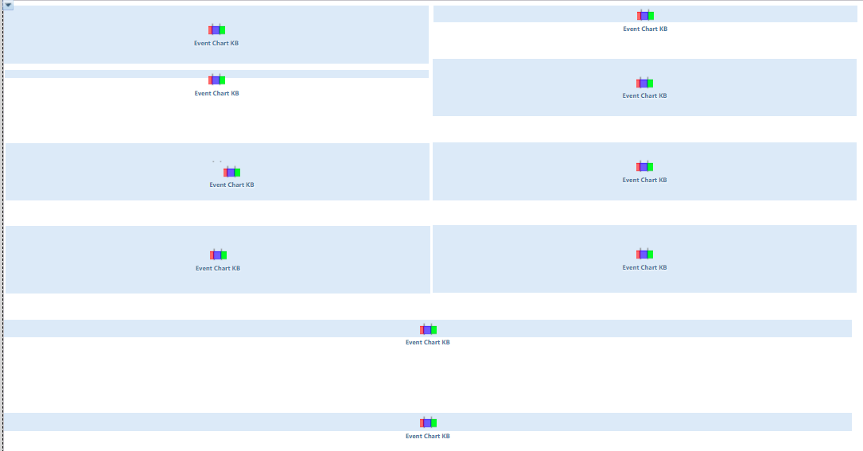
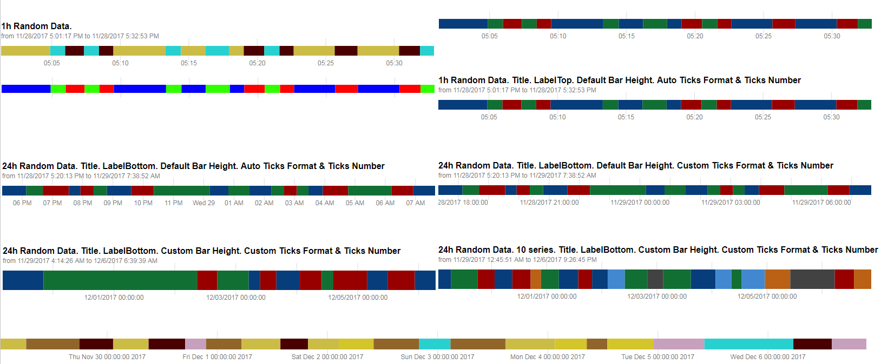
Implementation Example EventChartKB 0.0.114
IDE:
Comments to Version 0.0.114:
Runtime:

