Slide 1
Capstone Project Review
2D Map generating Bot

Slide 2
Members
Racherla Prabhat (12BCE1013)
Aditya Karnam (12BCE1061)
Pratik Kapasi (12BCE1049)

Slide 3
Problem Statement
The vision behind this project is to map an unknown environment into our systems, where physical human access is not feasible.
In day to day life, we can send the bot first into a building where we are not sure of the surroundings. Once the bot does a clean sweep of the entire place we will have a basic 2D layout of the entire place, then we can better decide which paths to take and which to avoid to for possible dangers.

Slide 4
Problem Statement
For example, assume a building is attacked by terrorist, and army people have no knowledge of the blueprint of the building. They don't know where the stairs are, how many rooms are there, what lies behind every door and other such minute details that may be of use to them to evacuate the building, save the hostage or kill the extremists. So they can send this bot surreptitiously, get the blueprint, then plan a rescue operation on the basis of it.
One more place where we can use an advanced version of this bot, that a bot that is capable of giving us 3D map i.e with the help of image processing if we can give generate such maps , then such bots can be used in caves or archaeological sites where we are not sure what we will find inside, is it safe to enter like that.

Slide 5
Working
We will access the robot remotely through ssh and run our scripts over it and control the motion of the bot. The robot consists of ultrasonic sensor, which we will be used to calculate the distance between the robot and the obstacles around it. Further the robot consist of motor driver and motor to facilitate the motion. Last but not the least. We will have GPS which will give us the coordinates of the bot which will in turn be reduced and mapped into real world desktop environment with scaled mapping. Each point will be plotted on regular intervals to get a smooth path of the robot going through the known/unknown areas.

Slide 6
Requirements Analysis
In keeping mind the working of the project our requirements comprises of hardware and software parts. We will be needing a some kind of processor that can transfer the command our code to the hardware.
So after a lot of literature survey we have decided to use Raspberry pi. Every member of our team has 1 1/2 – 2 years of experience in Linux, and since Pi runs Linux(wheezy) we have decided to use it as our processor. Also Pi working temperature ranges from 0 to 70 degree Celsius which adds to our advantages since the bot can be in any environment.

Slide 7
Requirements Analysis
We are using Raspberry Pi Model 2 for our project. Since it runs on a Broadcom 900MHz chipset coupled with 1GB of RAM it gives us enough power to process the multiple hardware components in less time.
We are using Ultrasonic Sensor HC-SR04 Distance Detector which provides 2cm - 400cm non-contact measurement function, the ranging accuracy can reach to 3mm.

Slide 8
Standards Used
IEEE Standard for IoT
We will be using IPv6 based communication with the Raspberry PI in compliance to the IEEE standards and Networking Standards.

Slide 9
Realistic Constraints
Constraints include efficient performance of the bot with low latency and high performance GPS sensing and mapping.
The robot hardware is a low cost product. Since we are using Raspberry PI and rugged plastic for the prototype the cost of building the robot would be less. A realtime cost of the product can be expected around 5000-6000 Rs.
Since the bot will be sent into unknown environments the working temperature might also affect the performance and efficiency. But the working range of Pi generally range from 0 to 70 degrees Celsius it is fair to be used in any environment.

Slide 10
Hardware Requirements
1. Raspberry Pi
2. Robot Chassis.
3. Motors
4. Motor Driver.
5. Wifi Module.
6. Sonar sensor.
7.GPS/IPS
8.Jumper Cables

Slide 11
Software requirements
1. Raspbian OS.(Jessie or Wheezy)
2. Python(2.7 or higher)
3. Text Editor (Sublime Text) for Programming/Debugging

Slide 12
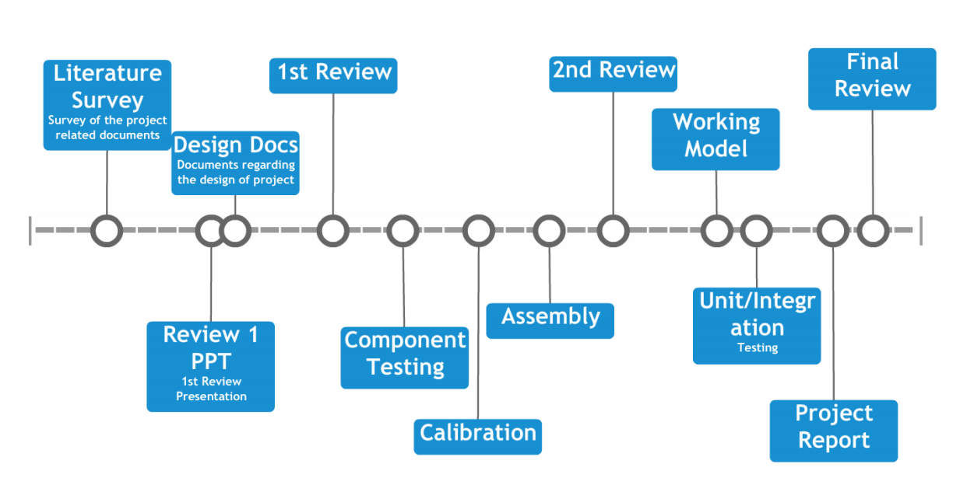
Timeline
Timeline made using : http://www.readwritethink.org/files/resources/interactives/timeline_2/

Slide 13
Literature Survey
1. Enable ipv6 in pi
http://weblog.aklmedia.nl/tag/raspberry-pi/
2. Raspberry PI Camera Module
http://picamera.readthedocs.org/en/release-1.10/
Python library for interfacing Pi camera. It can also record the stream to a file and stream it on a network.
Ref Video:
https://www.youtube.com/watch?v=T8T6S5eFpqE
Blog Post: http://thepihut.com/blogs/raspberry-pi-tutorials/16021420-how-to-install-use-the-raspberry-pi-camera

Slide 14
Literature Survey
3. Localisation of Bot
http://rossum.sourceforge.net/papers/Localization/PosPosterv4.pdf
https://www.diva-portal.org/smash/get/diva2:8964/FULLTEXT01.pdf
http://www.negenborn.net/kal_loc/thesis.pdf

Slide 15
Literature Survey
4. Setup your pi
http://raspberrypi.stackexchange.com/questions/7261/how-to-set-my-raspberry-pi-to-boot-into-the-gui
5. Working with GPS
http://blog.retep.org/2012/06/18/getting-gps-to-work-on-a-raspberry-pi/

Slide 16
Components
Components have been purchased from Potentiallabs.com
Robot Kit : http://potentiallabs.com/cart/buy-raspberry-pi-robotic-kit-online-hyderabad-india?search=Robot%20kit

