Slide 1

Ovarian Cancer Detection
INFO 6105 Group 18
Aditya Kanala
Maruti Rayalacheruvu

Slide 2
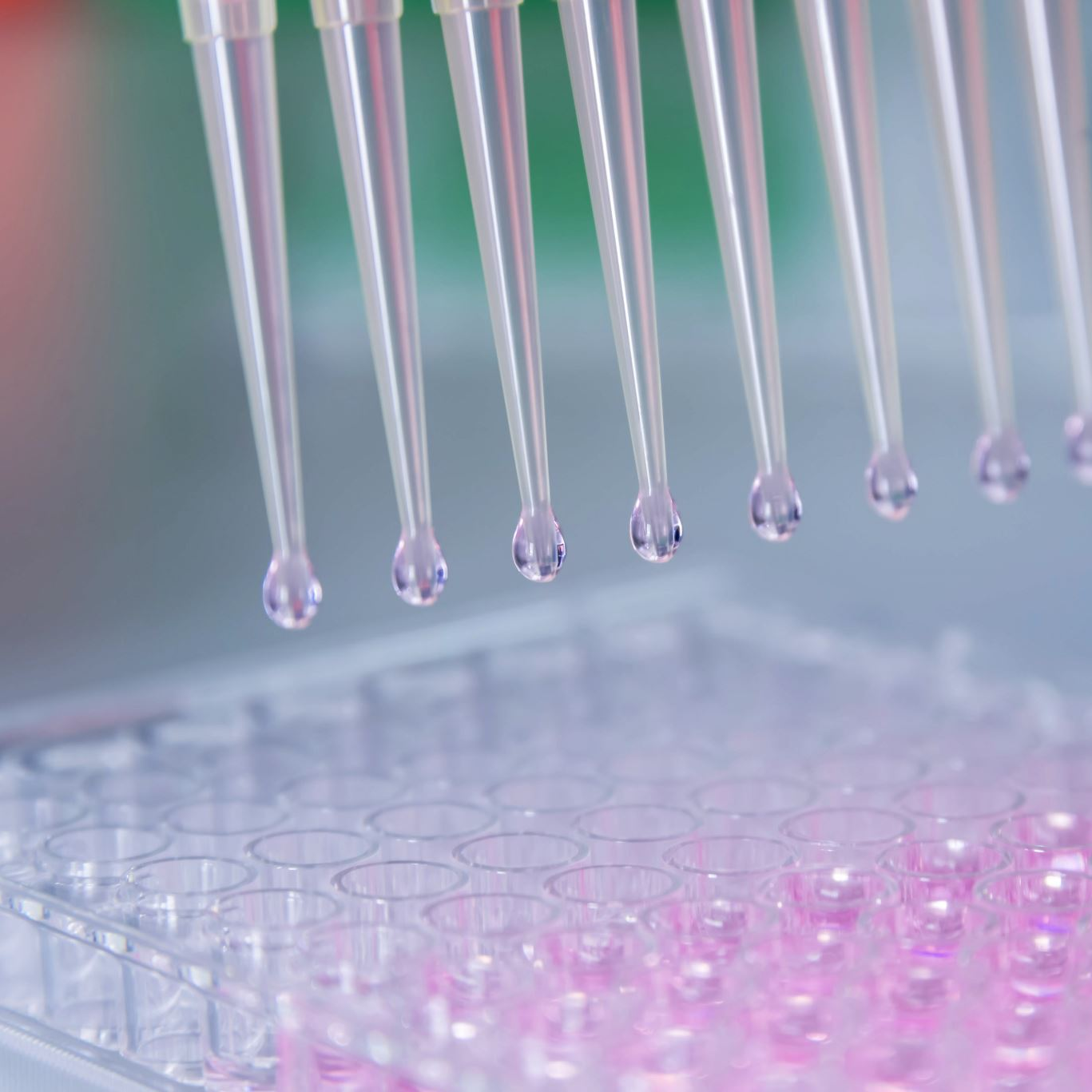
Introduction
Background
As the name suggests, this is a cancer that originates in the ovaries. This form of cancer is challenging to detect in its preliminary stages due to a lack of specific symptoms. As a result, it often goes unnoticed until it reaches an advanced stage
Motivation
Choosing ovarian cancer as a data science project presents a compelling opportunity to make a meaningful impact on healthcare.
Several motivations such as Enhancing Early Detection, Comprehensive Data Exploration, Machine Learning for Detection helped us drive the selection of this project
Goal
The main objective is to develop sophisticated predictive models and data-driven tools capable of accurately detecting the group of ovarian cancer. These models will focus on a comprehensive analysis of gene composition, including nuanced aspects such as gene expression levels and gene nomenclature.

Slide 3

Methodology
The methodology consists of 4 parts
Data Collection
The main objective is to gather relevant datasets essential for the analysis or problem at hand
Exploratory Data Analysis (EDA)
The collected data is analyzed and visualized to gain insights and understand the underlying patterns
Feature Engineering and Preprocessing
It involves transforming or creating new features from the existing ones or handle the existing data to enhance the predictive power of the model.
Model Building and Evaluation
The machine learning models are developed based on the preprocessed dataset by selecting the appropriate algorithms that align with the problem

Slide 4
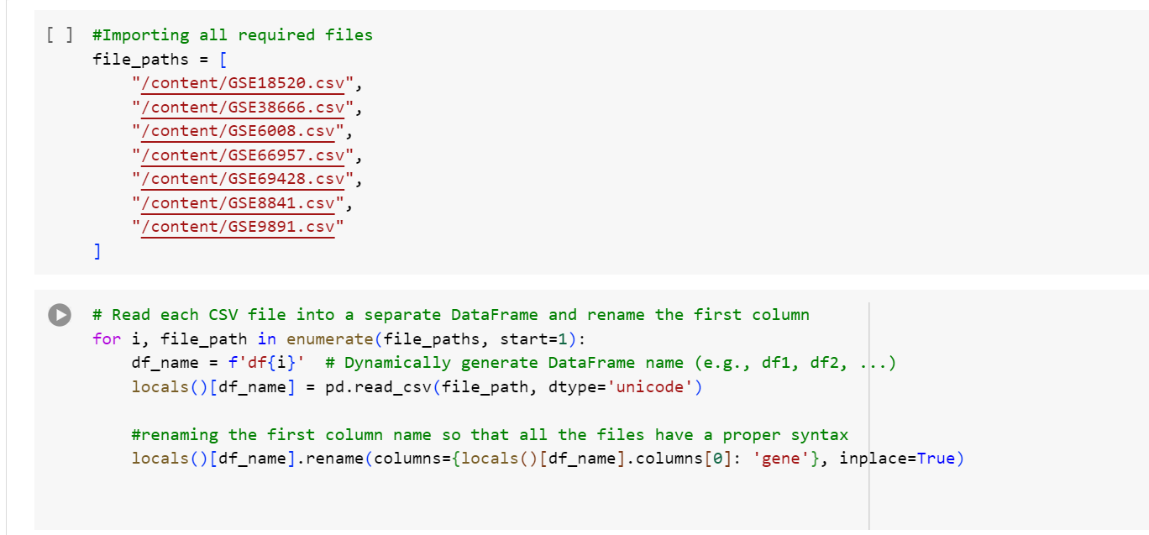
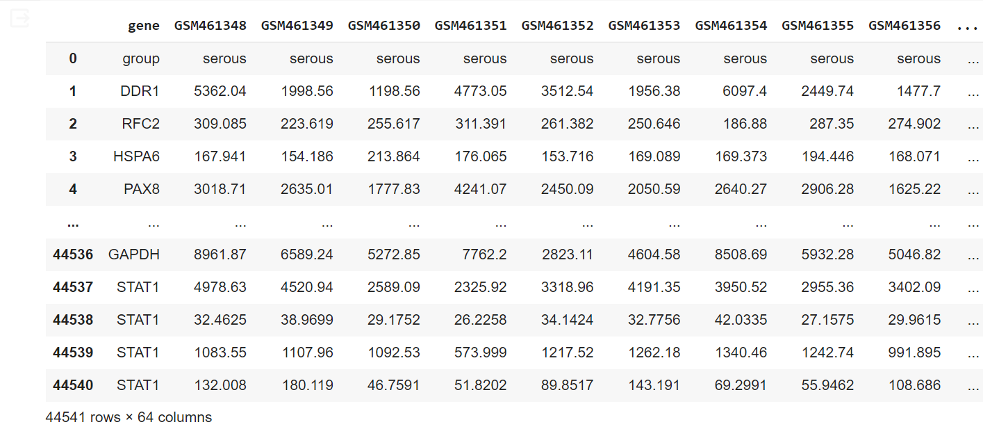
Step 1 – Data Collection
Used the Ovarian Cancer Data from the Kaggle database.
Data Set
Loaded multiple CSV files using pandas
Dynamically named DataFrames for each file, ensuring standardized syntax by renaming the first column to 'gene.'

Slide 5
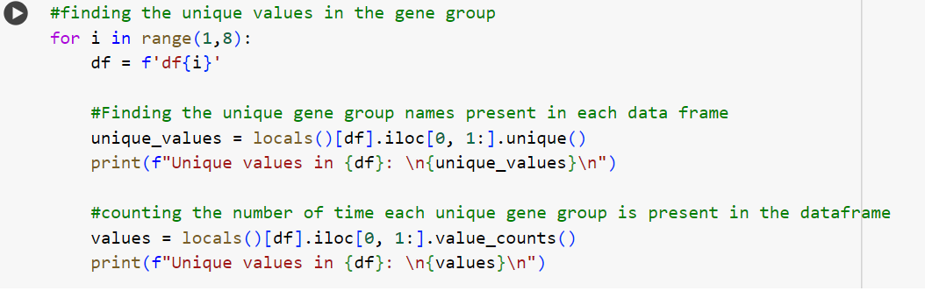

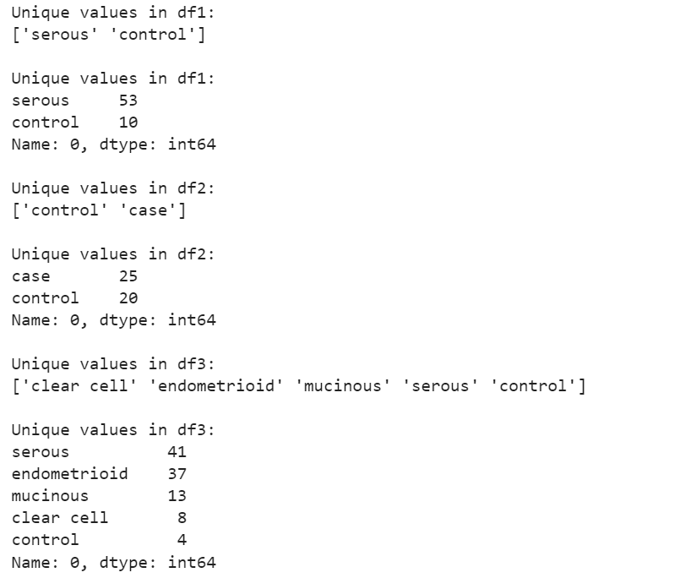
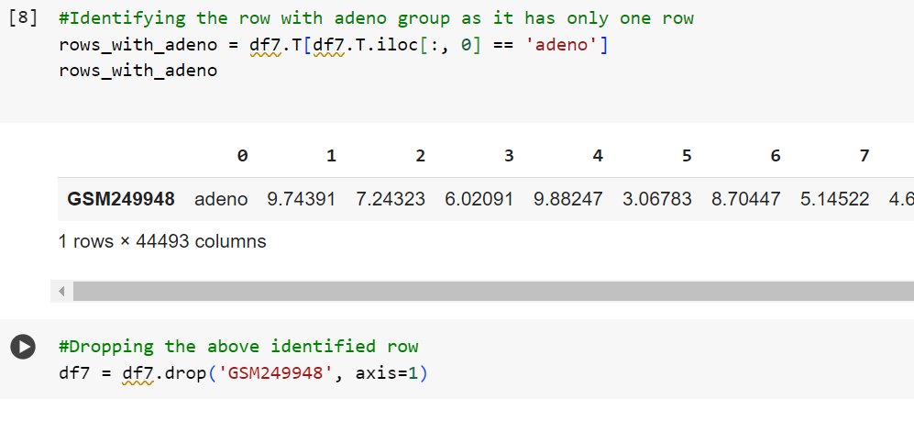
Step 2 – Exploratory Data Analysis (EDA)
Explored unique gene group values in each Data Frame, providing insights into the diversity of gene types
Detected and rectified anomalies ('cler cell' to 'clear cell').
Identified and dropped a row related to the 'adeno' group, ensuring data integrity.

Slide 6
Step 3 – Feature Engineering and Preprocessing
Data Preprocessing
Converted all the categorical data to numerical values
Grouped all the genes with same names for a given gene type and then inner joined all the data frames.
Data Transformation
Transposed data so that the target is in a column rather than a row
Data Visualizations
Plotted multiple visualizations for better understanding of the data
Data Splitting
Split the data into train and test with a test size of 20%
Feature Scaling
Applied Standard Scaling (Z-Score normalization) to the data to ensure all the features contribute equally
Principal Component Analysis (PCA)
Plotted a graph to know the optimal number of dimensions for dimensionality reduction and transformed the data
Oversampling of Imbalanced Data
Addressed imbalanced data using Synthetic Minority Oversampling technique in both the test and train data
Note:
* Each model has been clearly explained in the report for proper understanding *
* The above model headings redirects you to the notebook to specific functionality *

Slide 7

Step 4 – Model Prediction
K – Nearest Neighbours
XGBoost
Decision Tree
Note:
* Each model has been clearly explained in the report for proper understanding *
* The above model headings redirects you to the notebook where the model has been trained *

Slide 8
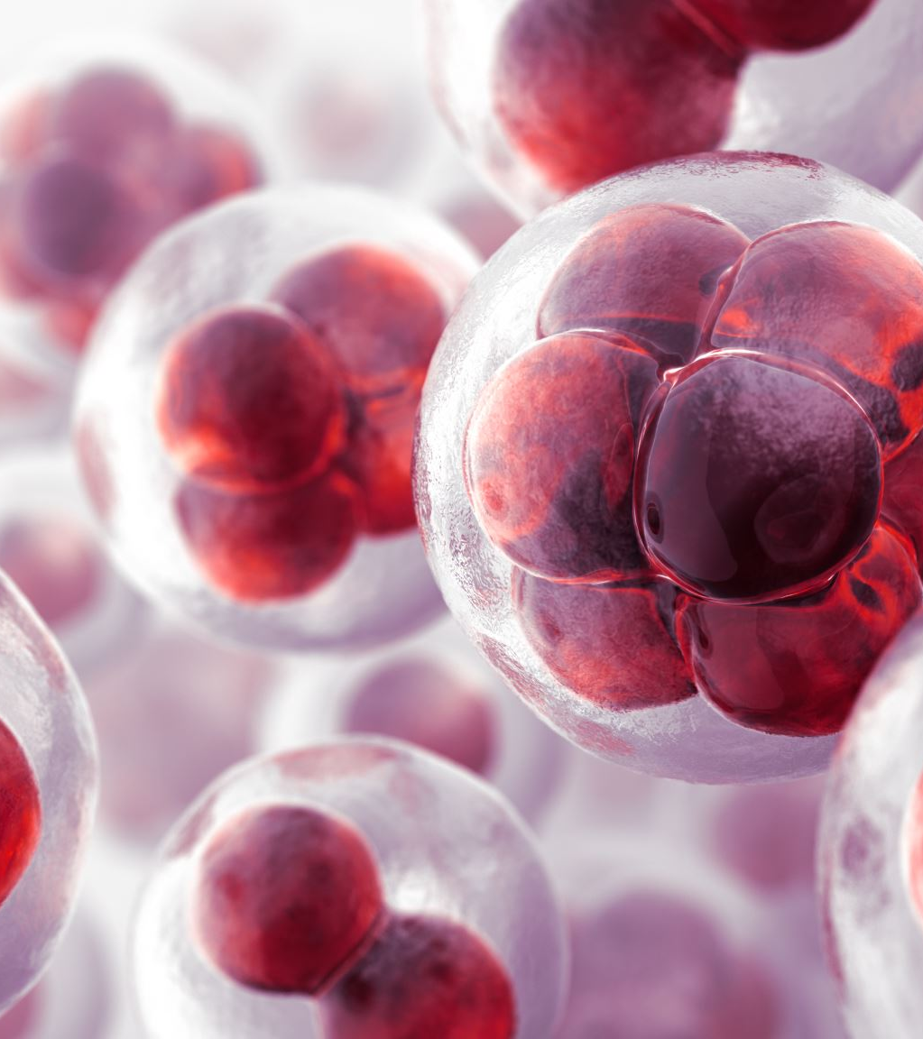
Description of the Dataset
The dataset contains several types of tumors, gene names, tumor groups and expression levels.
Tumors – Represented in Alphanumeric format, GSM-(XXXX). Each GSM entry in the database is a different type of tumor obtained from experiment data.
Gene Names - Alphanumeric symbols or labels used to identify and refer to specific genes
Tumor Groups - Endometrioid, serous, mucinous, and clear cell are different subtypes of epithelial ovarian cancer
Expression Levels - Represent the amount of gene expression (e.g., mRNA levels) in the samples within the group

Slide 9
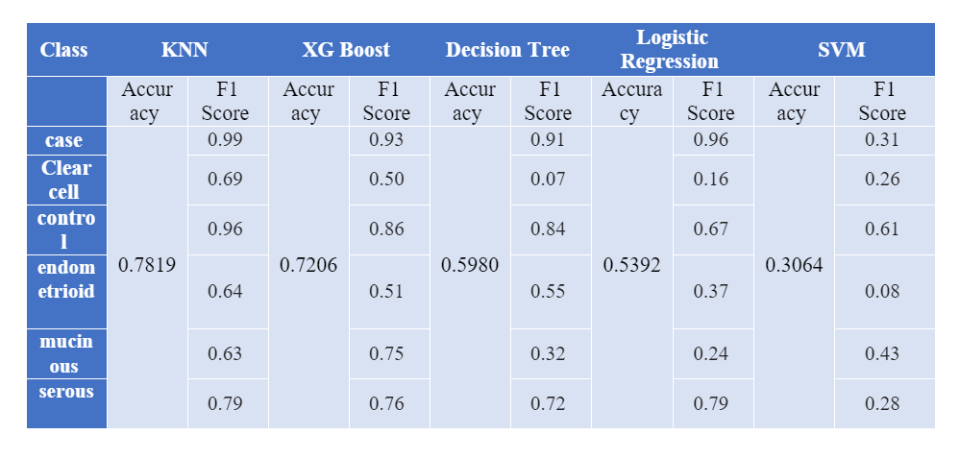
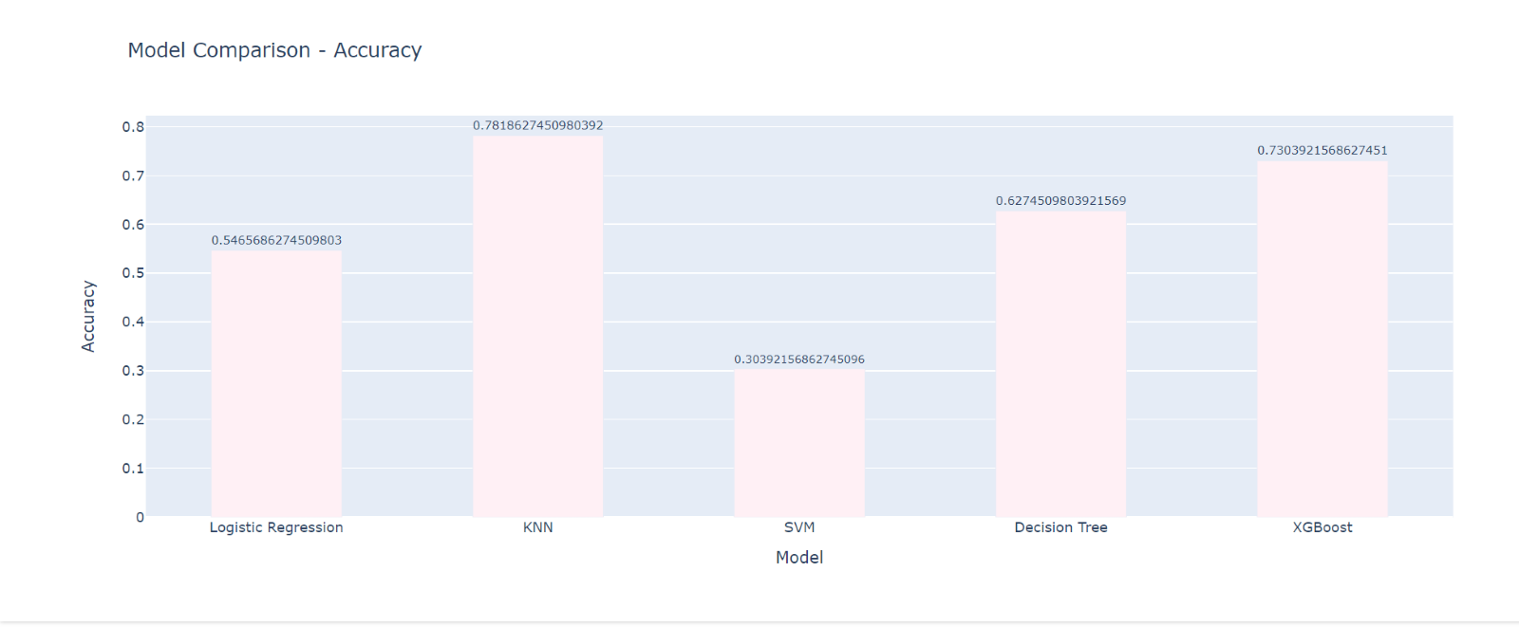
Result and Analysis
Created an interactive bar chart comparing the accuracies and F1 scores of different machine learning models.
We found KNN to be the most optimal algorithm considering the overall test accuracy and the F-1 scores in the classification report

Slide 10
Conclusion
Through this project we got to work on a real - world ovarian cancer data
01
Process, Analyze and Transform the data as per the problem requirement
02
Build predictive models based on the data with good accuracy
03
Compared the models and suggested an optimal algorithm for the problem solution
04

Slide 11
Thank You !!

