Slide 1

Cardiovascular Disease Prediction using ML Techniques
Aditya Karad(18115010)
Aman Tiwari(18115015)
Ritik Mathur(18117083)
Yash K Gandhi(18115124)

Slide 2
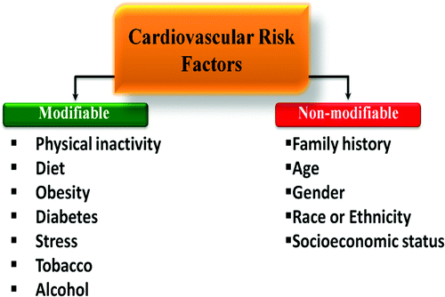
Introduction
CVD is a class of diseases that involve the heart or the blood vessels.
It is the leading cause of death across the globe. About 32% of all the deaths are from CVD.
Upto 90% of CVD can be prevented by improving risk factors.
Hence, it is important to identify people who are at a high risk of getting it.

Slide 3
Aim
Train ML models by using different classification algorithms on dataset.
Logistic Regression
K-Nearest Neighbours
Decision Tree classifier
Find best model for dataset
Correlation Heatmap

Slide 4

Dataset
Clinical Data obtained by Medical Examination of 70,000 Patients
Supervised Learning
X
y
Physical Data
Clinical Data
Habitual Data
Cardio
Id
Age
Gender
Height
Weight
Ap_hi
Ap_lo
Cholesterol Level
Glucose Intake
Smoke Intake
Alcohol Intake
Physical Activeness

Slide 5
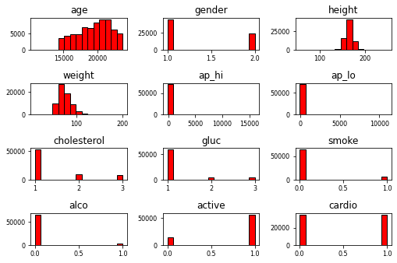
Dataset Attributes & Distribution

Slide 6
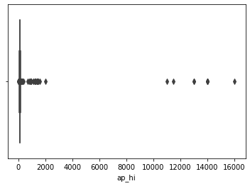
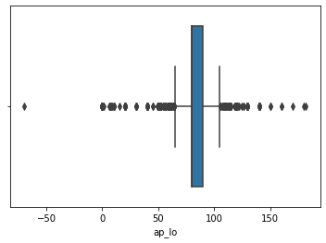
Dataset Preprocessing
Systolic Blood Pressure
Diastolic Blood Pressure
Outlier Removal
70,000 Entries - > 64,500 Entries
Standardization
x - > (x-u) / s

Slide 7
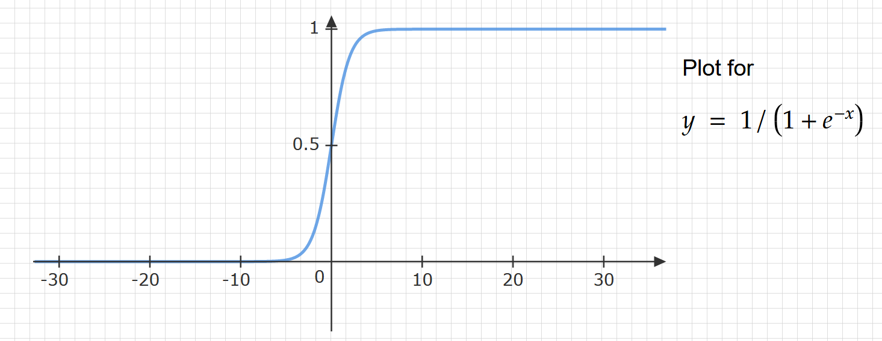
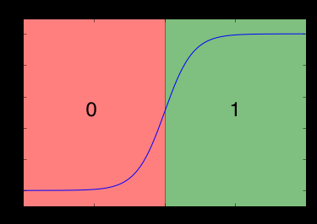
Logistic Regression
Logistic regression is a supervised learning method for classification. In our case, we can use it to classify whether a patient has cardiovascular disease (1 or 0).
Unlike linear regression, logistic regression transforms it’s output using sigmoid function to return a probability value.
The sigmoid function is an S-shaped. x ∈ (-∞, +∞), y ∈ (0,1).
As y ∈ (0,1), we can interpret output as P( ŷ=1 | x).
Setting a threshold helps to classify probabilities into categories.

Slide 8
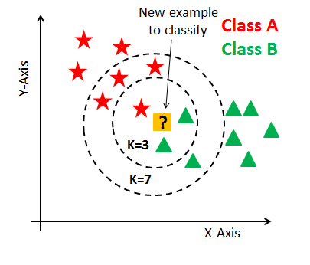
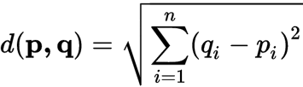
K-Nearest Neighbours
Supervised Algorithm for Classification and Regression
Assumes Similar things exist in Close Proximity
Captures the idea of Similarity

Slide 9
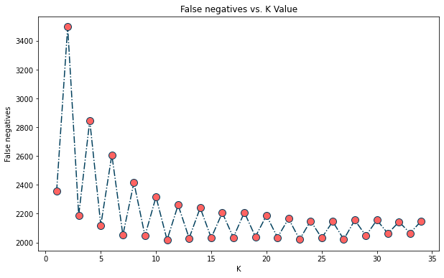
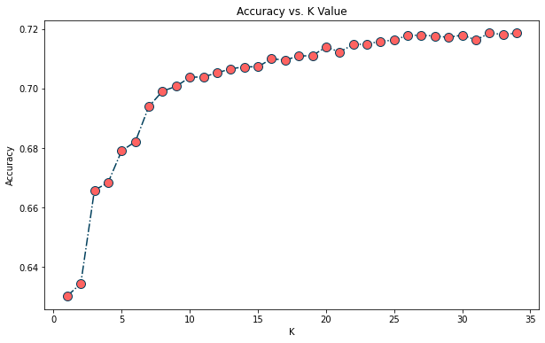
Determining the K-Value
False Negatives VS K Value
Accuracy VS K Value

Slide 10
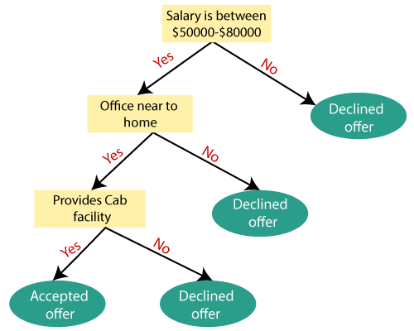

Decision Tree
Supervised learning method for classification and regression
Easily understandable tree-like structure
Mimics human thinking ability while making a decision

Slide 11
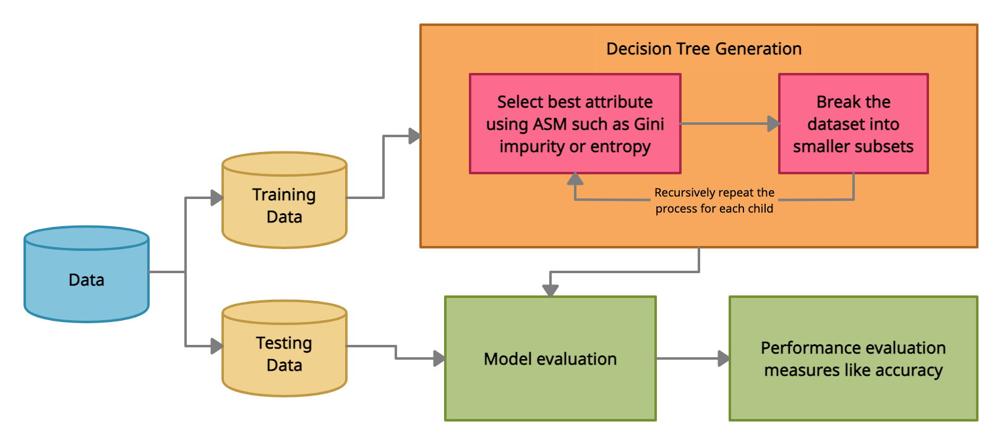
Algorithm

Slide 12
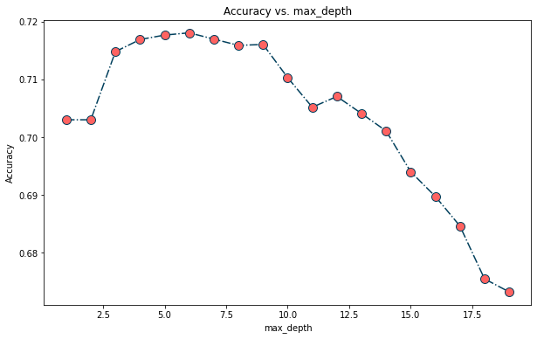
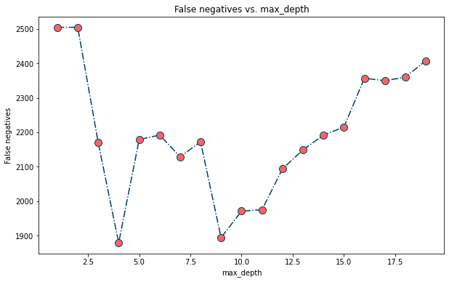
Determining maximum depth
Accuracy vs max_depth
False negatives vs max_depth

Slide 13
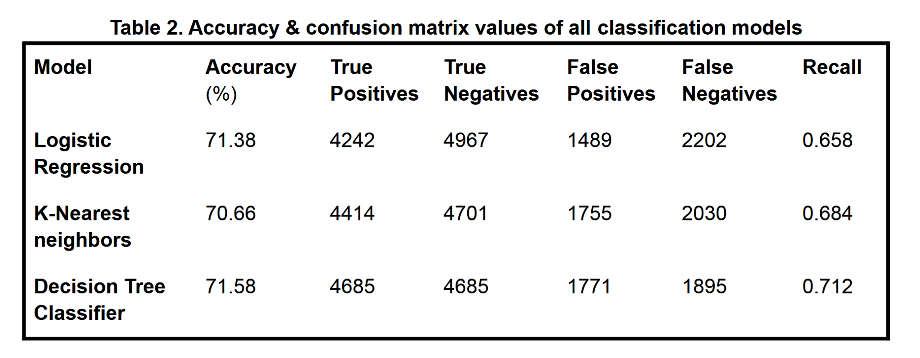
Results and Conclusion
We trained Logistic regression, K-nearest neighbors & decision tree classifier which received similar results in terms of accuracy. In terms of accuracy, Decision tree classifier fit our model the best with an accuracy of ~ 71.6%.
We must minimise false negatives. Why?
For minimising false negatives, Decision tree classifier seems to be the best method for our purpose.

Slide 14
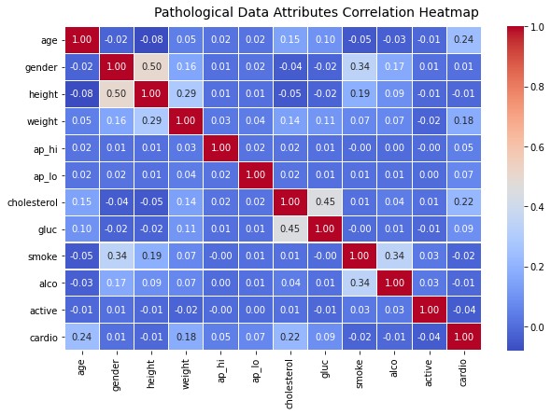
Results and Conclusion
Correlation heat map shows no strong correlation between any of the features with presence of cardiovascular disease.
Upon dropping the least correlated features & running the same model, we observed an small increase in accuracy & a significant increase in false negatives.

Slide 15
Thank you!

