Slide 1

Subquery

Slide 2
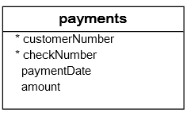
MySQL subquery in WHERE clause
MySQL subquery with comparison operators: You can use comparison operators e.g., =, >, <, etc., to compare a single value returned by the subquery with the expression in the WHERE clause.

Slide 3

Contd...
For example, the following query returns the customer who has the maximum payment.
SELECT customerNumber, checkNumber, amount
FROM payments
WHERE amount = (SELECT MAX(amount)
FROM payments);

Slide 4
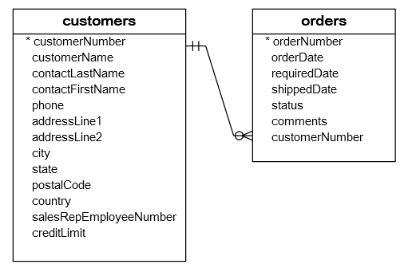
MySQL subquery with IN and NOT IN operators

Slide 5
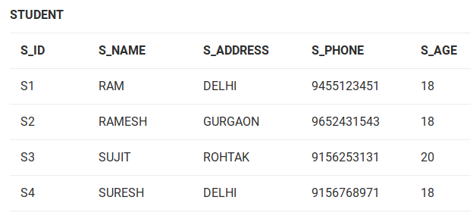
Contd...

Slide 6
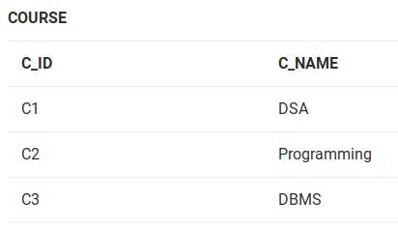

Slide 7
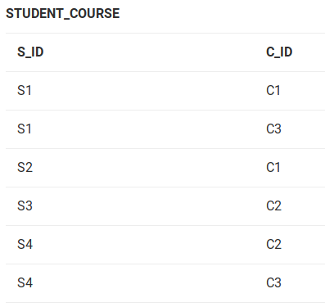

Slide 8
If we want to find out S_ID who are enrolled in C_NAME ‘DSA’ or ‘DBMS’
STEP 1: Finding C_ID for C_NAME =’DSA’ or ‘DBMS’
Select C_ID from COURSE where C_NAME = ‘DSA’ or C_NAME = ‘DBMS’
STEP 2: Using C_ID of step 1 for finding S_ID
Select S_ID from STUDENT_COURSE where C_ID IN
(SELECT C_ID from COURSE where C_NAME = ‘DSA’ or C_NAME=’DBMS’);

Slide 9
Contd..
The inner query will return a set with members C1 and C3 and outer query will return those S_IDs for which C_ID is equal to any member of set (C1 and C3 in this case). So, it will return S1, S2 and S4.

Slide 10
Contd...
If we want to find out names of STUDENTs who have either enrolled in ‘DSA’ or ‘DBMS’, it can be done as:
Select S_NAME from STUDENT where S_ID IN
(Select S_ID from STUDENT_COURSE where C_ID IN
(SELECT C_ID from COURSE where C_NAME=’DSA’ or C_NAME=’DBMS’));

Slide 11
NOT IN
If we want to find out names of STUDENTs who have either enrolled in ‘DSA’ or ‘DBMS’, it can be done as:
Select S_NAME from STUDENT where S_ID IN
(Select S_ID from STUDENT_COURSE where C_ID IN
(SELECT C_ID from COURSE where C_NAME=’DSA’ or C_NAME=’DBMS’));

Slide 12
Contd...
The innermost query will return a set with members C1 and C3. Second inner query will return those S_IDs for which C_ID is equal to any member of set (C1 and C3 in this case) which are S1, S2 and S4. The outermost query will return those S_IDs where S_ID is not a member of set (S1, S2 and S4). So it will return S3.

Slide 13
SUBQUERY IN INSERT CLAUSE
INSERT INTO ace_goldfinger_actors (first_name, last_name)
SELECT first_name, last_name FROM actor a
INNER JOIN film_actor fa ON
a.actor_id = fa.actor_id
WHERE fa.film_id =
(SELECT film_id FROM film
WHERE title = 'Ace Goldfinger');

Slide 14
-- Create a fresh table
DROP TABLE IF EXISTS ace_goldfinger_actors;
CREATE TABLE ace_goldfinger_actors
(first_name VARCHAR(45), last_name VARCHAR(45));

Slide 15
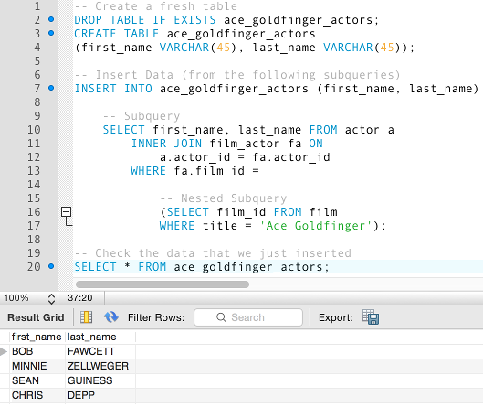

Slide 16
FROM clause
SELECT AVG(a) FROM
(SELECT
customer_id,
SUM(amount) a
FROM payment
GROUP BY customer_id) AS totals;

Slide 17
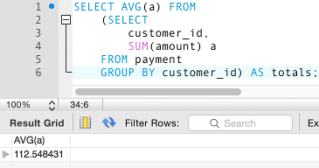
Contd...

Slide 18
Contd...
The above derived table returns the total amount each customer has spent, then the outer query returns the average across all customers.

Slide 19
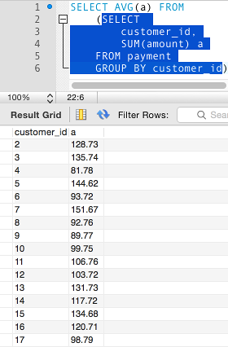

Slide 20
Co-related Nested Queries:
Co-related Nested Queries: In co-related nested queries, the output of inner query depends on the row which is being currently executed in outer query.
e.g.; If we want to find out S_NAME of STUDENTs who are enrolled in C_ID ‘C1’, it can be done with the help of co-related nested query as:
Select S_NAME from STUDENT S where EXISTS
( select * from STUDENT_COURSE SC where S.S_ID=SC.S_ID and SC.C_ID=’C1’);

Slide 21
Contd...
For each row of STUDENT S, it will find the rows from STUDENT_COURSE where S.S_ID = SC.S_ID and SC.C_ID=’C1’. If for a S_ID from STUDENT S, atleast a row exists in STUDENT_COURSE SC with C_ID=’C1’, then inner query will return true and corresponding S_ID will be returned as output.

