Slide 1

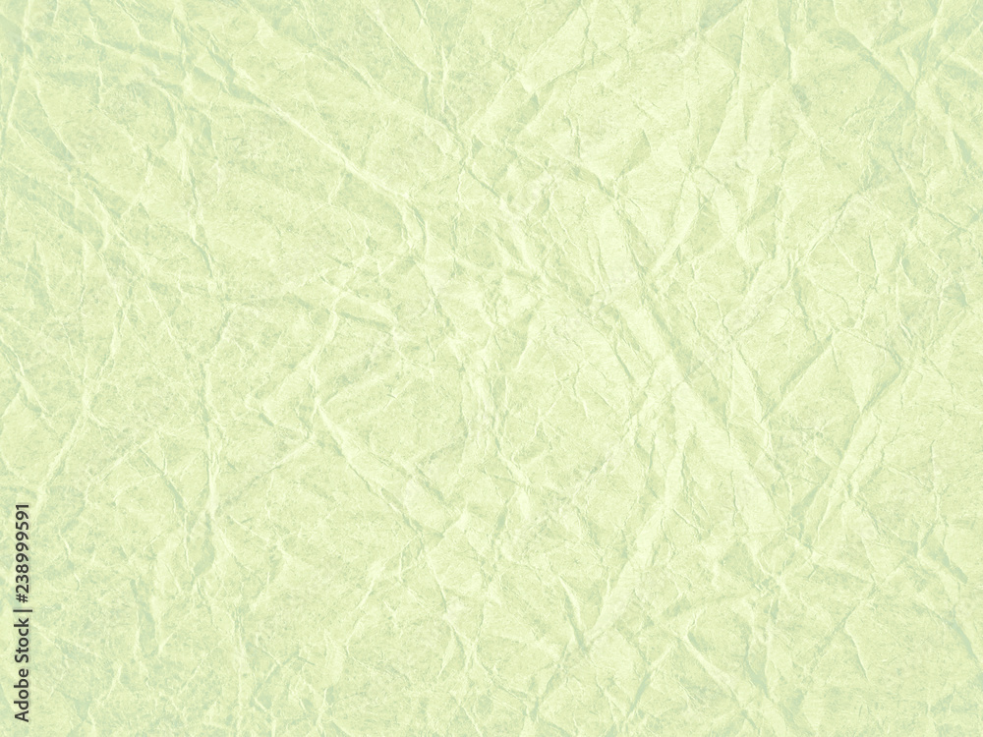



Sprout Square
Seed-paper based eco-friendly stationery & gifting startup
Plant the paper. Grow the memory
INDIA PRE-REVENUE PROTOTYPE STAGE

Slide 2
Sprout Square
Seed-paper based eco-friendly stationery & gifting startup
Plant the paper. Grow the memory
INDIA PRE-REVENUE PROTOTYPE STAGE

Slide 3

The Problem : Traditional Paper = Massive Waste
Single-Use
Culture
Environmental
Impact
Untapped
Demand
Modern consumers crave sustainable options, but current eco-friendly alternatives are often limited, aesthetically unappealing, or prohibitively expensive.
90% of greeting cards & invitations are used once and end up in landfills within days, contributing to an alarming waste cycle.
The paper industry is a major culprit in deforestation, excessive water consumption, and significant carbon emissions.

Slide 4
The Problem : Traditional Paper = Massive Waste
Single-Use
Culture
Environmental
Impact
Untapped
Demand
Modern consumers crave sustainable options, but current eco-friendly alternatives are often limited, aesthetically unappealing, or prohibitively expensive.
90% of greeting cards & invitations are used once and end up in landfills within days, contributing to an alarming waste cycle.
The paper industry is a major culprit in deforestation, excessive water consumption, and significant carbon emissions.

Slide 5




The Opportunity: A Cultural Shift Towards Sustainable Gifting
8-10M
12.6%
Indian Weddings
Eco-Friendly Growth
Annually, fueling a $130B economy ripe for sustainable innovation.
CAGR of the Indian eco-friendly products market, highlighting consumer demand.
$4.02B
$3.8B
Stationery Market
Global Eco-Gift Cards
Projected size by 2030, with a 5.64% CAGR, demonstrating robust growth.
Market projection by 2033, growing at a 12.2% CAGR, indicating a global trend.
Sustainability is no longer optional—it is expected by a growing conscious consumer base.

Slide 6
The Opportunity: A Cultural Shift Towards Sustainable Gifting
8-10M
12.6%
Indian Weddings
Eco-Friendly Growth
Annually, fueling a $130B economy ripe for sustainable innovation.
CAGR of the Indian eco-friendly products market, highlighting consumer demand.
$4.02B
$3.8B
Stationery Market
Global Eco-Gift Cards
Projected size by 2030, with a 5.64% CAGR, demonstrating robust growth.
Market projection by 2033, growing at a 12.2% CAGR, indicating a global trend.
Sustainability is no longer optional—it is expected by a growing conscious consumer base.

Slide 7



Our Solution: SproutSquare — Paper That Turns Into a Plant
SproutSquare transforms ordinary paper into a living legacy. Our seed-embedded products are designed for seamless integration into daily life, offering an eco-conscious alternative that brings joy and new life.
Used Like Normal
Our products function just like traditional stationery, maintaining quality and aesthetic appeal.
Plantable
After use, simply plant the paper in soil, turning what would be waste into growth.
Grows into Life
Watch as beautiful flowers or aromatic herbs sprout, a tangible memory of your eco-friendly choice.
🌱 From waste → living plant

Slide 8
Our Solution: SproutSquare — Paper That Turns Into a Plant
SproutSquare transforms ordinary paper into a living legacy. Our seed-embedded products are designed for seamless integration into daily life, offering an eco-conscious alternative that brings joy and new life.
Used Like Normal
Our products function just like traditional stationery, maintaining quality and aesthetic appeal.
Plantable
After use, simply plant the paper in soil, turning what would be waste into growth.
Grows into Life
Watch as beautiful flowers or aromatic herbs sprout, a tangible memory of your eco-friendly choice.
🌱 From waste → living plant

