Slide 1
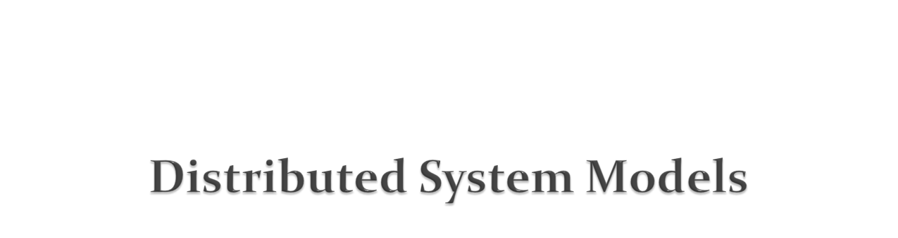
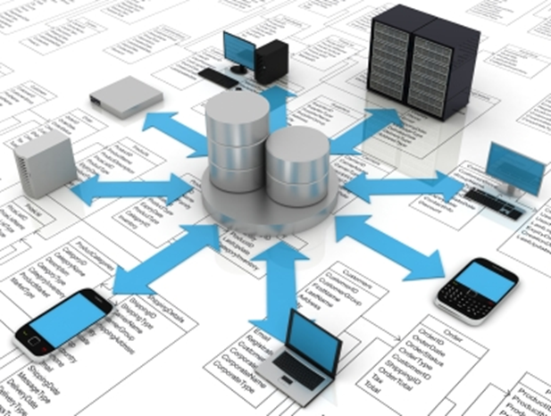
Dr. Sanjay P. Ahuja, Ph.D.
FIS Distinguished Professor of CIS
School of Computing
UNF

Slide 2

An architectural model of a distributed system defines the way in which the components of the system interact with each other and the way in which they are mapped onto an underlying network of computers. E.gs. include the client-server model and the peer process model.
The client-server model can be modified by:
The partition of data or replication at cooperating servers
The caching of data by proxy servers and clients
The use of mobile code and mobile agents. E.g. applets and object serialization
There is no global time in a distributed system so all communication is achieved by message passing. This is subject to delays, failures of various kinds on the networks, and security attacks. These issues are addressed by three models:
The interaction model deals with performance and with the difficulty in setting time limits in a distributed system, for example for message delivery.
The failure model attempts to give precise definitions for the various faults exhibited by processes and networks. It defines reliable communication and correct processes.
The security model discusses possible threats to processes and networks.

Slide 3

The security of a distributed system can be achieved by securing the processes and the channels used for their interactions and by protecting the objects (e.g. web pages, databases etc) that they encapsulate against unauthorized access.
Protecting objects: Some objects may hold a user’s private data, such as their mailbox, and other objects may hold shared data such as web pages. Access rights are used to specify who is allowed to perform which kind of operations (e.g. read/write/execute) on the object.
Threats to processes (like server or client processes) include not being able to reliably determine the identity of the sender.
Threats to communication channels include copying, altering, or injecting messages as they traverse the network and its routers. This presents a threat to the privacy and integrity of information. Another form of attack is saving copies of the message and to replay it at a later time, making it possible to reuse the message over and over again (e.g. remove a sum from a bank account).
Encryption of messages and authentication using digital signatures is used to defeat security threats.
Notes:
Other threats include denial of service where excessive number of frivolous requests are made thus overloading the server effectively rendering it unusable.
Also need to protect against mobile code (e.g. Java applets).

Slide 4
Widely varying modes of use: The system components are subject to wide variations in workload (e.g. some web pages have millions of hits a day and some may have no hits). Some applications have special requirements for high communication bandwidth and low latency (e..g multimedia apps).
Wide range of system environments: A distributed system must accommodate heterogeneous hardware, operating systems, and networks (e.g. wireless networks operate at a fraction of the capacity and much higher error rates than present day LANs).
Internal problems: Non-synchronized clocks, concurrency problems, many modes of hardware and software failures involving the individual components of the system.
External threats: Attacks on data integrity, ensuring confidentiality, denial of service.

Slide 5

The overall goal of any system architecture is to ensure that it will meet present and likely future demands on it. Major concerns include making the system reliable, manageable, adaptable, and cost-effective.
An architectural model for a distributed system:
a) simplifies and abstracts the functionality into individual components
b) decides on the placement of these individual components across a network of computers (distribution of data and workload).
c) considers the interrelationships between these components, i.e. their functional roles and communication patterns between them.
E.g. classifying processes as client or server processes thus identifying the responsibilities of each and assessing their workloads, determining the impact of their failures, and the placement of these processes such that the reliability and performance goals are met.
Variations of client-server systems include:
a) Moving code from one process to another (e.g. client downloading an applet from a server).
b) Enabling computers and other mobile devices to be added or removed seamlessly, allowing them to discover the available services and to offer services to others (e.g Jini).

Slide 6

Applications
Middleware
Operating System Platform
Computer and network hardware
Platform The hardware and the O/S. E.g.s Intel x86/Windows, Sun SPARC/Solaris, Intel x86/Linux etc.
Middleware Purpose is to mask heterogeneity and provide a convenient API to application developers. It raises the level of abstraction, for e.g. it may provide a mechanism for remote method invocation thereby reducing/eliminating network protocol details.
Sun RPC was among the earliest middleware. Object oriented middleware include RMI from Sun, CORBA from OMG, and Microsoft’s Distributed Common Object Model (DCOM).
CORBA provides services such as naming, security, transactions, persistent storage and event notification.

Slide 7

The Client-Server Model
‘
request
Client
reply Server
In a typical application, the server is concurrent and can handle several clients simultaneously.
Servers may in turn be clients of other servers. For e.g. a web browser (client) may contact a web server, which invokes a servlet that communicates with a database server (may be Oracle or an LDAP server). Another example may be a client that communicates with an application server (BEA’s WebLogic or IBM’s WebSphere) which communicates with a database server.
Services provided by multiple servers
Services may be implemented as several server processes in separate host computers interacting as necessary to provide a service to client processes. The data on which the service is based may be partitioned among the servers or each server may maintain replicated copies of the data.
E.g. the web is an example of partitioned data where each web server manages its own set of web pages.
Replication is used to increase performance and reliability and to improve fault-tolerance. It provides multiple consistent copies of data on different servers. E.g the web service provided at altavista.digital.com is mapped onto several servers that have the database replicated in memory.

Slide 8

Proxy servers and caches
Web browsers maintain a cache of recently visited web pages and other web resources in the client’s local file system , using a special HTTP request to check with the original server that the cached pages are up to date before displaying them.
Web proxy servers provide a shared cache of web resources for the client machines at a site or across several sites. The purpose of the proxy server is to increase availability of the service by reducing the load on the WAN and web servers.
Client Web Server
Proxy Server
Client Web Server
Peer Processes
All processes play similar roles, have similar application and communication code, interacting cooperatively as peers to perform a distributed activity or computation with no distinction between clients and servers. This can reduce IPC delays.
E.g. in a whiteboard application that allows several computers to view and interactively modify a picture that is shared between them, each peer process can use middleware to perform event notification and group communication to notify all the other application processes of changes to the picture. This would provide better interactive response than a server-based architecture where the server would be responsible for broadcasting all updates.

Slide 9

Mobile code
Applets are an example of mobile code. In this case, once the downloaded applet runs locally on the client side/web browser it gives better interactive response since network access is subsequently avoided.
Pull versus the push model: Most interactions with the web server are initiated by the client to access data. This is the pull model. However for some applications this may not work.
E.g. a stock broker’s application where the customer needs to be kept informed of any changes in the share prices as they occur at the information source on the server side. In this case we need additional software (may be a special applet) that receives updates from the server. This is the push model. The applet would then display the new prices to the user and maybe perform automatic buy/sell operations triggered by conditions set up by the customer and stored locally in the customer’s computer.
Mobile agents
A mobile agent is a running program (including both code and data) that travels from one computer to another in a network carrying out a task on someone’s behalf (such as collecting information), eventually returning with the results. Such an agent may, for example, access the local database.
Advantage over a static client making remote method calls on a server, possibly transferring large amounts of data is a reduction in communication cost and time through replacing remote calls with local ones.
Disadvantage is that mobile agents (like mobile code) are a potential security threat to the resources of the computer they visit. Need to verify the identity of the user on whose behalf the mobile code is acting (digital signatures) and then provide access (limited or full). The applicability of mobile agents may be limited.
Notes:
Mobile agents: for e.g web crawlers that need to access resources at web servers throughout the Internet work quite successfully by making remote method calls to server processes.
Also need to take into account the cost of serializing an object (code + data) that forms the mobile agent and sending it over the network. If many remote calls need to be made (many accesses to a database at a server site) then it may be productive to send a mobile agent instead but not otherwise.

Slide 10
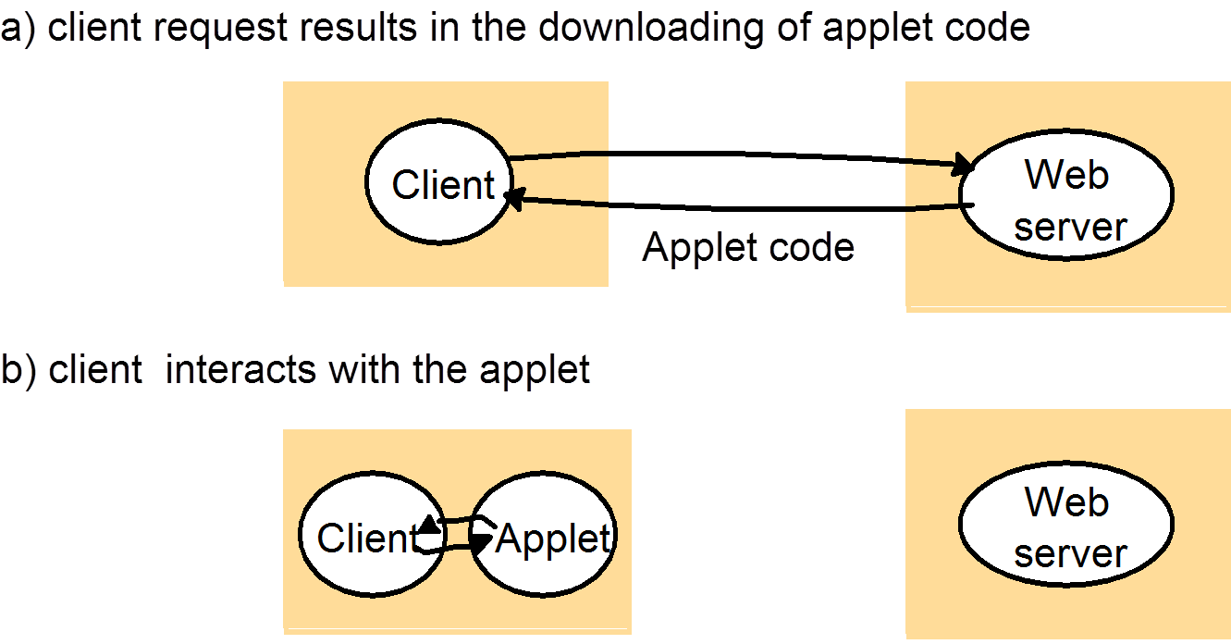

Slide 11

Network Computers
Eliminate the need for storing the operating system and application software on desktop PCs and instead download these from a remote file server. Applications are run locally but the files are managed by a remote file server. Since all the application data and code is stored by a file server, users may migrate from one network computer to another. The processor and memory capacities of a network computer can be constrained in order to reduce its cost. If a disk is provided, it holds only a minimum of software. The remainder of the disk is used as cache storage holding copies of software and data files recently downloaded from servers.
The falling PC prices have probably rendered the network computer a non-starter.
Thin clients
Thin client refers to a layer of software that supports a window-based GUI on the local computer while executing application programs on a remote computer. This architecture has the same low management and hardware costs as the network computer, but instead of downloading application code into the user’s computer, it runs them on a compute server - a powerful computer (typically a multiprocessor or a cluster computer) that has the processing power to run several applications concurrently.
Drawback: Highly interactive graphical apps like CAD and image processing will incur both network and operating system latencies.
E.g is the Citrix WinFrame product that provides a thin client process providing access to apps running in Win NT hosts.
Notes:
The maintenance of the disk cache requires no effort; cached objects are invalidated whenever a new version of the file is written at the relevant server.

Slide 12
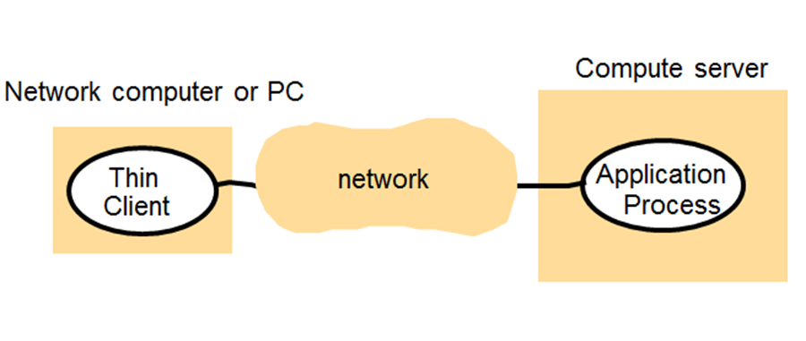
Notes:
The maintenance of the disk cache requires no effort; cached objects are invalidated whenever a new version of the file is written at the relevant server.

Slide 13
Performance Issues
Responsiveness: Interactive apps require a fast and consistent response. The speed at which the response is obtained is determined not just by the server and network load and performance, but also by the delays in all the software components involved, i.e, the operating system, the middleware services (such as remote method invocation support like naming) and the application code itself providing the service.
Systems must be composed of relatively few software layers and amount of data transferred must be small. In cases where a large amount of data needs to be transferred from the database for example, performance will be better when the large amount of data is transferred over one database connection rather than connecting several times and each time transferring a portion of the data.
Throughput: This is the rate at which computational work is done (number of users serviced per second) and is affected by the processing speeds and at clients and servers and by data transfer rates.
Balancing computational loads: On heavily loaded servers it is necessary to use several servers to host a single service and to offload work (e.g. an applet in the case of a web server) to the client where feasible.
For e.g. on heavily loaded web service (search engines, large commercial sites) you can have several web servers running on the same domain name in the background and rely on the DNS lookup service to return one of several host addresses (select one of the web servers) for a single domain name.

Slide 14
Quality of Service
Once users have the functionality they need from a service, the next factor is the quality of the service being provided. This depends on the following non-functional properties of the system: reliability, security, performance, and adaptability (or extensibility) to meet changing system requirements.
The performance aspect of QoS was traditionally defined in terms of responsiveness and computational throughput, but for applications handling time-critical data, performance has been redefined in terms of the ability to meet timeliness guarantees. In many cases, QoS refers to the ability of the system to meet such deadlines. Its achievement depends upon the availability of the necessary computing and network resources at the appropriate times. This includes being able to reserve critical resources.
Notes:
Time-critical data: data streams that are required to be processed or transferred from one process to another at a fixed rate. E.g. displaying successive video frames of a movie that is being retrieved from a video server to a client within some specified time limit.

Slide 15
Use of caching and replication
Systems often overcome performance problems by using data replication and caching. An example is the web-caching protocol used by HTTP to keep caches consistent.
Web-caching protocol
Both browsers and proxy servers cache responses to client requests from the web servers. Thus a client request may be satisfied by either a response cached by the browser or a by a proxy server between the client and the web server. The cache consistency protocol needs to ensure that the browsers with fresh (or reasonably fresh) copies of the resource held by the web server. The protocol works as follows.
A browser does not validate a cached response with the web server to see whether the cached copy is still up-to-date if the cached copy is sufficiently fresh. Even though the web server knows when a resource is updated, it does not notify the browsers and proxies with caches – to do that the web server would need to keep state (i.e. a record of interested browsers and proxies and HTTP is a stateless protocol). To enable browsers and proxies to determine whether their stored responses are stale, web servers respond to a request by attaching the expiry time of the resource and the current time at the server to the response.
Browsers and proxies store the expiry time and server time together with the cached response. This enables a browser or a proxy to calculate whether a cached response is likely to be stale. It does so by comparing the age of the response with the expiry time. The age of a response is the sum of the time the response has been cached and the server time. This calculation does not depend on the computer clocks on the web server and browsers or proxies agreeing with each other. If the response is stale, the browser validates the cached response with the web server. If it fails the test, the web server returns the a fresh response, which is cached instead of the stale response.

Slide 16
Dependability Issues
Dependability is a requirement in not only mission critical applications (e.g. command and control activities like air-traffic control systems) but also in e-commerce applications where the financial safety of the participants is involved. Dependability of computer systems is defined as correctness, security, and fault-tolerance.
Fault tolerance
Dependable applications should continue to function correctly in the presence of faults in hardware, software, and networks. Reliability is achieved through redundancy. Redundancy is expensive and there are limits to the extent to which it can be employed; hence there are also limits to the degree of fault tolerance that can be achieved.
At the architectural level, redundancy requires the use of multiple computers at which each process of the system can run and multiple communication paths through which messages can be transmitted. Data and processes can then be replicated wherever needed to provide the required level of fault tolerance. A common form of redundancy is having several replicas of a data item at different computers (e.g. replicating both an application server and the associated database server) so that as long as one of the computers is still running, the data item can be accessed. Of course, replicating data involves incurring the cost of keeping the multiple replicas up to date.
Security
Need to deal with attacks on data integrity, ensuring confidentiality, denial of service.

Slide 17
A model of a system determines the main entities of the system and describes how they interact with each other. The purpose of a model is to make explicit all the underlying assumptions about the system being modeled.
There are three kinds of models used to describe distributed systems:
The Interaction Model,
The Failure Model, and
The Security Model
The Interaction Model
Processes in a distributed system (e.g. client-side and server-side processes) interact with each other by passing messages, resulting in communication (message passing) and coordination (synchronization and ordering of activities) between processes. Each process has its own state. There are two significant factors affecting process interaction in distributed systems:
1) Communication performance is often a limiting characteristic;
2) there is no single global notion of time since clocks on different computers tend to drift.
Notes:
Process state: set of data that it can access and update, including program variables. The process state is private.

Slide 18

Performance of communication channels
Communication over a computer network has the following performance characteristics relating to latency, bandwidth and jitter:
The delay between the sending of a message by one process and its receipt by another is referred to as latency. The latency includes the propagation delay through the media, the frame/message transmission time, and time taken by the operating system communication services (e.g. TCP/IP stack) at both the sending and receiving processes, which varies according to the current load on the operating system.
The bandwidth of a computer network is the total amount of information that can be transmitted over it in a given time.
Jitter is the variation in the time taken to deliver a series of messages. This is relevant to real-time and multimedia traffic.
Two variants of the Interaction model are the Synchronous distributed system and the Asynchronous distributed system models.
Synchronous distributed systems are defined to be systems in which: the time to execute each step of a process has a known lower and upper bound; each transmitted message is received within a known bounded time; each process has a local clock whose drift rate from real time has a known bound. It is difficult to arrive at realistic values and to provide guarantees of the chosen values.
Asynchronous distributed systems have no bounds on process execution speeds, message transmission delays and clock drift rates. This exactly models the Internet, in which there is no intrinsic bound on server or network load and therefore on how long it takes, fro example, to transfer a file using FTP. Actual distributed systems tend to be asynchronous in nature.
Notes:
The throughput is the actual amount of information transmitted per sec over the network.
Distributed systems tend to follow the asynchronous models, but most middleware such as RMI, RPC, and CORBA make synchronous remote method calls in which the client blocks while waiting for the server’s response.

Slide 19

In a distributed system both processes and communication channels may fail. There are 3 categories of failures: omission failures, byzantine (or arbitrary) failures, and timing failures.
Omission Failures
These refer to cases when a process or communication channel fails to perform actions that it is supposed to.
Process Omission Failures:
1) Process Crash: The main omission failure of a process is to crash, i.e., the process has halted and it will not execute any more. Other processes may or may not be able to detect this state. A process crash is detected via timeouts. In an asynchronous system, a timeout can only indicate that a process is not responding – it may have crashed or may be slow, or the message may not have arrived yet.
2) Process Fail-Stop: A process halts and remains halted. Other processes may detect this state. This can be detected in synchronous systems when timeouts are used to detect when other processes fail to respond and messages are guaranteed to be delivered within a known bounded time.
Communication Omission Failures:
1) Send-Omission Failure: The loss of messages between the sending process and the outgoing message buffer.
2) Receive-Omission Failure: The loss of messages between the incoming message buffer and the receiving process.
3) Channel Omission Failure: The loss of messages in between, i.e. between the outgoing buffer and the incoming buffer.

Slide 20
Byzantine or Arbitrary Failures
A process continues to run, but responds with a wrong value in response to an invocation. It might also arbitrarily omit to reply. This kind of failure is the hardest to detect.
Communication channels can also exhibit this kind of failure by delivering corrupted messages; delivering messages more than once; or deliver non-existent messages. These kind of messages are rare because communication software (e.g. TCP/IP) use checksums to detect corrupted messages and use message sequence numbers to detect non-existent and duplicate messages.
Thus this kind of failure is masked either by hiding it or by converting it into a more acceptable type of failure. For e.g. checksums are used to mask corrupted messages - effectively converting a byzantine failure into an omission failure.
Timing Failures
These are applicable only to synchronous distributed systems where time limits are set on process execution time, message delivery time, and clock drift rate. Any of these failures may result in responses being unavailable to clients within a specified time interval.
In asynchronous distributed systems, no timing failures can be said to occur (even if a slow server response causes a timeout) because no timing guarantees have been made.

Slide 21
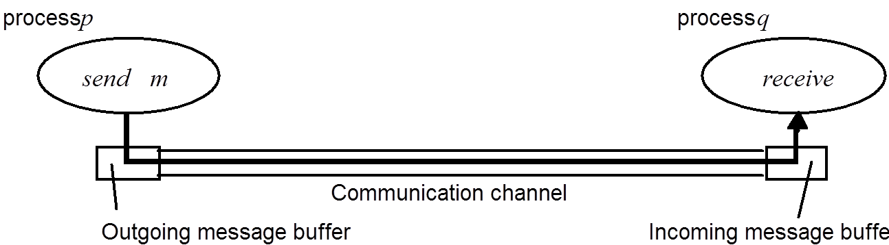

Slide 22
