Slide 1


Tutorial: Wireless Sensor Networks
November 2005
Krishna M. Sivalingam, Associate Professor
Dept. of CSEE
University of Maryland, Baltimore County (UMBC)
Baltimore, MD 21250
krishna@umbc.edu
www.cs.umbc.edu/~krishna; dawn.cs.umbc.edu
Please do not distribute
Copyright by Prof. Sivalingam. The softcopy may be used for personal research/academic purposes only.

Slide 2
General Overview
Introduction to Wireless Sensor Networks
Data Dissemination and Routing Protocols
Data Gathering
Medium Access Control Protocols
Locationing and Coverage
Testbeds/Applications
Security in Wireless Sensor Networks
Summary & Discussion

Slide 3
Motivation
GOAL: Deeply Networked Systems or Pervasive Networking
98% of all processors are not in traditional desktop computer systems, but in house-hold appliances, vehicles, and machines on factory floors
Add reliable wireless communications and sensing functions to the billions of physically embedded computing devices to support ubiquitous networked computing
Distributed Wireless Sensor Networks is a collection of embedded sensor devices with networking capabilities

Slide 4
Introduction to WSN

Slide 5
Background , contd.
Sensors
  Enabled by recent advances in MEMS technology
  Integrated Wireless Transceiver
  Limited in
    Energy
    Computation
    Storage
    Transmission range
    Bandwidth
CPU
Battery
Memory
Wireless
Transceiver
Sensing Hardware

Slide 6
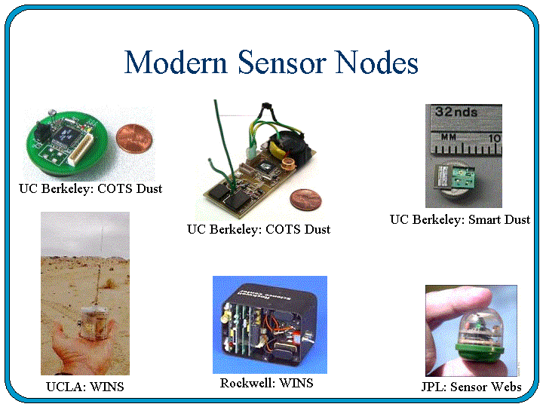
Background, contd.

Slide 7
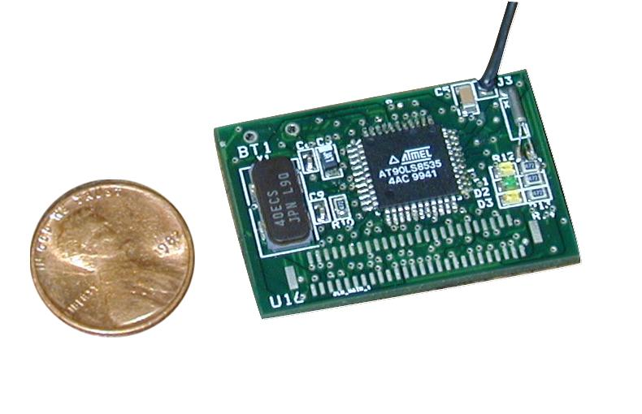
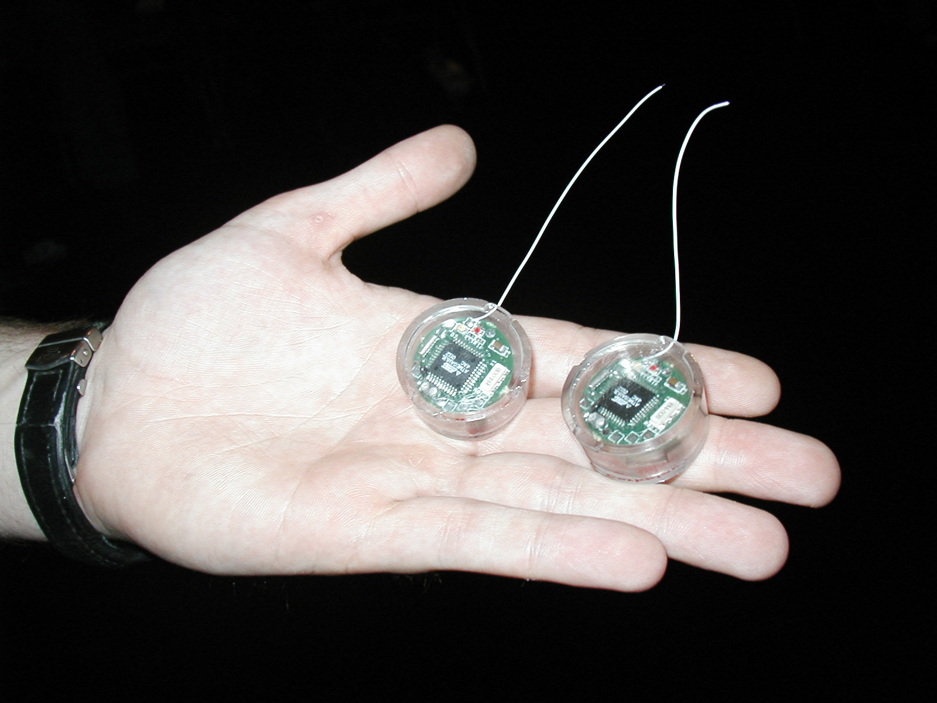
Sensor Nodes, contd.

Slide 8
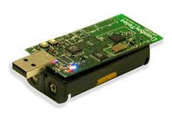
Sensors (contd.)
The overall architecture of a sensor node consists of:
  The sensor node processing subsystem running on sensor node main CPU
  The sensor subsystem and
  The communication subsystem
The processor and radio board includes:
  TI MSP430 microcontroller with 10kB RAM
  16-bit RISC with 48K Program Flash
  IEEE 802.15.4 compliant radio at 250 Mbps
  1MB external data flash
  Runs TinyOS 1.1.10 or higher
  Two AA batteries or USB
  1.8 mA (active); 5.1uA (sleep)
Crossbow Mote
TPR2400CA-TelosB

Slide 9
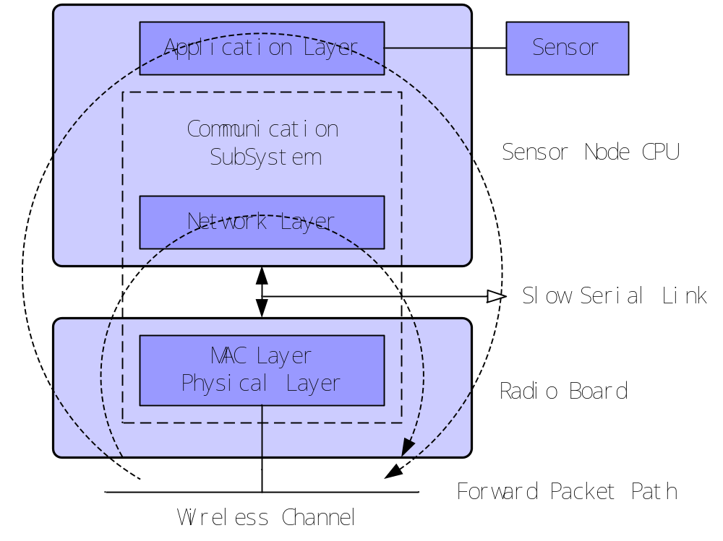
Overall Architecture of a sensor node

Slide 10
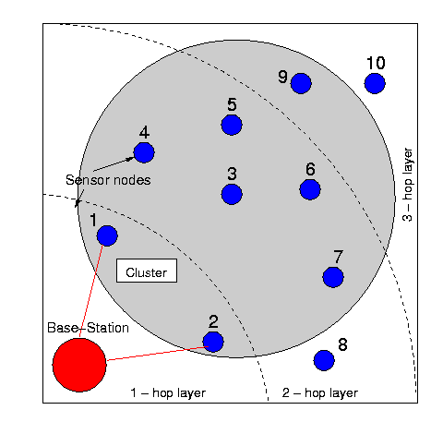
Wireless Sensor Networks (WSN)
Distributed collection of networked sensors

Slide 11
Networked vs. individual sensors
Extended range of sensing:
  Cover a wider area of operation
Redundancy:
  Multiple nodes close to each other increase fault tolerance
Improved accuracy:
  Sensor nodes collaborate and combine their data to increase the accuracy of sensed data
Extended functionality:
  Sensor nodes can not only perform sensing functionality, but also provide forwarding service.

Slide 12
Applications of sensor networks
Physical security for military operations
Indoor/Outdoor Environmental monitoring
Seismic and structural monitoring
Industrial automation
Bio-medical applications
Health and Wellness Monitoring
Inventory Location Awareness
Future consumer applications, including smart homes.

Slide 13

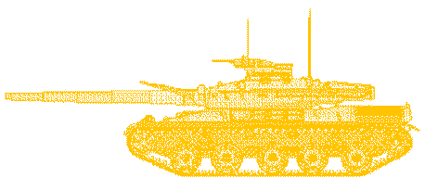

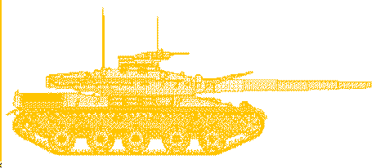
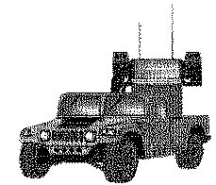
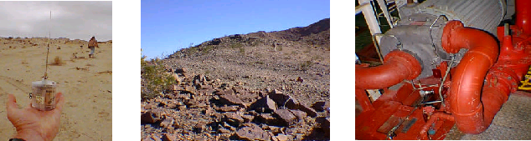
Applications, contd.
cooperative
processing
cooperative
S
E
N
S
I
N
G
signalling
THREAT
ALERT
ALERT
THREAT
M
-
U
L
T
I
H
O
P
C
O
M
M
U
N
I
C
A
T
I
O
N
Beam Formation
C
O
M
M
A
N
D
L
E
V
E
L

Slide 14
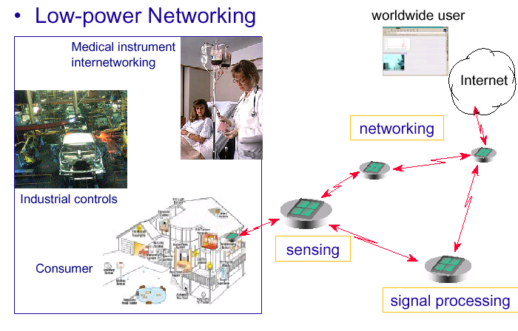
Applications, contd.

Slide 15
Characteristics and challenges
Deeply distributed architecture: localized coordination to reach entire system goals, no infrastructure with no central control support
Autonomous operation: self-organization, self-configuration, adaptation, exception-free
  TCP/IP is open, widely implemented, supports multiple physical network, relatively efficient and light weight, but requires manual intervention to configure and to use.
Energy conservation: physical, MAC, link, route, application
Scalability: scale with node density, number and kinds of networks
Data centric network: address free route, named data, reinforcement-based adaptation, in-network data aggregation

Slide 16
Challenges, contd.
Challenges
  Limited battery power
  Limited storage and computation
  Lower bandwidth and high error rates
  Scalability to 1000s of nodes
Network Protocol Design Goals
  Operate in self-configured mode (no infrastructure network support)
  Limit memory footprint of protocols
  Limit computation needs of protocols -> simple, yet efficient protocols
  Conserve battery power in all ways possible

Slide 17
WSN vs. MANET
Wireless sensor networks may be considered a subset of Mobile Ad-hoc NETworks (MANET).
WSN nodes have less power, computation and communication compared to MANET nodes.
MANETs have high degree of mobility, while sensor networks are mostly stationary.
  Freq. node failures in WSN -> topology changes
Routing protocols tend to be complex in MANET, but need to be simple in sensor networks.
Low-power operation is even more critical in WSN.
MANET is address centric, WSN is data centric.

Slide 18
Why not port Ad Hoc Protocols?
Ad Hoc networks require significant amount of routing data storage and computation
  Sensor nodes are limited in memory and CPU
Topology changes due to node mobility are infrequent as in most applications sensor nodes are stationary
  Topology changes when nodes die in the network due to energy dissipation
Scalability with several hundred to a few thousand nodes not well established
GOAL: Simple, scalable, energy-efficient protocols

Slide 19
Focus: Radio Transceiver Usage
The wireless radio transceiver is typically in three modes:
  Transmit – Maximum power consumption
  Receive
  Idle
  Turned off – Least power consumption
Sensor node exists in three modes: Active, standby, and battery dead
Turnaround time: Time to change from one mode to another (esp. important is time from sleep to wakeup and vice-versa)
Protocol design attempts to place node in these different modes depending upon several factors
Sample power consumption from 2 sensor nodes shown next

Slide 20
Rockwell Node (SA-1100 proc)
MCU Mode | Sensor Mode | Radio Mode | Power(mW)
Active | On | Tx(36.3mW) | 1080.5
 |  | Tx(13.8mW) | 942.6
 |  | Tx(0.30mW) | 773.9
Active | On | Rx | 751.6
Active | On | Idle | 727.5
Active | On | Sleep | 416.3
Active | On | Removed | 383.3
Active | Removed | Removed | 360.0
Sleep | On | Removed | 64.0

Slide 21
UCLA Medusa node (ATMEL CPU)
MCU Mode | Sensor | Radio(mW) | Data rate | Power(mW)
Active | On | Tx(0.74,OOK) | 2.4Kbps | 24.58
 |  | Tx(0.74,OOK) | 19.2Kbps | 25.37
 |  | Tx(0.10,OOK) | 2.4Kbps | 19.24
 |  | Tx(0.74,OOK) | 19.2Kbps | 20.05
 |  | Tx(0.74,ASK) | 19.2Kbps | 27.46
 |  | Tx(0.10,ASK) | 2.4Kbps | 21.26
Active | On | Rx | - | 22.20
Active | On | Idle | - | 22.06
Active | On | Off | - | 9.72
Idle | On | Off | - | 5.92
Sleep | Off | Off | - | 0.02

Slide 22
Energy conservation
Physical layer
Low power circuit(CMOS, ASIC) design
Optimum hardware/software function division
Energy effective waveform/code design
Adaptive RF power control
MAC sub-layer
Energy effective MAC protocol
Collision free, reduce retransmission and transceiver on-times
Intermittent, synchronized operation
Rendezvous protocols
Link layer
FEC versus ARQ schemes; Link packet length adapt.
Network layer
Multi-hop route determination
Energy aware route algorithm
Route cache, directed diffusion
Application layer
Video applications: compression and frame-dropping
In-network data aggregation and fusion
See Jones, Sivalingam, Agrawal, and Chen survey article in ACM WINET, July 2001;
See Lindsey, Sivalingam, and Raghavendra book chapter in Wiley Handbook of Mobile Computing,
Ivan Stojmenovic, Editor, 2002.

Slide 23
Network Architectures

Slide 24
Network Architectures
Layered Architecture
Clustered Architecture
Base
Station
Base
Station
Layer 1
Layer 2
Layer 3
Larger Nodes denote Cluster Heads

Slide 25
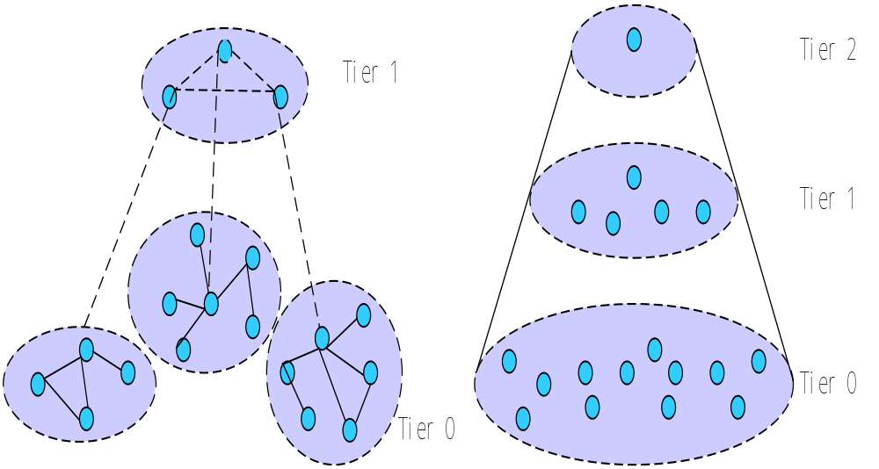
Clustered network architecture
Sensor nodes autonomously form a group called clusters.
The clustering process is applied recursively to form a hierarchy of clusters.

Slide 26
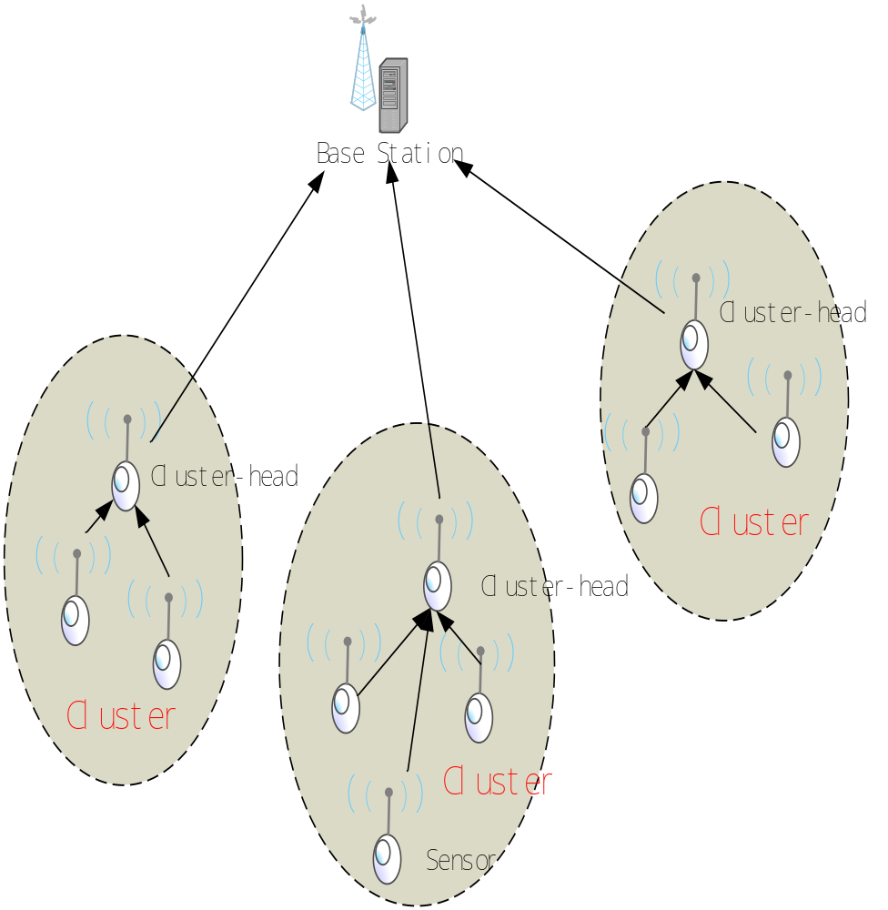
Cluster architecture (contd.)
Example - LEACH protocol
  It uses two-tier hierarchy clustering architecture.
  It uses distributed algorithm to organize the sensor nodes into clusters.
  The cluster-head nodes create TDMA schedules.
  Nodes transmit data during their assigned slots.
  The energy efficiency of the LEACH is mainly due to data fusion.

Slide 27
Layered Network Architecture
A few hundred sensor nodes (half/full duplex)
A single powerful base-station
Network nodes are organized into concentric Layers
Layer: Set of nodes that have the same hop-count to the base-station
Additional Mobile Nodes traversing the network
Wireless Multi-Hop Infrastructure Network Architecture (MINA)
A 10 node sensor network depicting cluster of node 3; there are 2 mobile nodes

Slide 28
MINA, contd.
  Set of wireless sensor nodes create an infrastructure – provide sensing and data forwarding functionality
  Mobile soldiers with hand-held units access the sensors for data and also to communicate with a remote BS
  BS is data gathering, processing entity and communication link to larger network
  Shorter-range, low-power transmissions preferred for covert operations and to conserve power

Slide 29
Data Dissemination Architectures and Protocols

Slide 30
Data Dissemination
In ad hoc networks, traffic is peer-to-peer
  Multi-hop routing is used to communicate data
In WSN, other traffic models are possible:
  Data Collection Model
  Data Diffusion Model
Data Collection Model: Source sends data to a collection entity (e.g. gateway): periodically or on-demand
Data Diffusion Model:
  Source: A sensor node that generates data, based on its sensing mechanisms’ observations
  Event: Something that needs to be reported, e.g. in target detection; some abnormal activity
  Sink: A node, randomly located in the field, that is interested in events and seeks such information

Slide 31
WSN Routing Protocol Requirements
Simple and robust – ad hoc, self-configuring and distributed algorithm
  Routes must converge quickly
Minimum overhead – Resources used must be minimal – must be energy efficient
Communication – Effectively use limited bandwidth
Ease of deployment – reasonably good performance even in harsh environments
Application mission aware – Flexible to be used in a wide variety of applications, yet use concepts like data fusion, if necessary and possible

Slide 32

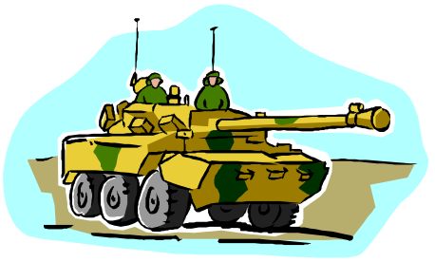


Data Diffusion: Concept
Sink 1
Sources
Sink 2

Slide 33
Diffusion: Basics
Data-centric vs. address centric architecture
  Individual network address is not critical; Data is important and is accessed as needed
User can pose a specific task, that could be executed by sensor nodes
Concept of Named Data: (Attribute, Value) Pair
Sink node requests data by sending “interests” for data
Interests are propagated through the network, setting up gradients in the network, designed to “draw” data
Data matching the interest is then transmitted towards the sink, over multiple paths (obtained by the gradients
The sink can then reinforce some of these paths to optimize

Slide 34
Diffusion Basics, contd.
Design Issues:
  How does a sink express its interest in one or more events?
  How do sensor nodes keep track of existing interests from multiple sinks?
  When an event occurs, how does data get propagated from source(s) to sink(s)?
  Can in-network data processing (e.g. data fusion), data aggregation and data caching help improve performance?
[Intanagonwiwat et. al.; ACM MobiCom 2000]

Slide 35
Diffusion Basics, contd
Example Task
{Type = Animal; Interval = 20ms; Time = 10s;
Region = [-100, 100, 200, 400] }
The above task instructs a sensor node in the specified region to track for animals; If animal is tracked/detected, then send observations every 20 ms for 10s
The above task is sent via interest messages and all sensor nodes register this task.
When a node detects an event, it then constructs a Data Event message

Slide 36
Diffusion: Basics, contd
Data Event Example:
{Type = Animal; Instance = Tiger;
Location = [101, 201]; Intensity = 0.4;
Confidence = 0.8; Timestamp = 2:51:00}
Interests and Gradients:
For each active task that a sink is interested in:
  Sink broadcasts interest to its neighbors
    Initially, to explore, it could set large interval (e.g 1s)
  Sink refreshes each interest, using timestamps
Each sensor node maintains an interest cache
  Interest aggregation is possible

Slide 37
Diffusion: Interests
When a node receives an interest, it:
  Checks cache to see if an entry is present.
  If no entry, creates an entry with a single gradient to neighbor who sent this interest
  Gradient specifies the direction and data rate.
Resend interest to a subset of its neighbors
  This is essentially flooding-based approach
  Other probabilistic, location-based and other intelligent forwarding approaches possible
Similar to multicast tree formation, at sink instead of at source

Slide 38
Diffusion: Interest Propagation
Sink 1
Sources
Sink 2

Slide 39
Diffusion: Data Propagation
When a sensor node detects a target, it:
  Searches interest cache for matching entry
  If found, computes highest requested event rate among its gradients
  Instructs sensor sub-system to generate data at this rate
  Sends data to neighbors on its gradient list
Intermediate nodes maintain a data cache
  Caches recently received events
  Forwards event data to neighbors on its gradient list, at original rate or reduced rate (intelligently)

Slide 40
Diffusion: Reinforcement
When sink gets an event notification, it:
  Picks a suitable set of neighbor(s) (best link, low delay, etc.) and sends a refresh interest message, with higher notification rate (e.g. every 10 ms instead of every 1s)
    This will prune some of its neighbors (since interests in a node’s cache will expire)
  Each selected neighbor forwards this new interest to a subset of its neighbors; selecting a smaller set of paths
Negative reinforcement also necessary to de-select weaker paths if a better path found.

Slide 41
Part III: Data Gathering Algorithms

Slide 42
Problem Definition
Objective: Transmit sensed data from each sensor node to a base station
  One round = BS collecting data from all nodes
Goal is to maximize the number of rounds of communication before nodes die and network is inoperable
Minimize energy AND reduce delay
  Conflicting requirements
Sensor Nodes
Base station

Slide 43
Energy*Delay metric
Why energy * delay metric?
  Find optimal balance to gather data quickly but in an energy efficient manner
  Energy = Energy consumed per round
  Delay = Delay per round (I.e. for all nodes to send packet to BS)
Why is this metric important?
  Time critical applications

Slide 44
Direct Transmission
Direct Transmission
  All nodes transmit to the base station (BS)
  Very expensive since BS may be located very far away and nodes need more energy to transmit over longer distances
    Farther the distance, greater the propagation losses, and hence higher the transmission power
  All nodes must take turns transmitting to the BS so delay is high (N units for a N-node network)
  Better scheme is to have fewer nodes transmit this far distance to lower energy costs and more simultaneous transmissions to lower delay

Slide 45
LEACH
Low Energy Adaptive Clustering Hierarchy
  Two-level hierarchy
Base
Station
Larger Nodes denote Cluster Heads

Slide 46
Scheme #1: PEGASIS
Goals of PEGASIS (Power-Efficient GAthering for Sensor Information Systems)
  Minimize distance nodes must transmit
  Minimize number of leaders that transmit to BS
  Minimize broadcasting overhead
  Minimize number or messages leader needs to receive
  Distribute work more equally among all nodes

Slide 47
PEGASIS
Greedy Chain Algorithm
  Start with node furthest away from BS
  Add to chain closest neighbor to this node that has not been visited
  Repeat until all nodes have been added to chain
  Constructed before 1st round of communication and then reconstructed when nodes di
Data fusion at each node (except end nodes)
  Only one message is passed at every node
Delay calculation: N units for an N-node network
  Sequential transmission is assumed

Slide 48
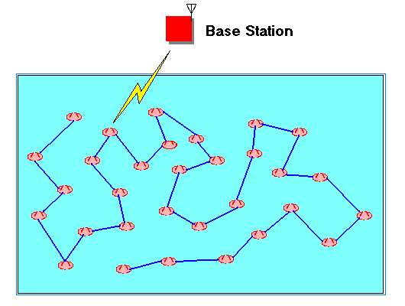
PEGASIS
End
Start

Slide 49
PEGASIS
Leader Selection
  Nodes become leaders in sequential order
  Allows random deaths
  Nodes will not become leader if the distance between neighbors is higher than a certain threshold (whereas in LEACH everyone becomes leader)
  Token is passed so that all nodes will know who is leader and which direction to pass message

Slide 50
Scheme #2: Binary Scheme
Chain-based as described in PEGASIS
At each level node only transmits to another node
All nodes receiving at any level rise to the next level
Delay: O(log2 N)
Step 4: c3 → BS
Step 3: c3 ←c7
Step 2: c1→ c3 c5→ c7
Step 1: c0→c1 c2→c3 c4→c5 c6→c7

Slide 51
Scheme # 3:Chain-based 3 level
For non-CDMA sensor nodes, binary scheme is not logical
Construct chain as described in PEGASIS
Divide chain into 10 groups (for the 100-node)
  To space out simultaneous transmissions to minimize interference
In each group, nodes will transmit one at a time
Finally, one node out of each group at each level will contain all the data and will rise to the next level until finally the leader will transmit to the BS
Total delay = 15 units (9+4+1+1) for 100-nodes

Slide 52
Chain-based 3 level scheme
Third Level
  Two nodes rise to top and non-leader transmits to leader
  Leader transmits to BS
c18 → BS
c18←c68
c8 →c18←c28←c38←c48 c58→ c68← c78 ←c88←c98 c0→c1→c2…c7→c8←c9 c10→c11…c18←c19 …c90 →c91…c98 ←c99

Slide 53
MAC Protocols for WSN

Slide 54
MAC Protocols
What is fundamentally different for MAC Protocol design in WSN?
  Low-power operation is even more critical
  Reduced coordination and synchronization is beneficial
  Resilience to frequent node failures
  Suitably blend with the network architecture
    Probably application dependent
  Scalability to support large number of nodes
    Thousands of nodes likely
    Limited bandwidth availability
    Would the 802.11 family of protocols work?

Slide 55
TDM-Based MAC
Considered for Clustered architecture
  Nodes are organized into clusters
  Each cluster has a clusterhead, that communicates directly with gateway or BS node
TDMA MAC
  The cluster head knows its members’ IDs
  Creates a simple TDM schedule, allocating time slots to members
  Broadcasts schedule to members
  Schedule may be periodically updated
  Rotating cluster heads possible

Slide 56
TDM-Based MAC, contd.
Advantages:
  Simple to coordinate within cluster
  No collisions
  Can be more energy-efficient: members wake up only when they have to send/receive data
Disadvantages:
  Adjoining clusters need to coordinate to operate in different channels (or frequencies)
  TDM is not very scalable to large number of nodes: high delays possible
  Nodes need to be synchronized within each cluster

Slide 57
S-MAC [Ye et. Al. 2002]
Sensor-MAC Protocol proposed in 2002
Assumptions
  Network consists of several small nodes, deployed in an ad hoc manner
  Nodes dedicated to a single or few collaborative applications: Per-node fairness is not critical
  In-network processing assumed: e.g. data fusion, data aggregation, collab signal processing
  Long idle periods and occasional burst of data: higher latency may be tolerated

Slide 58
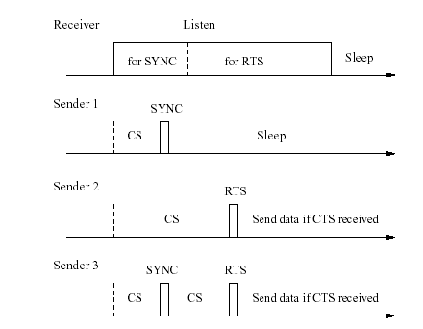
S-MAC details, contd.
Periodic Listen and Sleep Mode of operation
  Each node sleeps for a while; wakes up and then communicates with its neighbors, as necessary.
  Periodic synch among neighbors to reduce drift
  Pair-wise or group-wise node synch
  Nodes exchange schedule by broadcast
  MAC is still needed to avoid collisions

Slide 59
Localization (Location Discovery) Algorithms

Slide 60
Location Information
It is essential, in some applications, for each node to know its location
  Sensed data coupled with loc. data and sent
We need a cheap, low-power, low-weight, low form-factor, and reasonably accurate mechanism
Global Positioning Sys (GPS) is not always feasible
  GPS cannot work indoors, in dense foliage, etc.
  GPS power consumption is very high
  Size of GPS receiver and antenna will increase node form factor

Slide 61
Indoor Localization
Use a fixed infrastructure
  Beacon nodes are strategically placed
Nodes receive beacon signals and measure:
  Signal Strength
  Signal Pattern
  Time of arrival; Time difference of arrival
  Angle of arrival
Nodes use measurements from multiple beacons and use different multi-lateration techniques to estimate locations
Accuracy of estimate depends on correlation between measured entity and distance

Slide 62
Indoor Localization
Examples of Indoor Loc. Systems
  RADAR (MSR), Cricket (MIT), BAT (AT&T), etc.
Some approaches require a priori signal measurement and characterization and database creation
  Node obtains distance estimate by using database
  Not always practical to have database loaded in the individual node; only some nodes (e.g. gateway) might carry it.

Slide 63
Sensor Net. Localization
No fixed infrastructure available
Prior measurements are not always possible
Basic idea:
  Have a few sensor nodes who have known location information
  These nodes sent periodic beacon signals
  Other nodes use beacon measurements and triangulation, multi-lateration, etc. to estimate distance
Following mechanisms presented in Savvides et. al. in ACM MobiCom 2001

Slide 64
Sensor Net. Localization, contd.
Receiver Signal Strength Indicator (RSSI) was used to determine correlation to distance
  Suitable for RF signals only
  Very sensitive to obstacles, multi-path fading, environment factors (rain, etc.)
  Was not found to have good experimental correlation
  RF signal had good range, few 10metres
RF and Ultrasound signals
  The beacon node transmits an RF and an ultrasound signal to receiver
  The time difference of arrival between 2 signals is used to measure distance
  Range of up to 3 m, with 2cm accuracy

Slide 65
Localization algorithms
Based on the time diff. of arrival
Atomic Multi-lateration:
  If a node receives 3 becaons, it can determine its location (similar to GPS)
Iterative ML:
  Some nodes not in direct range of beacons
  Once an unknown node estimates its location, will send out a beacon
  Multi-hop approach; Errors propagated
Collaborative ML:
  When 2+ nodes cannot receive 3 beacons (but can receive say 2), they collaborate

Slide 66
Multi-lateration examples
Beacon Nodes
Unknown Nodes
Beacon Nodes
Unknown Nodes

Slide 67
Exposure; Coverage and Deployment

Slide 68
Coverage Problems
Coverage: is a measure of the Quality of service of a sensor network
How well can the network observe (or cover) a given event?
  For example, intruder detection; animal or fire detection
Coverage depends upon:
  Range and sensitivity of sensing nodes
  Location and density of sensing nodes in given region

Slide 69
Coverage, contd.
Worst-Case Coverage: Areas of breach (lowest coverage)
  Can be used to determine if additional sensors needed
Best-Case Coverage: Areas of best coverage
  Can be used by a friendly user to navigate in those areas

Slide 70
Coverage, contd.
Given: A field A with sensors S, where for each sensor $s_i \in S$, its location (x_i, y_i) is known (How? Based on the Localization Techniques described earlier). Areas I and F are initial and final locations of an agent traversing the field.
Problem: Identify P_B, the maximal breach path in S, starting in I and ending in F
  P_B is defined as the locus of points p in the region, where p is in P_B if the distance from p to the closest sensor is maximized.
  I and F are arbitrarily specified inputs.
Solution: Determine the Voronoi diagram corresponding to the sensor graph. The path P_B will be composed of line segments that belong to the Voronoi diagram.

Slide 71
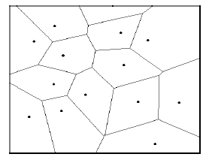
Voronoi diagrams
In 2D, the Voronoi diagram of a set of points partitions the plane into a set of convex polygons such that:
  All points inside a polygon are closest to only one site.
  The polygons have edges equidistant from nearby points.
Related is Delaunay Triangulation
  Connect points in V-Diag. whose polygons share a common edge.

Slide 72
Worst-Case Coverage: Alg.
Generate the bounded Voronoi diagram
  Let U and L denote vertex set and links of diag.
Create a graph with vertices from set U and links from L
  Weight of link in graph = minimum distance from all sensors in S
Do a breadth-first search to determine a path from I to F in the graph, such that the path has maximum edge cost
Multiple such breach paths are possible.

Slide 73
Best-Case Coverage
Problem: Identify P_S, the path with maximum support in S, starting at I and ending in F.
Solution: Use Delaunay triangulation
  The best path will be one connecting some of the sensor nodes
Similar approach to Max. Breach Path
  Use Delaunay instead of Voronoi
  The edge cost in the graph G, will be the length of the Delaunay triangle line segment.

Slide 74
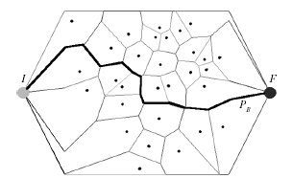
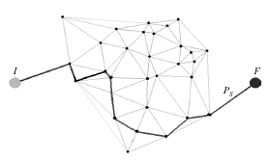
Examples
Fig. on left shows the bounded Voronoi diagram and the maximal breach path
Fig. on right shows the Delaunay Triangulation and the maximal support path
Question: Once these are determined, how to use these?

Slide 75
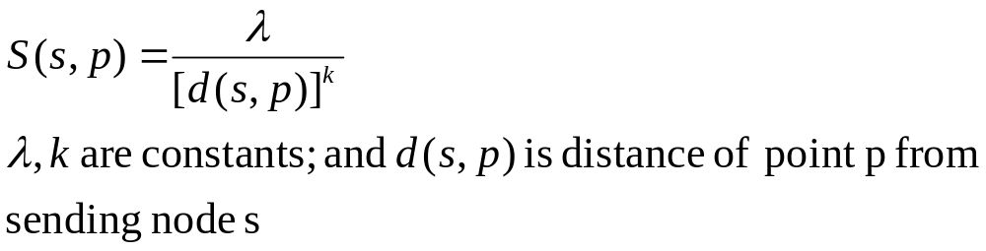
Exposure Problems
Exposure is related to the coverage
Exposure may be defined as the expected ability of observing a target in the sensor field
Formally defined as the integral of the sensing function (depends on distance from sensors) on a path from P_s to P_d
Sensing function depends on nature of sensors
Sensor model:

Slide 76
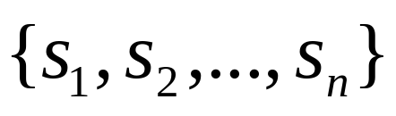
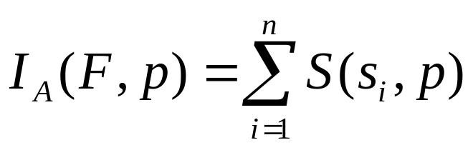
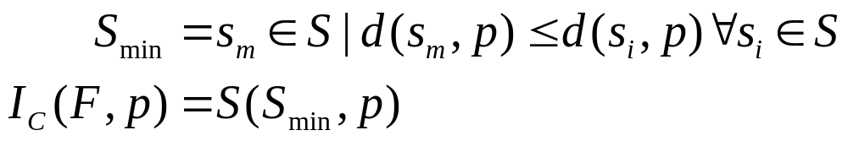
Exposure at a point
All-Sensor Field Intensity at Point p in field with n sensors denoted by
Closest-Sensor Field Intensity at Point p:

Slide 77
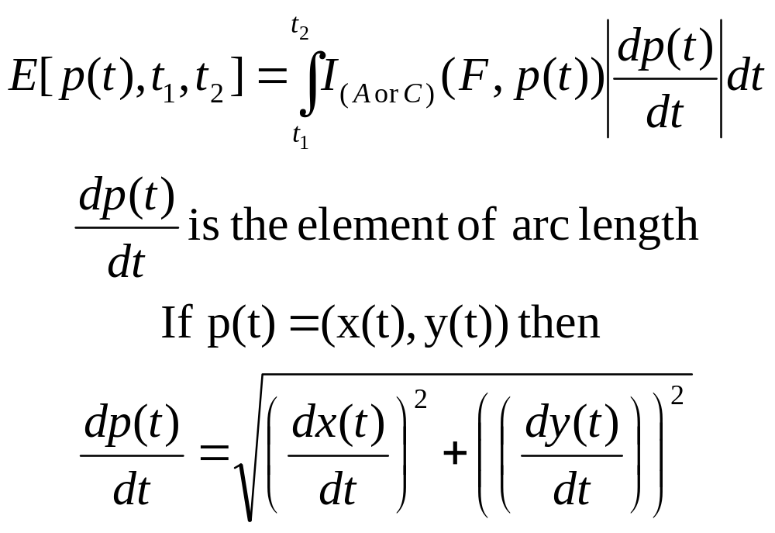
Exposure along a path
Suppose object O is traveling from point p(t1) to p(t2) along path p(t).
Exposure for object O during interval t1 to t2 along p(t) is defined as:

Slide 78
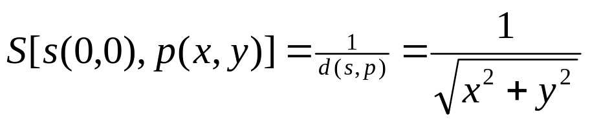
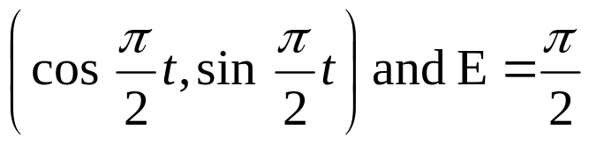
Exposure: Properties
Consider only 1 sensor at location (0,0). Let
Determine the path from a=(1,0) to point b=(X,Y) with minimum exposure
  Determine x(t), y(t) such that x(0) = 1; y(0) = 0; x(1) = X; y(1) = Y and the exposure function is minimized.
Lemma 1: If b=(0,1), then the minimum exposure path is

Slide 79
Exposure: Properties
Lemma 2: Given a sensor s and two points a and b, such d(s,a)=d(s,b), then the minimum exposure path between a and b is that part of the circle centered as s and passing through a and b.
Theorem: Let the sensor be located at (0,0) in a unit field. The minimum exposure path from (1,-1) to (-1,1) is as below:
S=(0,0)

Slide 80
Exposure: Properties
Let s be a sensor in a polygonal field with vertices v1,…,vn.
For the inscribed circle of the polygon, let edge v_i,v_{i+1} be tangent at point u_i
The minimum exposure path from vertex v_i to vertex v_j consists of:
  Line segment from v_i to u_i
  Part of inscribed circle from u_i to u_j
  Line segment from u_j to v_j
  (OR) in the opposite direction (from v_i to u_j etc)
Problem of MEP between 2 points in same corner or between 2 points inside the inscribed circle is open

Slide 81
Generic Exposure Problem
Given a network with randomly placed sensor nodes, how to determine minimum exp. Path
Solution:
  Tessellate the network into a set of equidistant grid points (with varying degree of precision)
  For each edge in the grid network, assign an edge equal to the exposure along the edge (integrated from the sensor function)
  Using Dijkstra’s algorithm, determine the shortest path from a source (based on edge weights)
  This is the min. exposure path

Slide 82
Security

Slide 83
Security in Sensor Networks
What is different ?
  Unfriendly, unattended environments
  Severe resource constraints render most of the cryptographic mechanisms impossible
  PKI is infeasible for sensor networks and have to rely on symmetric key cryptography
Security has never been more important!
  Applications in battlefield management, emergency response systems and so on
Key management is the most critical issue
  Focus of majority of the research
Following is review of some key research in the area

Slide 84
SPINS-Perrig et al, Berkeley
Complete suite of security protocols for sensor networks
SNEP (Secure Network Encryption Protocol)
  Data Confidentiality
  Authentication
  Integrity
  Freshness
μTESLA
  Lightweight version of TESLA for authenticated broadcast

Slide 85
SPINS: Applications
Authenticated Routing
  Base station can be authenticated using μTESLA
  For each time interval, the first packet heard is chosen as parent, which is authenticated later
  Prevents spurious routing
Node-to-Node Key Agreement
  A sends B a request with a nonce
  B asks BS for a session key using SNEP
  BS distributes shared session keys securely to A and B using SNEP with strong freshness

Slide 86
Key Management Scheme for DSN
Eschenauer et al, UMD (CCS 2002)
Based on probabilistic key sharing
Each node is equipped before deployment with a key-ring chosen randomly from a common key pool
Each key has an identifier associated with it
Shared secret key is established between two nodes by one of the two ways:
  Broadcasting the key identifiers and comparing them to find a common key if one exists
  Sending a challenge encrypted in a key; a valid response is a successful decryption of the challenge establishing a shared key

Slide 87
Key Mgmt Contd
There may not be a shared key between a pair of nodes
  In such a case a path to one node from the other is established through the secure links already in place
  A direct secure link is then established
If a node is compromised, its entire key-ring is revoked from the network
In general for a required probability of 0.5, 75 keys need to be in the key ring chosen from a pool of 10,000 keys.

Slide 88
Random Key Predistribution Schemes
Chan, Perrig et al, CMU, 2003
Proposes three random key predistribution schemes
  q-Composite random key predistribution
  Multi-path key reinforcement
  Random pair-wise scheme
q-Composite random key predistribution
  Builds on the work of Eschenauer and Gligor (referred to as basic scheme)
  Basic idea is to share q keys between nodes rather than just one key
  Final key is the hash of all q keys
An attacker now needs to capture more nodes in order to eavesdrop on any link with given probability

Slide 89
q-Composite Predistribution Contd.
However choosing size |S| of common key pool is tricky
  Too large May not find q common keys between every pair of node
  Too small Attacker can get a large sample of S by capturing just a few nodes
Choose largest |S| such that P_{connect} ≥ P
  P_{connect} is the probability of two nodes sharing sufficient keys to form a secure link (derived mathematically)
  P is the desired probability that two nodes form a secure link

Slide 90
q-Composite Predistribution Contd.
q-Composite scheme thus makes small scale attacks less appealing for an attacker
  Attacker can only gain a little additional information by capturing a few nodes
  e.g. amount of additional communication compromised when 50 nodes are captured is only 4.74% as compared to 9.52% for basic scheme
However makes network more vulnerable if large number of nodes are captured

Slide 91
Multi-path Key Reinforcement
Need to update the key once a secure link has been formed between two nodes
  To prevent attacker from obtaining and using the old key by capturing other nodes
Node A sends j random values over multiple disjoint secure paths to node B
The new key is computed from all the j values
Attacker has to eavesdrop on j paths in order to construct the key
The neighbors on those paths are called reinforcing neighbors

Slide 92
Multi-path Key Reinforcement Contd
Significant network overheads (~10X)
The method is not as effective when used with q-Composite
Both the methods essentially do the same thing
But their weakness compound each other
  Small key pool and high network overheads
Works well in conjunction with the basic scheme
  Reduces the eavesdropping probability 146 times!

Slide 93
Random pair-wise Key Scheme
Targeted at Node-to-Node authentication without any help from the base station
Each node need only save a random set of n*p keys instead of all n-1 keys
  p is the smallest probability that any two nodes have a shared key such that all nodes have shared keys with some high probability
Nodes are predeployed with m random pair-wise keys for m other nodes
Node broadcasts its identifier once deployed
Mutual key agreement with the neighbors takes place by cryptographic handshake

Slide 94
Random pair-wise Key Scheme Contd
Multi-hop range extension is simple with having neighbors rebroadcast the identifiers further
  Must be used to a limited number of hops to prevent DoS attack by an adversary
Distributed node revocation is possible by having nodes broadcast public votes against a misbehaving node
  Mechanism for detecting misbehavior assumed at each node
If A receives more than a threshold number of votes are against B, it cuts off all communication with B
Many practical issues arise!

Slide 95
Random pair-wise Key Scheme Contd
Node replication can be resisted by limiting the max degree of each node
  Degree counting is modeled in a similar way as vote counting for node revocation
Complete resilience against node capture
  A compromised node does not provide any further information
Large network size supported
  n = m/p where m is the key-ring size of a node and p is the smallest probability that any two nodes have a shared key such that all nodes have shared keys with some high probability

Slide 96
Testbeds and Applications

Slide 97
Habitat Monitoring
Traditional human monitoring methods for habitats are invasive and cause negative impact
  Often, repeated visits necessary to collect data
Ideal will be to establish a group of wireless sensor networks that sense and wirelessly transmit data
  Better for environment; Cheaper, Safer, etc.
Great Duck Island (GDI) Project by College of Atlantic; Intel and UC Berkeley
  Monitor usage patterns of nesting burrows
  Changes in burrow conditions during breeding season

Slide 98
GDI Project
Establishes multiple clusters of sensor networks
Each cluster or “patch” has a gateway node
Data from clusters forwarded over a wireless LAN (802.11b) connection to a basestation (part of the island’s field station)
The base station provides necessary connectivity to Internet
Sensors sense light, temp, pressure, infra-red, relative humidity in the burrows
Sensor data is archived & queried in real-time
Users with mobile devices and remote clients access data

Slide 99
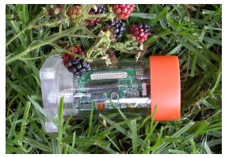
GDI Project, contd.
The sensor nodes are Berkeley Motes (40 Kbps radio, 4 MHz ATMEL chips, 512KB storage)
Motes encased in transparent acryclic enclosure
As of July 2002, 32 motes (nine in underground burrows)
Data collection and evaluation in progress

Slide 100
Smart Kindergarten project
Project at Univ. of California, Los Angeles and an elementary school
Plans to develop toys with embedded sensors, that can sense child’s response and wirelessly transmit data to an infrastructure
The toy can provide visual, aural, motion feedback and sense child’s speech, physical manipulation, etc.
Could enhance education process by providing a better learning environment – individualized, unobtrusive evaluation by teacher, adaptive, etc.

Slide 101
Other projects
Airbee Wireless’s Ronald Reagan Airport project:
  Every door in the airport could be outfitted with 900-MHz wireless sensors and automated locks, networked to a central point where rules could be set for when a door could be opened, by whom, by time of day, without the need for guards
  Q: Can a 900-MHz jammer disrupt the system?
http://wwwcsif.cs.ucdavis.edu/~yick/research/applications.html

Slide 102
More info…
Reality check: Questions to ask wireless sensor network vendors
[From http://www.networkworld.com/news/2005/100305-wireless-sensors.html]
  How complex is deployment vs. that of conventional wired networks?
  How stable are standards like Zigbee?
  Why go with standard-based approaches vs. possibly more flexible proprietary mesh networking protocols?
  Will radio interference be a factor with multiple sensor nets with hundreds or even thousands of nodes?

Slide 103
More info…
  Can a deliberate jamming attempt shut down the entire net?
  What tools are available to manage these nets, and to treat them as part of an enterprise IP net?
  How can data from sensor nets be integrated with existing enterprise applications?
  How realistic are battery life projections of months or years?
  What are the total life-cycle costs of sensors nets, including battery replacement?

Slide 104
More Information
Wireless Sensor Networks, An Edited Book
  Co-Editors: Znati, Sivalingam and Raghavendra
  Springer Publishers, 2004
  18 Chapters contributed by leading researchers in the field
Other Books also available
  Ivan Stojmenovic
  Feng Zhao
  S.S. Iyengar

Slide 105
Coming Soon Near You
IEEE Communication Society’s Third Annual Intl Conf. on Sensor and Ad Hoc Comm. & Networks (SECON)
  www.ieee-secon.org/2006
  Reston, VA (Hyatt Reston) near Dulles
  Sep. 25-29, 2006
  Interested in submitting papers, participating in panels, presenting a demo, SPONSORING or anything else related, pl contact Krishna Sivalingam at krishna@umbc.edu (General Chair)

Slide 106
Coming Soon Near You
IEEE Communication Society and Create-Net (Italy)’s Second Annual Intl Conf. on Security and Privacy for Emerging Areas in Communication Networks
  www.securecomm.org
  Baltimore/DC area
  Sep./Oct., 2006
  Interested in submitting papers, participating in panels, presenting a demo, SPONSORING or anything else related, pl contact Krishna Sivalingam at krishna@umbc.edu (Steering Cmte Co-Chair)

Slide 107
Unsolicited Plug
Crossbow Technology’s Wireless Sensor Network Training Course
  November 9-10, 2005, Towson, MD
  Burkshire Marriott Conference Hotel
  Contact slee@xbow.com

Slide 108
Other topics …
Transport protocols
Data compression and data fusion
Low-power design issues
Simulation toolkits/environments specific to Sensor Networks

Slide 109
Summary
Motivation for Wireless Sensor Networks
Data Dissemination and related routing protocols
Data Gathering algorithms
MAC and Organization protocols
Localization algorithms
Coverage and Exposure
Applications and Testbeds
Security
Summary

Slide 110

THANK YOU!
Happy Diwali (Festival of Lights in India)

