Slide 1

-1-

Slide 2

Business Case Study
TEAM: SKAM
SHARLENE WADHWA
KRISHNNA SARRDAH
ADITYA KHAIRE
MAURVIN SHAH
-2-

Slide 3
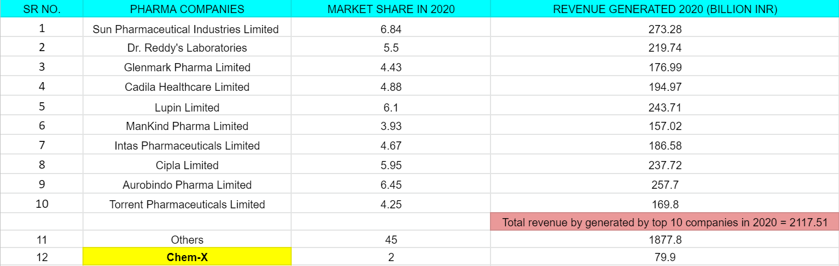
QUESTION 1
GIVEN DATA
-3-

Slide 4
QUESTION 1
TO FIND
What will be the Market Share of Chem-X and the top 10 companies in 2021?
Also calculate the revenue generated by Chem-X in 2021?
-4-

Slide 5
QUESTION 1
SOLUTION
First half of 2021
During the period of the first 6 months of 2021, it is given that the top 10 companies will lose 2.2% of their revenue generated. Therefore, the revenue lost by the top 10 companies can be calculated using the following formula given below
Formula: Σ [Revenue generated by top 10 companies]₂₀₂₀ x 2.2%
= 2117.51 x 2.2%
= 46.585 (Total revenue lost by the top 10 companies in Billion INR)
Simultaneously, half of the lost revenue (50%) will go to Chem-X and the rest will be assigned to others.
Hence from the revenue loss, the revenue added to Chem-X and others respectively will be
= 46.585/2
= 23.2925 (Billion INR)
-5-

Slide 6
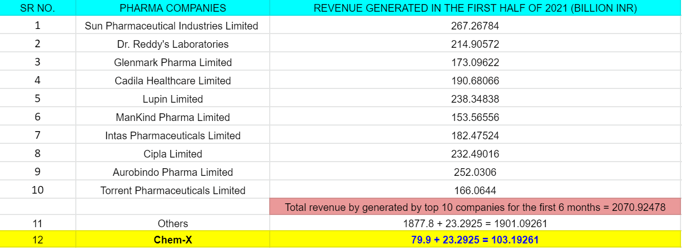
QUESTION 1
-6-

Slide 7
QUESTION 1
Second half of 2021
During the period of the next 6 months of 2021, it is given that the overall revenue generation for each individual company will increase by 5%. Therefore, the revenue generated for the year 2021 can be calculated using the following formula given below
Formula: [Revenue of a company]_{First half of 2021} + 5%
Furthermore, to calculate the updated market share values of the pharma companies for the year 2021 we use the formula
Formula: [Market share of a company] ₂₀₂₁ = [Revenue of company]₂₀₂₁ x 100
Σ [Revenue of all companies]₂₀₂₁
-7-

Slide 8
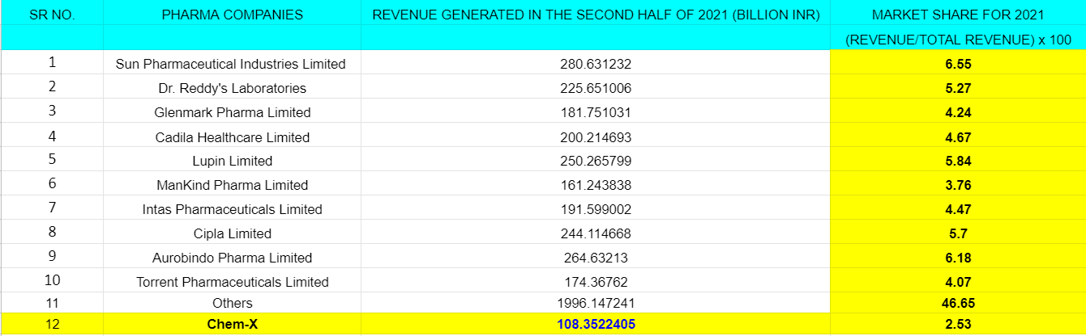
QUESTION 1
THE MARKET SHARE OF CHEM-X AND THE TOP 10 COMPANIES FOR 2021 IS HIGHLIGHTED AND MENTIONED IN THE PIE CHART OF THE CONSECUTIVE SLIDES
B. THE REVENUE GENERATED BY CHEM-X IN 2021 IS 108.3522 BILLION INR
-8-

Slide 9
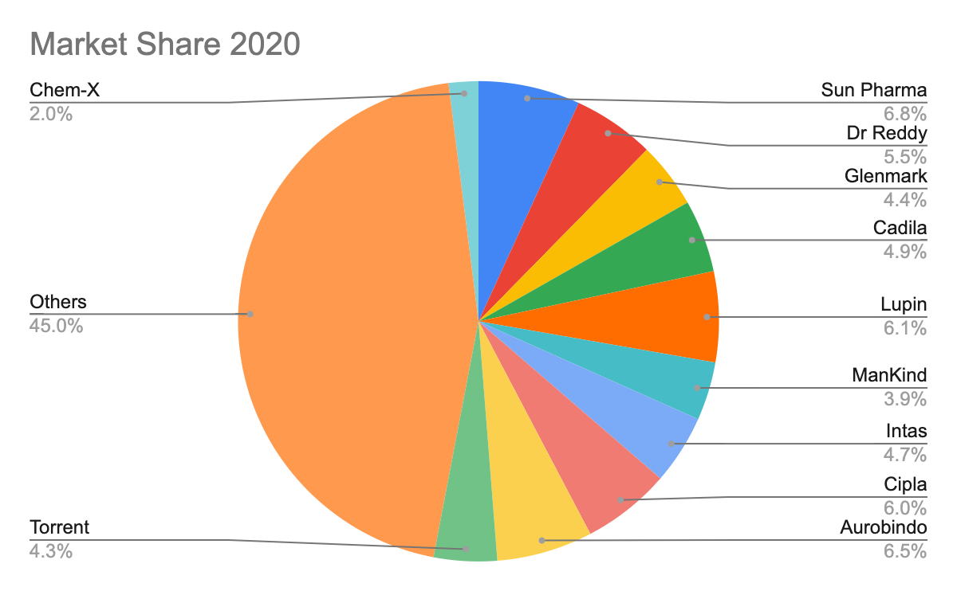
QUESTION 1
-9-

Slide 10
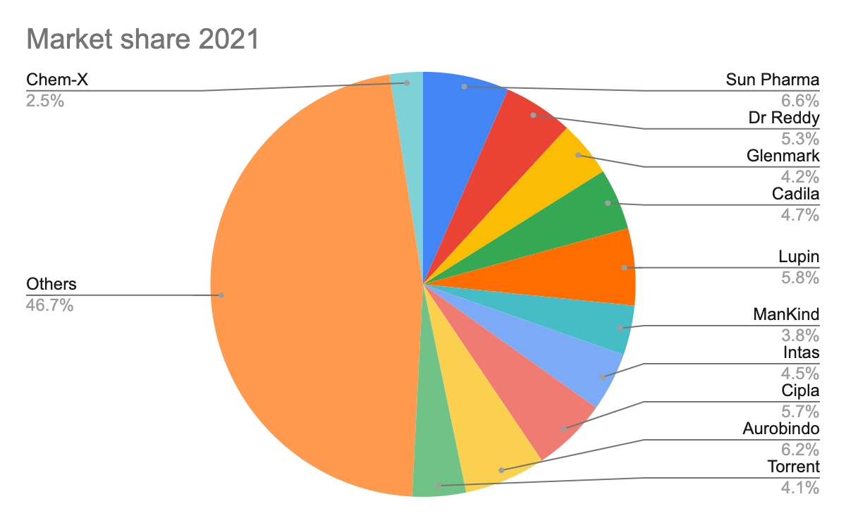
QUESTION 1
-10-

Slide 11
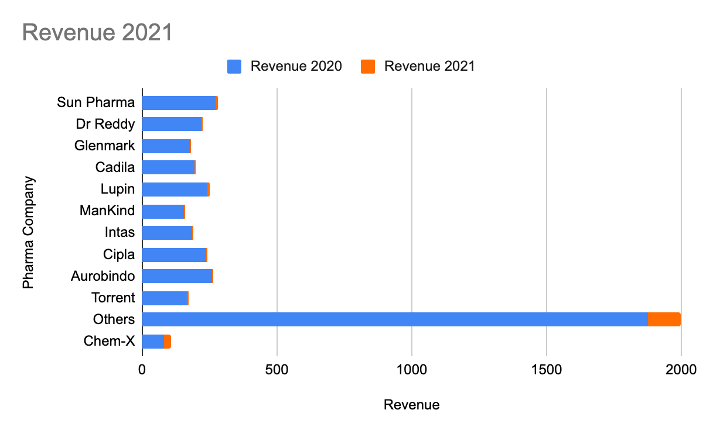
QUESTION 1
-11-

Slide 12
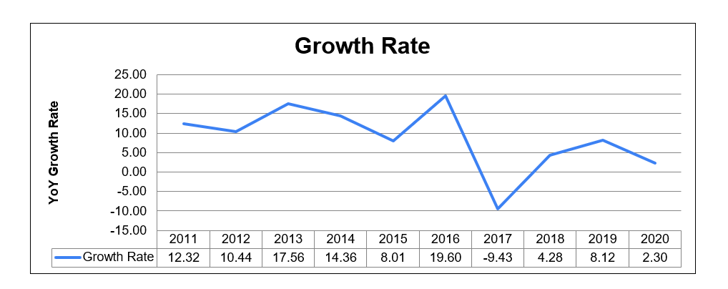
QUESTION 2
GIVEN DATA
Growth rate of Medical MoJo across 10 years
-12-

Slide 13
QUESTION 2
TO FIND
Q2) Revenue generated by Chem-X by 2031, considering Chem-X grows at an average growth rate (across 10 years) as Medical MoJo.
-13-

Slide 14
QUESTION 2
SOLUTION
Average Growth Rate
Formula: [AGR]_{N} = GR₁ + GR₂ + GR₃ + GR₄ + … + GR_{n}
N
Where [AGR]_{N} : Average Growth rate over the time period of N
GR : Growth Rate
∴ [AGR]₁₀ of Medical MoJo = 12.32 + 10.44 + 17.56 + 14.36 + 8.01 + 19.60 - 9.43 + 4.20 + 8.12 + 2.30
10
= 8.756
It is given [AGR]₁₀ of Medical MoJo = [AGR]₁₀ of Chem-X
∴ [AGR]₁₀ of Chem-X =8.756
-14-

Slide 15
QUESTION 2
From Question 1, we know that the revenue of Chem-X for the year 2021 is 108.353 Billion INR
Let’s assume, Chem-X is growing at an annual growth rate of x%
YEAR | 2022 | 2023 | 2024 | 2025 | 2026 | 2027 | 2028 | 2029 | 2030 | 2031
GR | x | x | x | x | 1.5x | x | x | 0 | 0 | 0
Given, the growth rate from 2028 becomes stagnant
Higher uptake (about 1.5) in the average growth in 2026
-15-

Slide 16
QUESTION 2
[AGR]₁₀ of Chem-X = 8.756 =
x + x + x + x + 1.5x + x + x + 0 + 0 + 0
10
Therefore 8.756 = 7.5x
10
x = 11.675%
Using this value of x we calculate the revenue for Chem-X for the years 2021 to 2031, the values of which are present in the following slide.
-16-

Slide 17
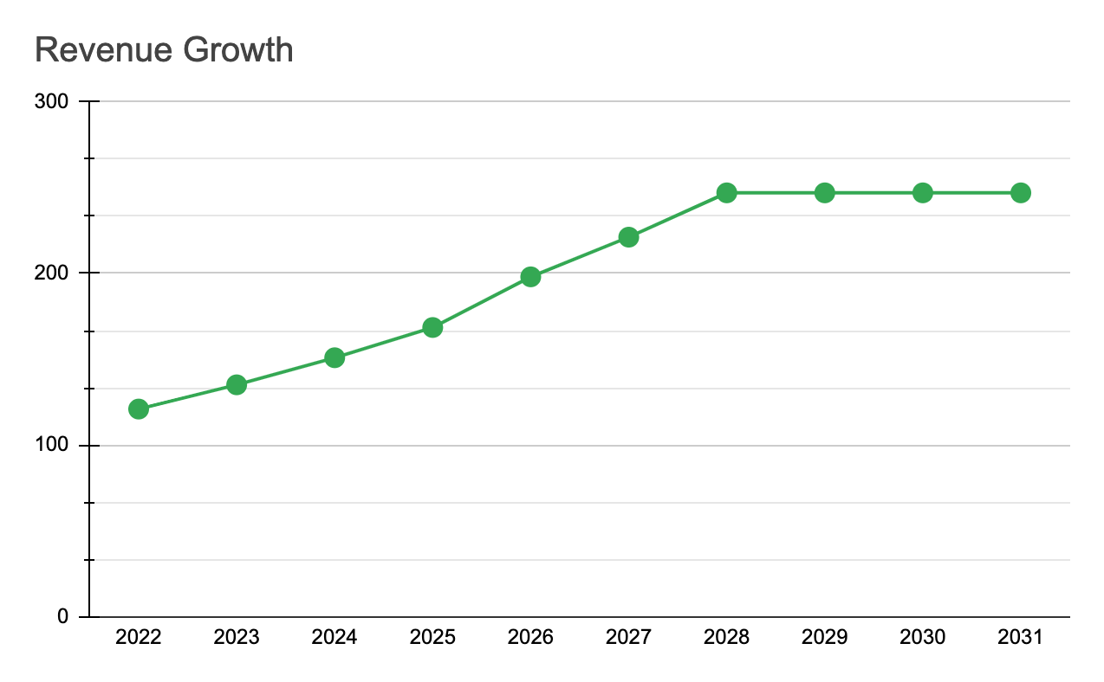
QUESTION 2
-17-

Slide 18
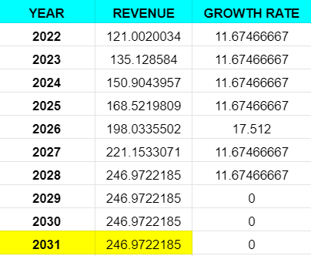
QUESTION 2
2. THE REVENUE FOR CHEM-X GENERATED IN 2031 WILL BE 246.977 BILLION INR
-18-

