Slide 2
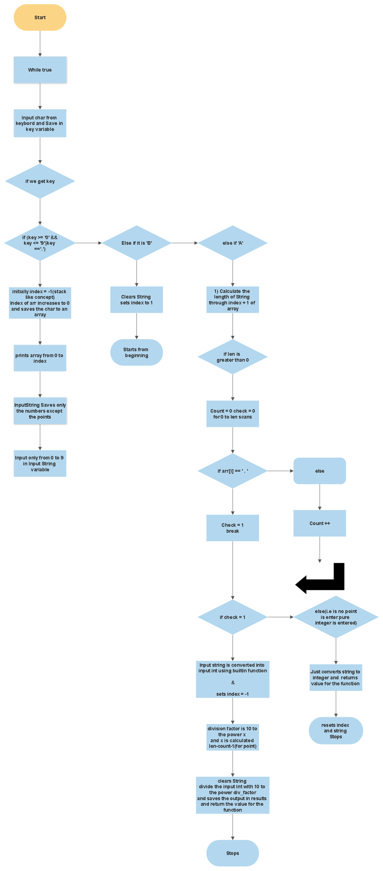

Slide 3
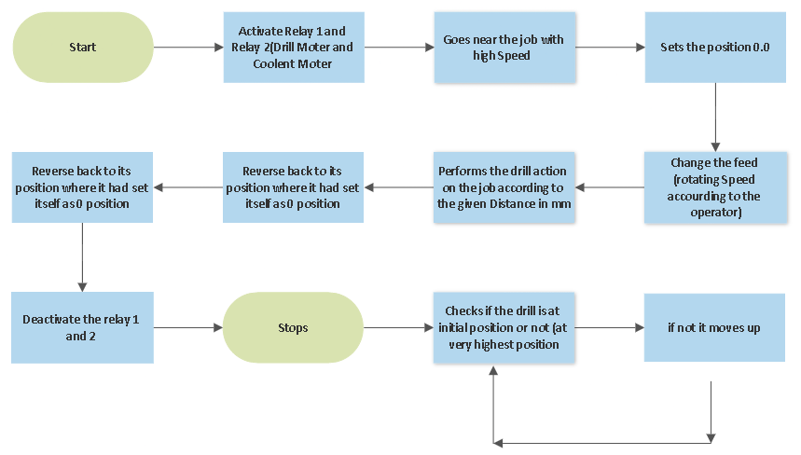

Slide 4
/*
This programs is for CNC Single Axis leth machine developed by Octagon Manufacturing Technology on Dt 10 March 2023
*/
/*-----------------------------------------------------------------------*/
// Included all Libraries that are need
#include <LiquidCrystal_I2C.h> // for 16x2 Display
#include <FlexyStepper.h> // To control Stepper Moter
#include <Keypad.h> // To take Input fro 4x4 keyboard
#include <math.h> // To Use Math function power(a,b)
/*-----------------------------------------------------------------------*/

Slide 5
// Defined all the arduino pins
// Arduino uno 0 and 1 pins are not used
const int BUTTON_PIN = 2; //Arduino pin no 2 for start the main drilling process
const int limitSwitchPin = 3; //Arduino pin no 3 to initilise the position of Drill structure to the very upper position
const int ROW_NUM = 4; //Arduino pin no 4,5,6,7 used for keypad Connect R1,R2,R3,R4 with 4,5,6,7 respectively
byte pin_rows[ROW_NUM] = {4,5,6,7};
const int MOTOR_DIRECTION_PIN = 8; //Arduino pin no 8 connected to tb6600 Stepper Driver dir+
const int MOTOR_STEP_PIN = 9; //Arduino pin no 9 connected to tb6600 Stepper Driver pul+
const int relaymoter = 10; //Arduino pin no 10 connected to in1 of relay module
const int relaypumpmoter = 11; //Arduino pin no 11 connected to in2 of relay module
//Arduino uno 12 are 13 pins aren't used
const int COLUMN_NUM = 4; //Arduino pin no A0,A1,A2,A3 used for keypad Connect C1,C2,C3,C4 with A0,A1,A2,A3 respectively
byte pin_column[COLUMN_NUM] = {A0,A1,A2,A3};
//Arduino uno A4 used as SDA pin for LCD Display
//Arduino uno A5 used as SCL pin for LCD Display
/*--------------------------------------------------------------------------*/

Slide 6
// Defined all the constants and variable required in program
float pos = 0 , dist = 0 , speed = 0 , drill_distance = 0 ; // Variables use in operation Function
float result = 0;
int index = -1 ; // Purpose use for Display of array first iterate with 1 and then add element in array stack like concept
int i ; // Used in for loops
long inputInt ; // Saves only pure number excluding point
char arr[10] ; // Saves all the element from keypad from 0 to 9 amd also '.' only used for displaying purpose on LCD
char keys[ROW_NUM][COLUMN_NUM] =
{
{'1','2','3', 'A'},
{'4','5','6', 'B'},
{'7','8','9', 'C'},
{'.','0','#', 'D'}
} ; // maped keys
String inputString = ""; //Saves only pure characters from 0 to 9 After every update the char is added up (concatenation addition of char values such as 1234)
/*-----------------------------------------------------------------------------*/

Slide 7
// Created object for Keypad
Keypad keypad = Keypad( makeKeymap(keys), pin_rows, pin_column, ROW_NUM, COLUMN_NUM );
//Created object for I2C Dispaly
LiquidCrystal_I2C lcd(0x27, 16, 2);
// Created object for stepper moter
FlexyStepper stepper;
/*___________________________________________________________________________________________________________________*/

Slide 8
// Function to take input from user Display it on LCD and return float value at the end
float num_value(String msg) // name of the function is num_value
{
while(true) // Takes the input until user doesn't press 'A'
{
lcd.setCursor(0,0); // sets cursor to 0,0 and clears the display
lcd.clear();
lcd.print(msg); // display the input operation
char key = keypad.getKey(); // gets the char from keybord <-----|
if (key !=NO_KEY) // Checks if the User has entered the value else again goes to previous line---|
{
/*----------------------------------------------------------------------*/

Slide 9
if (key >= '0' && key <= '9'||key =='.') //checks if the input key is from 0 to 9 or 'A' or 'B' if from 0 to 9 or '.' executes fires if blocks
{
// Intates the index from -1 to 0 ans becomes arr[0] ans saves the key for next key it wil be arr[1] and so on..
index =index+1;
arr[index]=key;
// Displays all the array till last element enter i.e is index +1 on LCD it also display '.' and still it is not a float number it is just string
lcd.setCursor(0,1);
for(int k = 0;k<index+1;k++)
{
lcd.print(arr[k]);
}

Slide 10
// Concanation of char keys each time after display excluding the '.'
if( key != '.' )
{
inputString += key;
}
}
/*---------------------------------------------------------------*/
// If key is B the function is recalled and input process is again started
else if (key == 'B')
{
inputString = "";
index = -1;
lcd.clear();
return num_value(msg);
}
/*----------------------------------------------------------------*/

Slide 11
// If key is A the inputstring string is converted ti integer variable inputint
else if (key == 'A')
{
if (inputString.length() > 0) //length is greater than 0
{
int count = 0 , check = 0 , len = 0; // initilizer
len = index+1; // saves the length arr i.e if arr value is "10.56" then len is 5
/*-------------------------------------*/
// below code scans if arr contains piont (.) or not
for(i = 0; i<len;i++)
{
if(arr[i]=='.')
{
check =1; // if it contains point then it changes the value of check from 0 to 1 and stops checking
break;
}
else
{
count = count +1; // iterates the count from 0 until just before it gets point(.) }

Slide 12
}
/*---------------------------------------*/
// if arr contains the point (.) it executs the if part else else part
if (check == 1)
{
// we will divide the pure integer number with 10 to the power something but something is our let say div_factor
// in prev example "10.56" if we divide "1056" with (10 to the power 2) that is 100 we will get 10.56
// So here div_factor will be 2 therefore here len = 5 and count = 2 for the example if we scan arr so div_factor is len - count -1 i.e is 5-2-1 = 2
// here we have substracted 1 because count iteration just before (.) and in len there is one iteration for (.) also
int div_factor = len - count - 1 ;
inputInt = inputString.toInt(); // Converts string to interger ex "1056" to 1056
result = float(inputInt)/(pow(10, div_factor)); // divide using math.h function power 10 to the power div_factor
inputString = ""; //resets the inputString
index = -1; // resets the index
return result;
}

Slide 13
// if no point is there then no need to divide by anything
else
{
inputInt = inputString.toInt(); // converts string to integer
index = -1; // resets the index
inputString = ""; // resets the inputString
result = (float) inputInt;
return result;
}
}
}
}
}
}
/*____________________________________________________________________________________________________________*/
// gets the distance initially it has to travel to reach near job
float before_drill()
{
dist = num_value("Home Position");
return dist;
}

Slide 14
/*_____________________________________________________________________________________________________________*/
// gets the feed for drilling (speed for drilling)
float speeds()
{
speed = num_value("Enter Speed");
return speed;
}
/*______________________________________________________________________________________________________________*/
// gets the value how much you want to drill
float pos_value()
{
pos = num_value("Drilling Depth");
return pos;
}
/*______________________________________________________________________________________________________________*/

Slide 15
void setup()
{
/*-----------------------------------------------------------------------------------------------------*/
// setup pins input and output
inputString.reserve(10); // maximum number of digit for a number is 10, change if needed
pinMode(BUTTON_PIN, INPUT_PULLUP);
pinMode(limitSwitchPin, INPUT_PULLUP);
stepper.connectToPins(MOTOR_STEP_PIN, MOTOR_DIRECTION_PIN);
stepper.setStepsPerMillimeter(25 * 1); // 1x microstepping
pinMode(relaymoter,OUTPUT);
pinMode(relaypumpmoter,OUTPUT);
/*-----------------------------------------------------------------------------------------------------*/
// Welcomes
welcome();
/*------------------------------------------------------------------------------------------------------*/

Slide 16
void operation(float pos,float dist,float speed) // main drill operation takes distance as pos take downward distance in dist and feed in speed
{
// Starts the Drill bit moter and coolent pump by activating relays
digitalWrite(relaymoter,HIGH);
digitalWrite(relaypumpmoter,HIGH);
/*----------------------------------------------------------------------------*/
// goes near the job i.e given downward dist(home position)
stepper.setSpeedInMillimetersPerSecond(33999999999999);
stepper.setAccelerationInMillimetersPerSecondPerSecond(3399999999999);
dist = (800*dist)/62;
stepper.moveToPositionInMillimeters(dist);
stepper.setCurrentPositionInSteps(0.0);
// goes and drill the job with given with pos
stepper.setSpeedInMillimetersPerSecond(speed);
stepper.setAccelerationInMillimetersPerSecondPerSecond(150.0);
drill_distance = (800*pos)/62;
stepper.moveToPositionInMillimeters(drill_distance);
delay(100);

Slide 17
// goes upwards
stepper.setSpeedInMillimetersPerSecond(33999999999999);
stepper.setAccelerationInMillimetersPerSecondPerSecond(3399999999999999);
stepper.moveToPositionInMillimeters(-0.0);
stepper.moveToPositionInMillimeters(-dist);
// Switch off the drilling bit and Coolent Pump
digitalWrite(relaymoter,LOW);
digitalWrite(relaypumpmoter,LOW);
delay(10);
}
/*_____________________________________________________________________________________________________________*/

Slide 18
// Drill Initilizer
void initilizer()
{
stepper.setSpeedInStepsPerSecond(20000);
stepper.setAccelerationInStepsPerSecondPerSecond(10000);
while (digitalRead(limitSwitchPin) == HIGH)
{
stepper.moveRelativeInSteps(-200);
}
stepper.setCurrentPositionInSteps(0);
}
/*________________________________________________________________________________________________________________*/

Slide 19
// Welcome program
void welcome()
{
lcd.init();
lcd.backlight();
lcd.clear();
lcd.setCursor(0, 0);
lcd.print("Octagon Manufactring");
lcd.setCursor(2, 1);
lcd.print("leth machine");
delay(3000);
lcd.clear();
}
/*__________________________________________________________________________________________________________________*/

Slide 20
// initilizing the drill
lcd.setCursor(0, 0);
lcd.print("Setting Up Drill");
delay(2000);
initilizer();
lcd.clear();
lcd.print("Completed");
lcd.clear();
/*------------------------------------------------------------------------------------------------------*/
// taking Home Distance
dist = before_drill();
lcd.clear();
/*------------------------------------------------------------------------------------------------------*/

Slide 21
// taking feed for drill
speed = speeds();
lcd.clear();
/*------------------------------------------------------------------------------------------------------*/
// taking how much drill is to be done
pos = pos_value();
lcd.clear();
}
/*_________________________________________________________________________________________________________________________________*/

Slide 22
void loop()
{
lcd.setCursor( 0, 0 ); // Displays the enterd values
lcd.print("Home feed Depth");
lcd.setCursor(1,0);
lcd.print(dist);
lcd.setCursor(1,7);
lcd.print(speed);
lcd.setCursor(1,11);
lcd.print(pos);
while(digitalRead(BUTTON_PIN) == HIGH)
{
/*Do Nothing*/
}
operation(pos,dist,speed); //performs operation
//initilizer(); // uncomment this only if limit Switch is working fine
}

Slide 23
