Slide 1

Design and Analysis of Optimized Multi-Mode Taps FIR Filters
MP EVALUATION - 03
BACHELOR OF TECHNOLOGY
IN
ELECTRONICS AND COMMUNICATION ENGINEERING
2026
Presented By-
Aditya Khuttan (22BEC053)
Group Number:17
Under the guidance of
Dr. Ankur Changela

Slide 2
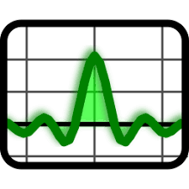
Presentation Outlines
Introduction
Motivation
Problem Statement
Literature Review
Research Gaps
Objectives
Proposed Methodology
Multi-Mode FIR Filter Architecture
Optimized FIR Architecture
MATLAB Analysis
Verilog and Vivado Implementation
FPGA Implementation
Results and Comparison
Timeline
Conclusion and Future Scope
References

Slide 3

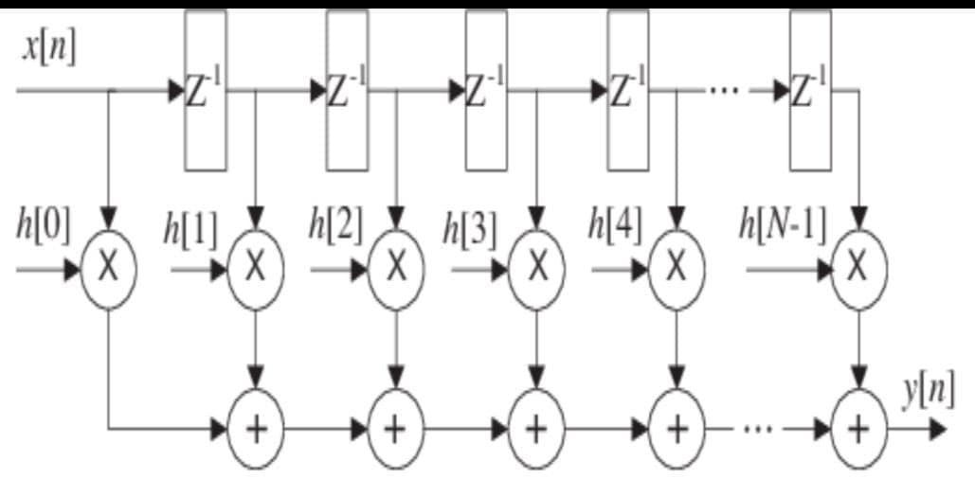
Introduction
Introduction to FIR Filters
F IR stands for Finite Impulse Response filter.
F I R filters are one of the most important components in Digital Signal Processing (DSP) systems.
The output of an F I R filter depends only on:
  Present input samples
  Previous finite input samples
F I R filters are called “finite” because their impulse response settles to zero in finite time.
FIR Filter Equation:
Where:
y[n] = Output signal
x[n−k] = Delayed input samples
h[k] = Filter coefficients
N = Number of taps
Advantages of FIR Filters
Linear phase response
Guaranteed stability
Easy hardware implementation
Suitable for FPGA and VLSI implementation
Better noise handling capability
Applications of FIR Filters
Audio and speech processing
Wireless communication systems
Biomedical signal processing
Image processing
Radar and DSP applications

Slide 4
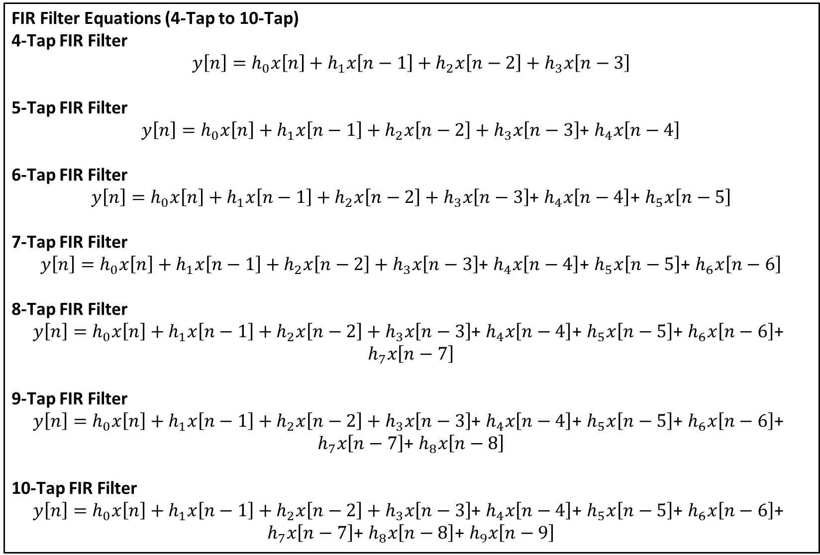
FIR Filter Equations (4-Tap to 10-Tap)
4-Tap FIR Filter
$$y\left[n\right]=h_{0}x\left[n\right]+h_{1}x\left[n−1\right]+h_{2}x\left[n−2\right]+h_{3}x\left[n−3\right]$$
5-Tap FIR Filter
$y\left[n\right]=h_{0}x\left[n\right]+h_{1}x\left[n−1\right]+h_{2}x\left[n−2\right]+h_{3}x\left[n−3\right]$+ $h_{4}x\left[n−4\right]$
6-Tap FIR Filter
$y\left[n\right]=h_{0}x\left[n\right]+h_{1}x\left[n−1\right]+h_{2}x\left[n−2\right]+h_{3}x\left[n−3\right]$+ $h_{4}x\left[n−4\right]$+ $h_{5}x\left[n−5\right]$
7-Tap FIR Filter
$y\left[n\right]=h_{0}x\left[n\right]+h_{1}x\left[n−1\right]+h_{2}x\left[n−2\right]+h_{3}x\left[n−3\right]$+ $h_{4}x\left[n−4\right]$+ $h_{5}x\left[n−5\right]$+ $h_{6}x\left[n−6\right]$
8-Tap FIR Filter
$y\left[n\right]=h_{0}x\left[n\right]+h_{1}x\left[n−1\right]+h_{2}x\left[n−2\right]+h_{3}x\left[n−3\right]$+ $h_{4}x\left[n−4\right]$+ $h_{5}x\left[n−5\right]$+ $h_{6}x\left[n−6\right]$+ $h_{7}x\left[n−7\right]$
9-Tap FIR Filter
$y\left[n\right]=h_{0}x\left[n\right]+h_{1}x\left[n−1\right]+h_{2}x\left[n−2\right]+h_{3}x\left[n−3\right]$+ $h_{4}x\left[n−4\right]$+ $h_{5}x\left[n−5\right]$+ $h_{6}x\left[n−6\right]$+ $h_{7}x\left[n−7\right]$+ $h_{8}x\left[n−8\right]$
10-Tap FIR Filter
$y\left[n\right]=h_{0}x\left[n\right]+h_{1}x\left[n−1\right]+h_{2}x\left[n−2\right]+h_{3}x\left[n−3\right]$+ $h_{4}x\left[n−4\right]$+ $h_{5}x\left[n−5\right]$+ $h_{6}x\left[n−6\right]$+ $h_{7}x\left[n−7\right]$+ $h_{8}x\left[n−8\right]$+ $h_{9}x\left[n−9\right]$

Slide 5
Need for FIR Filter Optimization:
Motivation
Limitations of Conventional FIR Filters
Large number of multipliers and adders
High switching activity and memory usage
Increased power consumption and delay
Higher FPGA area utilization
Challenges in FPGA Implementation
As tap count increases:
Arithmetic complexity increases
Critical path delay increases
LUT and DSP usage increases
Proposed Optimization Techniques
Develop scalable FIR filters from 4-Tap to 10-Tap
Improve speed and hardware efficiency
Reduce arithmetic complexity and switching activity
Implement multiple filter modes in a single architecture
Coefficient symmetry
Pipelining
Resource sharing
Clock enable based low-power design
Balanced adder tree
Expected Outcomes
Reduced power consumption
Reduced path delay
Lower LUT and DSP utilization
Higher throughput and FPGA efficiency

Slide 6
Background
Background of the Work
FIR filters are essential building blocks in DSP systems
FPGA implementation provides:
Parallel processing
Real-time operation
High throughput
Reconfigurability
Existing Challenges
Traditional FIR architectures suffer from:
High arithmetic complexity
Large DSP usage
Higher LUT consumption
Increased dynamic power
Long critical path delay
Solution Approach
Optimization techniques are used to:
Reduce power
Reduce delay
Reduce FPGA resource utilization
Improve throughput
Improve hardware efficiency

Slide 7
Problem Statement
Traditional FIR filter architectures require multiple multipliers and adders, which increase:
Power consumption
Propagation delay
FPGA resource utilization
Arithmetic complexity
As the number of taps increases:
Critical path delay increases
DSP and LUT usage increases
Hardware efficiency decreases
Problem to be Solved
Design an optimized FPGA-based multi-mode FIR filter architecture that:
Reduces power consumption
Minimizes delay
Optimizes LUT and DSP utilization
Improves throughput and timing performance
Proposed Solution
Apply optimization techniques such as:
Coefficient symmetry
Pipelining
Resource sharing
Clock-enable based low-power operation
Balanced adder tree architecture

Slide 8
LITERATURE REVIEW
Literature Review Overview
Several researchers proposed optimization methods for FIR filters:
References | Techniques Used | Advantages | Drawbacks
[1] | Coefficient symmetry | Reduced multipliers | Complex scaling
[3] | Low-power multiplier | Reduced switching activity | Limited throughput
[5] | Vedic multiplier | Low power and area | Increased design complexity
[6] | Pipelining and retiming | High speed | Increased register count
[7] | CSD coefficients | Reduced arithmetic complexity | Coefficient dependency
[9] | Approximate MAC | Reduced power consumption | Accuracy reduction
[10] | Truncated MAC | Improved performance | Approximation error
[17] | Parallel processing | High throughput | Increased hardware utilization
[19] | Low-power FPGA FIR | Reduced power | Limited scalability
[20] | Higher-order FPGA FIR | Scalable architecture | Increased complexity
Observation
Most previous works focused on:
Single optimization techniques
Limited scalability
Limited comparative analysis

Slide 9
Research Gaps
Very less comparative
study for:
Power
Delay
Area
Research Gaps Identified
Proposed Solution
Existing Limitations
Limited FPGA-based scalable architectures
Develop scalable optimized FIR filters from 4-Tap to 10-Tap
Limited comparison
between:
Even tap FIR filters
Odd tap FIR filters
Apply combined optimization techniques to improve FPGA performance and efficiency
Most works use only one
optimization method.
Very few studies combine:
Pipelining
Coefficient symmetry
DSP optimization
Resource sharing
Low-power optimization
Additional Gaps

Slide 10
OBJECTIVES
Main Objectives of the Proposed Work
Design FIR filters from 4-Tap to 10-Tap:
Compare optimized and non-optimized architectures Analyze
Power consumption
Implement LPF, HPF, BPF and BSF in a single architecture
Generate filter coefficients using MATLAB FDATool
Implement FIR filters using Verilog HDL and Xilinx Vivado
Apply optimization techniques such as:
Coefficient symmetry
Pipelining
Resource sharing
Low-power optimization
Propagation delay
LUT and DSP utilization
Improve overall FPGA hardware efficiency and throughput

Slide 11
Proposed Methodology
Generate FIR filter coefficients using MATLAB FDATool
Convert coefficients into fixed-point representation
Design FIR filter architectures using Verilog HDL
Develop testbench for functional verification
Perform behavioral simulation in Xilinx Vivado
Apply optimization techniques:
1.Coefficient symmetry
Pipelining
2.Resource sharing
3.Clock-enable based low-power design
synthesis and FPGA implementation
Analyze and compare:
1.Power consumption
2.Delay
3.LUT utilization
4.DSP utilization 5.Tools Used
MATLAB FDATool
Verilog HDL
Xilinx Vivado
Nexys A7 FPGA Board

Slide 12
Multi-Mode FIR Filter Architecture
Multi-Mode FIR Filter Supported Modes
Mode | Filter Type
00 | LPF
01 | HPF
10 | BPF
11 | BSF
Features
Single architecture supports multiple filters.
Coefficient switching used for different modes.
Reduces hardware redundancy.
Improves FPGA resource efficiency.

Slide 13
Non-Optimized FIR Architecture
Conventional FIR Filter Structure
Uses traditional Multiply–Accumulate (MAC) architecture
Separate multiplier and adder used for each tap
Direct accumulation increases arithmetic complexity Main Components
Shift registers
Multipliers
Adders
Accumulator unit Limitations
High power consumption
Increased propagation delay
Large LUT and DSP utilization
Higher switching activity
Longer critical path delay Observation
As the number of taps increases:
Hardware complexity increases
FPGA resource usage increases
Overall system performance decreases

Slide 14
Optimized FIR Architecture
Proposed Optimized FIR Filter Structure
Designed to improve FPGA performance and hardware efficiency
Uses combined optimization techniques to reduce complexity
Optimization Techniques Used
Coefficient symmetry
Pipelining
Resource sharing
Balanced adder tree
Clock-enable based low-power operation
DSP optimization
Advantages
Reduced power consumption
Reduced propagation delay
Lower LUT and DSP utilization
Reduced arithmetic complexity
Higher throughput and faster operation
Observation
The optimized architecture provides better speed, lower area
utilization, and improved FPGA efficiency compared to the conventional FIR filter design.

Slide 15
Coefficient Symmetry Exploitation
In symmetric FIR filters:
ℎ[𝑘] = ℎ [𝑁 − 1 − 𝑘]
Symmetric coefficients allow sharing of multiplication operations.
Input samples are added before multiplication using pre-adders.
Benefits
Reduces number of multipliers
Minimizes DSP slice utilization
Lowers hardware complexity
Reduces power consumption
Improves FPGA resource efficiency
Impact on Architecture
Faster computation
Lower arithmetic complexity
Better optimized FIR filter implementation for higher tap counts

Slide 16
Balanced Adder Tree
Concept of Balanced Adder Tree
Instead of serial accumulation, additions are performed in parallel stages.
The adder structure is balanced to reduce arithmetic depth.
Working
Partial outputs are grouped and added simultaneously.
Reduces the number of sequential addition levels.
Advantages
Reduced critical path delay
Faster accumulation process
Improved throughput
Better timing performance Impact on FIR
Architecture
Lower propagation delay
Improved hardware efficiency
Faster FPGA-based FIR filter implementation

Slide 17
Pipelining Technique
Concept of Pipelining
Pipelining divides long combinational paths into smaller stages by inserting registers between operations.
It allows multiple operations to execute simultaneously in different
stages.
Purpose of Pipelining
Reduce critical path delay
Increase operating frequency
Improve throughput and timing performance
Advantages
Faster data processing
Improved speed performance
Better timing stability
Suitable for higher-order FIR filters
Impact on FIR Architecture
Reduced propagation delay
Increased hardware efficiency
Enhanced overall FPGA performance

Slide 18
Low Power Optimization
Low-Power Techniques Used
Clock Enable (CE) based operation
Operand isolation
Reduced switching activity
Glitch reduction techniques
Working Principle
Arithmetic units remain active only when required.
Unnecessary switching is minimized during idle conditions.
Advantages
Reduced dynamic power consumption
Improved energy efficiency
Lower heat generation
Better FPGA power performance
Impact on FIR Filter
Lower overall power usage
Efficient operation for higher tap FIR filters
Improved low-power FPGA implementation

Slide 19
MATLAB Analysis
MATLAB-Based FIR Filter Design
MATLAB FDATool is used to generate FIR filter coefficients.
Coefficients are designed for:
  LPF (Low Pass Filter)
  HPF (High Pass Filter)
  BPF (Band Pass Filter)
  BSF (Band Stop Filter)
Design Process:
Select filter type and order
Define cutoff frequencies
Generate FIR coefficients
Convert coefficients into fixed-point format
Advantages
Accurate coefficient generation
Easy frequency response analysis
Faster filter verification
Simplified FIR design process
Outcome
Generated coefficients are used for Verilog HDL implementation and FPGA-based FIR filter design.

Slide 20
MATLAB Results
MATLAB-Based FIR Filter Analysis
FIR filters designed and analyzed using MATLAB FDATool.
Frequency responses generated for:
  LPF (Low Pass Filter)
  HPF (High Pass Filter)
  BPF (Band Pass Filter)
  BSF (Band Stop Filter)
Results Observed
LPF passes low-frequency signals
HPF passes high-frequency signals
BPF allows selected frequency band
BSF rejects selected frequency band
Analysis Performed
Magnitude response
Frequency response
Coefficient verification
Outcome
FIR filter coefficients successfully generated and verified
MATLAB results validated the correct operation of all filter modes before FPGA implementation
.

Slide 21
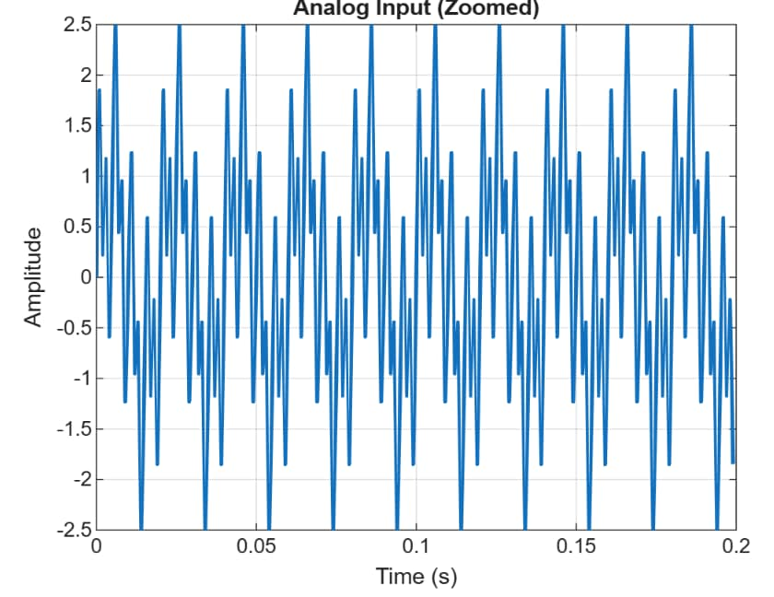
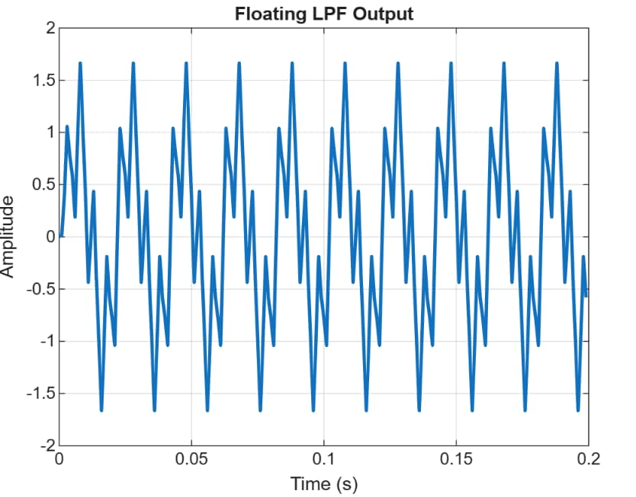




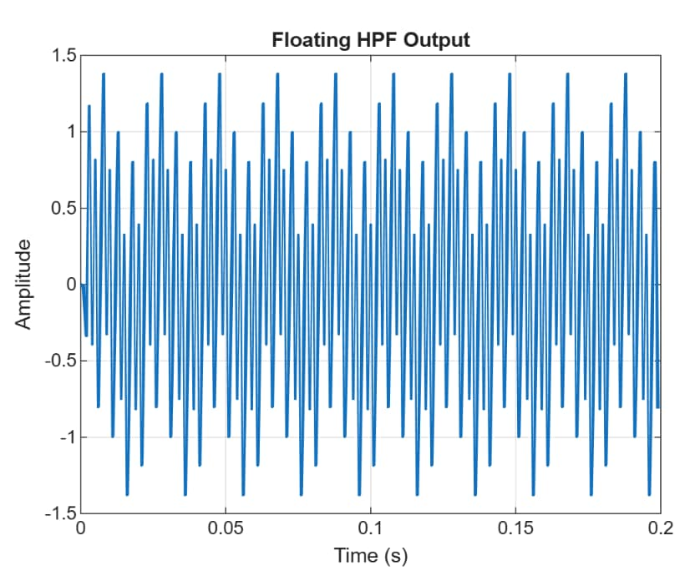
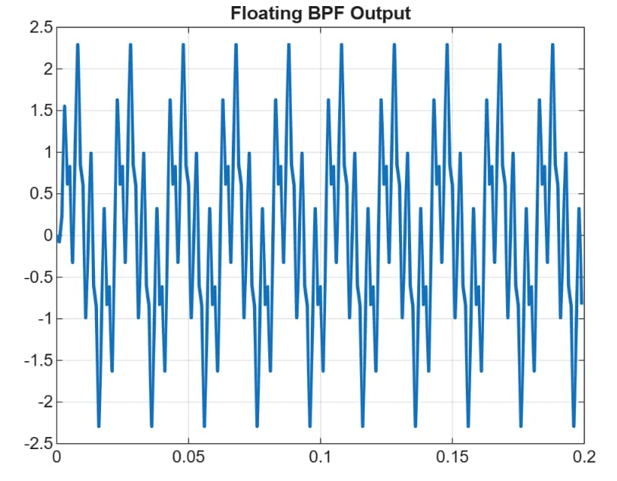
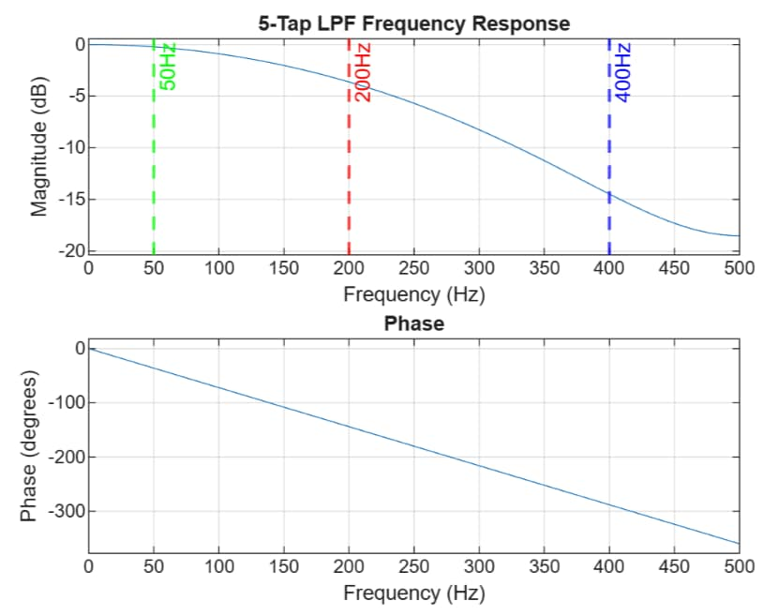
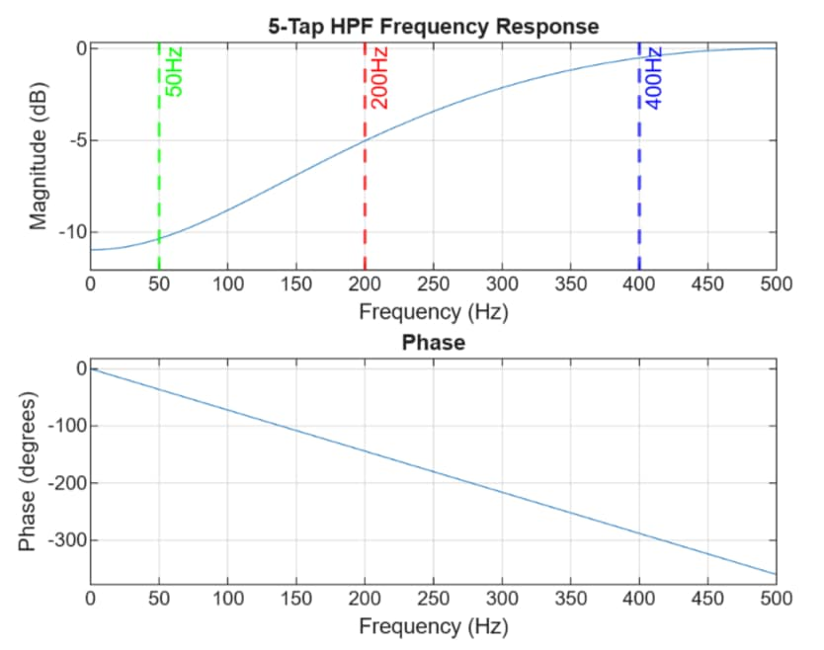
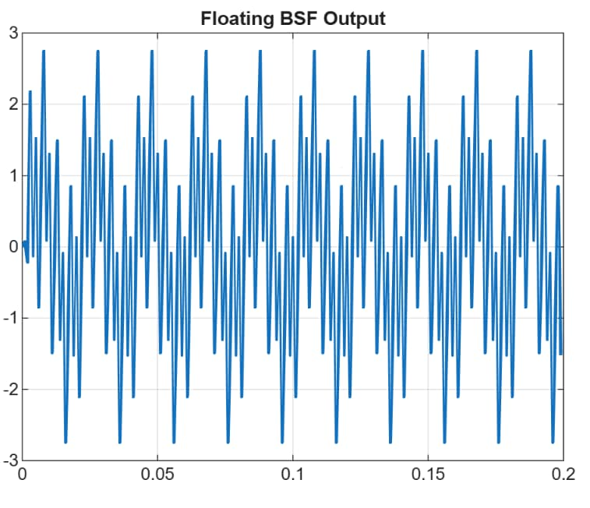
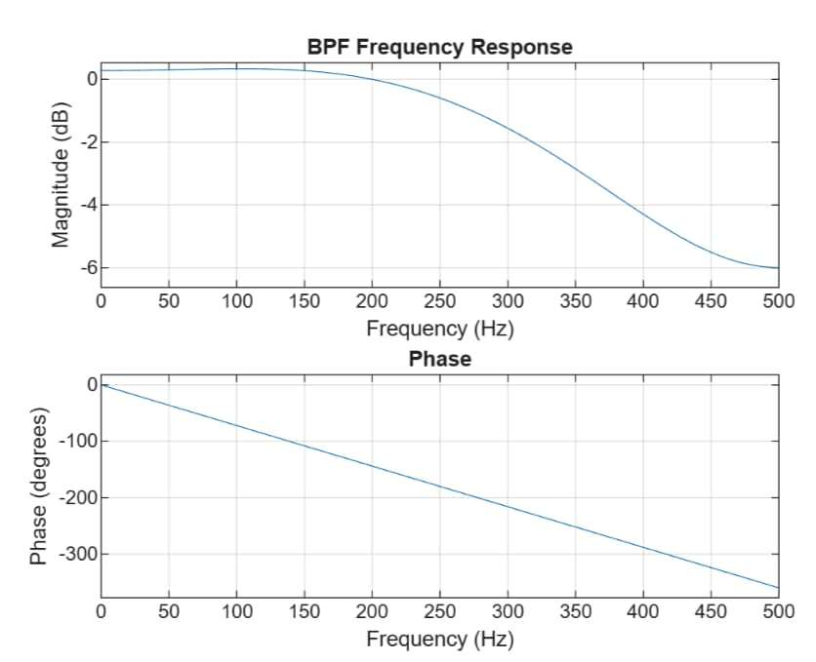
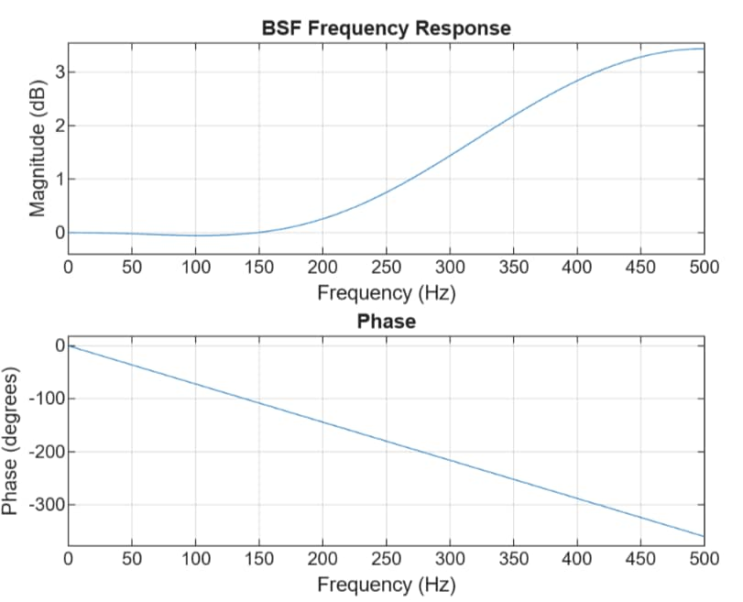
MATLAB PLOTS FOR 5 TAP FIR

Slide 22

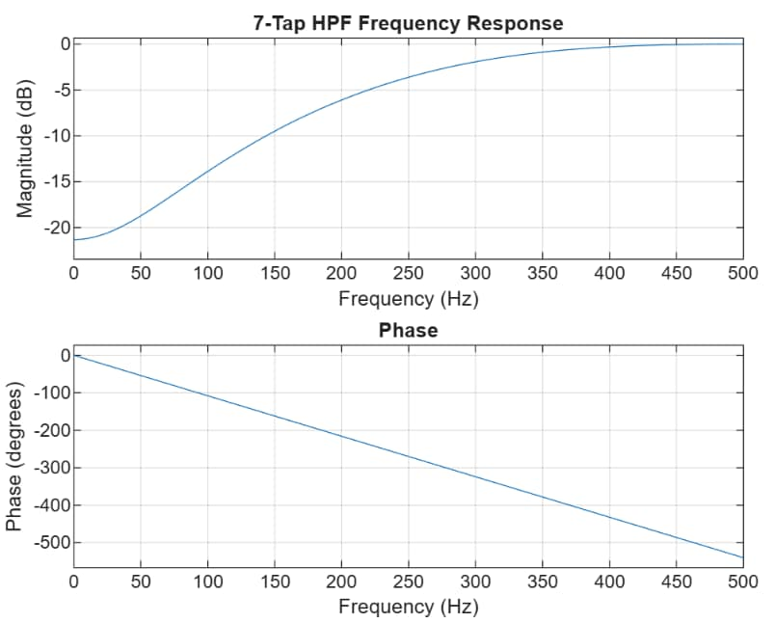



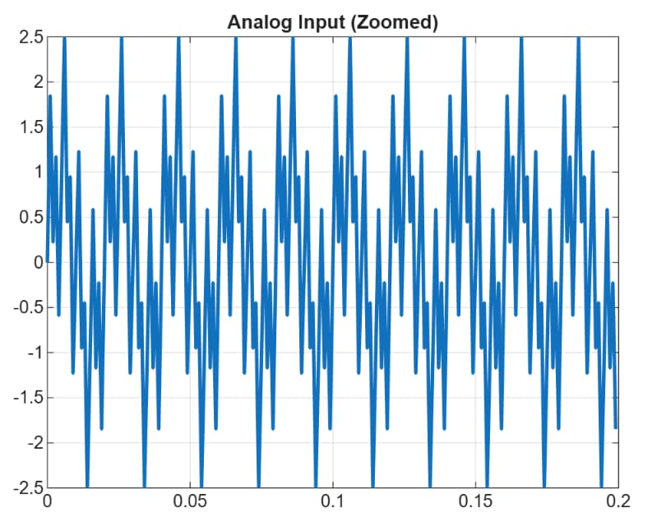
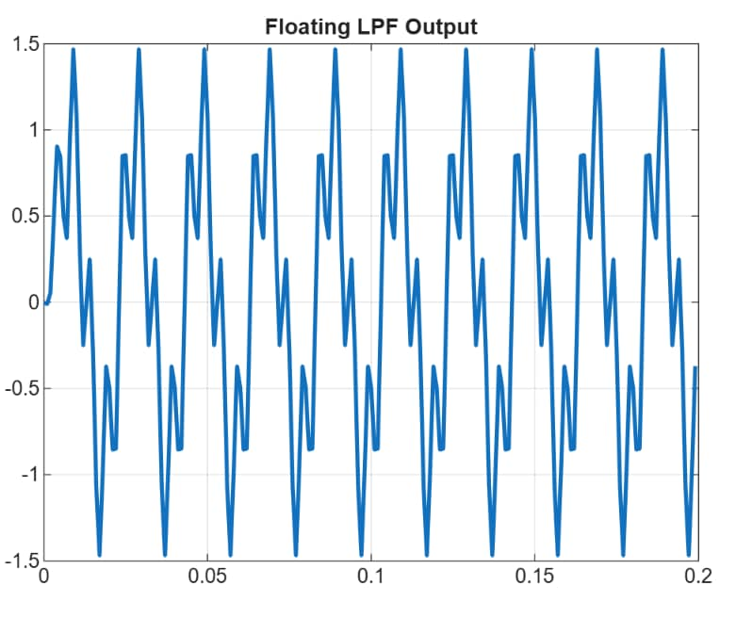
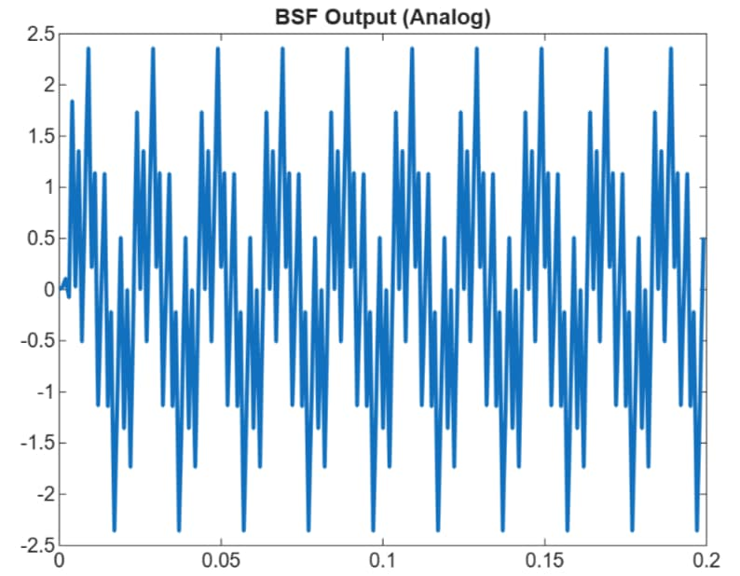
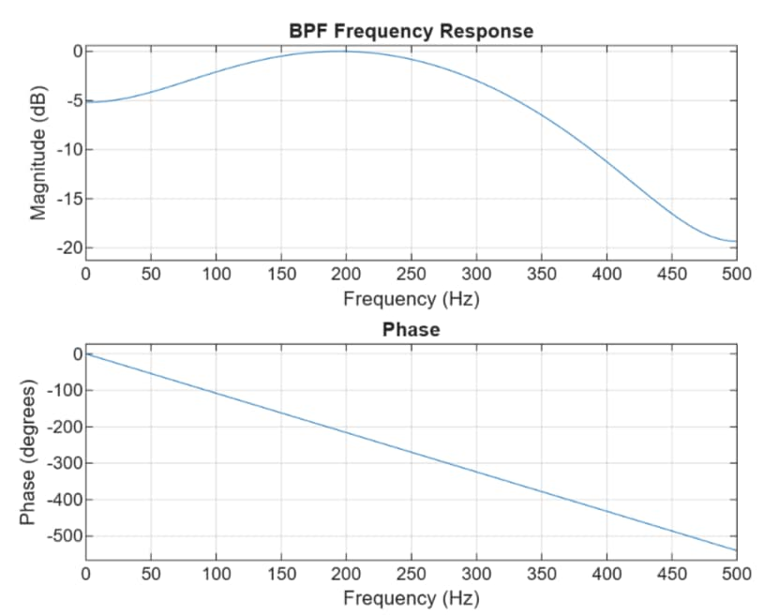
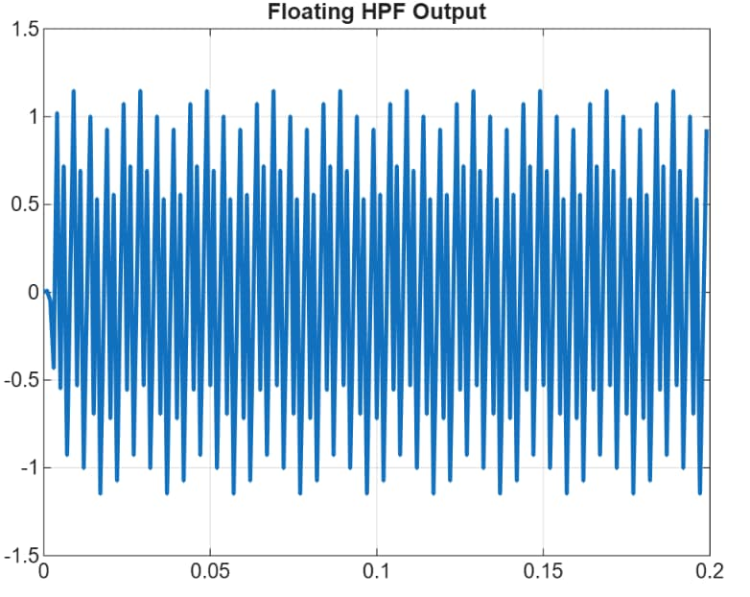
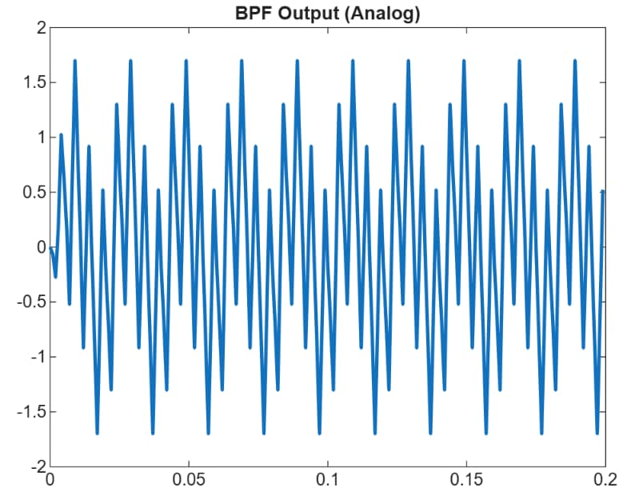
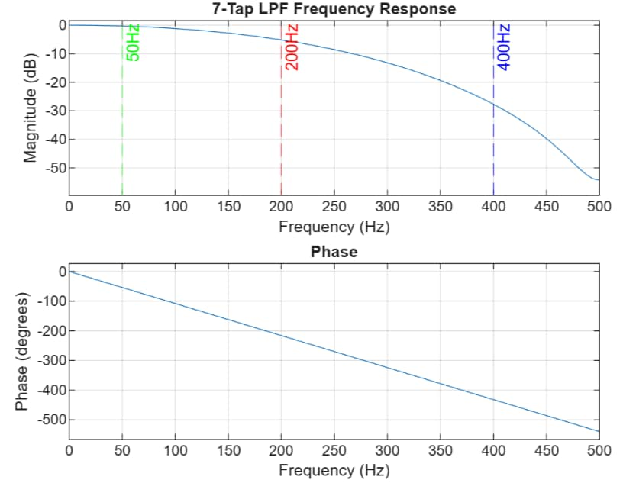
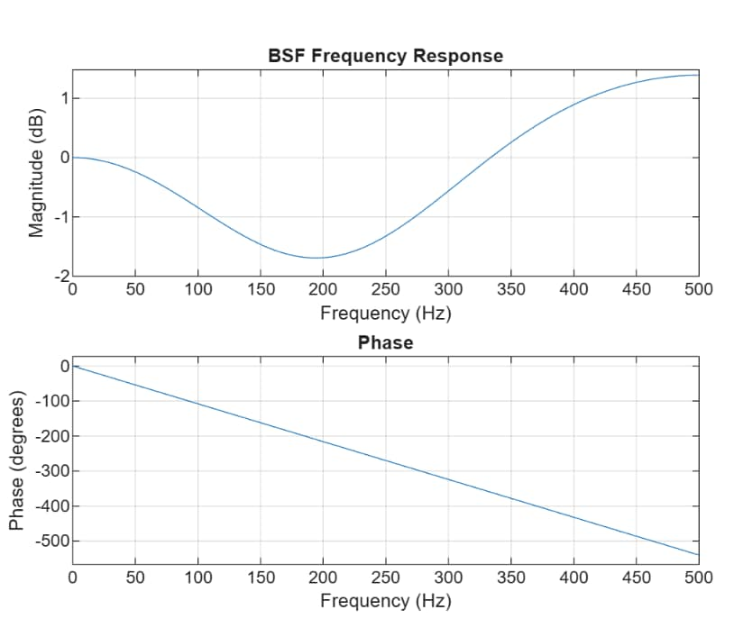
MATLAB PLOTS FOR 7 TAP FIR

Slide 23
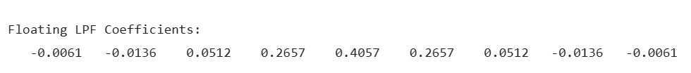
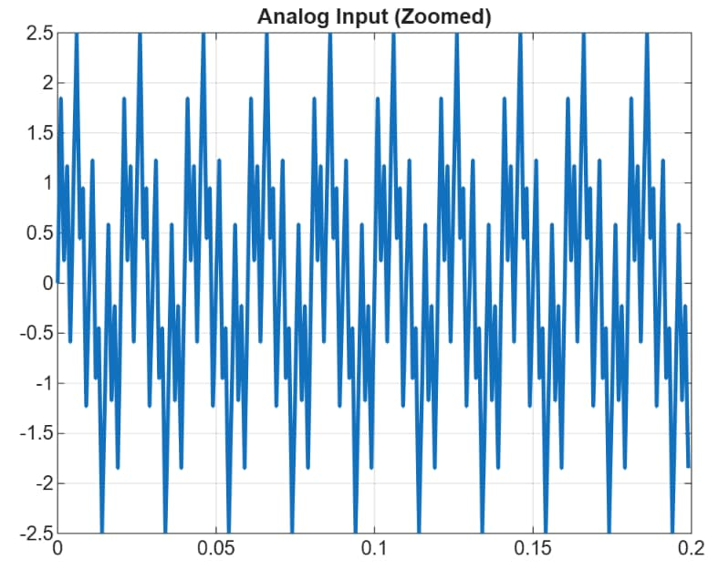
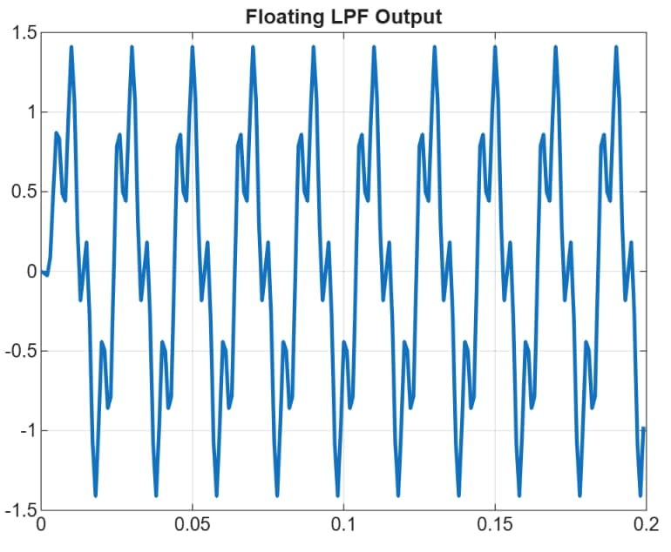
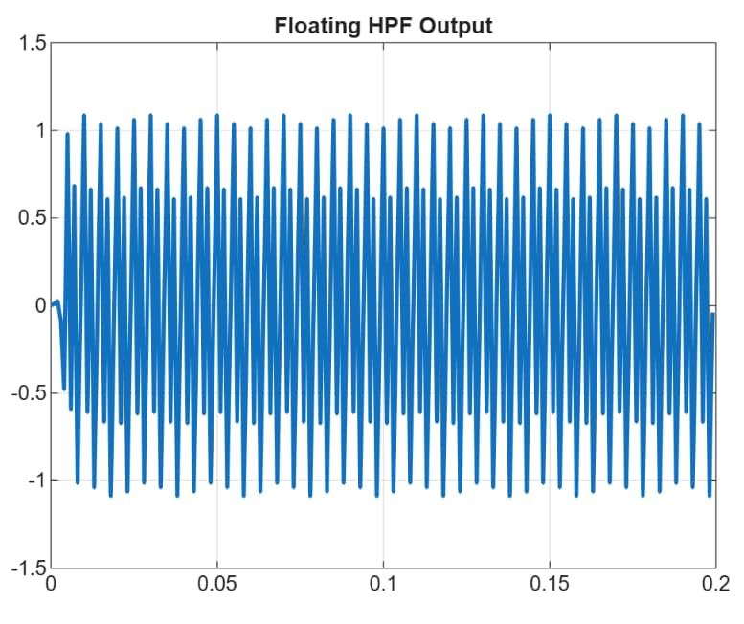
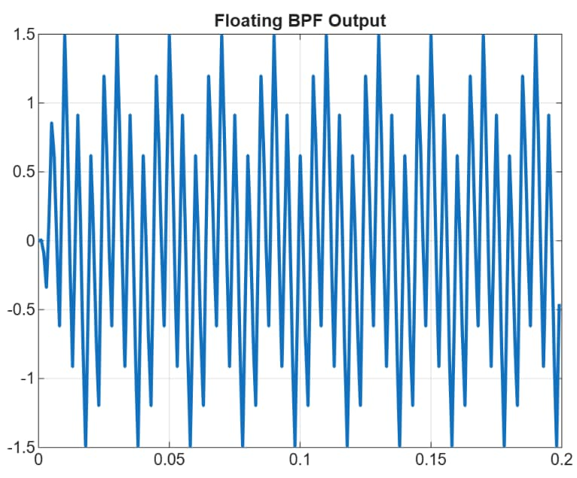
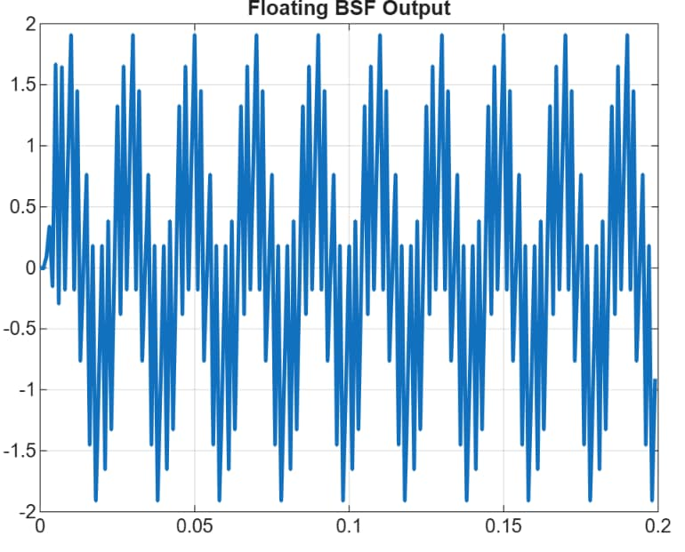
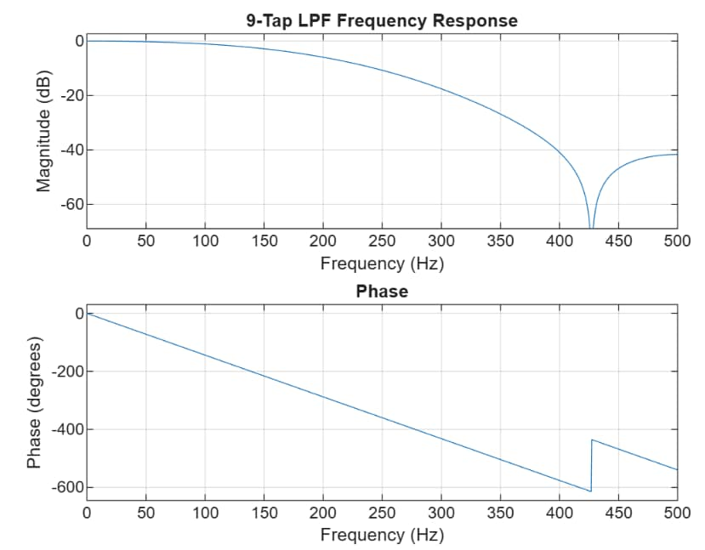
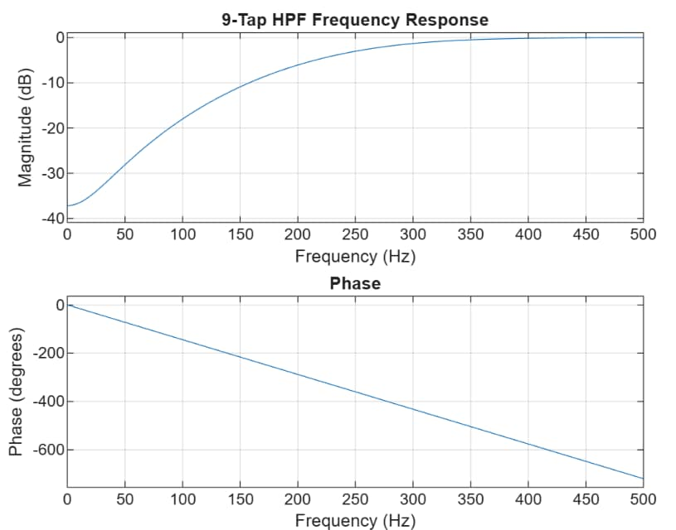
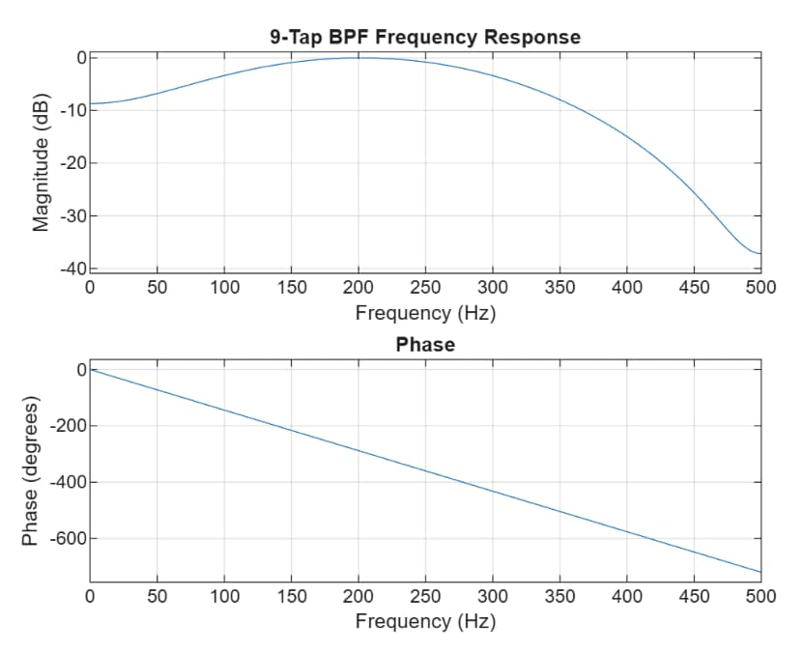
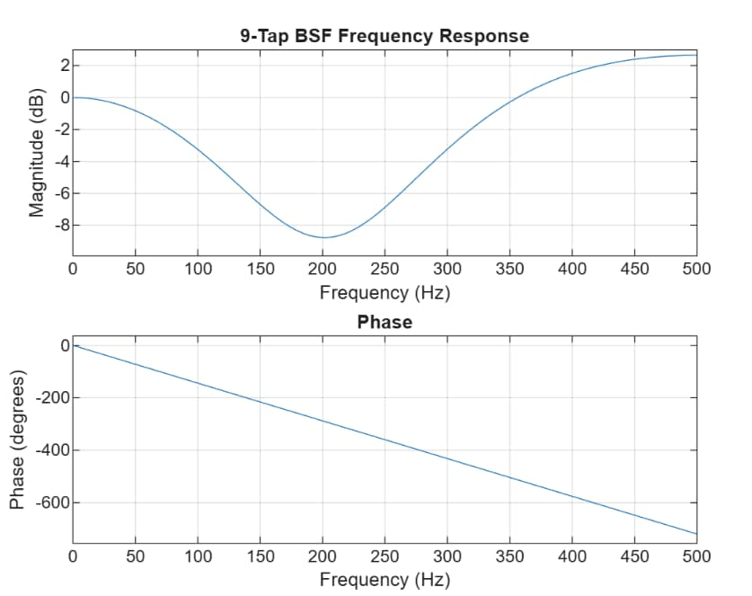
MATLAB PLOTS FOR 9 TAP FIR

Slide 24
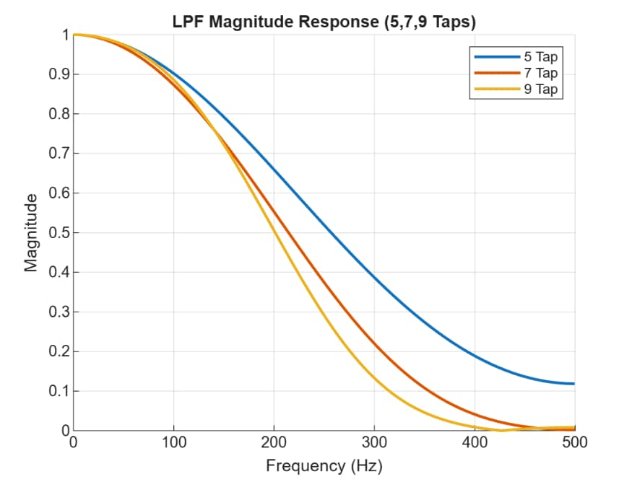
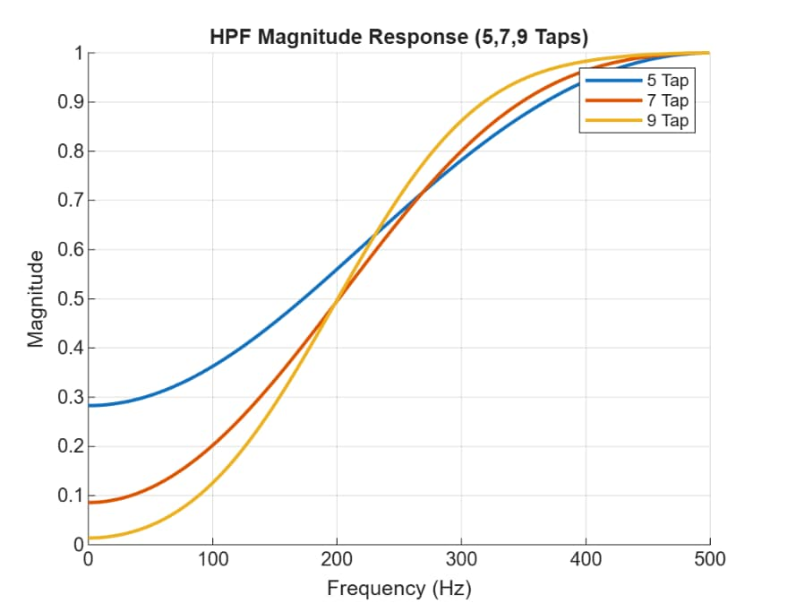
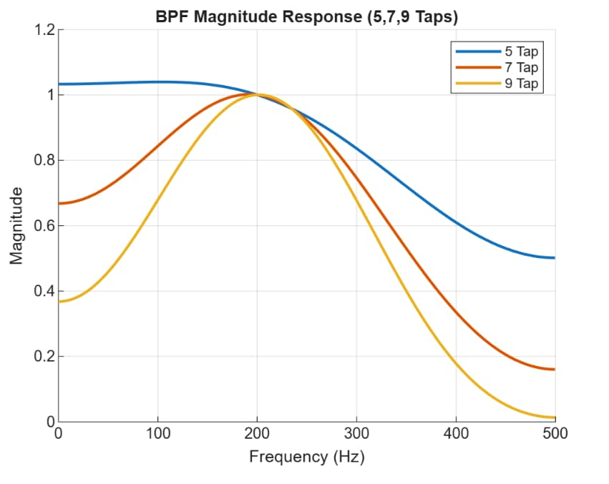
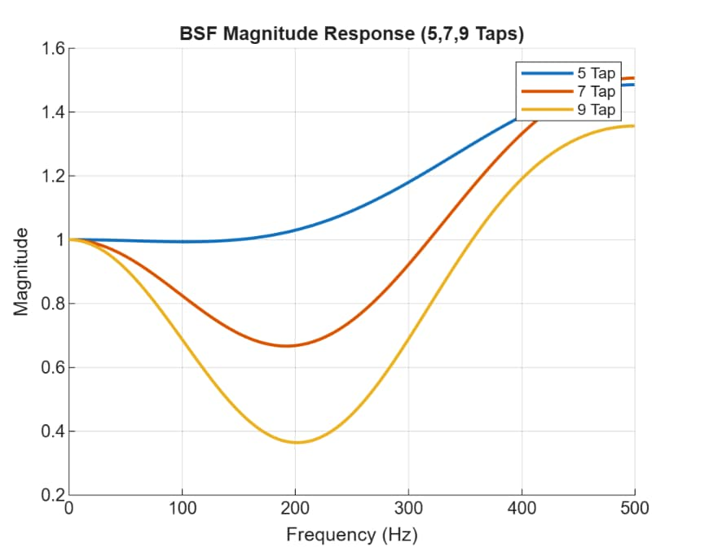
Frequency Response of LPF,HPF,BPF,BSF

Slide 25
Verilog and Vivado Implementation
FIR Filter Implementation Using Verilog HDL
FIR filter architectures from 4-Tap to 10-Tap are designed using Verilog HDL.
Multi-mode filter implementation supports:
  LPF
  HPF
  BPF
  BSF
Main Modules Implemented
Shift registers
Multiply–Accumulate (MAC) units
Coefficient selection logic
Clock Enable (CE) control logic
Output accumulation block
Verification Process
Functional verification performed using testbenches
Simulation carried out in Xilinx Vivado
Advantages
Hardware-level implementation
Scalable and modular design
Efficient FPGA realization
Easy integration with optimization techniques

Slide 26
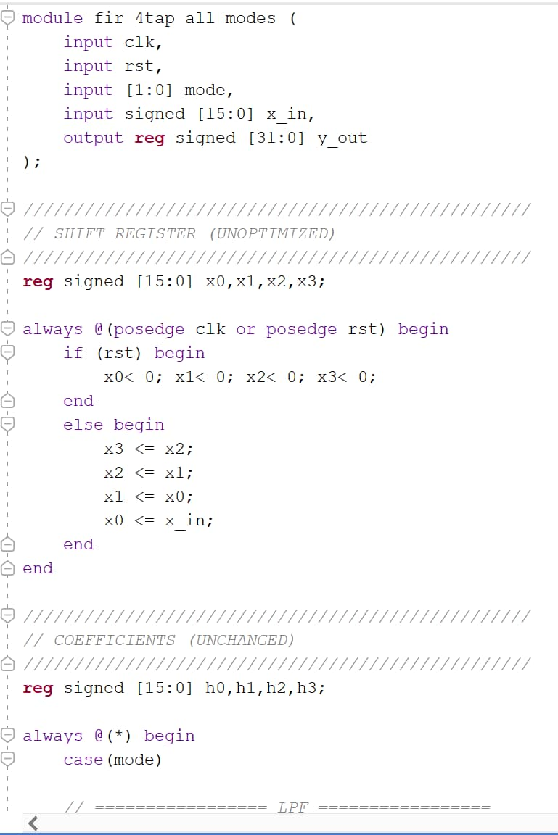
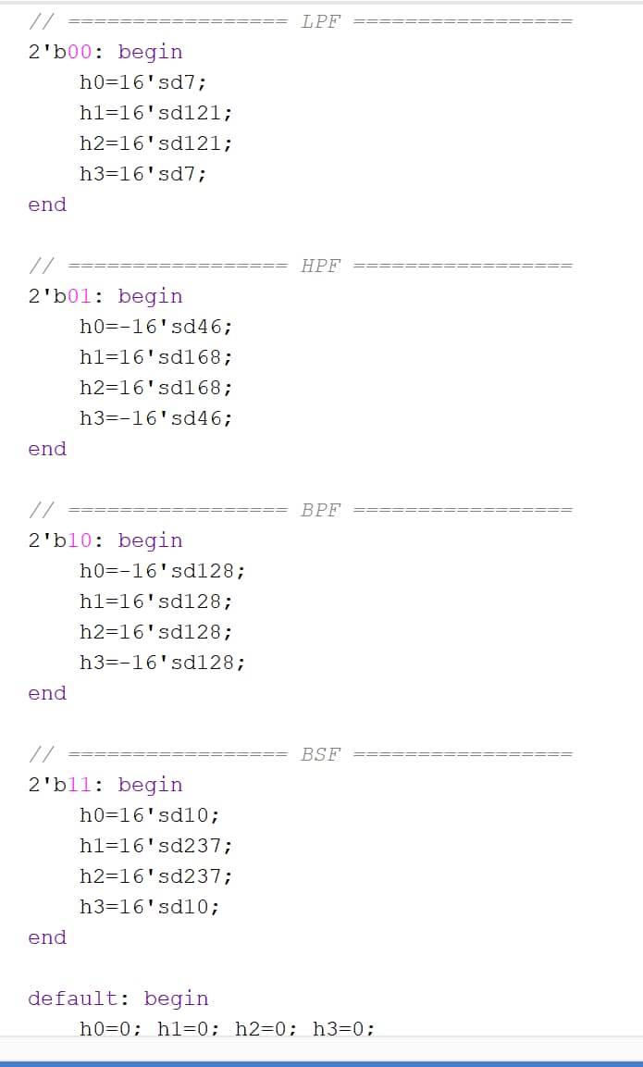
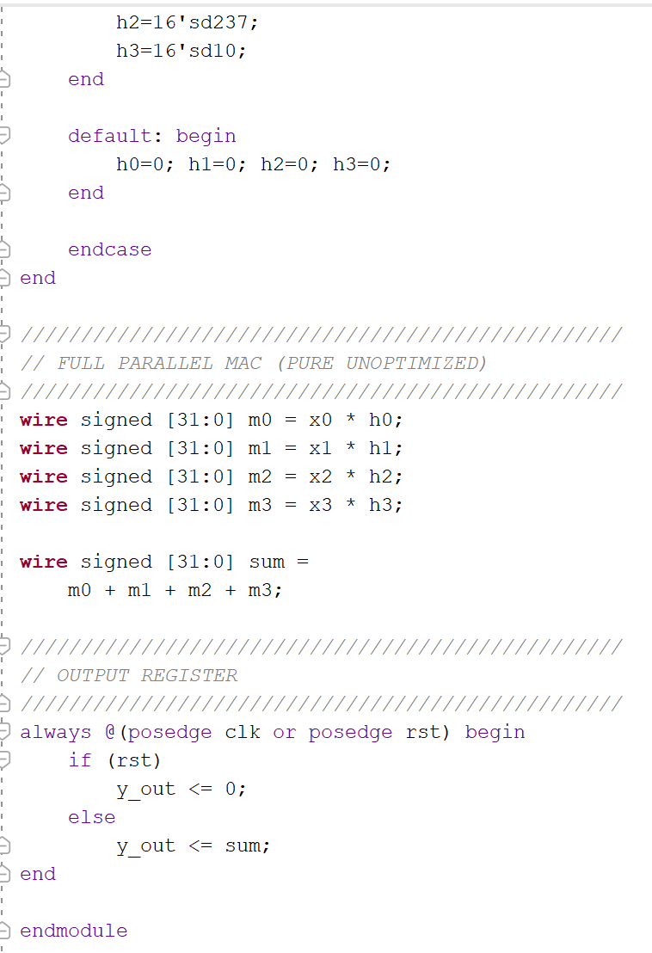
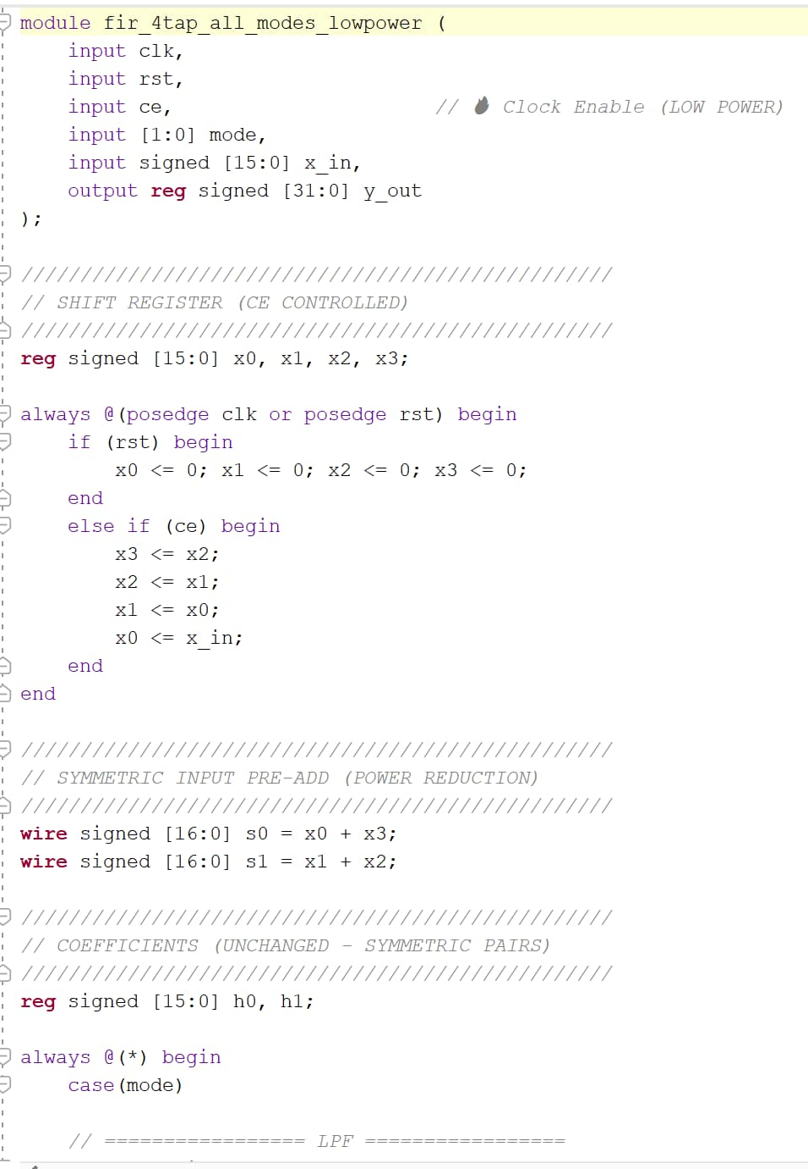
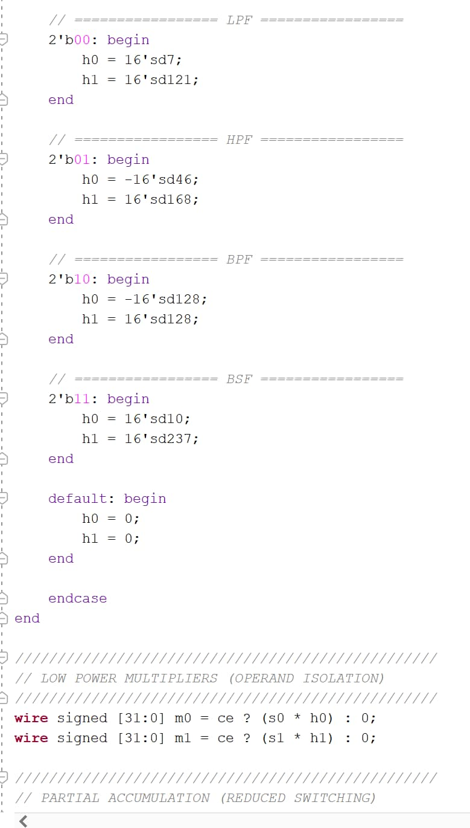
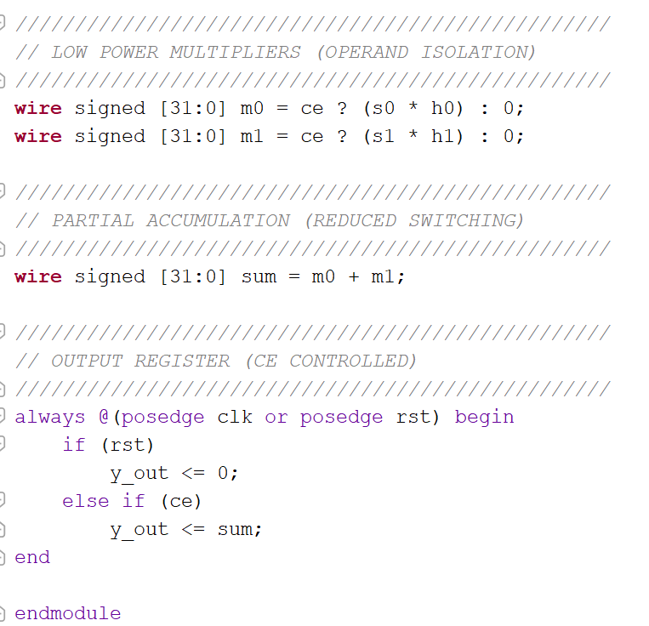
Verilog Code From 4-10 Taps
VERILOG CODE For 4-Tap FIR Filter: Without optimized
VERILOG CODE For 4-Tap FIR Filter: With optimized

Slide 27
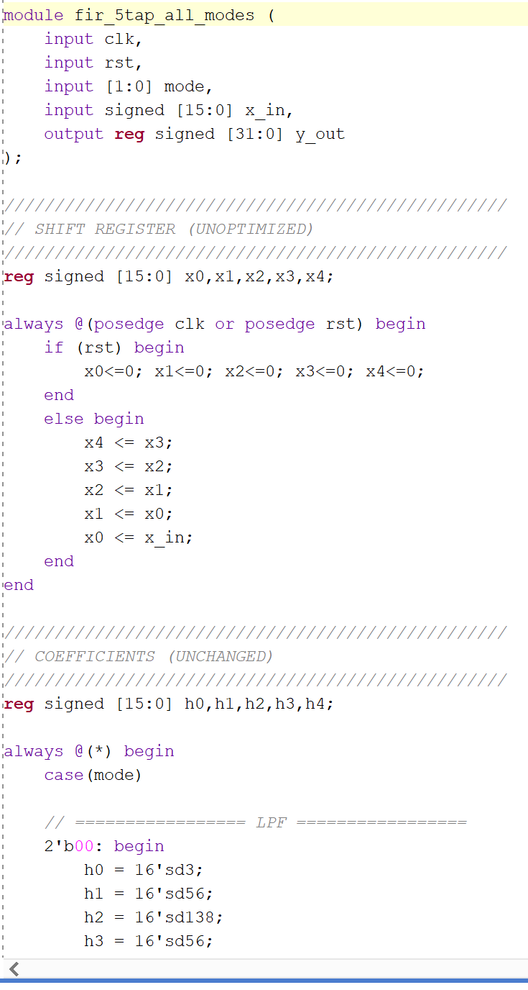
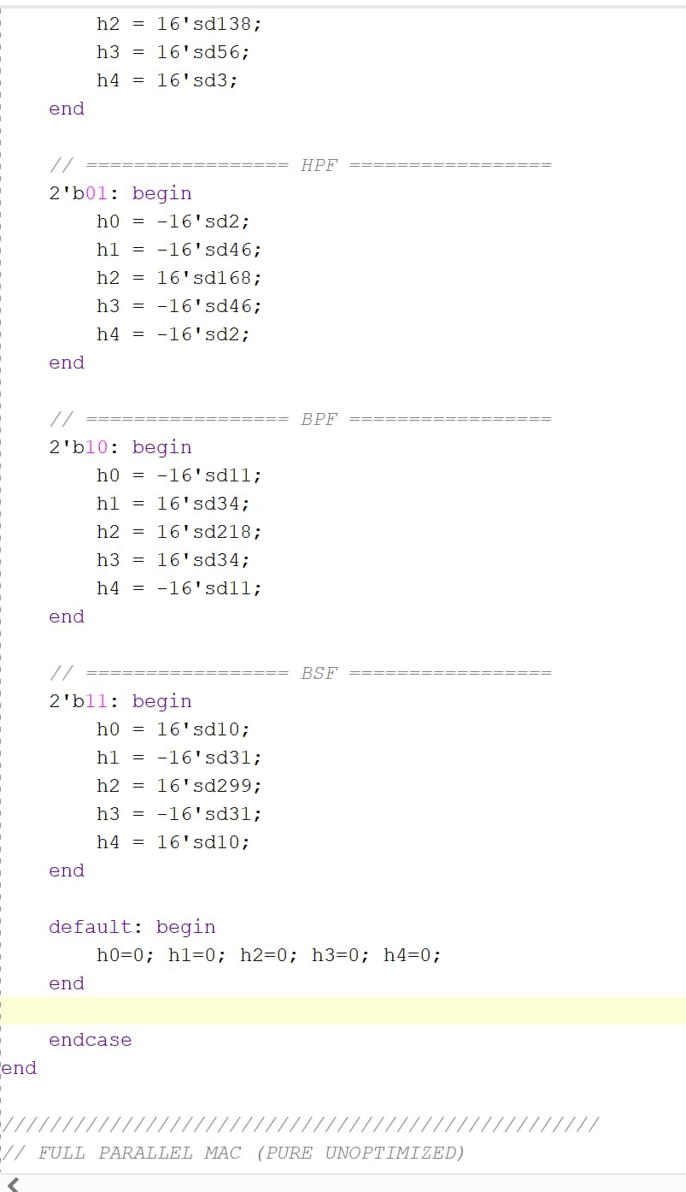
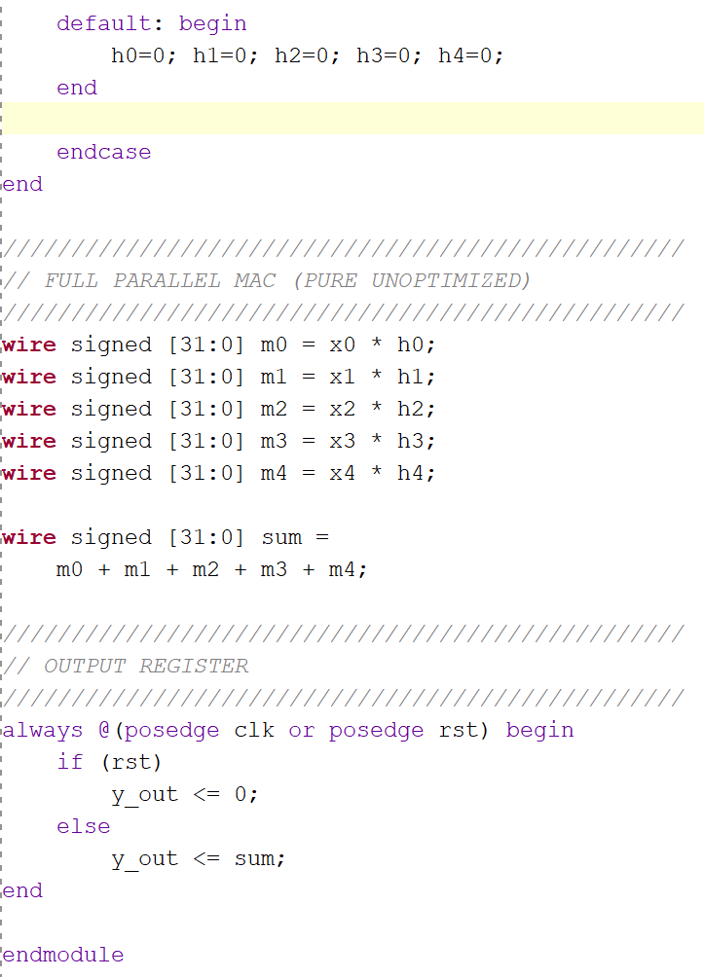
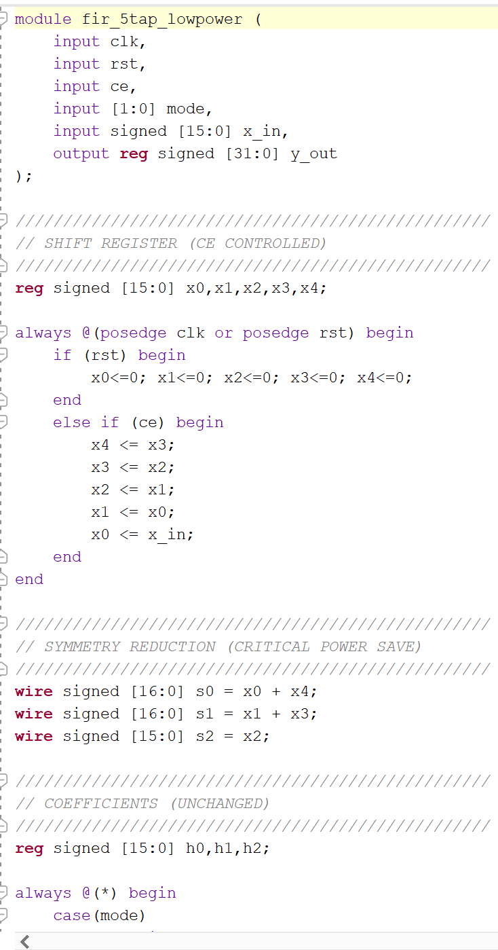
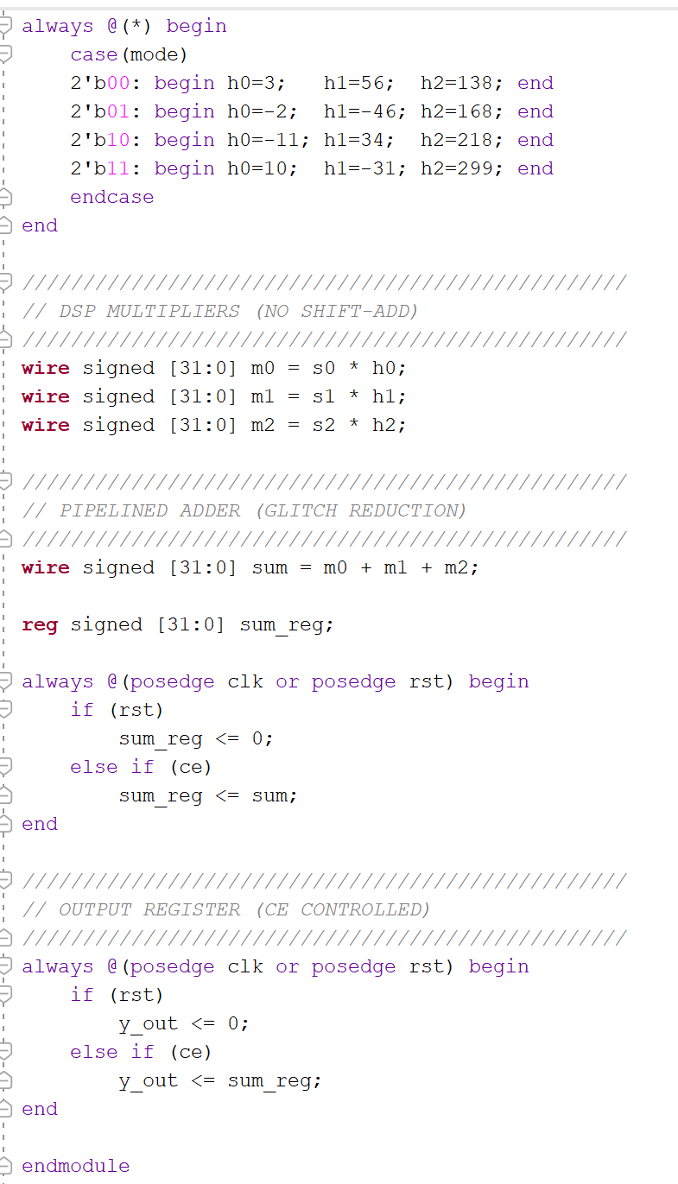
VERILOG CODE For 5-Tap FIR Filter: Without optimized
VERILOG CODE For 5-Tap FIR Filter: With optimized

Slide 28
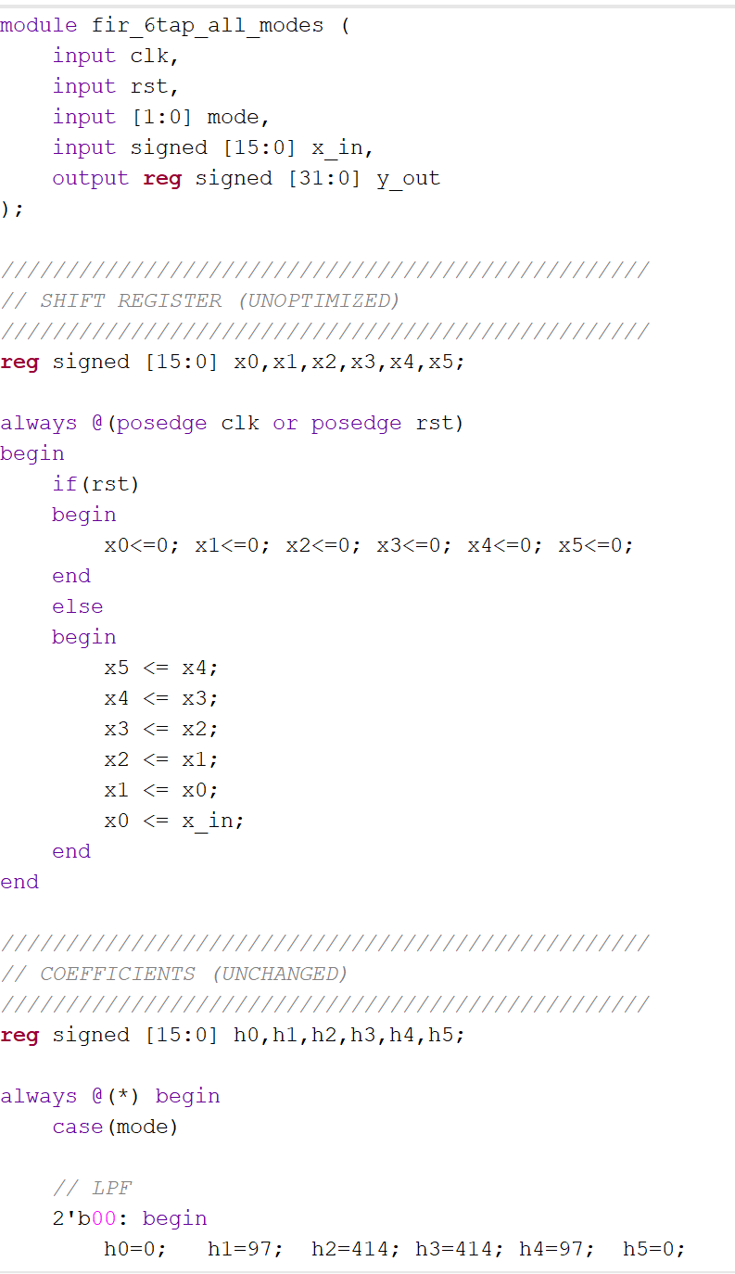
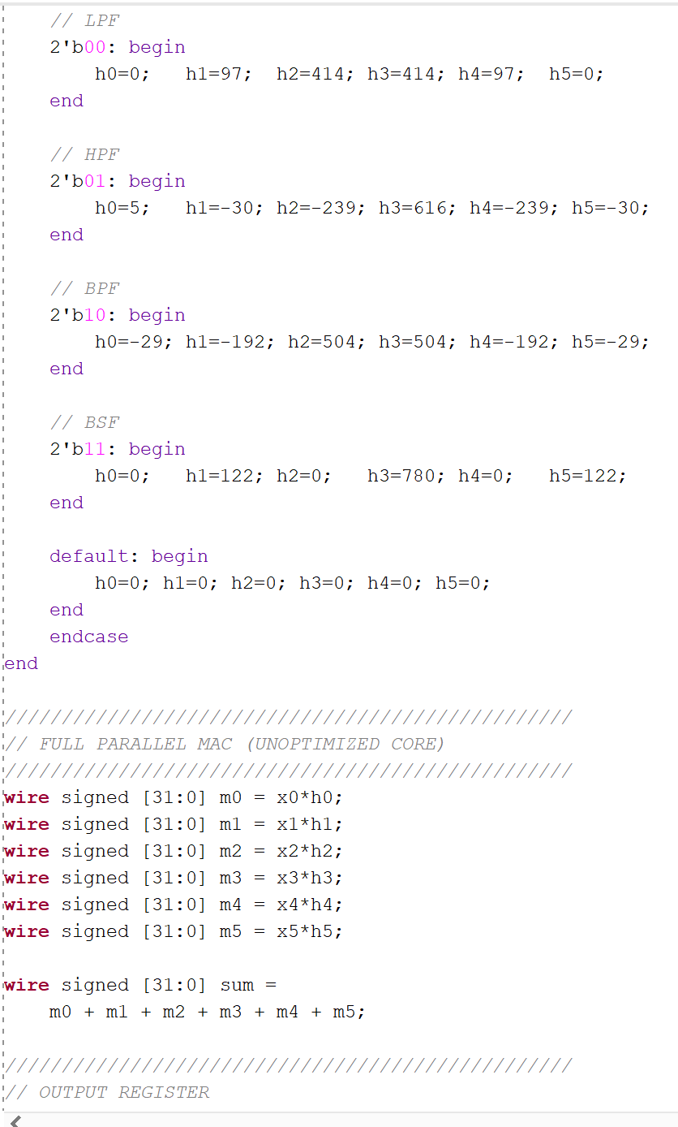
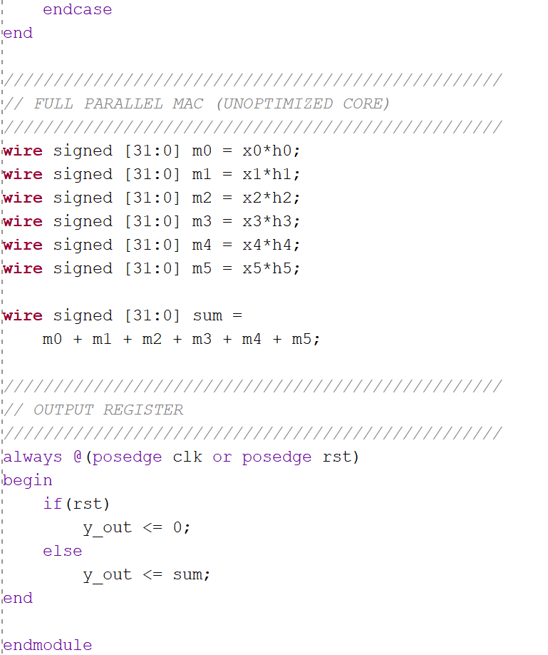
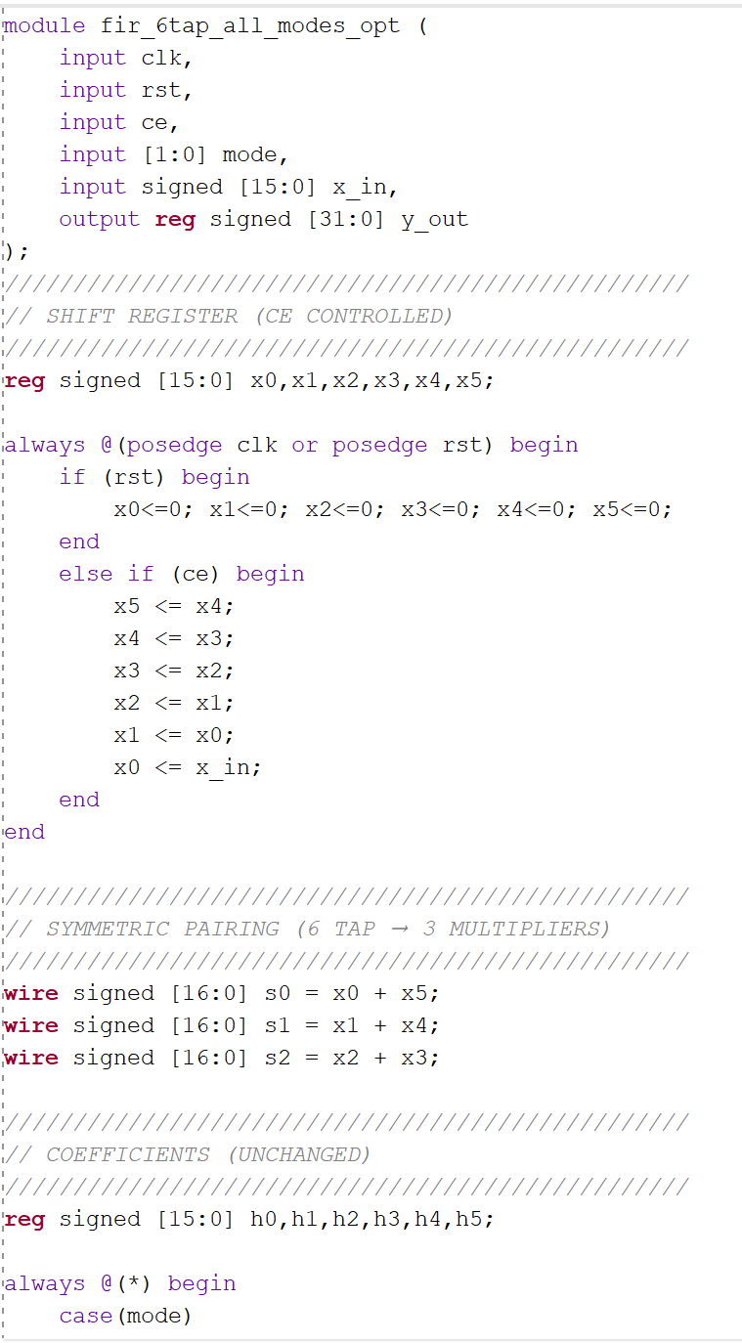


VERILOG CODE For 6-Tap FIR Filter: Without optimized
VERILOG CODE For 6-Tap FIR Filter: With optimized

Slide 29






VERILOG CODE For 7-Tap FIR Filter: Without optimized
VERILOG CODE For 7-Tap FIR Filter: With optimized

Slide 30






VERILOG CODE For 8-Tap FIR Filter: Without optimized
VERILOG CODE For 8-Tap FIR Filter: With optimized

Slide 31







VERILOG CODE For 9-Tap FIR Filter: Without optimized
VERILOG CODE For 9-Tap FIR Filter: With optimized

Slide 32







VERILOG CODE For 10-Tap FIR Filter: Without optimized
VERILOG CODE For 10-Tap FIR Filter: With optimized

Slide 33
Testbench and Simulation
Testbench Design
Testbench developed to verify functional correctness of FIR filter architectures
Different input stimulus signals applied for testing
All filter modes verified:
  LPF
  HPF
  BPF
  BSF
Testbench Components
Clock generation
Reset logic
Input sample generation
Mode selection logic
Output monitoring
Simulation in Xilinx Vivado
Behavioral simulation performed using Vivado Simulator
FIR filter outputs analyzed using waveform results
Verification Results
Correct filtering operation achieved
Proper MAC functionality verified
Stable output response observed
Successful operation from 4-Tap to 10-Tap FIR filters

Slide 34







TESTBENCH for 4 Tap FIR Filter: Without optimized
TESTBENCH for 4 Tap FIR Fiter: With optimized

Slide 35








TESTBENCH for 5 Tap FIR Filter: without optimized
TESTBENCH for 5 Tap FIR Filter: with optimized

Slide 36






TESTBENCH for 6 Tap FIR Filter: Without optimized
TESTBENCH for 6 Tap FIR Filter: With optimized

Slide 37







TESTBENCH for 7Tap FIR Filter: Without optimized
TESTBENCH for 7 Tap FIR Filter: With optimized

Slide 38








TESTBENCH for 8 Tap FIR Filter: Without optimized
TESTBENCH for 8 Tap FIR Filter: With optimized

Slide 39



TESTBENCH for 9 Tap FIR Filter: Without optimized
TESTBENCH for 9 Tap FIR Filter: With optimized

Slide 40








TESTBENCH for 10Tap FIR Filter: Without optimized
TESTBENCH for 10Tap FIR Filter: With optimized

Slide 41




Simulation of Without Optimized 4 TAP FIR Filter
Simulation of With Optimized 4 TAP FIR Filter
Simulation of Without Optimized 5TAP FIR Filter
Simulation of With Optimized 5TAP FIR Filter

Slide 42




Simulation of Without Optimized 6TAP FIR Filter
Simulation of With Optimized 6TAP FIR Filter
Simulation of Without Optimized 7TAP FIR Filter
Simulation of With Optimized 7TAP FIR Filter

Slide 43




Simulation of Without Optimized 8TAP FIR Filter
Simulation of With Optimized 8TAP FIR Filter
Simulation of Without Optimized 9TAP FIR Filter
Simulation of With Optimized 9TAP FIR Filter

Slide 44


Simulation of Without Optimized 10TAP FIR Filter
Simulation of With Optimized 10TAP FIR Filter

Slide 45
FPGA Implementation
FPGA-Based FIR Filter Implementation
Designed FIR filters are implemented on FPGA using Xilinx Vivado.
FPGA platform used: Nexys A7-100T Board
Implementation Steps
FPGA Parameters Analyzed
LUT utilization
DSP slice utilization
Register utilization
Timing performance
Power consumption
Observation
Optimized FIR architecture shows:
  Lower resource utilization
  Reduced delay
  Improved hardware efficiency
  Better overall FPGA performance
RTL synthesis
Design optimization
Place and route
Bitstream generation
Hardware implementation

Slide 46



Slide 47



Slide 48




FPGA IMPLEMENTATION XDC OF 4 TAP FIR FILTER WITHOUT OPTIMIZED
FPGA IMPLEMENTATION XDC OF 4 TAP FIR FILTER WITH OPTIMIZED

Slide 49






FPGA IMPLEMENTATION OF 6 TAP FIR FILTER WITHOUT OPTIMIZED
FPGA IMPLEMENTATION OF 6 TAP FIR FILTER WITH OPTIMIZED

Slide 50
Resource Utilization Analysis
FPGA Resource Analysis
The FIR filter architectures were analyzed based on FPGA resource utilization using Xilinx Vivado.
Parameters Evaluated
LUT utilization
DSP slice utilization
Register utilization
Observation
Optimized FIR architecture uses fewer FPGA resources compared to the conventional design.
Resource reduction achieved using:
  Coefficient symmetry
  Resource sharing
  DSP optimization
  Balanced adder tree
Advantages of Optimization
Lower hardware complexity
Improved FPGA efficiency
Better scalability for higher tap filters
Outcome
Optimized FIR filters achieved reduced LUT and DSP utilization while maintaining efficient filtering performance.Improvement becomes larger for higher tap counts.

Slide 51








Without Optimized for 4,5,6,7-Taps
With Optimized for 4,5,6,7-Taps

Slide 52






Without Optimized for 8,9,10-Taps
With Optimized for 8,9,10-Taps

Slide 53
Timing Analysis
Timing Performance Evaluation
Timing analysis performed using Xilinx Vivado to evaluate the speed performance of FIR filter architectures.
Parameters Analyzed
Critical path delay
Optimization Techniques Used
Pipelining
Balanced adder tree
Optimized datapath structure
Observation
Optimized FIR architecture achieved lower propagation delay compared to the conventional design.
Critical path delay reduced significantly for higher tap filters.
Result
Critical path reduced
Throughput increased Maximum Delay Improvement Approximately:
45.75% delay reduction achieved

Slide 54






Without Optimized 4-Tap
With Optimized 4-Tap
Without Optimized 5-Tap
With Optimized 5-Tap
Without Optimized 6-Tap
With Optimized 6-Tap

Slide 55








Without Optimized 7-Tap
With Optimized 7-Tap
Without Optimized 8-Tap
With Optimized 8-Tap
Without Optimized 9-Tap
With Optimized 9-Tap
Without Optimized 10-Tap
With Optimized 10-Tap

Slide 56
Power Analysis
FPGA Power Consumption Analysis
Power analysis performed using Xilinx Vivado Power Analyzer.
Comparison carried out between optimized and non-optimized FIR architectures.
Parameters Considered
Dynamic power
Static power
Total power consumption
Power Reduction Techniques Used
Clock Enable (CE) based operation
Reduced switching activity
Operand isolation
Optimized datapath structure
Optimized FIR architecture consumed lower power compared to the conventional design.
Power reduction improved overall energy efficiency of the FPGA implementation.
Maximum Power Improvement
Approximately: 4.44% power reduction achieved

Slide 57






Results and Comparison
POWER Without Optimized 4 -TAP FIR Filter
POWER With Optimized 4 -TAP FIR Filter
POWER Without Optimized 5-TAP FIR Filter
POWER With Optimized 5-TAP FIR Filter
POWER Without Optimized 6-TAP FIR Filter
POWER With Optimized 6-TAP FIR Filter

Slide 58








POWER Without Optimized 7-TAP FIR Filter
POWER With Optimized 7-TAP FIR Filter
POWER Without Optimized 8-TAP FIR Filter
POWER With Optimized 8-TAP FIR Filter
POWER Without Optimized 9-TAP FIR Filter
POWER With Optimized 9-TAP FIR Filter
POWER Without Optimized 10-TAP FIR Filter
POWER With Optimized 10-TAP FIR Filter

Slide 59
Performance Parameters
Parameters Used for Performance Analysis
1. Power Consumption
Measures total FPGA power usage
Includes dynamic and static power
2. Propagation Delay
Measures critical path delay
Determines speed of filter operation
3. LUT Utilization
Indicates FPGA logic resource usage
Lower LUT usage improves hardware efficiency
4. DSP Utilization
Measures number of DSP slices used
Important for arithmetic optimization
5. Register Utilization
Indicates storage resource usage in FPGA
6. Throughput
Measures processing speed and data handling capability
Objective
Compare optimized and non-optimized FIR architectures based on:
Power
Delay
Area utilization
Hardware efficiency
Overall FPGA performance

Slide 60
Comparison Table for 4-10 Taps with and without optimized
Taps | Power WO (W) | Power OPT (W) | Delay WO (ns) | Delay OPT (ns) | LUT WO | LUT OPT | LUT as logic WO | LUT as logic OPT | Total LUT WO (DSP+LUT as logic) | Total LUT OPT (DSP+LUT as logic) | REG WO | REG OPT
4 | 0.127 | 0.126 | 9.007 | 8.496 | 1540 | 770 | 21 | 20 | 1561 | 790 | 65 | 65
5 | 0.129 | 0.126 | 10.838 | 7.282 | 1925 | 1155 | 25 | 25 | 1950 | 1180 | 81 | 113
6 | 0.130 | 0.127 | 12.423 | 8.722 | 2310 | 1155 | 28 | 25 | 2338 | 1180 | 97 | 129
7 | 0.131 | 0.129 | 14.035 | 7.691 | 2695 | 1540 | 27 | 42 | 2722 | 1582 | 113 | 145
8 | 0.133 | 0.129 | 16.056 | 11.178 | 3080 | 1540 | 27 | 27 | 3107 | 1567 | 129 | 129
9 | 0.135 | 0.130 | 20.330 | 11.029 | 3080 | 1925 | 111 | 29 | 3191 | 1954 | 176 | 145
10 | 0.135 | 0.129 | 19.675 | 10.716 | 3850 | 1540 | 28 | 57 | 3878 | 1597 | 161 | 145
Improvement Table for 4-10 Taps with and without optimized
Taps | Power Improvement (%) | Delay Improvement (%) | Total LUT Improvement (%)
4 | 0.79% | 5.67% | 49.39%
5 | 2.33% | 32.81% | 39.49%
6 | 2.31% | 29.79% | 49.53%
7 | 1.53% | 45.20% | 41.88%
8 | 3.01% | 30.38% | 49.57%
9 | 3.70% | 45.75% | 38.77%
10 | 4.44% | 45.54% | 58.82%

Slide 61






Graphs for Power,Delay ,Total Area vs taps
Improvement for Power, Delay ,Total Area vs taps

Slide 62






Power Delay Product and Throughput vs Taps for without and with optimized
Comparison of without and with optimized for Power,Delay ,Total Area vs taps

Slide 63
Current Results Achieved
Achievements
FIR filters designed from 4-Tap to 10-Tap
Multi-mode filter successfully implemented
FPGA implementation verified
Optimization techniques successfully applied
Maximum Improvements Achieved
Delay Improvement ≈ 45.75%
LUT Improvement ≈ 58.82%
Power Improvement ≈ 4.44% Conclusion from Results Optimized architecture is:
Faster
More efficient
More scalable
Lower power
Based on the analysis in this work, the odd tap architecture is more suitable to implement the generalized multi-mode FIR filter, while the even tap is better for implementing LPF and BPF.
Tap Type | LPF | HPF | BPF | BSF
Even | Good | Moderate | Good | Moderate
Odd | Relatively Good | Good | Relatively Good | Good

Slide 64
Timeline
Task | Status
Literature Review | Completed
MATLAB Coefficient Generation | Completed
Verilog Coding | Completed
Testbench Design | Completed
Simulation in Vivado | Completed
FPGA Synthesis | Completed
Power and Delay Analysis | Completed
Comparative Analysis | Completed
Thesis Documentation | Completed
Final Evaluation Preparation | Ongoing

Slide 65
Conclusion and Future Scope
Conclusion
Optimized multi-mode FIR filters from 4-Tap to 10-Tap were successfully designed and implemented.
LPF, HPF, BPF, and BSF operations were integrated into a single architecture.
Optimization techniques such as:
  Coefficient symmetry
  Pipelining
  Resource sharing
  Balanced adder tree
  Clock-enable low-power operation
  significantly improved FPGA performance.
Achievements
Reduced power consumption
Reduced propagation delay
Lower LUT and DSP utilization
Improved throughput and hardware efficiency
Final Observation
The optimized FIR architecture provides a scalable, low-power, and high-speed solution for FPGA-based DSP applications.

Slide 66
Future Scope:
Possible Extensions
Design higher-order FIR filters
Implement adaptive FIR filter architectures
ASIC-based implementation for VLSI applications
Apply AI/ML-based optimization techniques
Use advanced multiplier architectures
Real-time DSP and wireless communication applications
Biomedical and image processing systems
Future Goal
Further improve power efficiency, speed, and scalability for next-generation FPGA and embedded DSP systems.

Slide 67
References
[1] F. F. Daitx, V. S. Rosa, E. Costa, P. Flores, and S. Bampi, “VHDL generation of optimized FIR filters,” in Proc. Int. Conf. Signals, Circuits and Systems (SCS), IEEE, 2008.
[2] R. K. Dwivedi and R. Dwivedi, “FIR filter implementation using MATLAB FDATool and Xilinx Vivado,” International Journal of Engineering Research & Technology (IJERT), vol. 6, no. 10, Oct. 2017.
[3] C. Maheswari, B. Gowthami, and K. Neelima, “Design of energy efficient and low power asynchronous 8×8 multiplier,” Advances in Natural and Applied Sciences, vol. 11, no. 8, pp. 530–536, 2017.
[4] M. Sakthimohan and J. Deny, “An optimistic design of 16-tap FIR filter with Radix-4 Booth multiplier using improved Booth recoding algorithm,” Microprocessors and Microsystems, 2020.
[5] M. Sumalatha, P. V. Naganjaneyulu, and K. S. Prasad, “Low power and low area VLSI implementation of Vedic design FIR filter for ECG signal de-noising,” Microprocessors and Microsystems, vol. 71, p. 102883, 2019.
[6] P. Patali and S. T. Kassim, “High throughput and energy efficient FIR filter architectures using retiming and two level pipelining,” Procedia Computer Science, vol. 171, pp. 617–626, 2020.
[7] K. Y. Khoo, A. Kwentus, and A. N. Willson Jr., “A programmable FIR digital filter using CSD coefficients,” IEEE J. Solid-State Circuits, vol. 31, no. 6, pp. 868–874, Jun. 1996.
[8] D. Li, Y. C. Lim, Y. Lian, and J. Song, “A polynomial-time algorithm for designing FIR filters with power-of-two coefficients,” IEEE Trans. Signal Process., vol. 50, no. 8, pp. 1935–1941, Aug. 2002.
[9] M. Masadeh, O. Hasan, and S. Tahar, “Input-conscious approximate multiply-accumulate (MAC) unit for energy-efficiency,” IEEE Access, vol. 7, pp. 147129–147142, 2019.
[10] P. Lyakhov, M. Valueva, G. Valuev, and N. Nagornov, “A method of increasing digital filter performance based on truncated multiply-accumulate units,” Applied Sciences, vol. 10, no. 24, p. 9052, 2020.

Slide 68
[11] M. I. Akram and A. U. H. Sheikh, “Efficient implementation of tap delay line filter using high speed digital signal processor,” in Proc. 11th Int. Conf. Information Sciences, Signal Processing and their Applications (ISSPA), 2012.
[12] J. Akter and R. I. Mazumdar, “Efficient design and implementation of a 4-tap FIR filter using Braun multiplier and ripple carry adder (RCA),” in Proc. 3rd Int. Conf. Intelligent Systems, Advanced Computing and Communication (ISACC), IEEE, 2025.
[13] K. S. Ashim and P. Mathur, “FPGA based realization of a high-speed 8-tap FIR filter for signal processing applications,” in Proc. IEEE Global Conf. for Advancement in Technology (GCAT), 2023.
[14] A. Kumar, S. Yadav, and N. Purohit, “Exploiting coefficient symmetry in conventional polyphase FIR filters,” IEEE Access, vol. 7, pp. 162883–162897, 2019.
[15] M. Alawad and M. Lin, “Memory-efficient probabilistic 2-D finite impulse response (FIR) filter,” IEEE Trans. Multi-Scale Comput. Syst., vol. 4, no. 1, pp. 69–82, Jan.–Mar. 2018.
[16] A. M. George, S. K. John, and S. Kala, “FPGA implementation of an efficient FIR filter using double MAC unit,” in Proc. IEEE Int. Symp. Smart Electronic Systems (iSES), 2024.
[17] B. Kishor and K. Raj, “Design and implementation of high throughput and efficient FIR filter architectures using parallel processing,” in Proc. Int. Conf. Recent Innovation in Smart and Sustainable Technology (ICRISST), 2024.
[18] B. R. Rao et al., “Design and implementation of 6-tap FIR filter using MAC for low power applications,” International Journal for Research in Applied Science & Engineering Technology (IJRASET), vol. 10, no. VI, Jun. 2022.
[19] B. Rashidi, B. Rashidi, and M. Pourormazd, “Design and implementation of low power digital FIR filter based on low power multipliers and adders on Xilinx FPGA,” Univ. of Tabriz, Technical Report.
[20] G. Singh and N. R. Prakash, “FPGA implementation of higher order FIR filter,” International Journal of Electrical and Computer Engineering (IJECE), vol. 7, no. 4, Aug. 2017.

