Slide 1


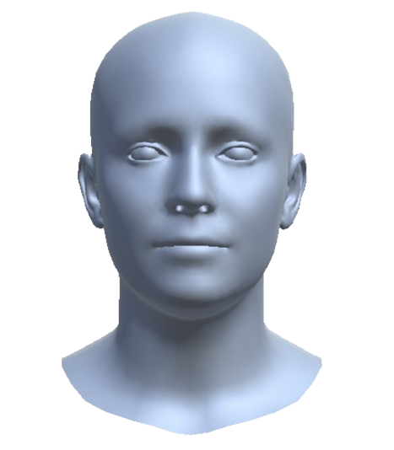
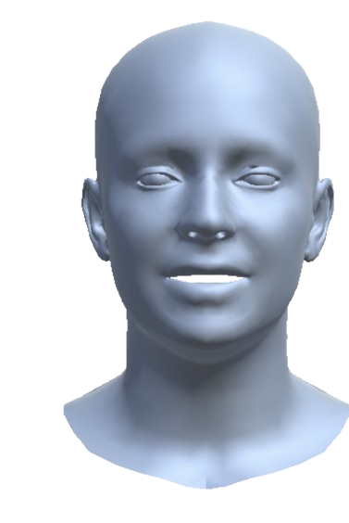
(a) Feature Extraction & Projection
(b) Bidirectional Cross-Modal Fusion
(c) Residual Fusion & Norm
(d) Temporal LSTM
(Audio)
2 stacked layers
Linear Projection
[768 → 256]
Multi-Head Cross-Attention
[heads = 8]
Layer Norm
LSTM
[B, T, 768]
[B, T, 256]
Concatenate
[B, T, 512]
(FLAME params)
Linear Projection
[512 → 56]
MLP Projection
[56 → 128 → 256]
Multi-Head Cross-Attention
[heads = 8]
Layer Norm
[B, T, 256]
[B, T, 56]
FLAME Parameters 56D

