Slide 1


SMART IRRIGATION
ADITYA KUMAR
AICTE Student ID: STU683e953b8ce931748931899
AICTE Internship ID: INTERNSHIP_1748923002683e727a876ea

Slide 2

Learning Objectives
Understand sensor-based data collection for agriculture
Learn preprocessing, feature engineering, and EDA
Apply machine learning for classification of watering need
Deploy a basic ML model using Streamlit for automation
GOAL
Source :
www.freepik.com/

Slide 3
Tools and Technology used
Python (Data processing, ML model training)
Pandas and Matplotlib (for EDA)
Streamlit (for deployment and simple UI)
Scikit-learn (for training decision tree model)
CSV (data format for storing sensor values)

Slide 4
Methodology
Collected sensor data from 19 different channels (CSV format)
Cleaned the dataset and removed irrelevant columns
Performed Exploratory Data Analysis (EDA) to understand sensor behavior
Trained a Decision Tree Classifier to predict pump actuation
Used prediction to decide whether to turn pump ON/OFF
Created a Streamlit app to simulate real-time decision making

Slide 5
Problem Statement:
In traditional farming, farmers often don’t know when and how much to water
this Leads to overwatering or underwatering affecting crop yield
Labor-intensive process for large farmlands
Need for an automated solution using data and sensors

Slide 6
Solution:
Used 19 sensors to collect data about soil and environment
Used 3 pumps to control watering
Built a ML model (Decision Tree) based on sensor values
Based on certain values, the model actuated the pump (i.e., switched ON/OFF)
Automated irrigation system based on intelligent decision-making
GITHUB LINK : https://github.com/adityakr-010/Week-1/blob/main/app.ipynb

Slide 7
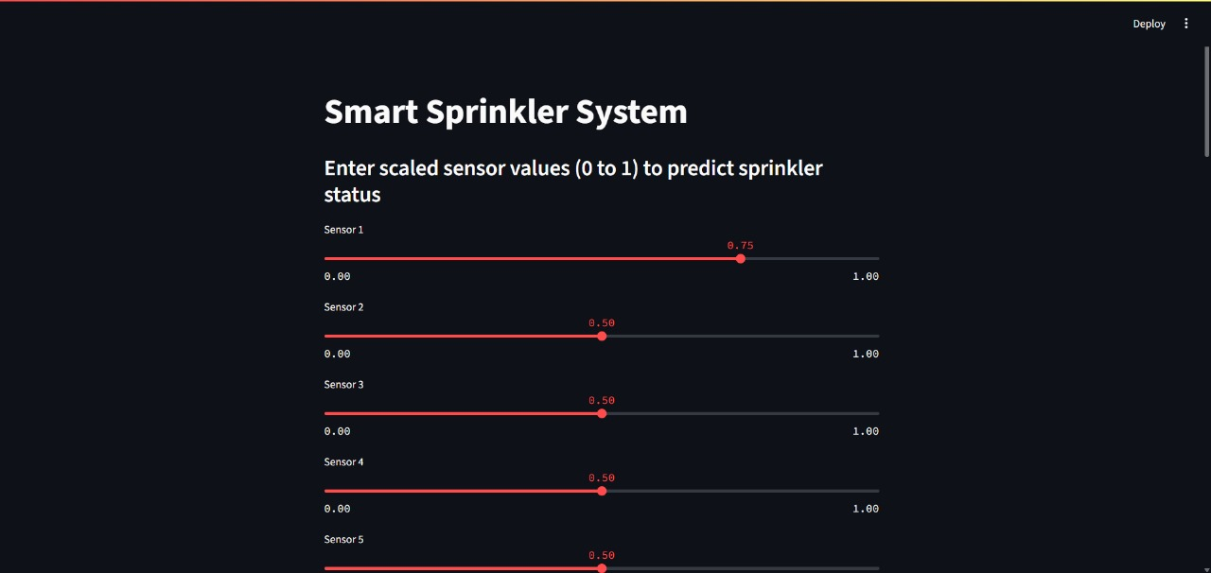
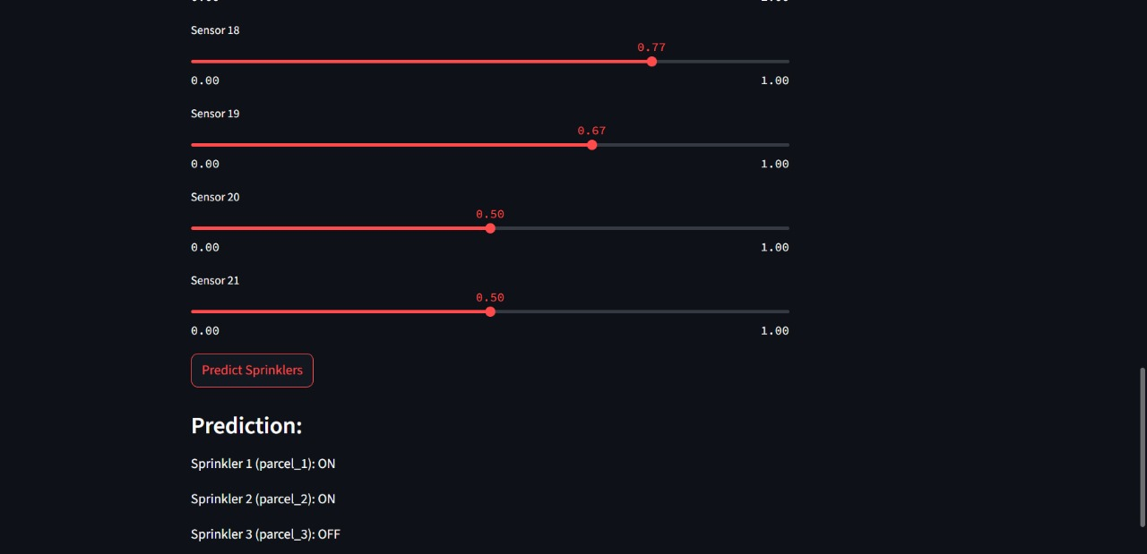
Screenshot of Output:

Slide 8
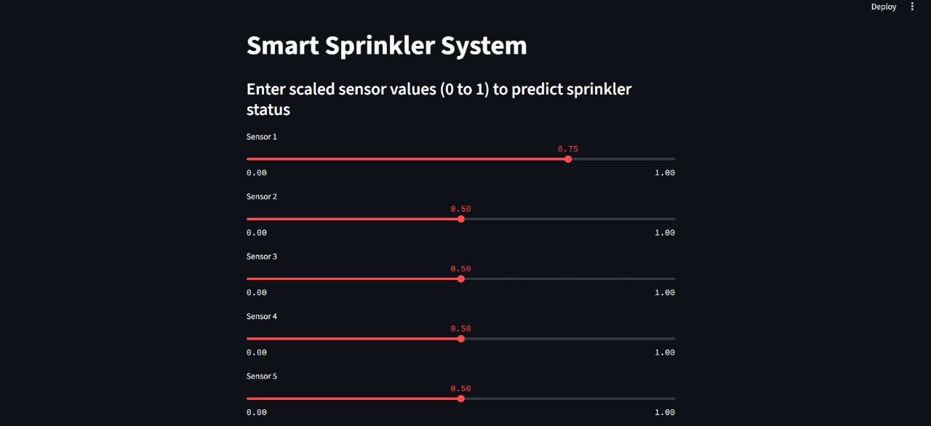
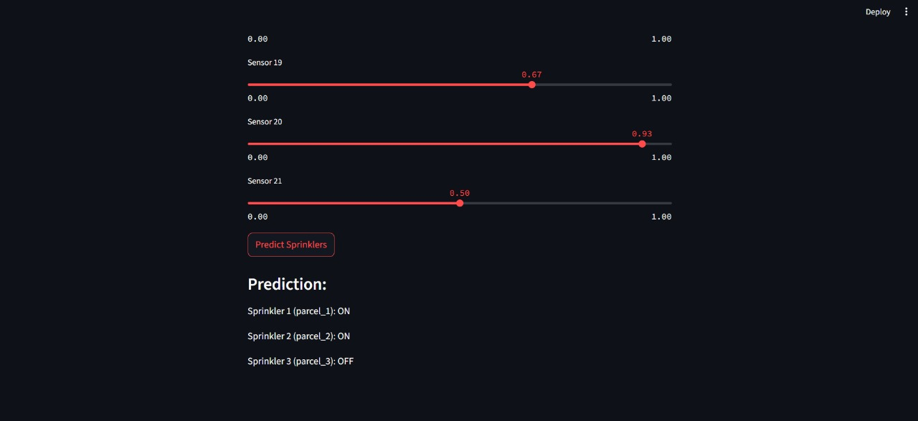

Slide 9
Conclusion:
Preprocessed dataset and applied EDA
Trained a decision tree to predict irrigation need
Automated pump actuation using model output
Created a basic UI for real-time predictions

