Slide 1

Travel buddy
Team Optimizers presents …

Slide 2
Topic – App for Tourism on Char Dham ( Uttarakhand )
Problem Statement –
Users can book verified professional travel guides which will help in communication , cultural insight , protection
App wallet which makes payments more secure , helps user to be organized and user can track its expenses through SMS they receive after each payment

Slide 3
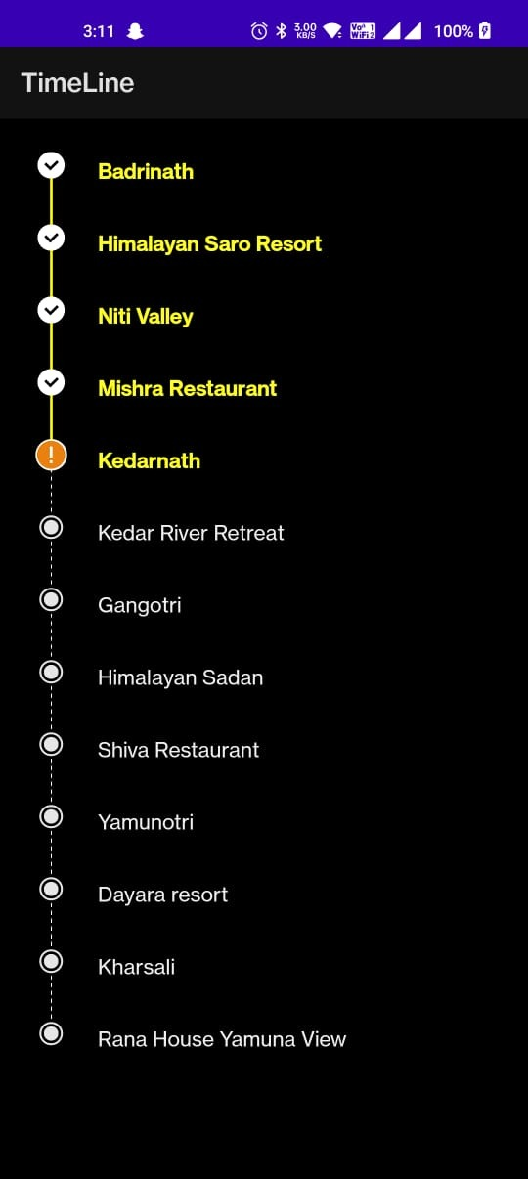
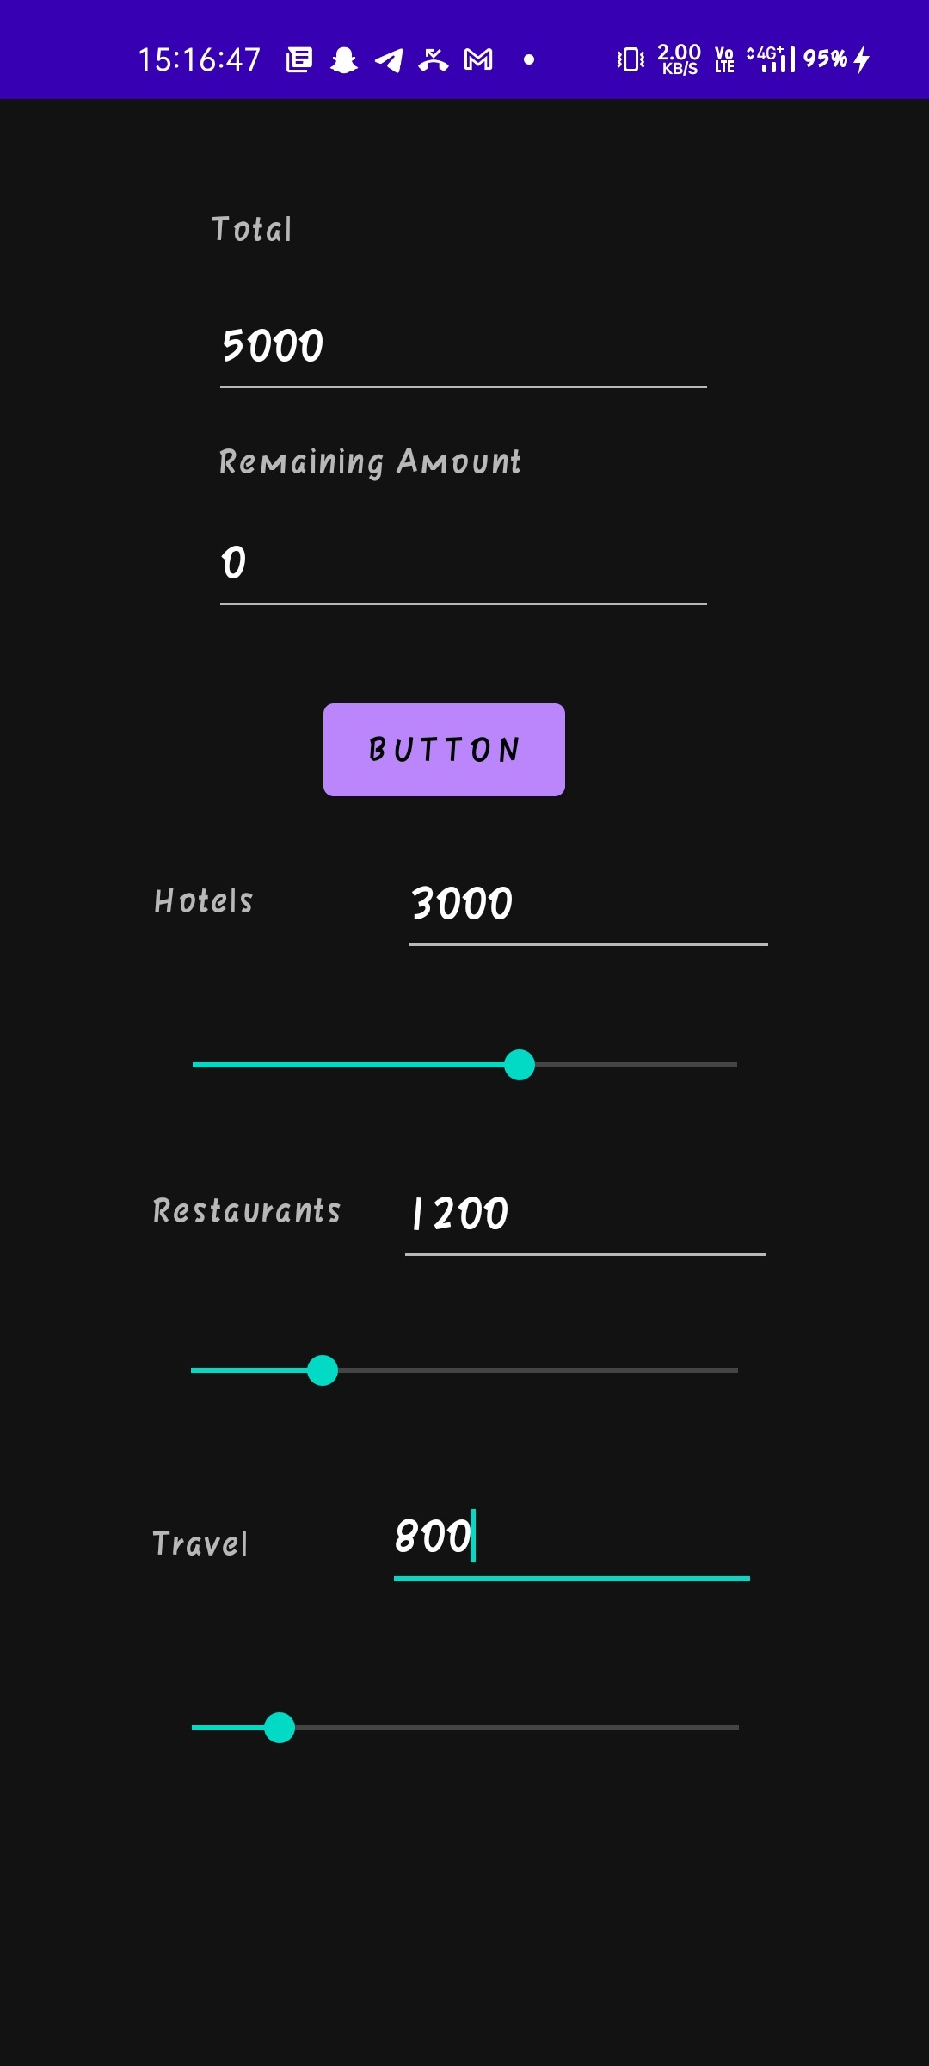
Special Features
Trip timeline – this feature will help our guide our users to track their journey at
any stop. They'll be able to check the places to visit and places already
visited. They'll be able to check their wish list as well as the confirmed option.
Budget Assistant – this will help you to manage your expenses throughout the trip

Slide 4
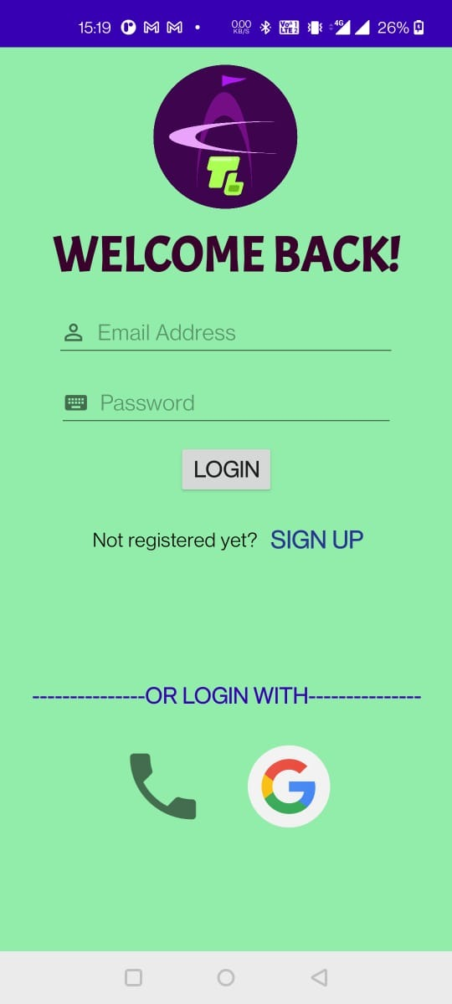
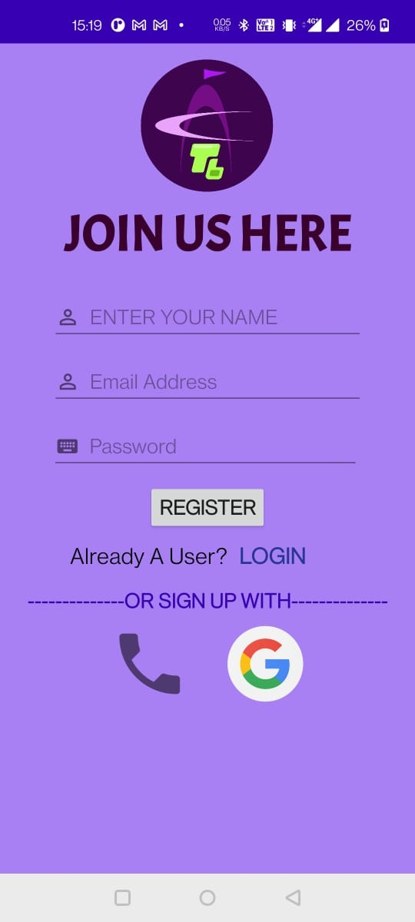
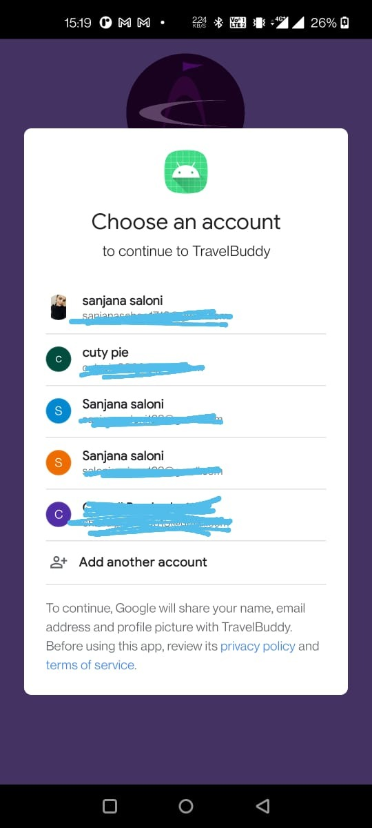
User Profile when a user uses the app for first time then only , he needs to register through google account , email , phone number.
Log in : if the user has already registered then he only needs to login . If the user had registered through google account then he only needs to click on the user id to login.

Slide 5
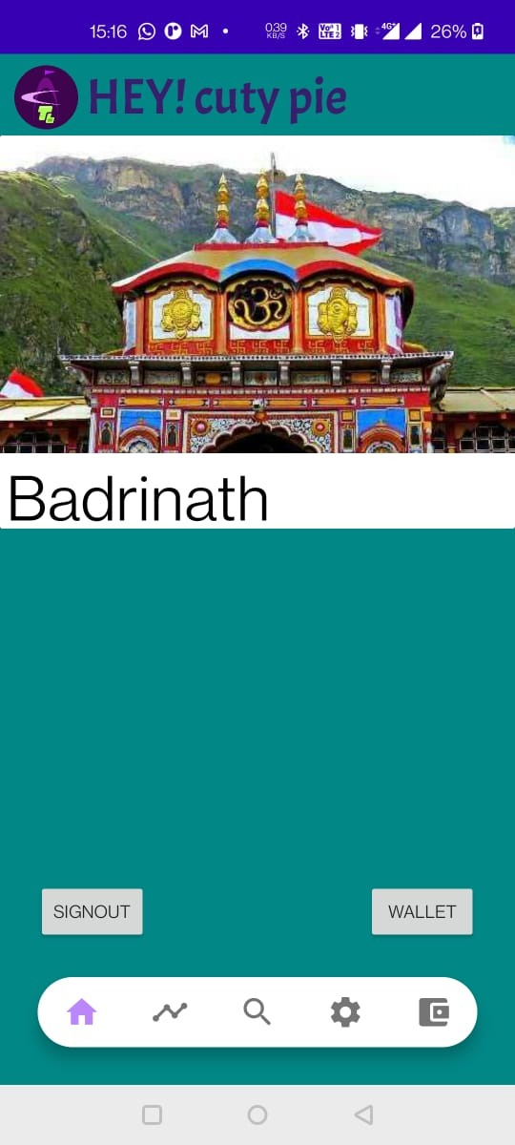
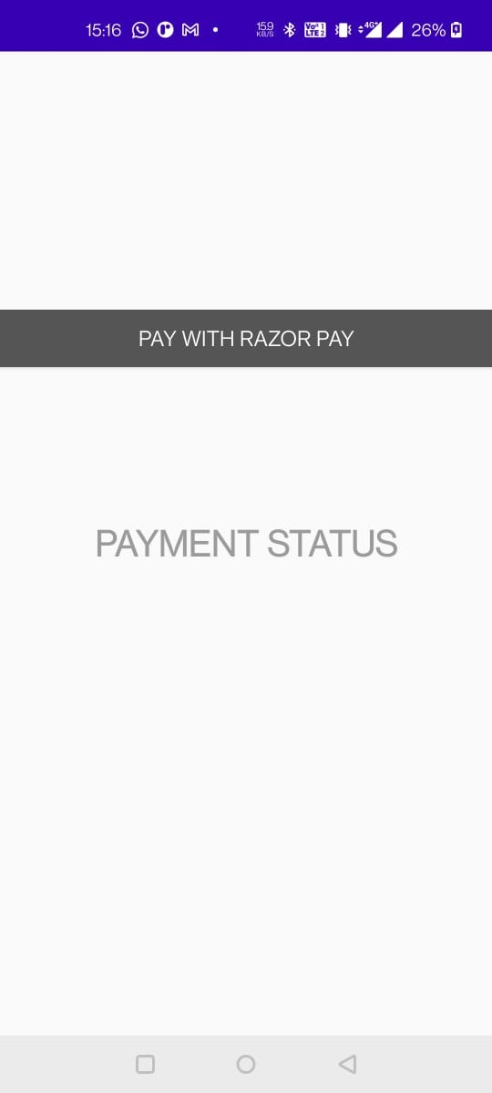
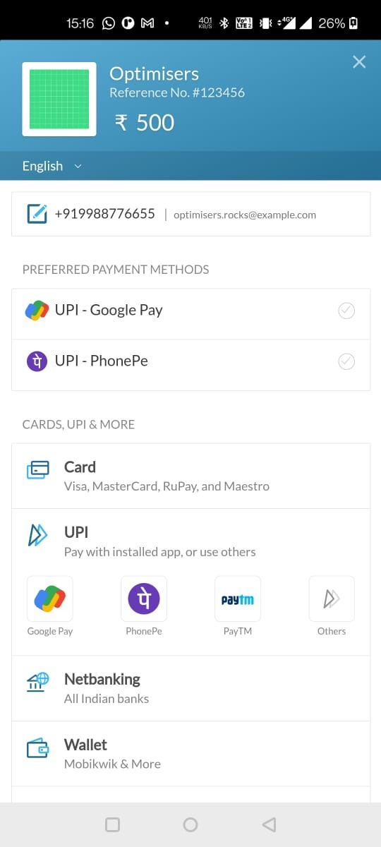
Local Travel Guide – Our app provides trusted and experienced verified local travel guide , who will guide you throughout the journey . They will make the journey safe , help you with the communication , provide you cultural insight and save time.
Wallet : User can add money to the wallet through RazePay which accepts payment method of debit cards , credit cards , EMI , etc.
The added wallet money can be used for hotel bookings, restaurants and other payments .
The app wallet makes sure the transactions are safe , secure and fast.

Slide 6
Contributions –
Sanjana Saloni Sahoo – Frontend (Android Studio using java) , wallet ,Google Account Implementation and Email login
Priyansu Dash – Backend(Google Firestore database ) and data collection
Sarthak Kumar Sahoo – Backend and Connectivity
Aditya Kumar (Leader) – Frontend (java) and budget assistance

