Slide 1

Identify And Localize COVID-19 Abnormalities on Chest Radiographs
Team details
Name | USN
Aditya Krishna Vamsy Mudragada | 01FE18BEC006
Manali V. Hiremath | 01FE18BEC074
Manish Pujar | 01FE18BEC076
Nikhil N. Akalwadi | 01FE18BEC088

Slide 2
Problem Statement
We focus on developing an app that identifies and localises COVID-19 abnormalities on chest radiographs by categorizing them as "negative", "typical", "indeterminate", "atypical".

Slide 3
Objectives
Train a model to classify the RoI as "negative", "typical", "indeterminate", "atypical"
Train a model for localization of area of infection in the radiograph (X-Ray images)
Deploy the algorithm/model on Android platforms.

Slide 4
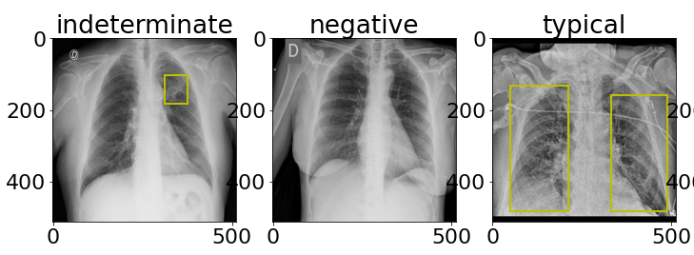
A glance at the dataset:siim-covid19-detection
A total of 6,334 chest scans in DICOM format (including Train & Test data) under the classes "negative", "typical", "indeterminate", "atypical"
Bounding box coordinates for training

Slide 5
Methodology used:
Classification: MobileNetV3
Localization of region of infection: YOLO or F-RCNN

Slide 6
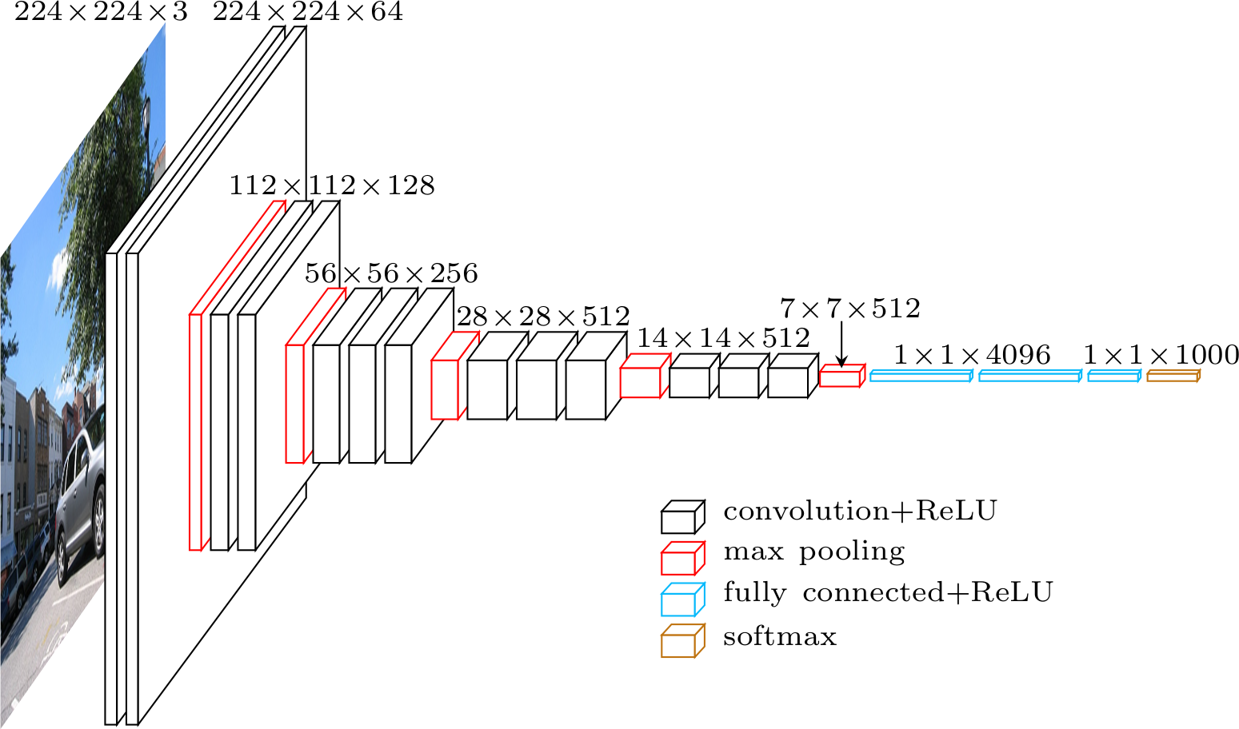
Architecture of F-RCNN Algorithm

Slide 7
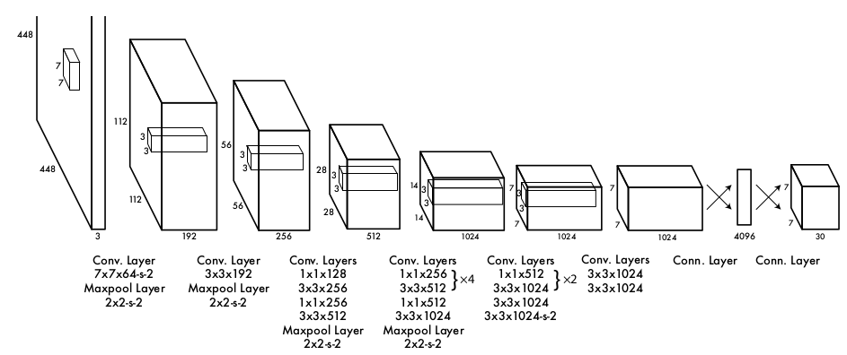
Architecture of YOLO Algorithm

Slide 8
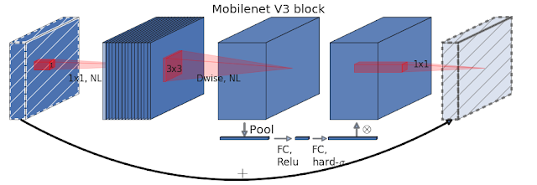
Architecture of MobileNetV3 Algorithm

Slide 9
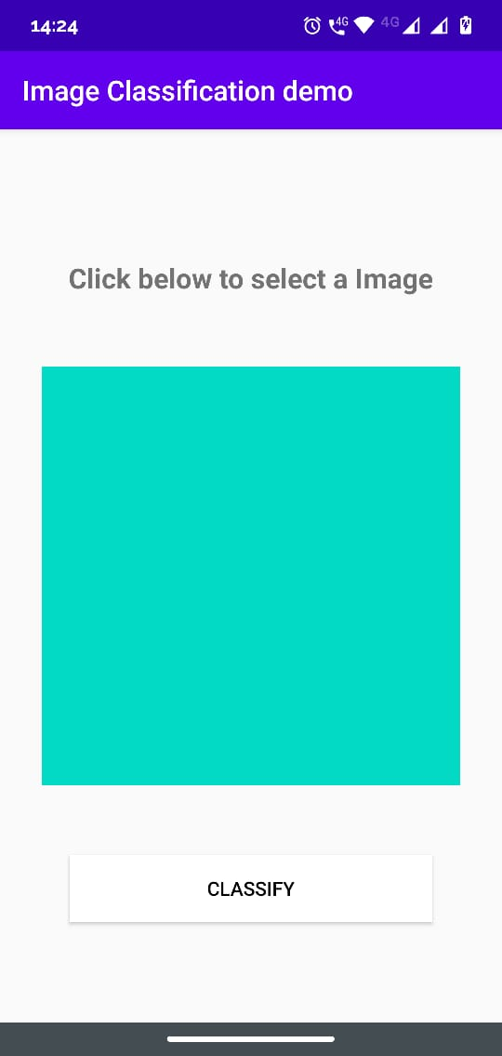
Covid-19 detector Application
This an android application for Covid-19 detection
The app is developed using ML kit APIs for our custom model
The model is integrated with the app using Android Studio

Slide 10
Results

Slide 11
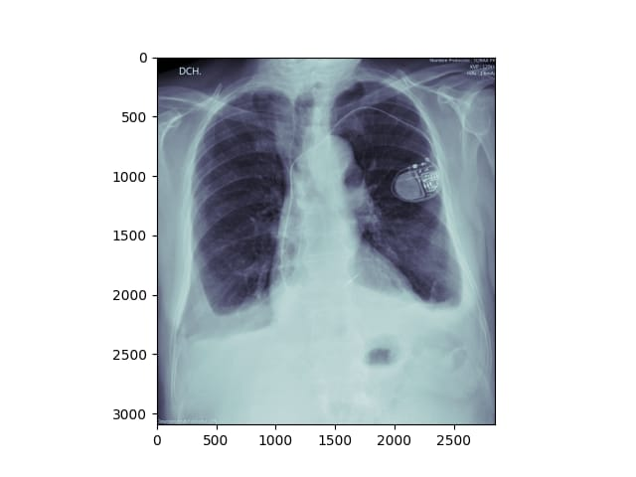
Ground truth image and label:
Atypical:

Slide 12
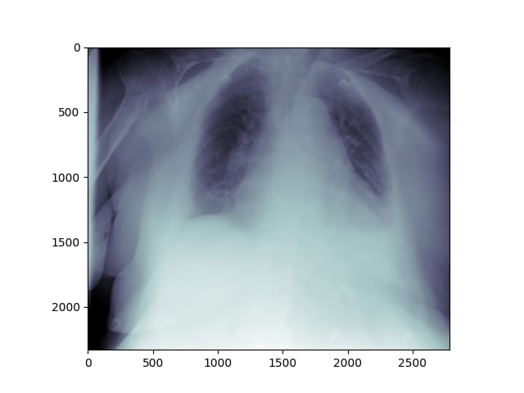
Ground truth image and label:
Typical:

Slide 13
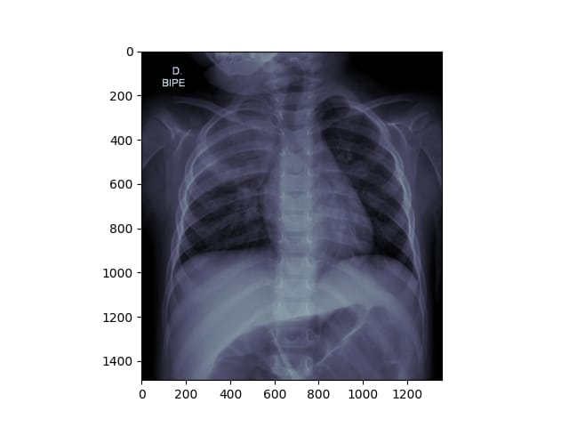
Ground truth image and label:
Indeterminate:

Slide 14
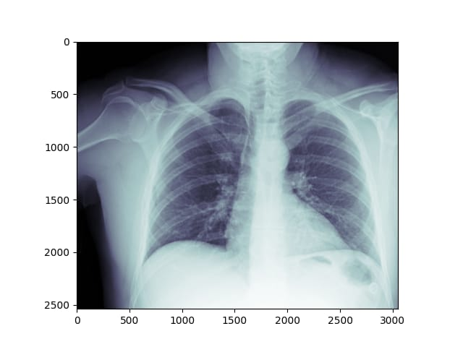
Ground truth image and label:
Negative:

Slide 15
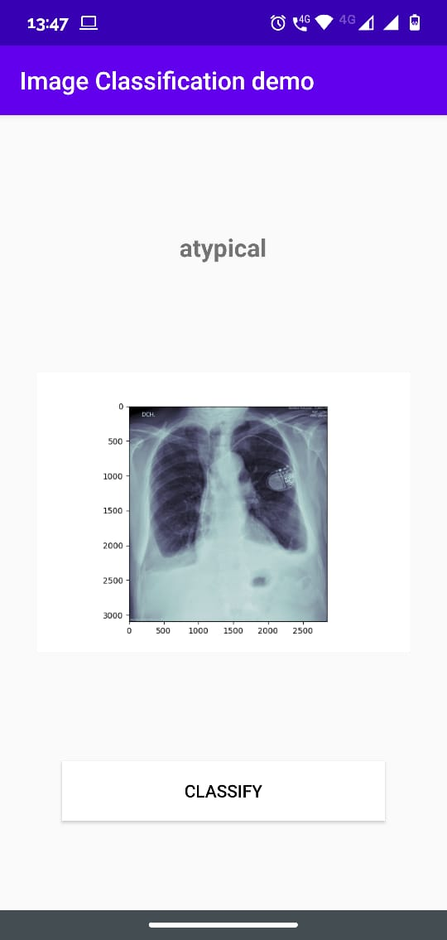
Predicted classes:
Atypical:

Slide 16
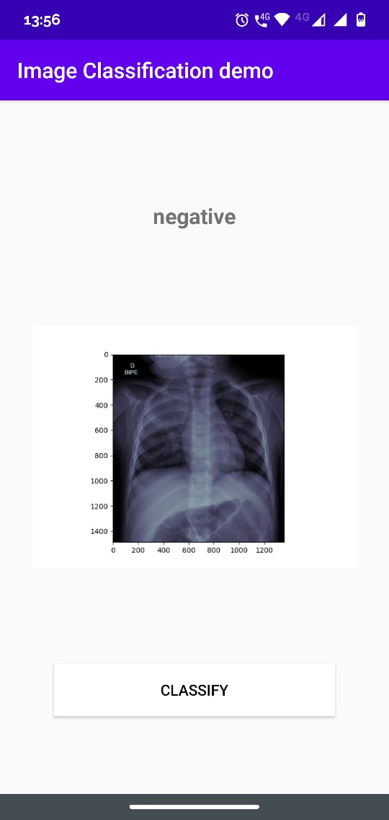
Predicted classes:
Negative:

Slide 17
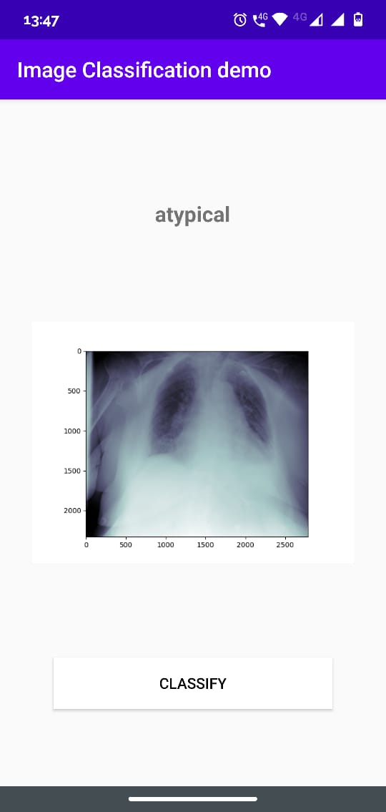
Predicted classes:
Atypical:

Slide 18
Predicted classes:
Negative:

