Slide 1
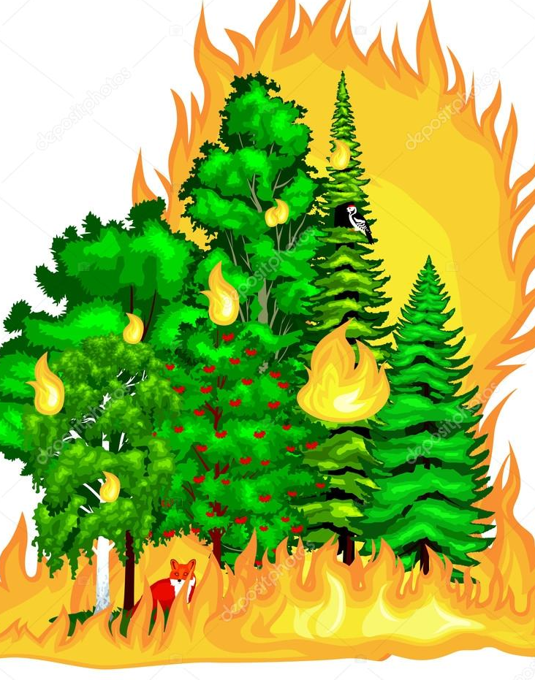
Forest Fires
Presented by:
Aditya Kulai
Gaurav Cariappa
Gauri Bansal
Konain Mukadam

Slide 2
Introduction
The purpose of this project is Developing a Model for an early warning method.
Analyzing the data set which comprises forest fire record in a Portuguese park.
Understanding the underlying relationship between various predictors and area burnt.
Predicting the probable area burnt in the event of a future forest fire.
Determining which variables are most likely to cause most significant fires.
This model would give authorities a powerful tool in the fight against fire damage.

Slide 3
EDA: Analysis of the Data
On running the basic summary analysis we find that this dataset has 517 objects of 13 variables.
The most interesting observation on the overall summary was that there are only 270 observations where area burnt(in hectares) is > 0.
The Mean area Burnt is 12.847, if the whole dataset is observed.
The mean area burnt is 24.6 hectares, if the non-zero observations considered.
Next step is to analyze the Months, days and frequency of occurrences to determine which of these parameters (months, days) are significant.

Slide 4
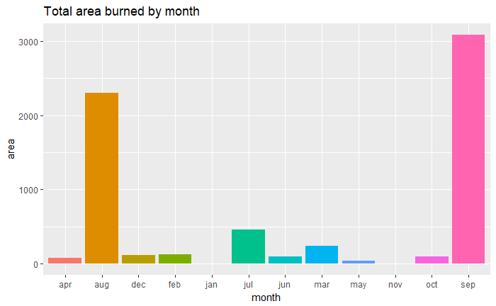
Area by Month
We note that September, August and July have the most area burnt.

Slide 5
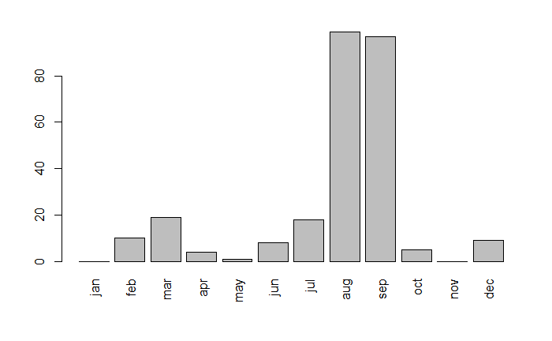
Occurrences by Month
We notice that August and September have the Most occurrences of fires. ( put column on the side)

Slide 6
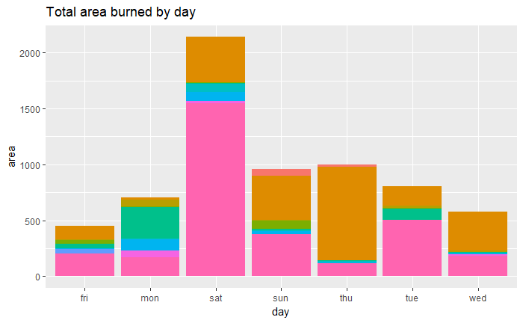
Area by Day
We find that Saturday, by a distance, accounts for the most total area burnt.

Slide 7
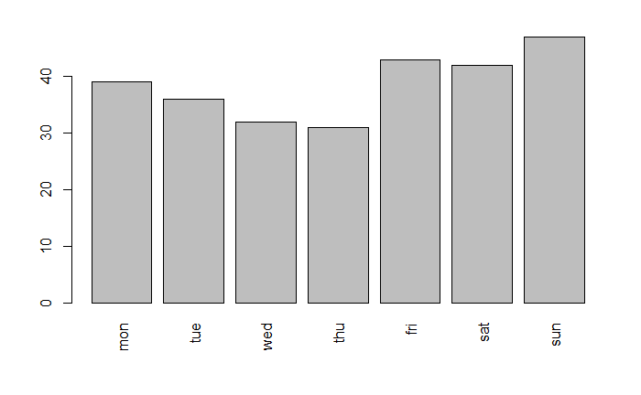
Occurrences by Day
We notice that Friday has the Least Total Area Burnt but has the 2nd Highest Occurrences ( put column on the side)

Slide 8
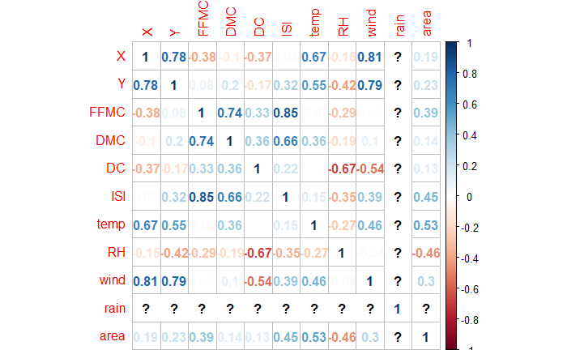
Analyzing the Top 10 Fire Breakouts
We categorized the particularly damaging fires, to be the ones to affect most area (top 10).
On Observing the Correlation Matrix for the top 10 fires, we notice the following correlation coefficients of significance between area and 5 other parameters:
1) Temperature * (0.53)
2) ISI * (0.45)
3) RH * (-0.46)
4) FFMC * (0.39)
5) Wind * (0.3)
Note: RH is the only parameter with a negative correlation coefficient that is an increase in RH results a lesser area burnt in the top 10 area burnt data set.

Slide 9
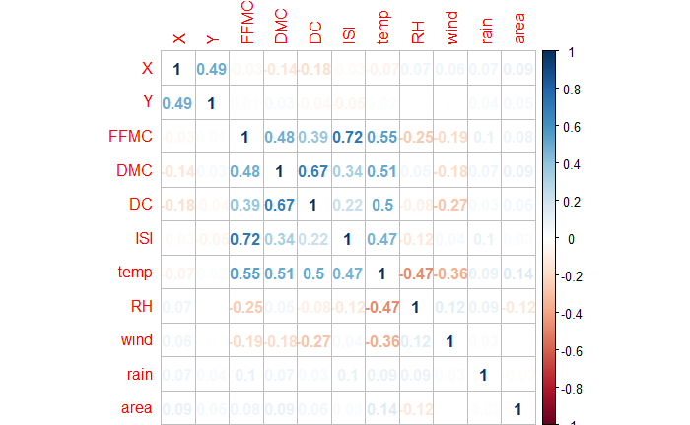
Correlation for Different Samples of Data
Key Findings:
Decrease in Correlation Coefficient between area and temperature, ISI from the Top 10 (0.53,0.45) to Top 20 (0.21,0.25) and negligible in the sample of top 200 (approx. 0,0.14).
Weak Correlation between area and every other parameter within the dataset.
We decided that neither Polynomial nor Linear Correlation can be useful to predict in this case.

Slide 10
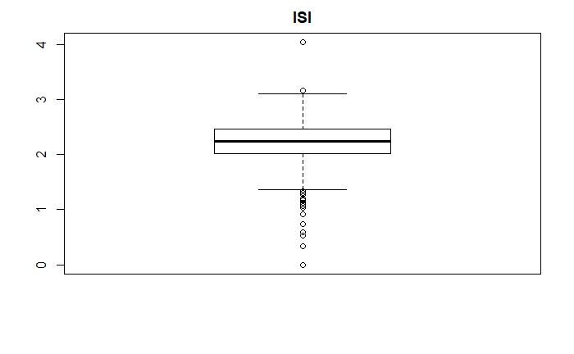
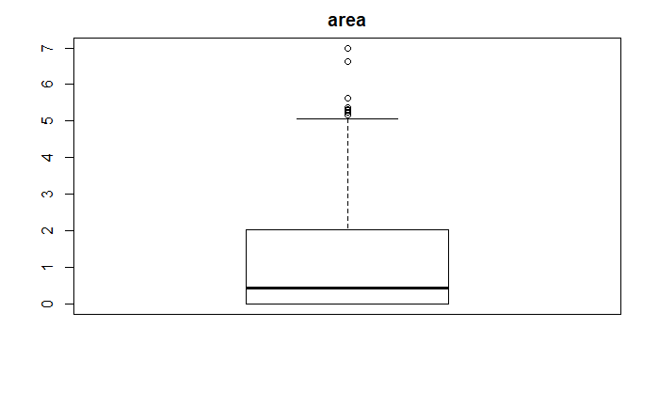
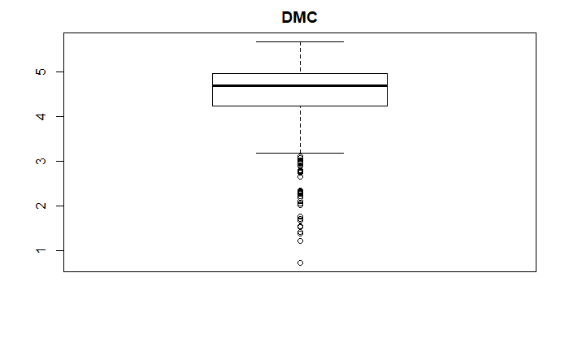
Examining our Data Set for Outliers
We run Boxplots on all Parameters and determine cases where there is a dense concentration of outliers.
Parameters with Considerable Outliers (we find that ISI DMC and area have data with considerable amount of outliers).
ISI
AREA
DMC

Slide 11
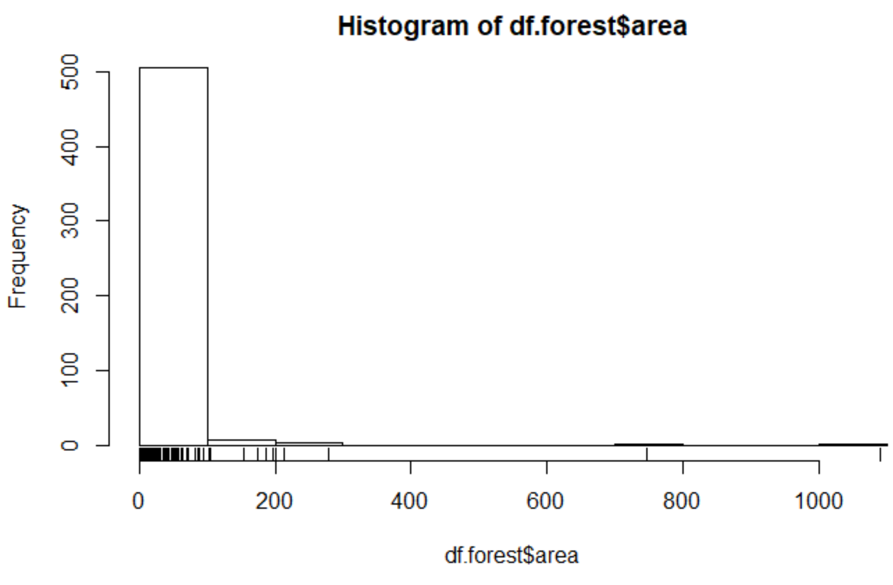
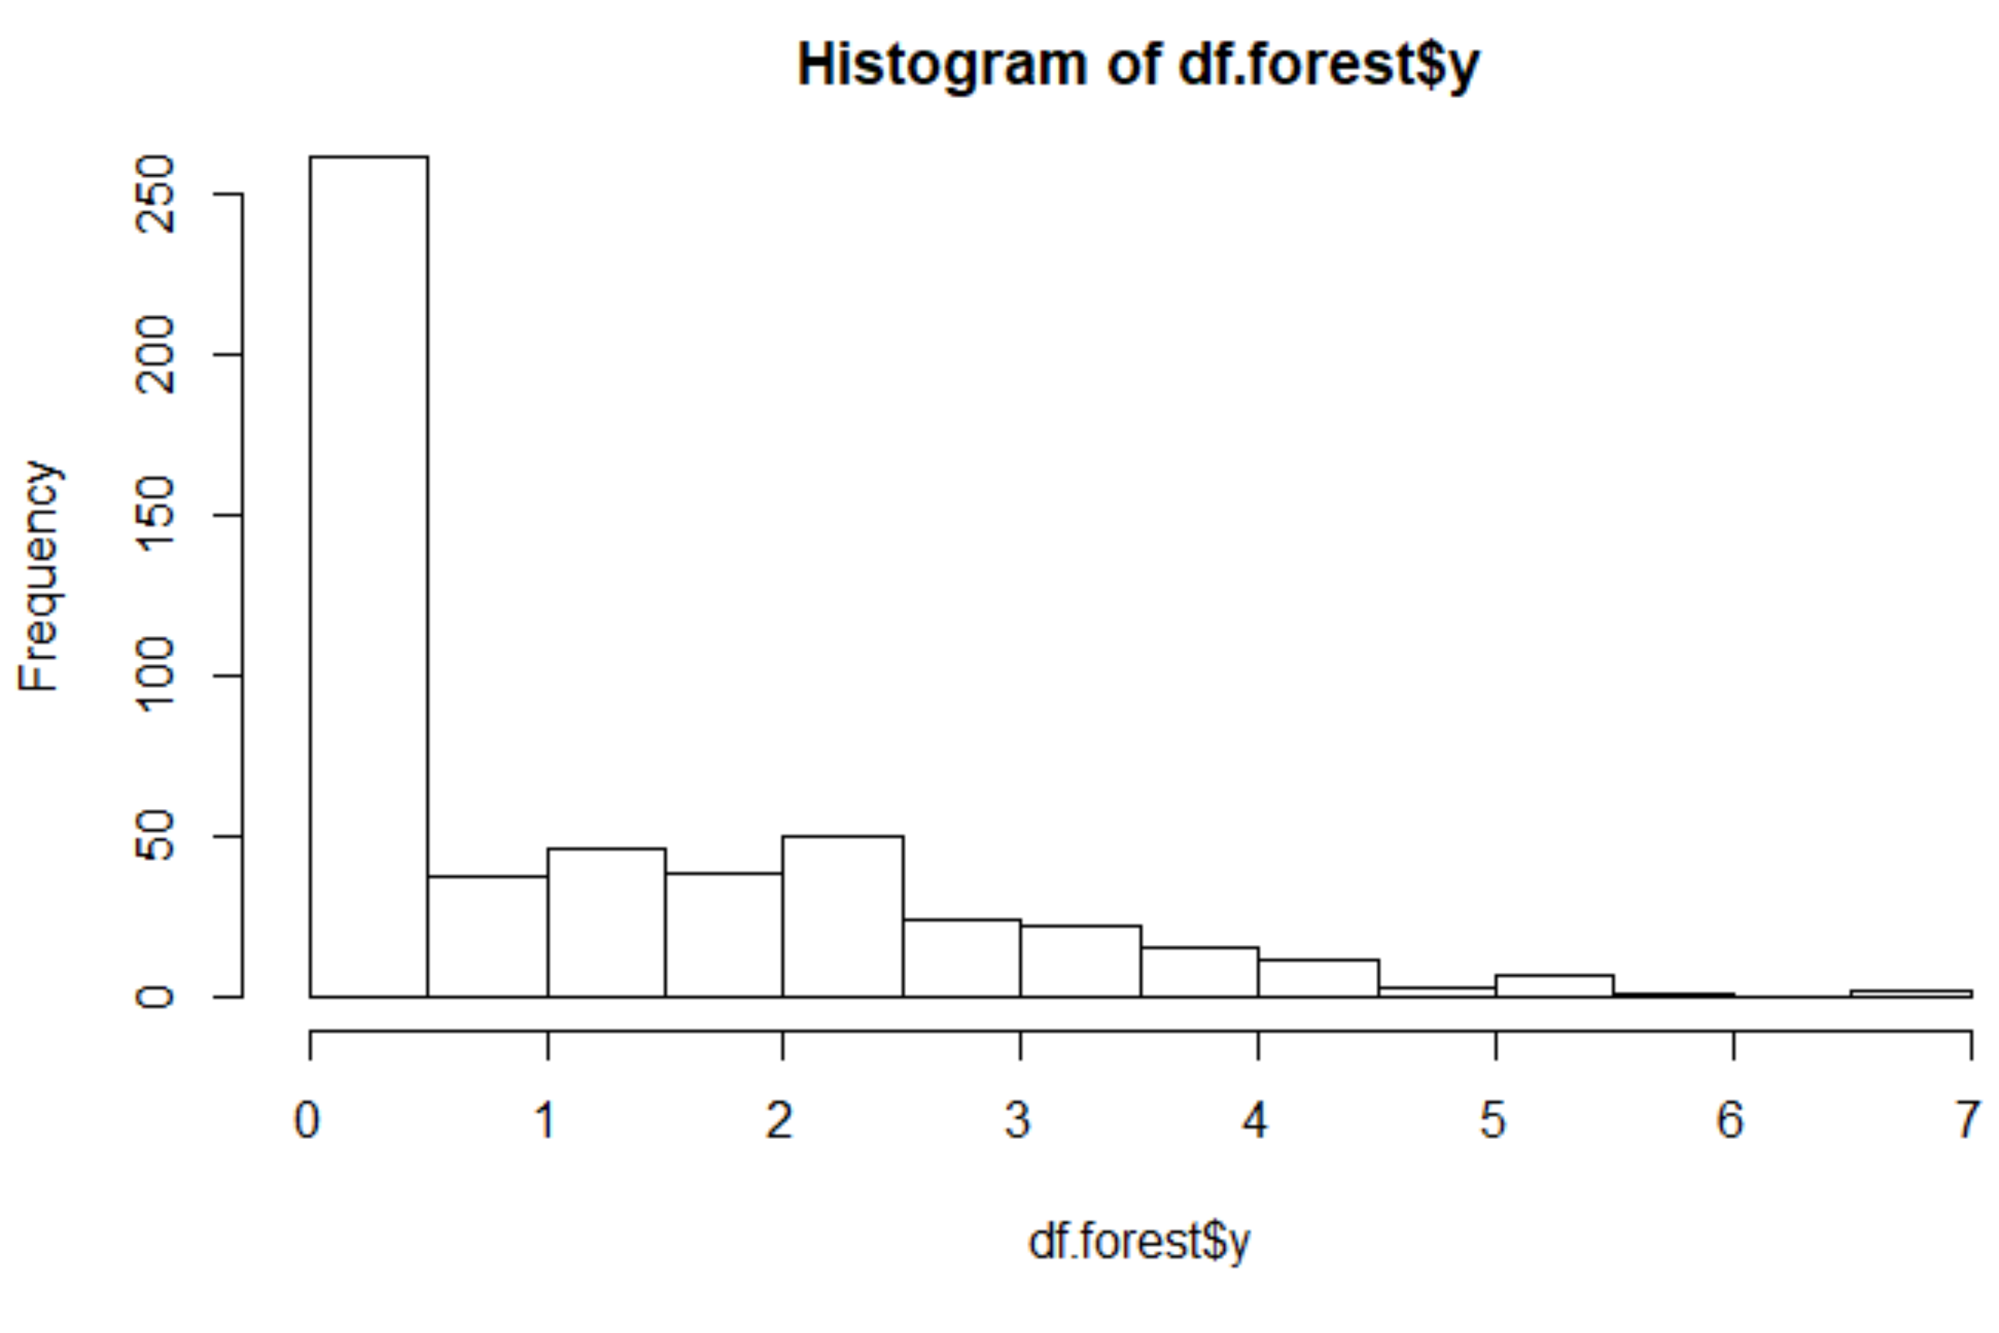
Preprocessing
Heavily Skewed: Area
Processed Form: log(Area+1)

Slide 12
Assumptions: Important Factors
Based on findings from the paper “A Data Mining Approach to Predict Forest Fires using Meteorological Data” by Cortez and Morias (2007) we inferred that the most important variables affecting Burnt Forest Area are:
Rain
Temperature
Relative Humidity
Wind

Slide 13
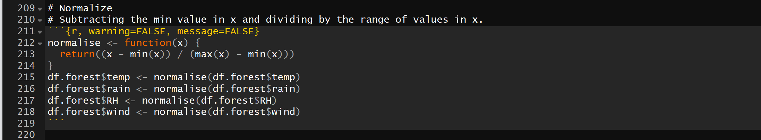
Feature Scaling: Normalization
Standardizing the range of Independent Variables.
Implementing this using Normalization.
Normalizing continues variables between 0 and 1 in order to control different ranges.

Slide 14
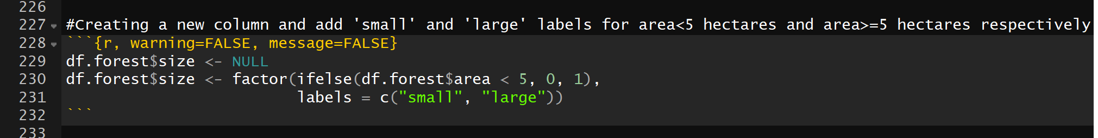
Assumptions: Data Preparation for Model
We approached it as a Classification Problem.
We tried to predict weather conditions that gave rise to small fires (< 5 Hectares) since they constitute most of the occurrences in the data.
We created a new column “size” to accommodate area as labels.

Slide 15
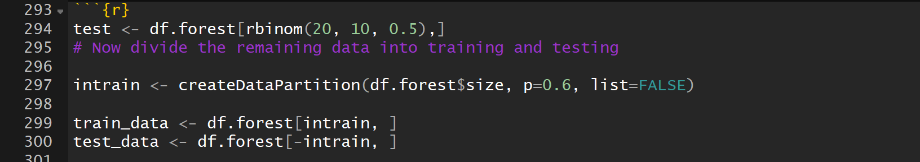
Cross-Validation and Data Splitting
We split the data into 3 parts namely:
Training Data: 60%
Testing Data: 20%
Cross-Validation Test Data: 20%

Slide 16
Prediction Models
Random Forest Classifier
Gradient Boosting
Linear SVM
Kernel SVMs

Slide 17
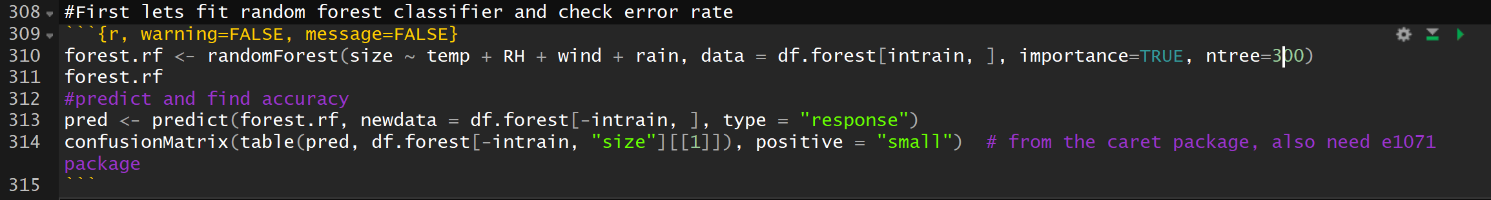
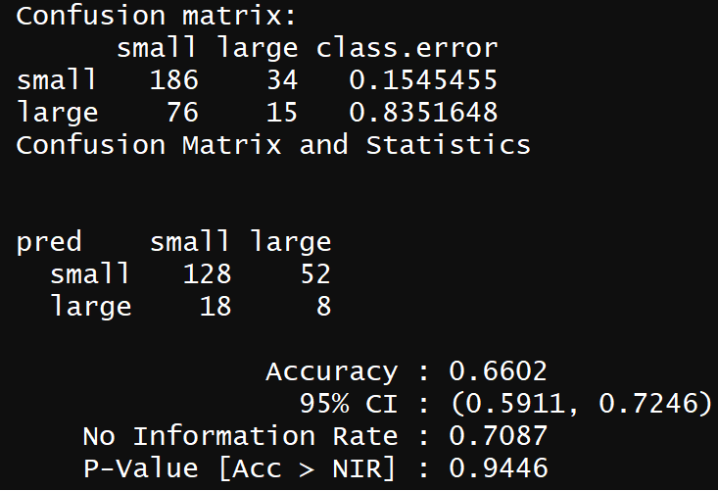
Random Forest Classifier
Using Random Forest we tried to predict the size of the area burned.
We attained an accuracy of 66% using this model.
Hence, we decided not to go forward with this model.

Slide 18
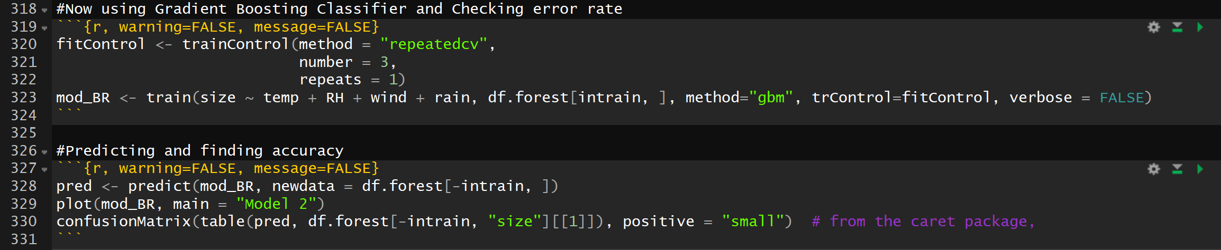
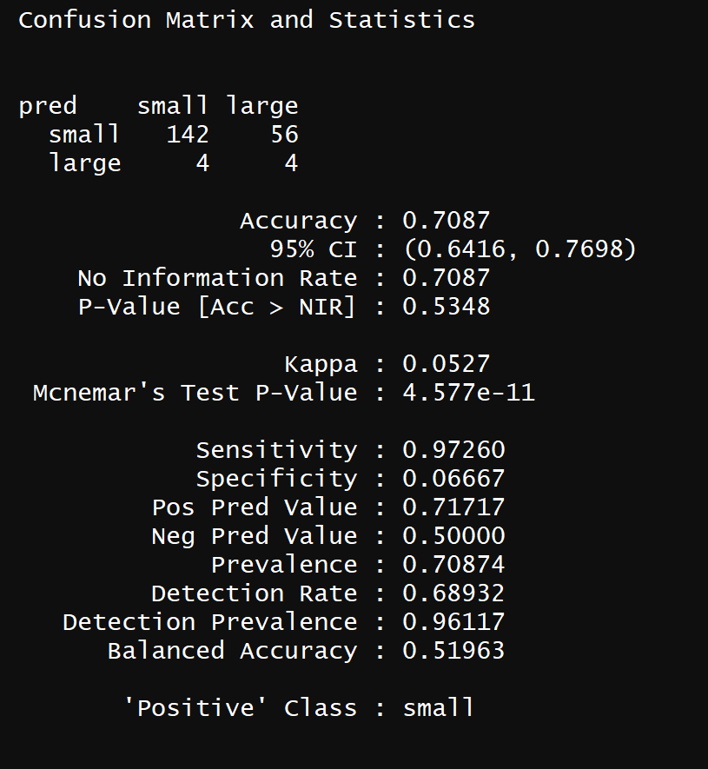
Gradient Boosting
Using Gradient Boosting we tried to predict the size of the area burned.
We attained an accuracy of 71% using this model.
This accuracy was better than Random Forest, but we still tried a few other models.

Slide 19
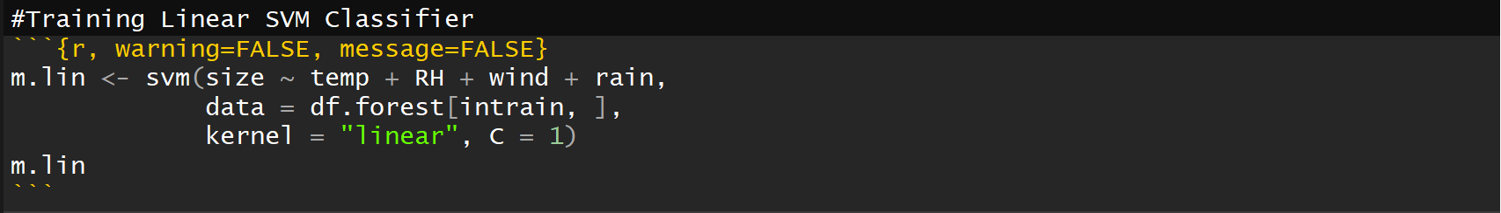
Linear Support Vector Machine
Using Gradient Boosting we tried to predict the size of the area burned.
We attained an accuracy of 71% using this model.
This accuracy was better than Random Forest, but we still tried a few other models.

Slide 20
Kernel Support Vector Machine

