Slide 1

Presenter : Adityakumar Dhruvkumar Shukla
Amit Shahu

Slide 2

CBOT
THE CLEANING ROBOT

Slide 3
Overview of the Design
To conceptualize the dust monitoring robot, we first designed it on paper and later on solid works . Here are some of its features:
The robot can be controlled via an app through the internet. This allows the user to connect to the robot from anywhere.
An onboard camera that live streams a video feed to the smartphone can help the user to maneuver around the house and interact with the pet.
An add-on treat bowl that can reward your pet remotely.
Digitally fabricated parts also used recycled parts of old cd-drive for customizing a robot .
A Raspberry Pi was used to connect to the internet as it features an onboard wifi mode.(here we are used a vmware for simulating a raspberry pi )
An Arduino was used along with a CNC shield to give commands to the stepper motors.

Slide 4
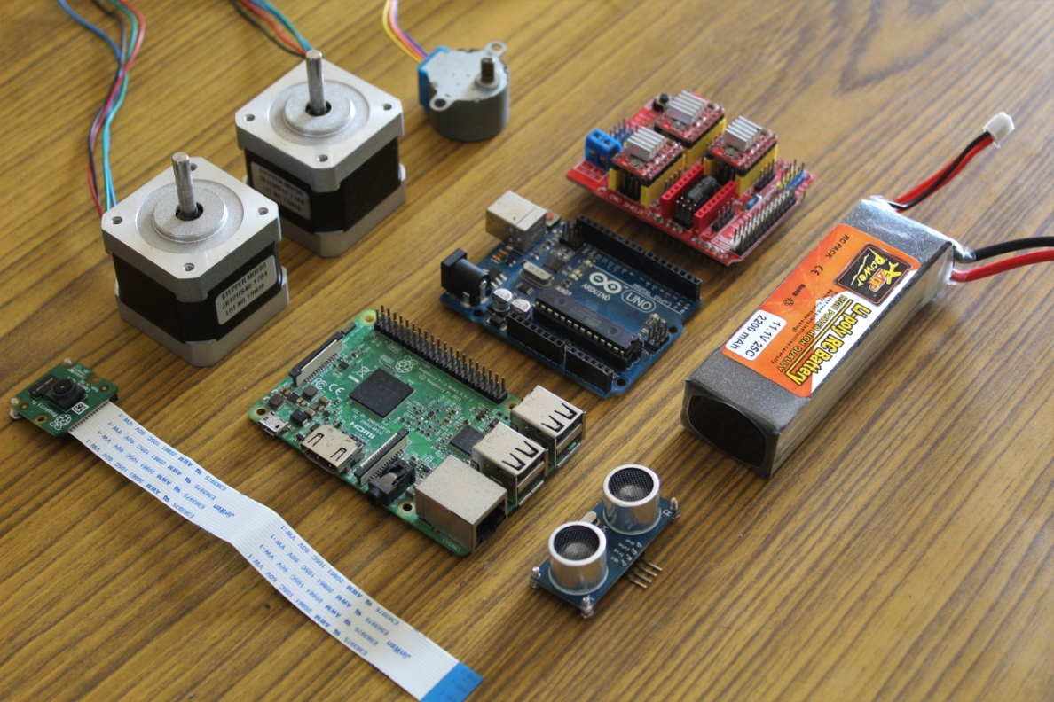
Materials Needed
ELECTRONICS:
Arduino Uno x 1
Raspberry Pi (flashed with latest raspbian) x 1
CNC Shield x 1
A4988 Stepper Motor Driver x 2
Picamera x 1
Ultrasonic Distance Sensor x 1
11.1v Lipo Battery x 1
NEMA 17 Stepper Motor x 2
5v UBEC x 1

Slide 5
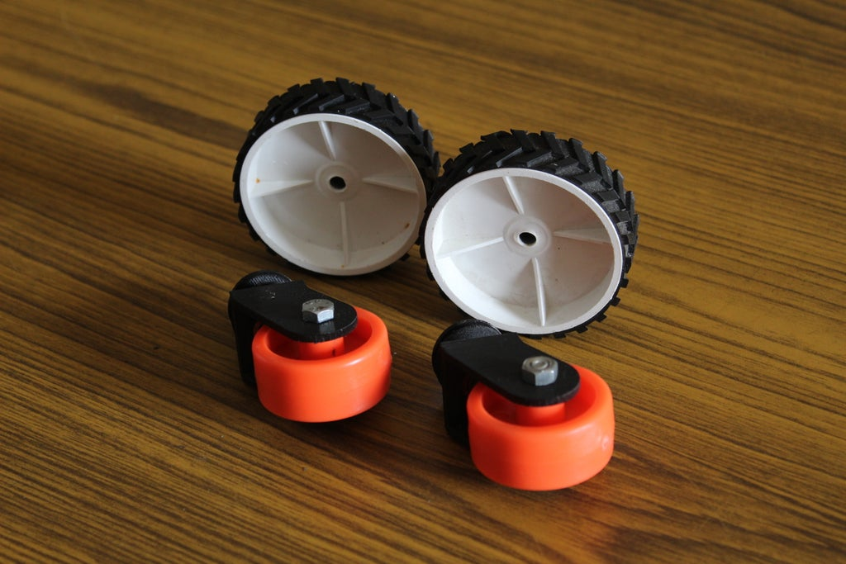
HARDWARE:
Wheels x 2 (the wheels that we used were 7cm in diameter)
Castor Wheels x 2
M4 and M3 nuts and bolts

Slide 6
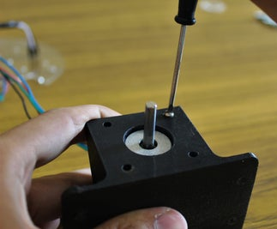
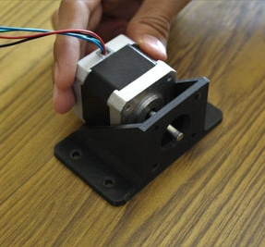
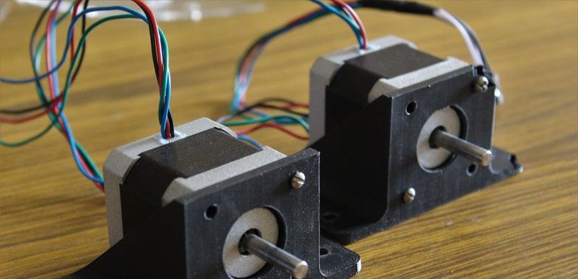
Attaching the Stepper Motor

Slide 7
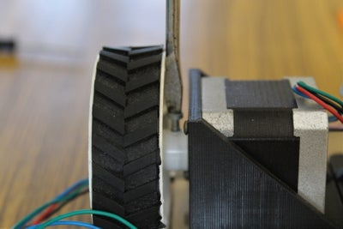
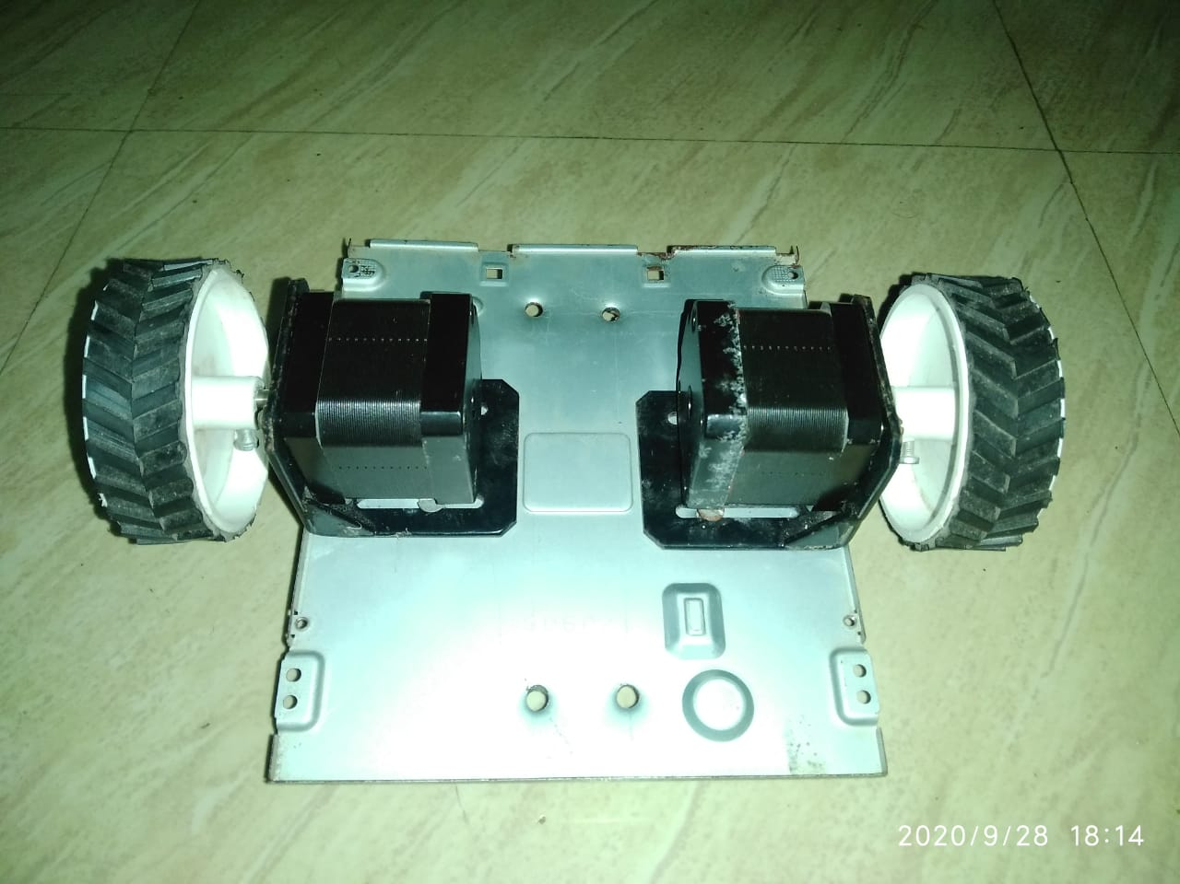
Fitting the Wheels

Slide 8
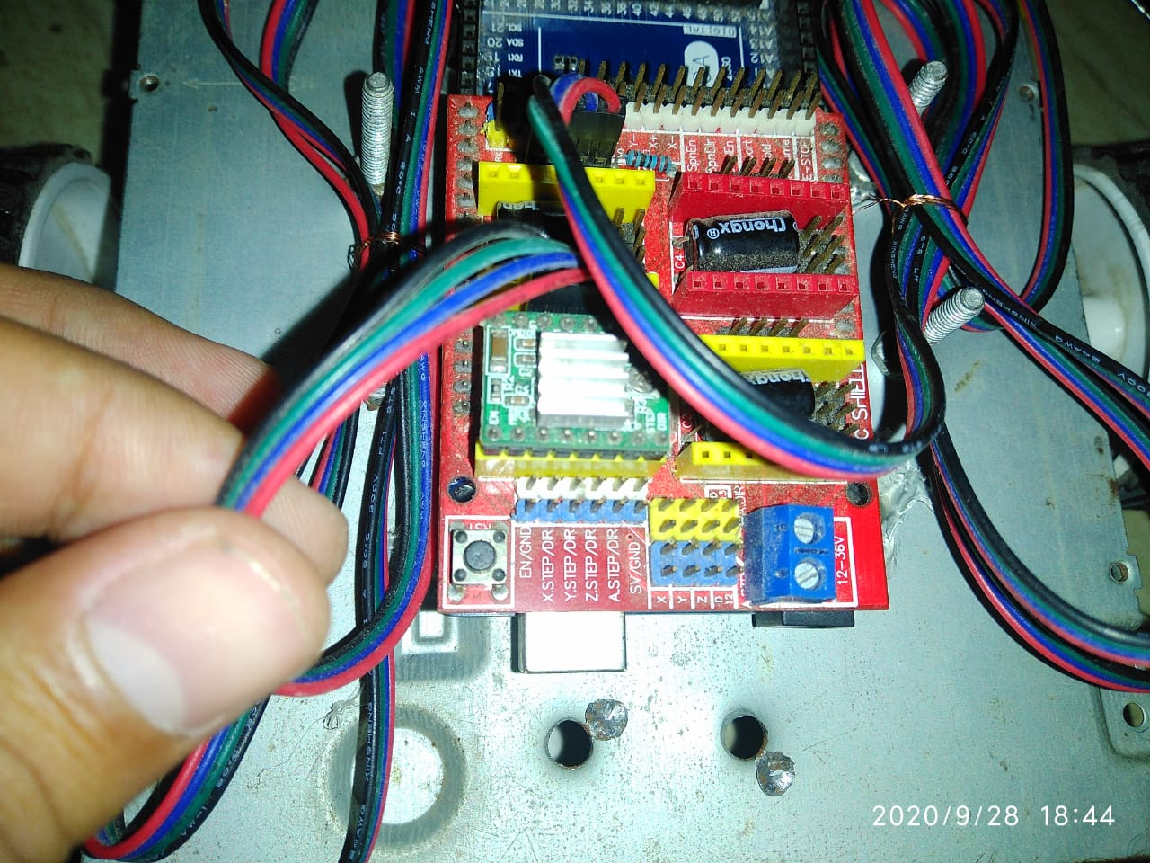
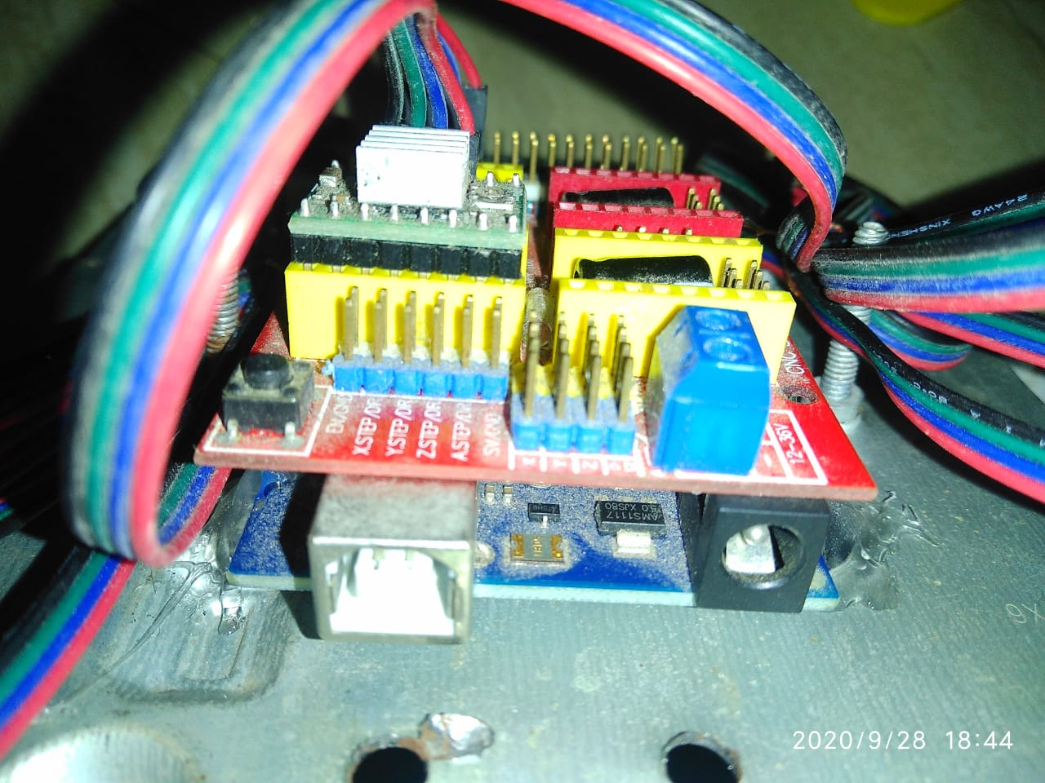
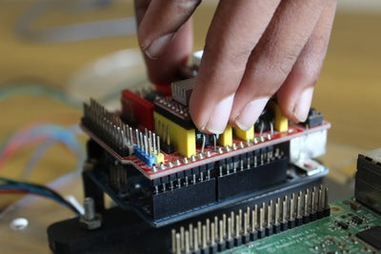
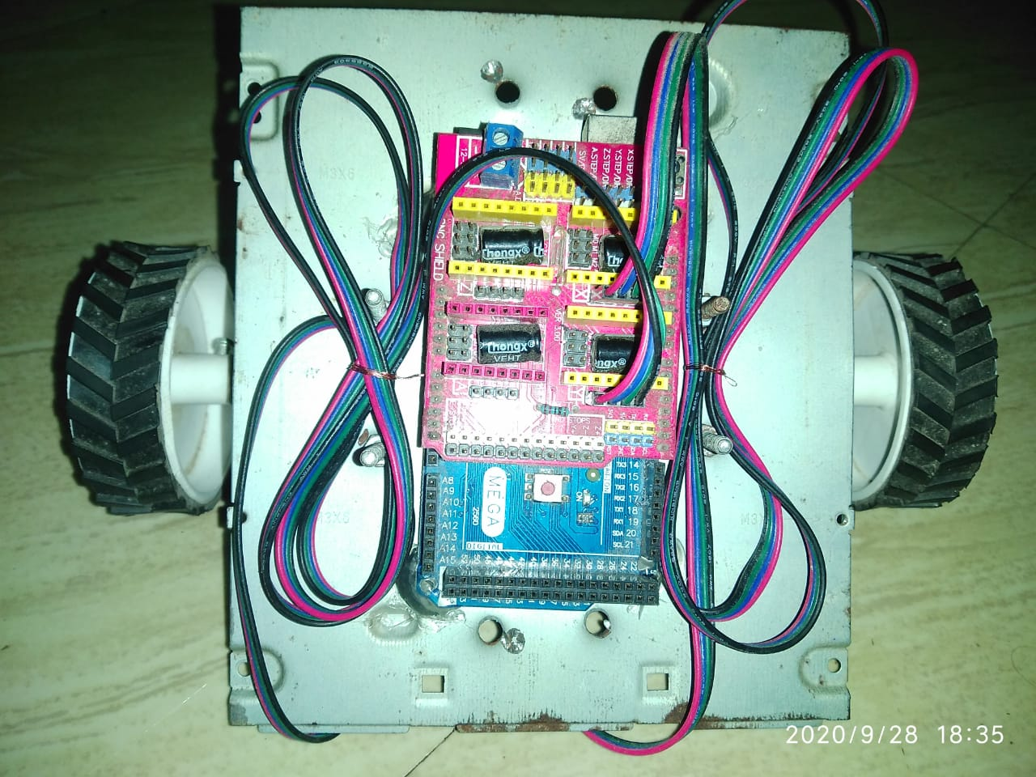
Electronics

Slide 9
Left stepper to CNC shield X-axis port
Right stepper to CNC shield Y-axis port
With the stepper motors attached, connect the Arduino to the Raspberry Pi using the Arduino's USB cable. Eventually the Raspberry Pi and Arduino are going to communicate through this cable.
Note: The front of the robot is the side with the Raspberry Pi
Once the base of the chassis is fully assembled, it's time to mount the electronics onto the metal panel. We have made holes in the metal panel that align with the mounting holes of the Arduino and the Raspberry Pi. Using 3D printed standoffs we elevated the electronics slightly above the acrylic panels so that all the excess wiring can be tucked away neatly underneath. Mount the Arduino and the Raspberry Pi to their corresponding mounting locations using M3 nuts and bolts. Once the Arduino is fixed attach the CNC shield to the Arduino and connect the stepper wires in the following configuration.

Slide 10
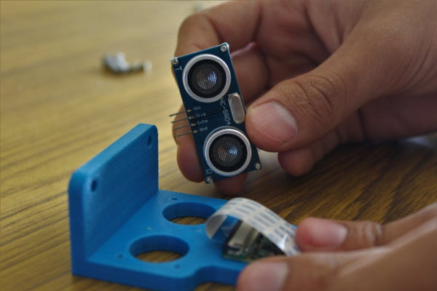
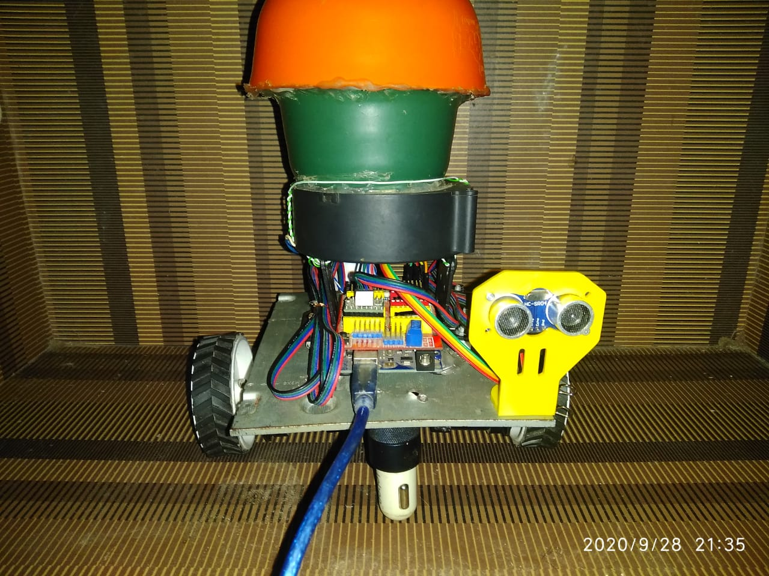
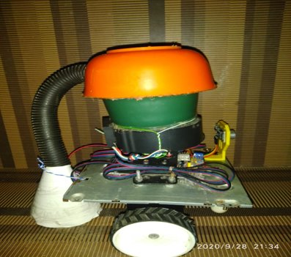
Vision System

Slide 11
The primary environment input for our pet monitoring robot is vision. We decided to use the Picamera which is compatible with the Raspberry Pi to feed a live stream to the user via the internet. We also used an ultrasonic distance sensor to avoid obstacles when the robot is functioning autonomously. Both sensors attach onto a holder with the help of screws.
The Picamera slots into its designated port on the Raspberry Pi and connect the ultrasonic sensor in the following manner:
Ultrasonic Sensor VCC to 5v rail on CNC shield
Ultrasonic Sensor GND to GND rail on CNC shield
Ultrasonic Sensor TRIG to X+ end stop pin on CNC shield
Ultrasonic Sensor ECHO to Y+ end stop pin on CNC shield

Slide 12
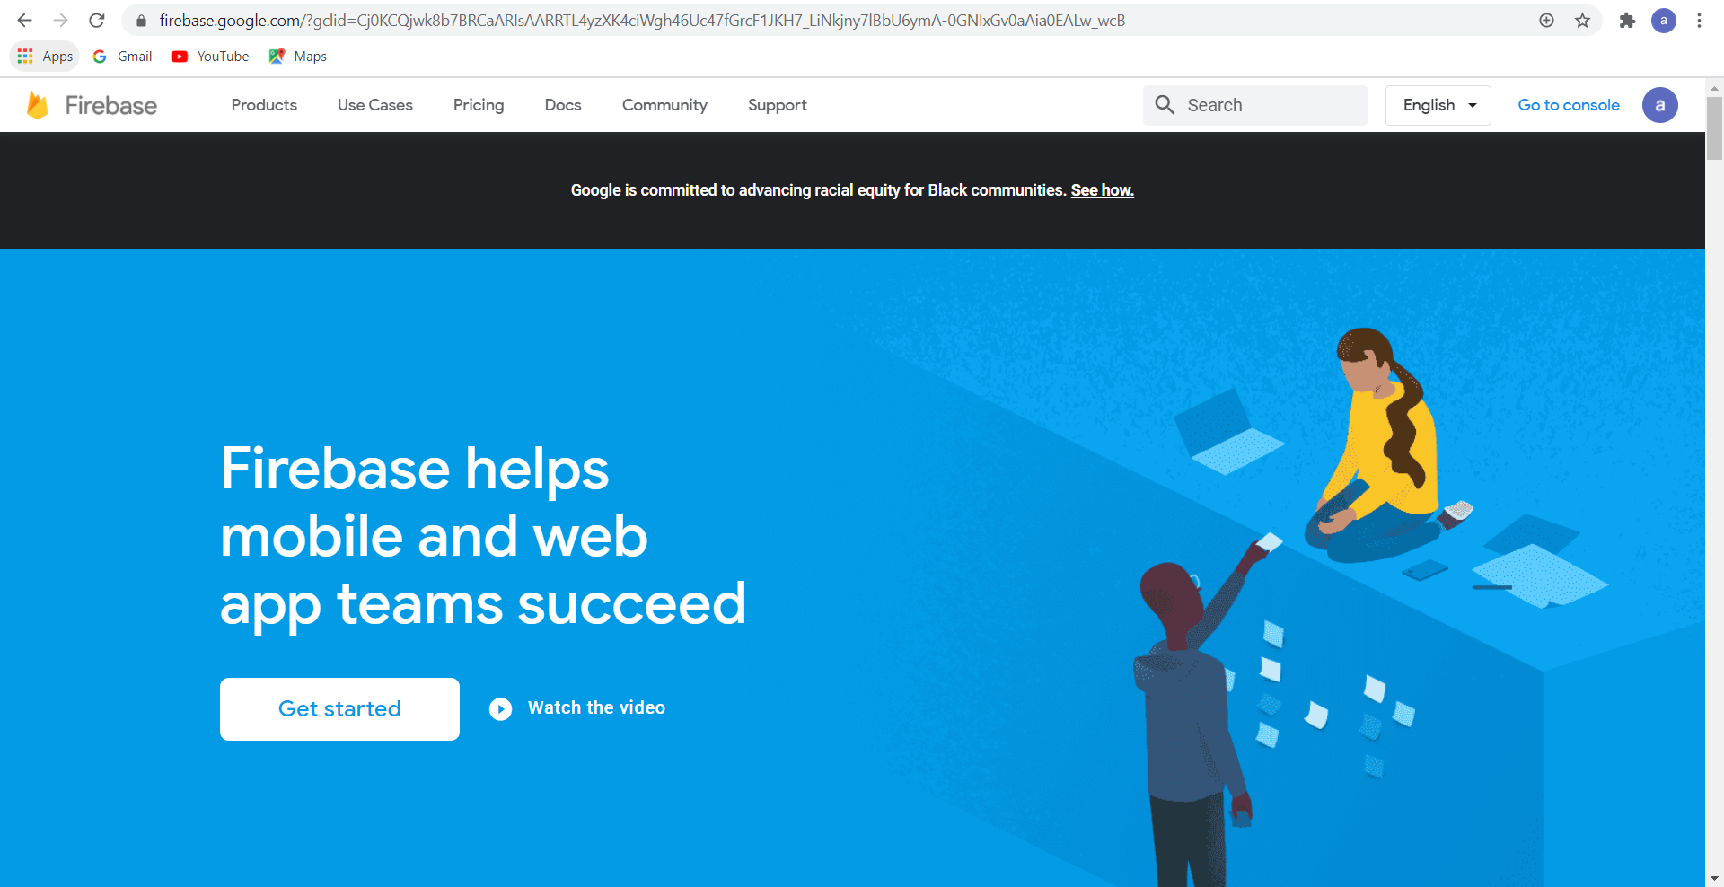
Setting Up the Cloud Database

Slide 13
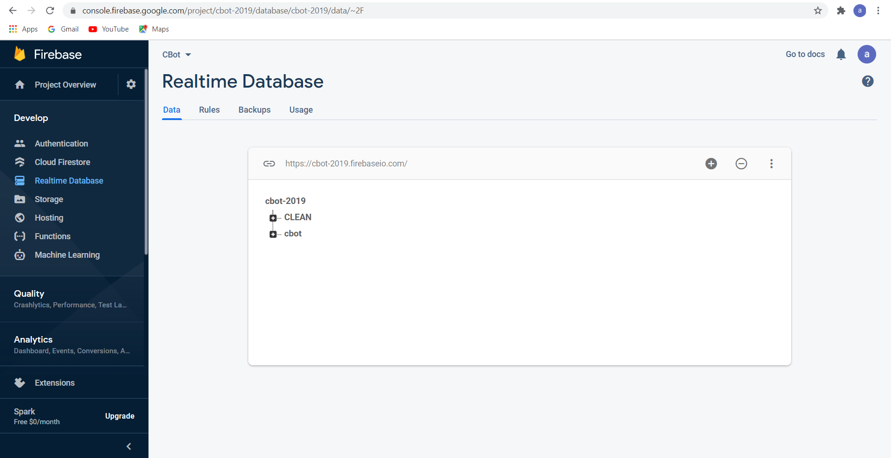
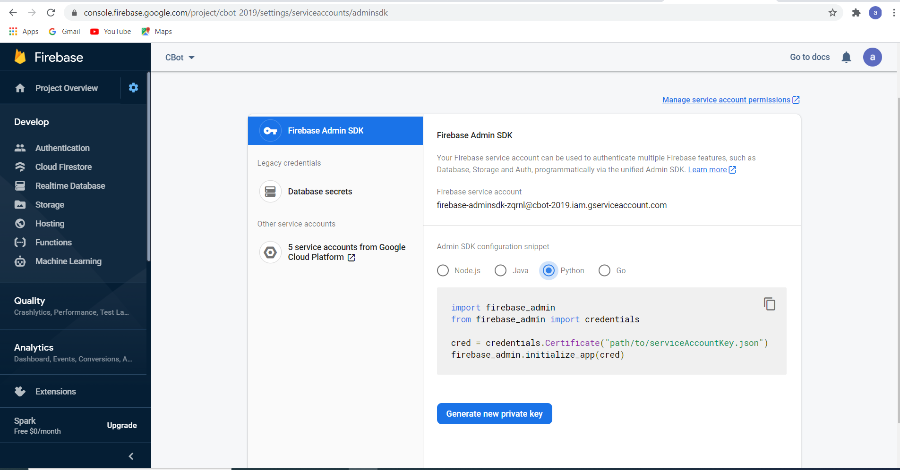
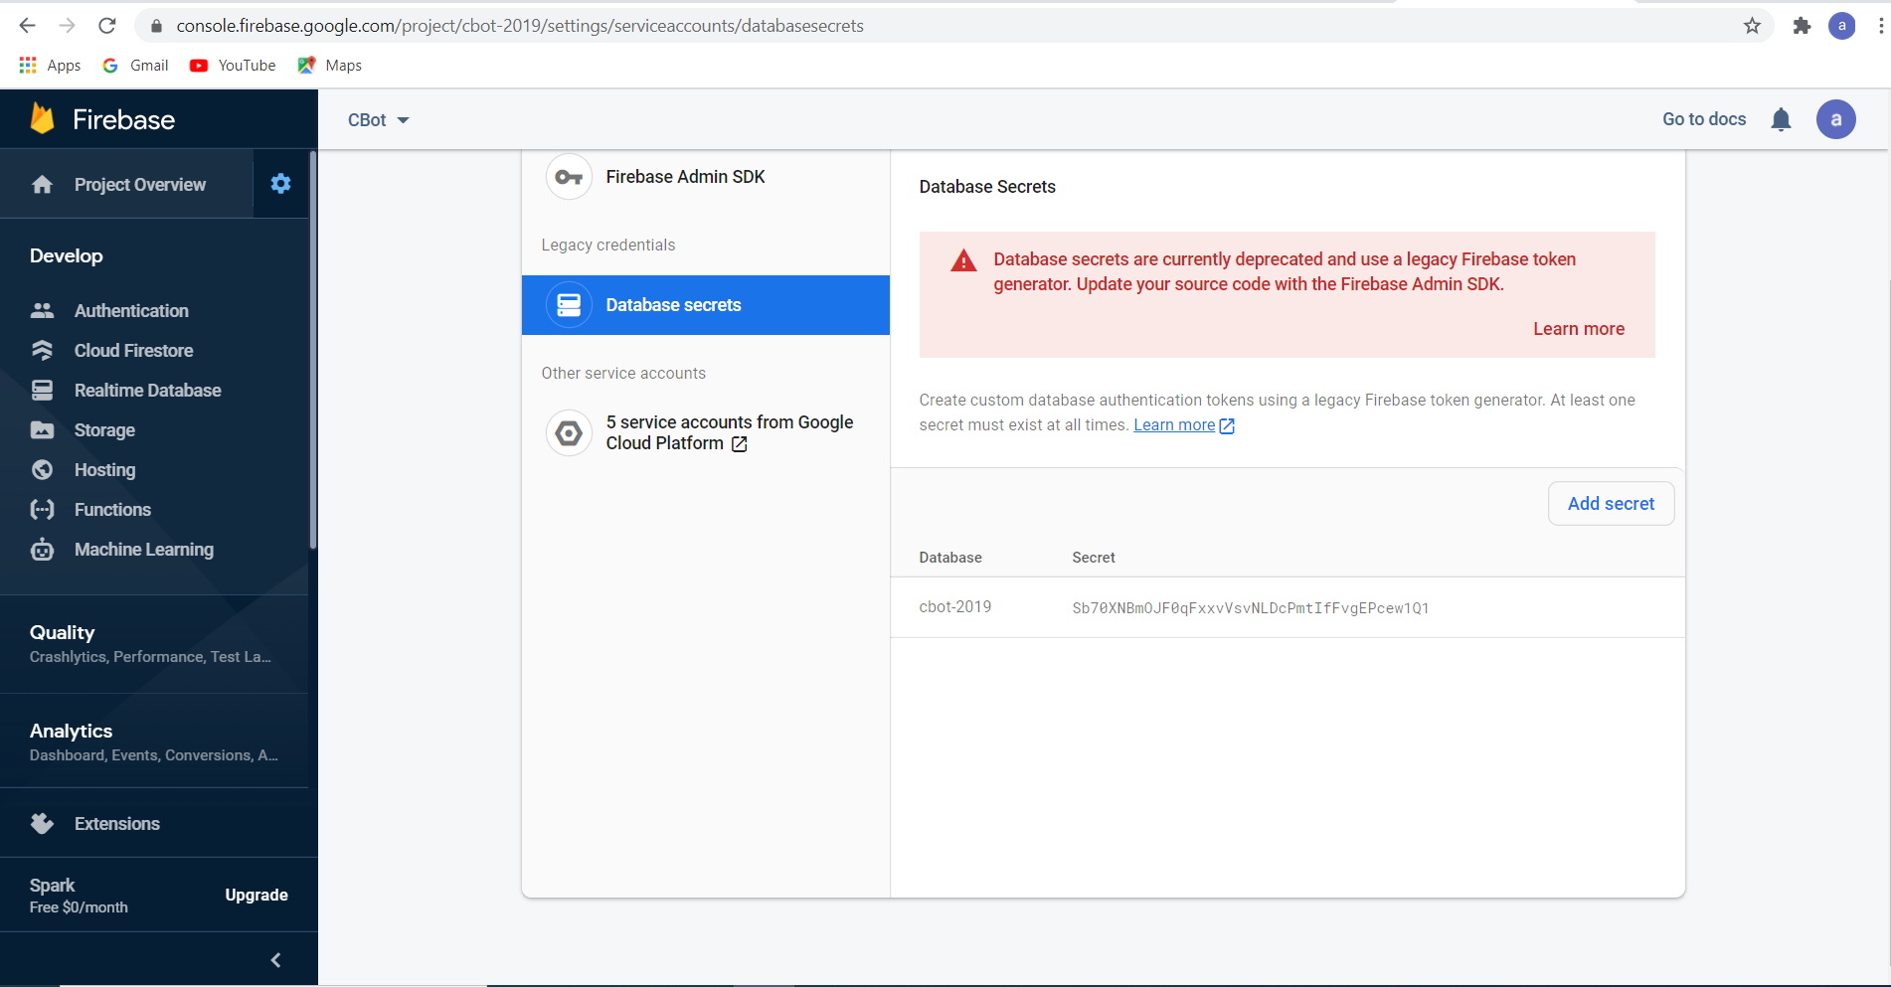

Slide 14
The first step is to create a database for the system so that you can communicate with the robot from your mobile app from anywhere in the world. We are using (Google firebase), which will lead you to the Firebase website (we must log in with your Google account). Click on the "Get Started" button which will take you over to the firebase console. Then create a new project by clicking on the "Add Project" button, fill in the requirements (name, details, etc) and complete by clicking on the "Create Project" button.
We just require Firebase's database tools, so select "database" from the menu on the left-hand side. Next click on the "Create Database" button, select the "test mode" option. Next set the database to a "realtime database" instead of the "cloud firestore" by clicking on the drop-down menu at the top. Select the "rules" tab and change the two "false" to "true", finally click on the "data" tab and copy the database URL, this will be required later on.
The last thing that you will need to do is to click on the gear icon next to the project overview, then on "project settings", then select the "service accounts" tab, finally click on "Database Secrets" and note down the security code of your database. With this step complete, you have successfully created your cloud database which can be accessed from your smartphone and from the Raspberry Pi. (Use the pictures attached above in case of any doubts, or just drop a question in the comment section)

Slide 15
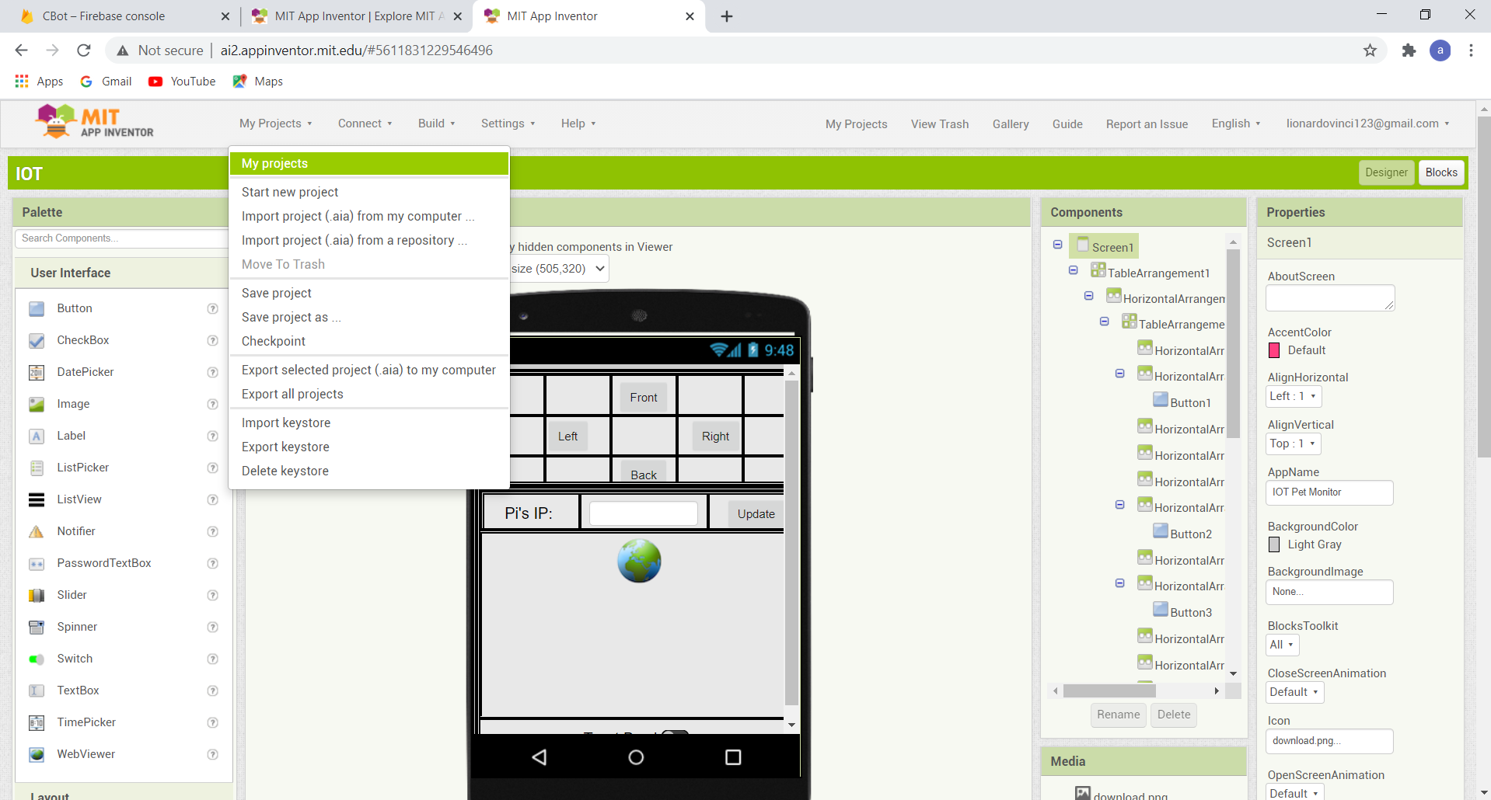
Creating the Mobile App

Slide 16
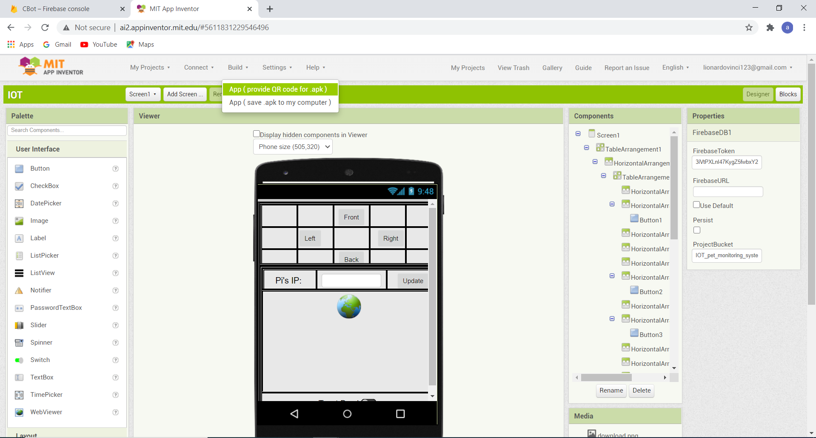
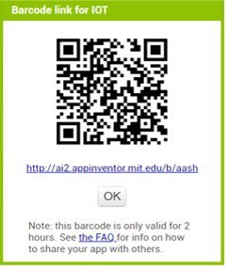

Slide 17
The next part of the IoT system is the smartphone application. We decided to use MIT App Inventor to make our own customized app. To use the app that we created first open the following link (MIT App Inventor), which will lead you to their webpage. Next click on "create apps" towards the top of the screen, then log in with your Google account.
Create a new project just give its name and we can also import a project by given below
.Open the "projects" tab and click on "Import project (.aia) from my computer" next select the file that you just downloaded and click "ok". In the components window, scroll all the way down till you see "FirebaseDB1", click on it and modify the "FirebaseToken", "FirebaseURL" to the values that you had kept a note of in the previous step. Once these steps are complete you are ready to download and install the app. You can download the app directly onto your phone by clicking on the "Build" tab and clicking on "App (provide QR code for .apk)" then scanning the QR code with your smartphone or clicking "App (save .apk to my computer)" you will download the apk file onto your computer which one can then shift to your smartphone.

Slide 18
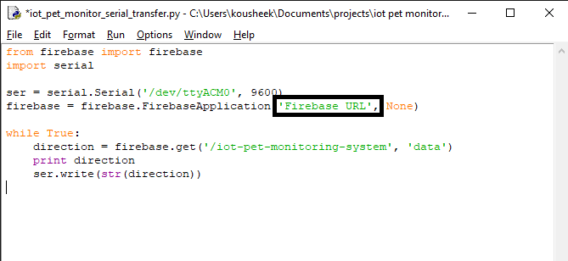
Programming the Raspberry Pi

Slide 19
The Raspberry Pi is used for two primary reasons.
It transmits a live video stream from the robot to a web server. This stream can be viewed by the user using the mobile app.
It reads the updated commands on the firebase database and instructs the Arduino to perform the required tasks.
For setting up the Raspberry Pi to live-stream, a detailed tutorial already exists and can be found here. The instructions boil down to three simple commands. Switch on the Raspberry Pi and open the terminal and enter the following commands.
git clone https://github.com/silvanmelchior/RPi_Cam_Web_Interface.git
cd RPi_Cam_Web_Interface
./install.sh
Once the installation is complete, restart the Pi and you should be able to access the stream by searching http://your Pi's IP address on any web browser.
With the live streaming set up, you will need to download and install certain libraries to be able to use the cloud database. Open up a terminal on your Pi and enter the following commands:
sudo pip install requests==1.1.0
sudo pip install python-firebase
Finally, download the python file attached below and save it on your Raspberry Pi. On the fourth line of the code change the COM port to the port the Arduino is connected to. Next, change the URL on line 8 to the firebase URL you had kept a note of earlier. Finally, run the program through the terminal. This program fetches the commands from the cloud database and relays it to the Arduino through the serial connection.

Slide 20
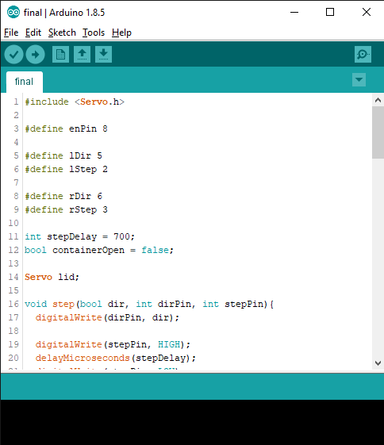
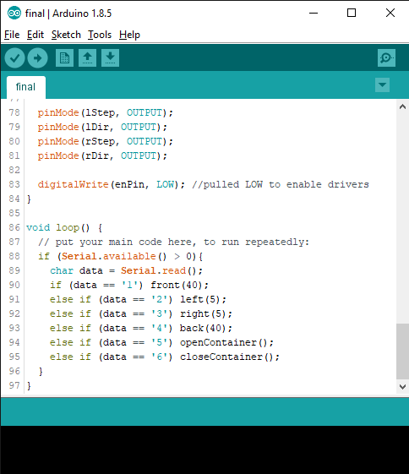
Programming the Arduino

Slide 21
The Arduino is used to interpret the commands from the Pi and instructs the actuators on the robot to perform the needed tasks. Download the Arduino code attached below and upload it onto the Arduino. Once the Arduino is programmed, connect it to one of the Pi's USB ports using the dedicated USB cable.
The robot will be powered off a 3 cell lipo battery. The battery terminals need to be split into two, where one goes directly to the CNC shield to power the motors, while the other gets connect to the 5v UBEC, which created a steady 5v power line which will be used to power the Raspberry Pi through the GPIO pins. The 5v from the UBEC is connected to the 5v pin of the Raspberry Pi and the GND from the UBEC is connected to the GND pin on the Pi.

Slide 22
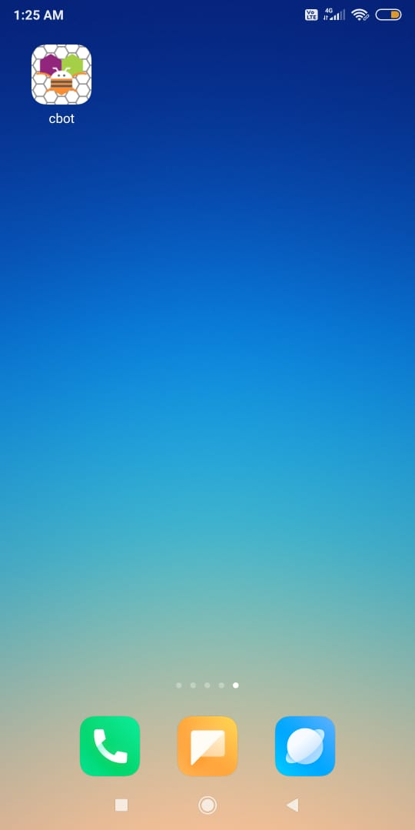
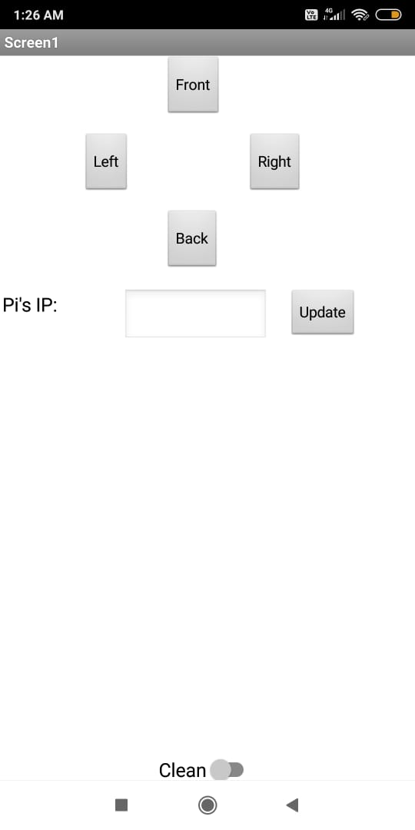
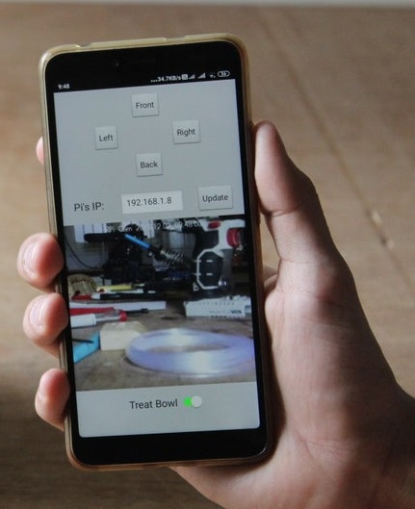
Using the App

Slide 23
The interface of the app allows one to control the monitoring robot as well as stream a live feed from the onboard camera. To connect to your robot make sure you have a stable internet connection and then simply type in the Raspberry Pi's IP address in the provided textbox and click the update button. Once done, the live feed will appear on your screen and you should be able to control the various functions of the robot.
Real Time Project Video Link :https://drive.google.com/file/d/1p5iKalj7L87cWMcq7hTSqPqVna_LLdJb/view?usp=sharing

Slide 24


