Slide 1

IILM UNIVERSITY, GREATER NOIDA
INTERNSHIP REPORT PRESENTATION
Data Analytics
Job Simulation
Deloitte Australia | Forage Virtual Experience Program
Aditya Kumar
Roll No. 2410031161 | B.Tech CSE, Section 2CSE7
September 2026

Slide 2






ABOUT THE STUDENT
Candidate Profile
Roll Number
2410031161
Aditya
Kumar
Institute
IILM University, Greater Noida, U.P.
B.Tech – Computer Science & Engineering
Programme
B.Tech CSE, Section 2CSE7, Batch 2024–2028
Internship Domain
Data Analytics & Forensic Technology
Duration
Self-paced Virtual Simulation | Completed September 2026
Deloitte Data Analytics Job Simulation • Aditya Kumar
02

Slide 3



ABOUT THE PROGRAM
Deloitte & Forage
Deloitte is one of the world's leading professional services networks and a “Big Four” accounting and consulting firm, operating across audit, tax, risk advisory, enterprise technology, and strategy consulting. Deloitte partners with Forage, a virtual work-experience platform, to deliver open-access Job Simulations that let students worldwide practise real, on-the-job tasks – free of cost and selection rounds.
Deloitte Australia
Forage Platform
Verified Certificate
Simulation designed and supported by Deloitte Australia's data-analytics practice.
Hosted on Forage – a free, self-paced virtual work-experience programme.
Certificate of Completion verified by Deloitte's Chief HR Officer, Tina McCreery.
Deloitte Data Analytics Job Simulation • Aditya Kumar
03

Slide 4




PROBLEM STATEMENT
Bridging Theory and Applied Analytics
Although many engineering students learn the theoretical foundations of data analytics and statistics in coursework, very few get structured, hands-on exposure to applying these concepts to messy, real-world business datasets in a consulting context. Concepts such as data unification, dashboard design, and forensic data analysis are often understood only theoretically – with little practice cleaning data, building visualisations, and defending evidence-based conclusions.
This internship addressed that gap – practically learning the full analytics-to-forensics workflow:
→
→
→
Unify Data
Analyse Trends
Forensic Investigation
Report Findings
Deloitte Data Analytics Job Simulation • Aditya Kumar
04

Slide 5






PROJECT OBJECTIVES
What the Simulation Set Out to Achieve
Unify Raw Data
Identify Trends
Build Dashboards
Consolidate telemetry data from four global factories, supplied as one JSON file, into a single dataset.
Detect operational bottlenecks and downtime patterns from the unified dataset.
Design an interactive Tableau dashboard to communicate insights to stakeholders.
Forensic Analysis
Classify Data
Report Conclusions
Apply a forensic algorithm in Excel to quantify gender pay equality across roles.
Classify complex workforce datasets to pinpoint where pay gaps are most prevalent.
Propose clear, evidence-based business conclusions to the forensic lead.
Deloitte Data Analytics Job Simulation • Aditya Kumar
05

Slide 6



TECHNOLOGIES & TOOLS
The Toolkit Behind the Simulation
Microsoft Excel
Tableau
JSON Data
Trend Analysis
Data cleaning & forensic analysis
Interactive dashboard design
Multi-source telemetry unification
Operational bottleneck detection
Forensic Techniques
Data Classification
Data Visualization
Forage Platform
Quantitative pay-equity analysis
Structuring complex workforce data
Stakeholder-ready reporting
Self-paced virtual work experience
Deloitte Data Analytics Job Simulation • Aditya Kumar
06

Slide 7




SYSTEM ARCHITECTURE
From Raw Data to Business Insight
Data Layer
Raw telemetry data from four global factories, supplied as a single JSON file
↓
Processing Layer
Data cleaning & unification into a structured, analysable dataset
↓
Analysis Layer
Trend and bottleneck analysis performed on the unified dataset
↓
Visualization Layer
Interactive Tableau dashboard presents insights to stakeholders
↓
Forensic Layer
Forensic algorithm in Excel quantifies gender pay equality by role & location
↓
Reporting Layer
Business conclusions compiled and proposed to the forensic lead
Deloitte Data Analytics Job Simulation • Aditya Kumar
07

Slide 8
METHODOLOGY
The Two-Task Simulation Journey
1
Data Analysis – Operational Insights
Unified telemetry data from four global factories (single JSON file) into one dataset. Identified operational bottlenecks and downtime patterns, and designed an interactive Tableau dashboard to visualise trends for Daikibo Industrials' stakeholders.
2
Forensic Technology – Pay Equity Investigation
Investigated an internal complaint of salary inequality across global roles. Applied a forensic analysis algorithm in Excel to quantify gender pay equality, classified complex datasets, and proposed conclusions to the forensic lead.
Note: This was a self-paced, unpaid virtual job simulation completed in September 2026; there was no stipend associated with it.
Deloitte Data Analytics Job Simulation • Aditya Kumar
08

Slide 9
EXPECTED OUTCOMES
Skills & Capabilities Gained
Ability to clean and unify raw, multi-source data (e.g., JSON telemetry data) into one analysable dataset
Practical understanding of identifying operational bottlenecks and trends from business data
Hands-on exposure to building interactive dashboards in Tableau for stakeholder communication
Capability to apply forensic, quantitative techniques in Excel to investigate workplace pay equity
Skill to classify complex datasets and draw defensible, evidence-based business conclusions
A completed Deloitte Data Analytics Job Simulation Certificate, verified by Deloitte's Chief HR Officer
Deloitte Data Analytics Job Simulation • Aditya Kumar
09

Slide 10
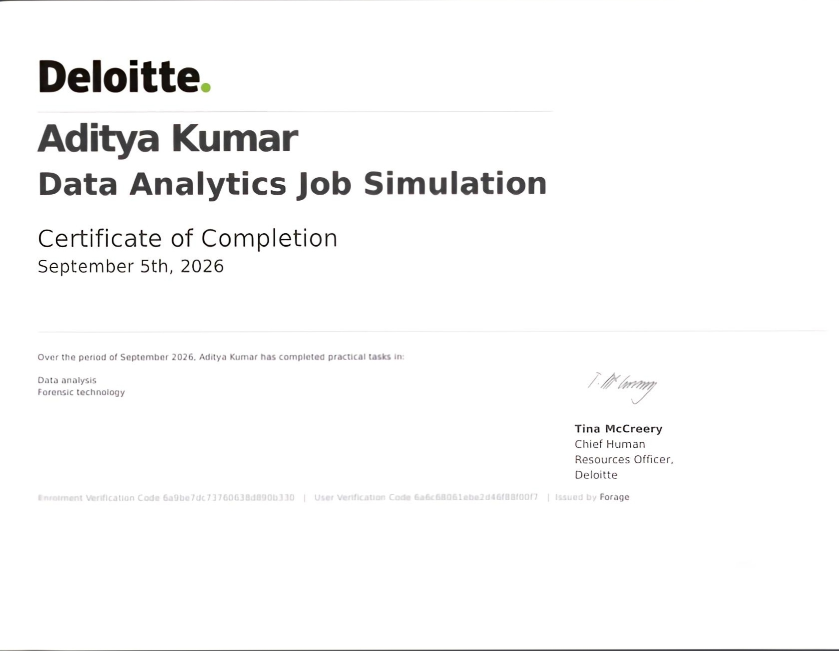

CERTIFICATION
Successfully Completed
Issuing Organization
Deloitte, verified by Tina McCreery, Chief Human Resources Officer
Platform
Forage
Date of Completion
September 5th, 2026
Practical Tasks
Data Analysis & Forensic Technology
Deloitte Data Analytics Job Simulation • Aditya Kumar
10

Slide 11
Thank You
Deloitte Data Analytics Job Simulation | Forage Virtual Experience Program
Aditya Kumar
Roll No. 2410031161 | IILM University, Greater Noida

