Slide 1
Capstone project
Telecom Churn

Slide 2
Telecom Churn Data set
At Mobicom, you are a business analyst and have been urgently called into a meeting with the marketing head and retention manager. The agenda of this meeting is to discuss the results of Industry survey reports that have been just released. In response to these reports, senior management at Mobicom is concerned that the market environment of rising churn rates and declining ARPU will hit them even harder as churn rate at Mobicom is relatively high. Currently they have been focusing on retaining their customers on a reactive basis when the subscriber calls in to close the account. But this alone does not seem to be enough and the management team is keen to take more initiatives on this front. One of these is to roll out targeted proactive retention programs, which include usage enhancing marketing programs to increase minutes of usage (MOU), rate plan migration, and a bundling strategy among others. To be able to effectively drive these retention strategies, a few key questions of interest require urgent attention and you been given the task of showcasing data based insights and recommendations relating to subscriber churn.

Slide 3
Churn Market Survey Report
Mobile operators who lead in loyalty outperform their competition in network and service quality, as well as in customer care, according to the 2014 Acquisition and Retention Study Report from Nokia. While retention drivers vary by market maturity, delivering excellent quality keeps customers happy and loyal. The study results also show that churn continues to keep operators on their toes with 40% of customers globally planning to switch provider in the next 12 months. Cost and billing plays a key role across markets when deciding to stay with an operator, but is specifically important for emerging markets where 49% of customers consider it to be the most important factor when deciding to stay with an operator, with network and service quality following at 25%. When it comes to data usage, the number of subscribers experiencing problems is high. Among the problems they report are slow download speeds (20%), data throttling (17%) and applications that don’t work (16%). Another key finding of the 2014 Acquisition and Retention Study Report is that recommendations from family and friends have gained in importance in the decision to switch operators. Subscribers who have switched operators in recent months reported two key information sources in their decision: the Internet and recommendation of family and friends.
Another report by Ovum forecasts a falling ARPU, which will continue to decline across all markets.

Slide 4
Proactive Retention Strategies
Usage based promotions to increase minutes of usage (MOU) for both voice and data. It is an accepted fact that low usage and high churn go hand in hand.
Rate Plan Migration is a strategy to move customers from non-optimal plans to optimal plans as it has been observed that subscribers on non-optimal rate plans have significantly higher odds of churn relative to subscribers on optimal rate plans.
Offer bundling and churn have been found to be negatively correlated. A family bundle is an option that is being considered especially in the light of one of the observations from the survey that referrals from family and friends are a deciding factor for switching carrier.

Slide 5
Definitions
Bundling : A bundling strategy involves offering several products/services for sale as one combined
product (e.g., package deal), using demand for the dominant product to sell a secondary offer. This combined product is offered at a discount price so that it is cheaper to buy the bundle than products separately.
Optimal rate plan : A post-paid wireless rate plan typically includes a fixed number of voice minutes that a customer can use per month. Usage exceeding the monthly allowance is called overage and is charged at a premium per-minute rate. Unless customers have a good understanding of their historical usage patterns and have the ability to predict their future wireless needs accurately, selecting an optimal rate plan to subscribe can be a challenging task. Conceptually, non-optimal rate plan subscribers could have saved money by switching to other more suitable plans to minimize overage. Specifically, customer’s rate plan suitability is determined based on their actual voice usage, the monthly rate of their selected plans, and the associated overage charges. Given that rate plan is not available on the data file, a proxy for non-optimal rate plan could be higher overage revenue as a percentage of total revenue.
Artificial churn/spinners or serial churners : “Artificial” churn may be encouraged by so called “spinners”, who disconnect and reconnect to the same network by taking advantage of offers available.

Slide 6
Agenda
Understanding Data: Creating a data quality report
Variable Profiling: Continuous Variables
Variable Profiling: Categorical Variables
Data preparation: Binning, missing value imputation, derived variables and dummy variable creation
Model Building: Using step wise to select variable
Final model
Creating customer segments

Slide 7
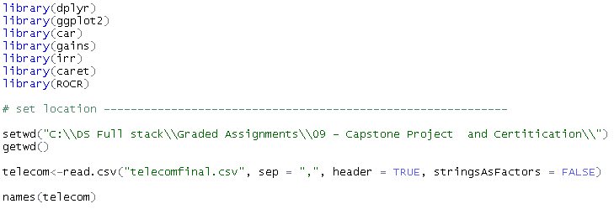
Understanding Data: loading libraries and Data set file path

Slide 8
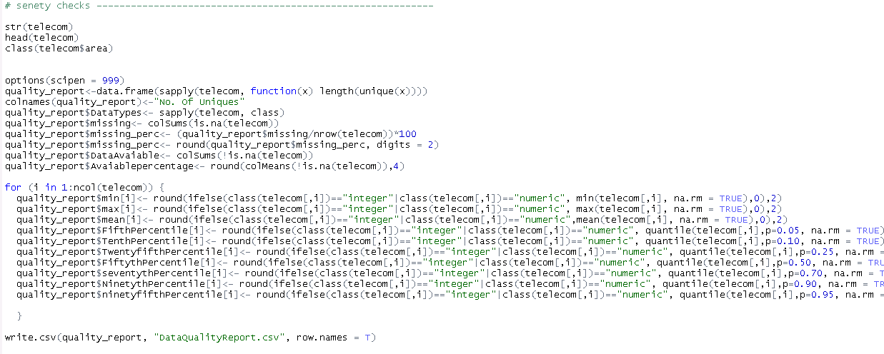
Understanding Data: Creating a data quality report

Slide 9
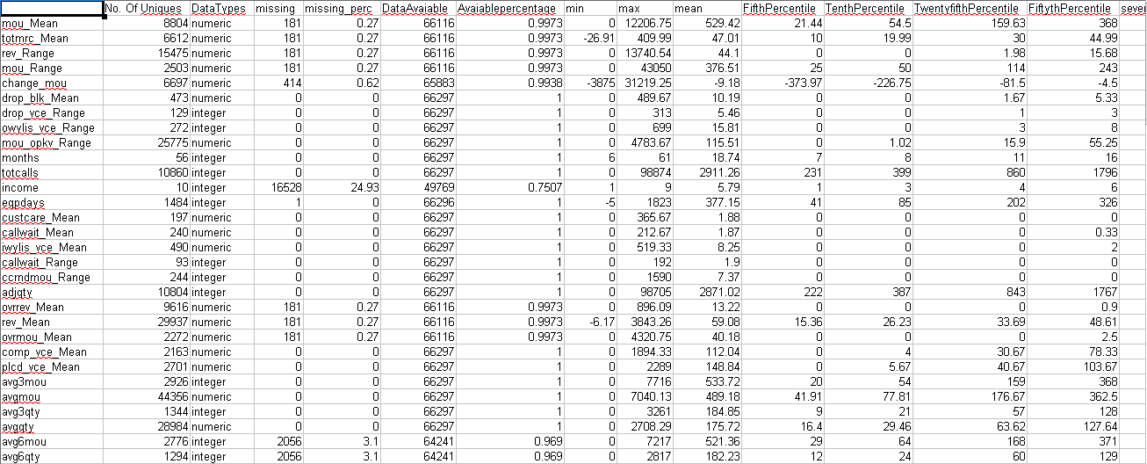
Understanding Data: Summary of the data set

Slide 10
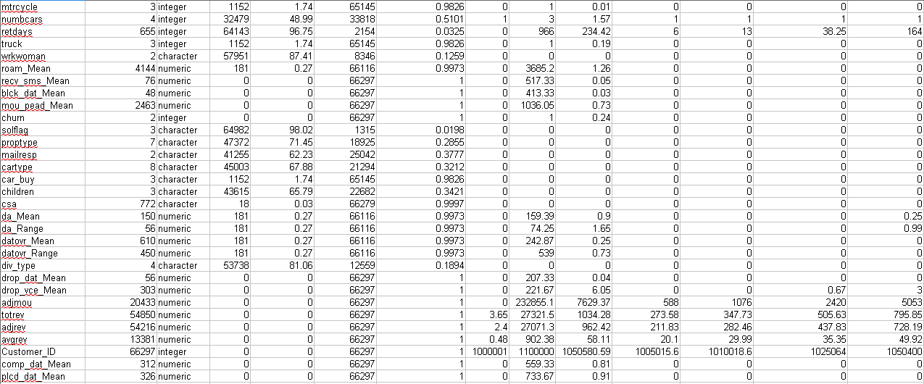
Understanding Data: Create a data quality report

Slide 11
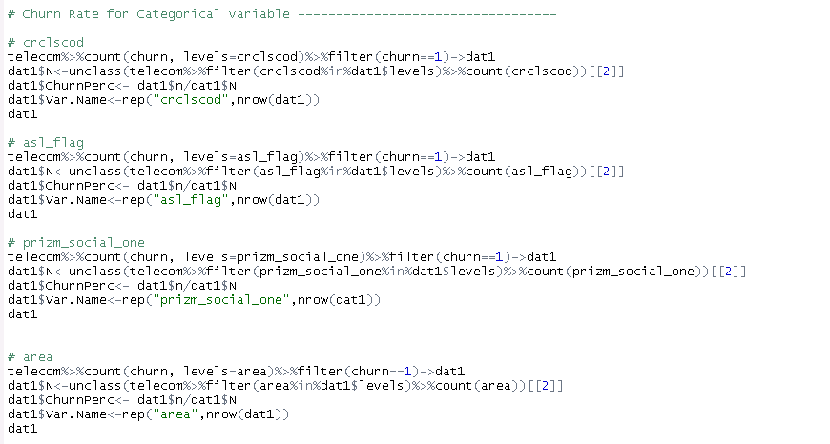
variable profiling for all categorical variables against churn

Slide 12
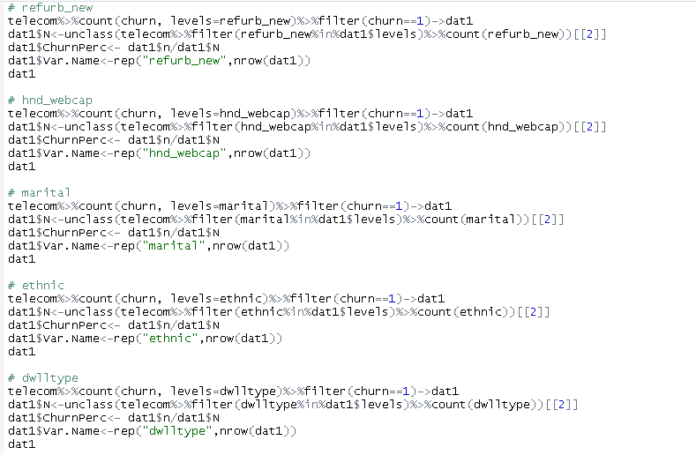
Variable Profiling: Categorical Variables

Slide 13
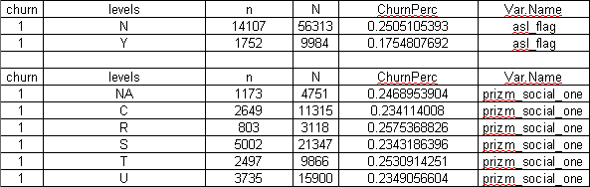
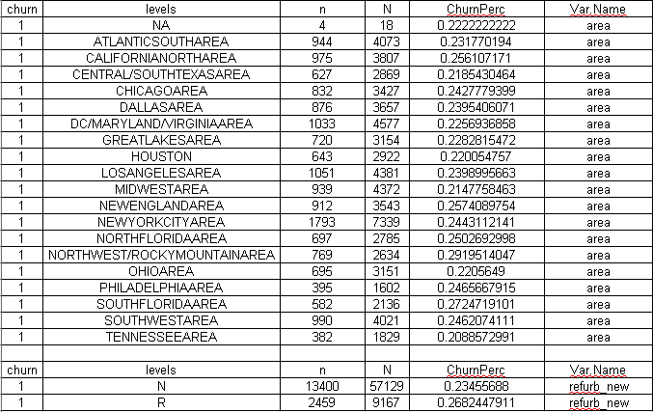
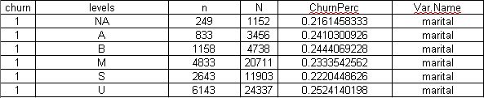
Variable Profiling: here we can see the event rate for all categorical variables, it look like below the table

Slide 14
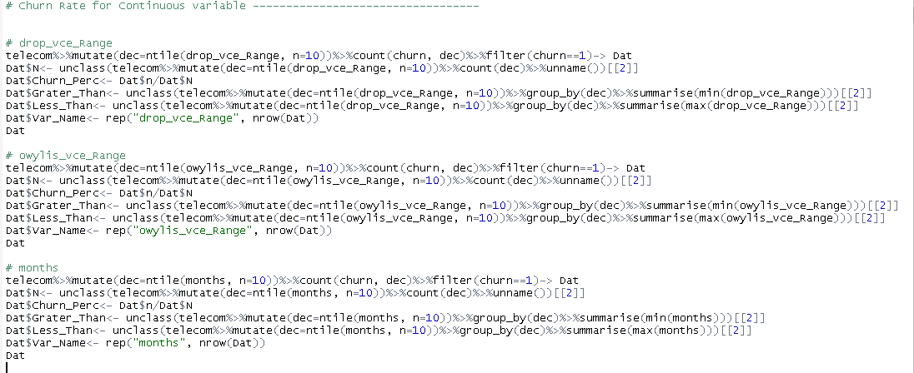
variable profiling for all continuous variables against churn

Slide 15
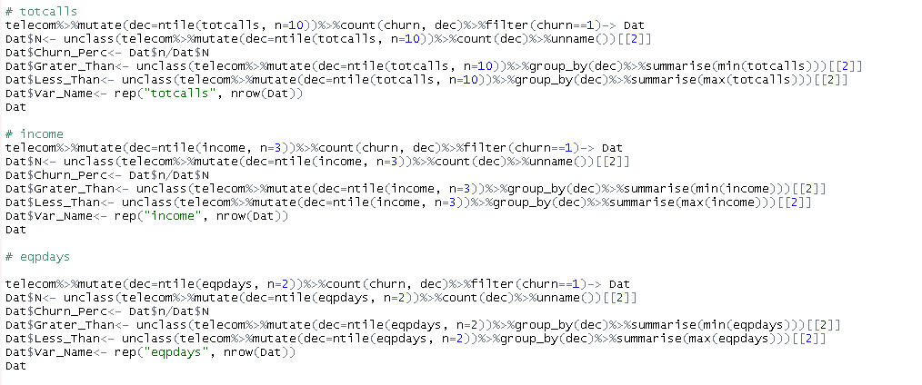
Variable Profiling: Continuous Variables

Slide 16
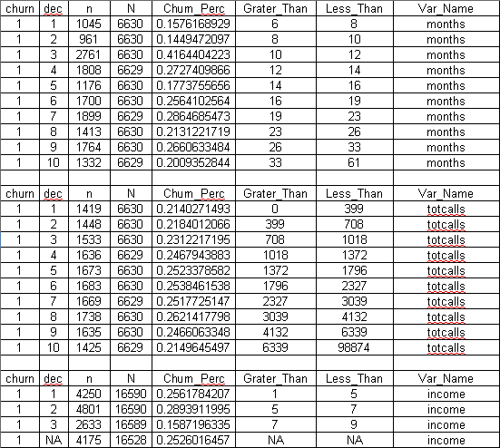
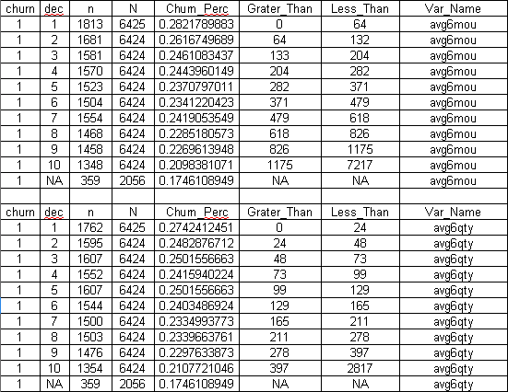
Variable Profiling: here we can see the event rate for all continuous variables, it look like below the table

Slide 17
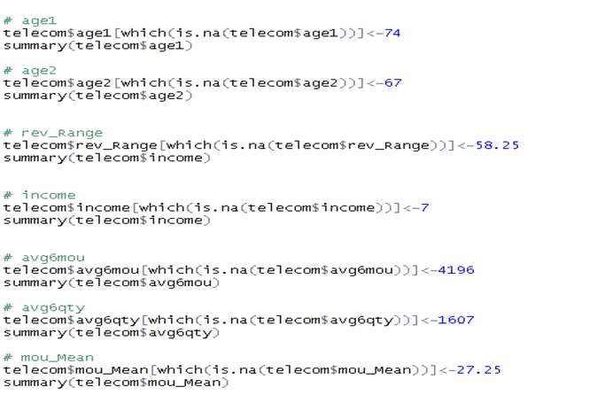
Data preparation :missing value imputation for all Continuous variables and categorical variables

Slide 18
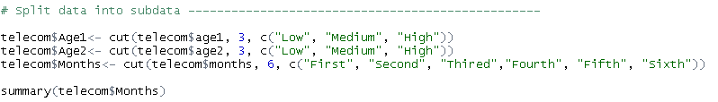
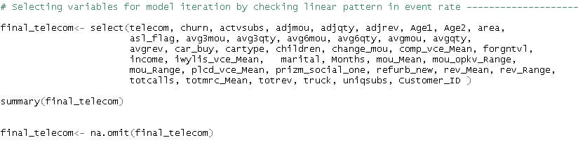
derived variables for model iteration

Slide 19
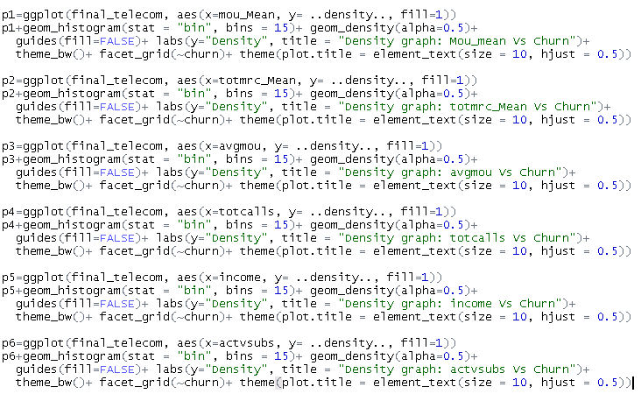
Data Visualization

Slide 20
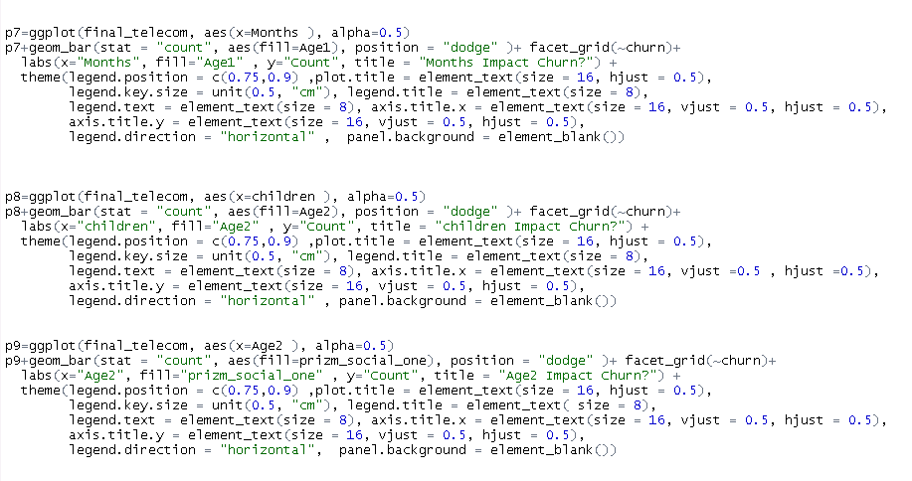
Data Visualization

Slide 21
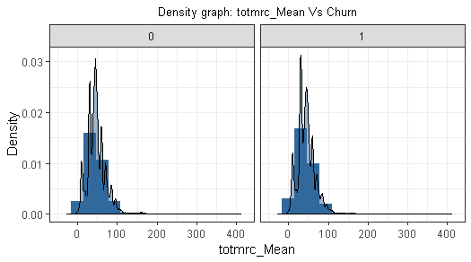
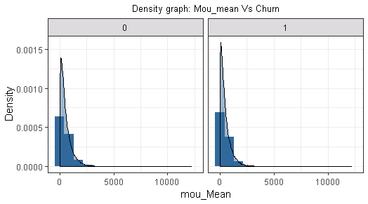
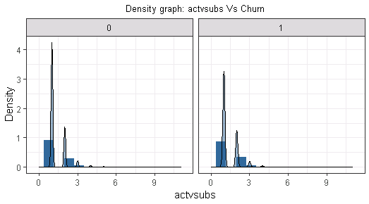
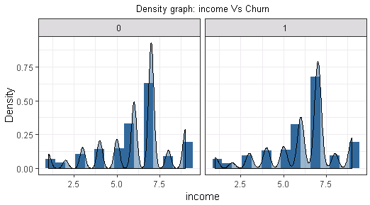
Data visualization: univariate analysis

Slide 22
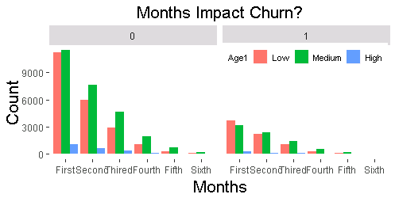
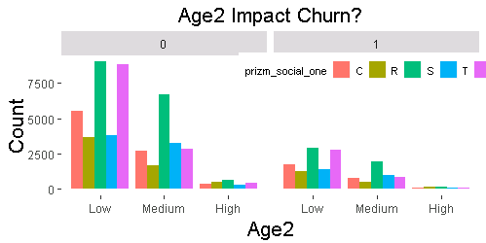
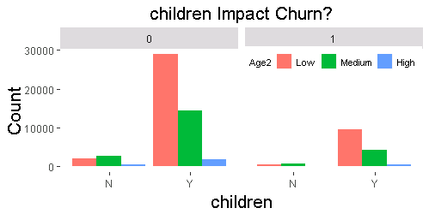
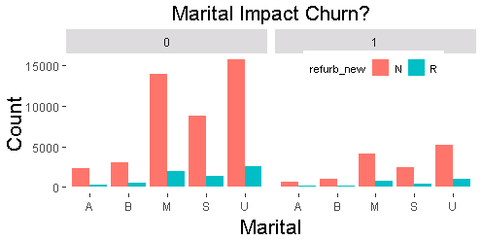
Data visualization: Multivariate analysis

Slide 23
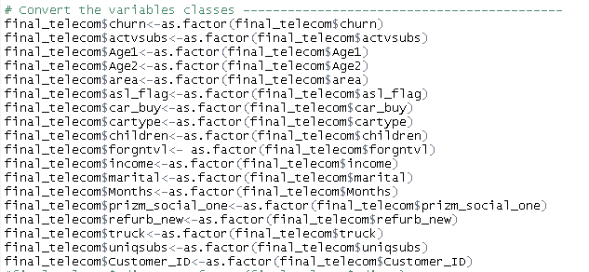
Convert the variable classes into factor

Slide 24
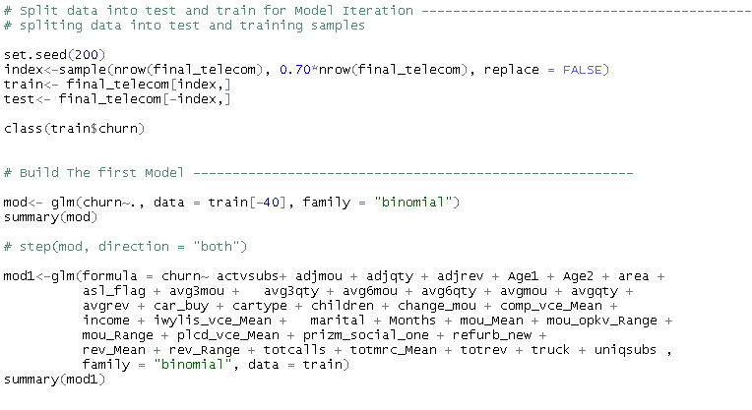
Split data into train and test data set for model iteration and create model using logistic regression

Slide 25
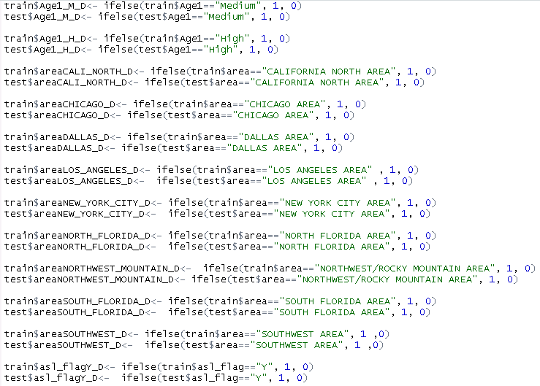
Creating dummies of significant variables for model iteration

Slide 26
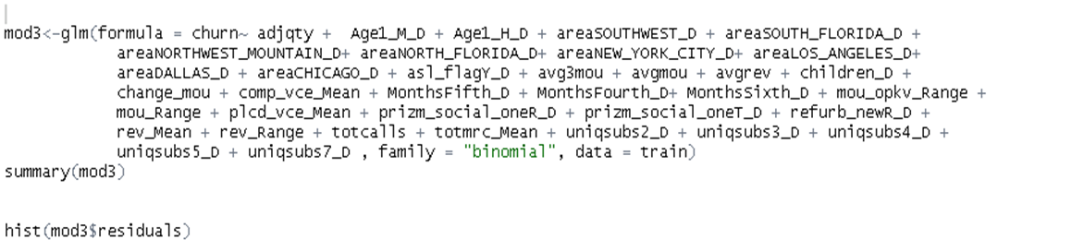
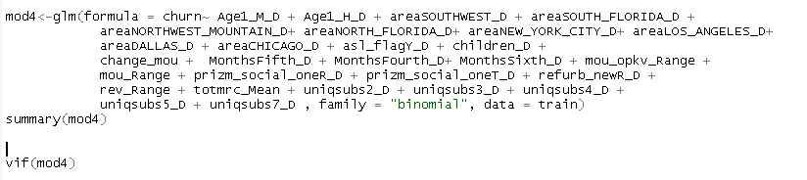
Re-run the model to find significant estimators

Slide 27
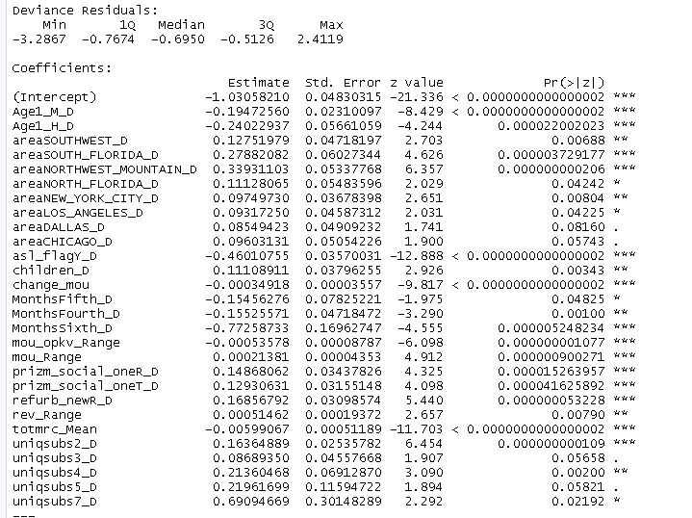
Model 4th of all variables are significant

Slide 28
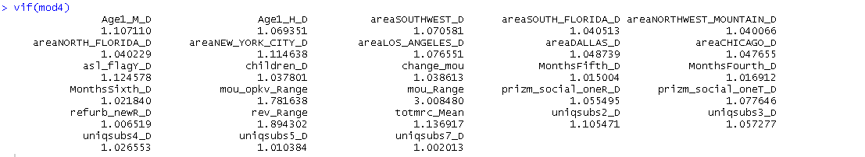
Check multicollinearity

Slide 29
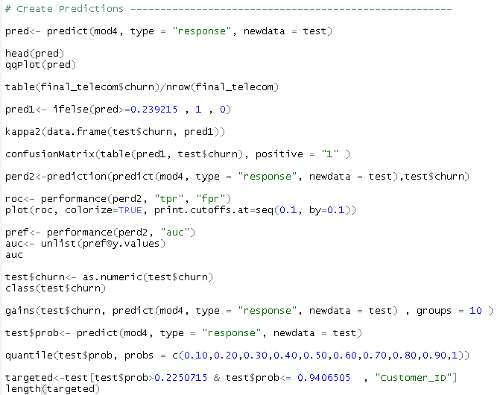
Create predictions

Slide 30

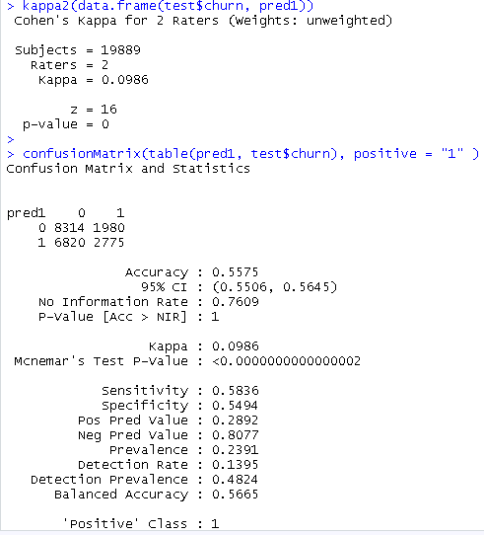


Calculate predictions to find accuracy

Slide 31
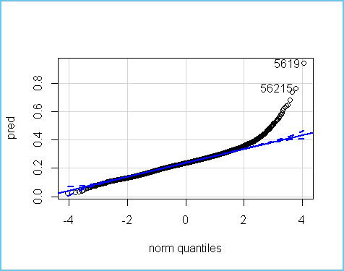
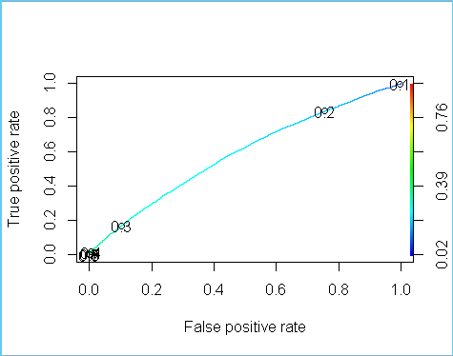
Find residuals and roc curve

Slide 32
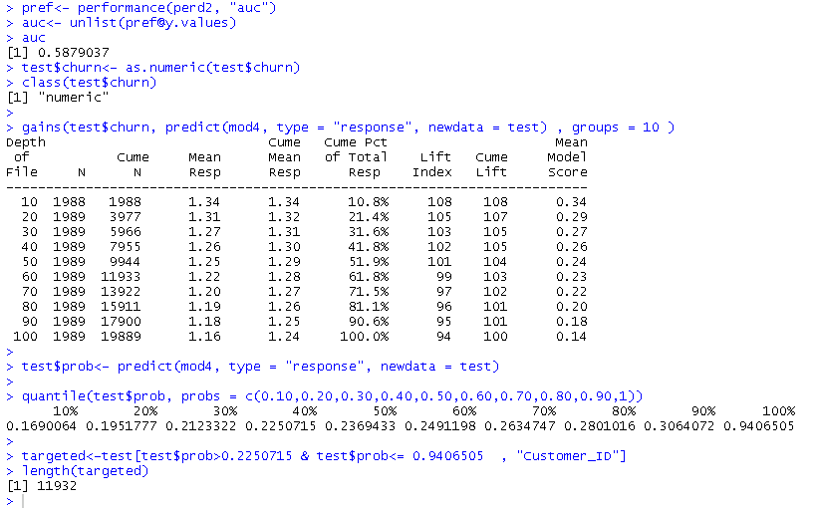
Predict target customer using gains chart

Slide 33
Top Line Questions of Interest to Senior Management:
What are the top five factors driving likelihood of churn at Mobicom?
Thus family bundles should be rolled out for families with 7 unique subscribers. Special offers should be given to customers who makes retention calls, at the earliest as per their grievances. Special plans should be rolled out for people with last Months . Special plans should be rolled out for customers located in NORTHWEST/ROCKY
MOUNTAIN AREA and SOUTH FLORIDA AREA.

Slide 34
Top Line Questions of Interest to Senior Management:
Validation of survey findings.
A) Whether “cost and billing” and “network and service quality” are important factors influencing churn behavior?
The following variables explain "cost and billing" and "network and service quality“:
Variables totmrc_Mean i.e. 'base plan charge' representing cost to customer, variable rev_Range i.e. 'Range of Revenue(charge amount)‘ representing billing amount, variable ovrrev_Mean = DATOVR_MEAN + VCEOVR_MEAN i.e. 'Mean overage revenue‘ (It is the sum of data and voice overage revenues) representing the overage revenue earned from customers after billing the same to them. and variable totrev i.e. 'Total revenue' representing total revenue earned from customers. And final model does not take tot_rev and rev_Range
Having said that, if we notice above mentioned beta values, a unit increase in them is having almost 0% impact on churn. SO it seems cost and billing is not very important factors here influencing churn behavior at Mobicom.

Slide 35
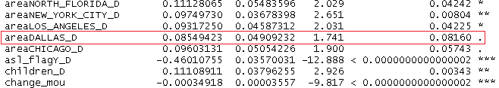
Top Line Questions of Interest to Senior Management:
B) The following variables explain "network and service quality“
Of the above variables, the beta coefficient of variable areaDALLAS_D is expressing a very important factor influencing Churn behavior. That is with the increase in the number of Months since a customer makes a retention call, the customer's chances of churning is very high. This could probably be because their grievances are not being catered to properly. These customers should be paid more attention to and special offers should be made to them depending upon their grievances.

Slide 36
Top Line Questions of Interest to Senior Management
Are data usage connectivity issues turning out to be costly? In other words, is it leading to churn?
comp_dat_Mean - Mean no. of completed data calls.
plcd_dat_Mean - Mean number of attempted data calls placed
opk_dat_Mean - Mean number of off-peak data calls
blck_dat_Mean - Mean no. of blocked / failed data calls
datovr_Mean - Mean revenue of data overage.
datovr_Range - Range of revenue of data overage
drop_dat_Mean - Mean no. of dropped / failed data calls
The Data Quality Report for all the above variables show that only 10% to 15% customers are actualy making data calls or using the internet. This could be a matter of concern since the global market survey report shows "Subscribers who have switched operators in recent months reported two key information sources in their decision: the Internet and ecommendation of family and friends. In this case it seems customers are not really using the internet. So it would be good to work towards attaining more customers to use data and also towards proving quality network connectivity and service to provide maximum customer satisfaction and reduce Churn. Since there is not enough usable data for the above variables they are not showing any influence on the Churn Behavior at Mobicom.

Slide 37
Top Line Questions of Interest to Senior Management
Would you recommend rate plan migration as a proactive retention strategy?
Variable ovrrev_Mean = DATOVR_MEAN + VCEOVR_MEAN i.e. 'Mean overage revenue‘. It is the sum of data and voice overage revenues representing the overage revenue earned from customers after billing the same to them. The variable ovrrev_Mean is eliminated by the final model so it is not showing a strong impact of overage billing as an influencer of churn behavior. Though this might be a matter of concern for few individual customers and they could be catered to on case to case basis. But overall rate plan migration as a proactive retention strategy might not help much at Mobicom.

Slide 38
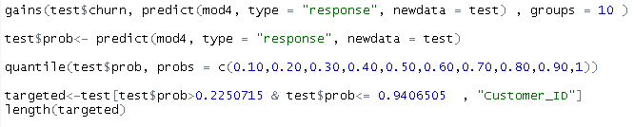
Top Line Questions of Interest to Senior Management
What would be your recommendation on how to use this churn model for prioritization of customers for a proactive retention campaigns in the future?
11932 of customers will use for a proactive retention campaigns in the future.

Slide 39
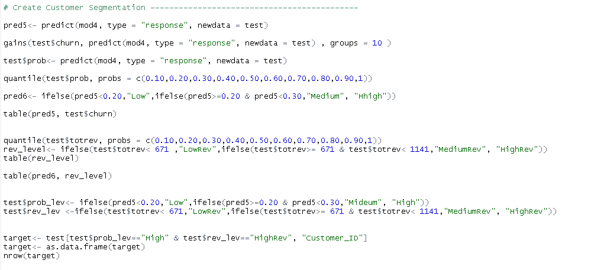
Create customer segments

Slide 40
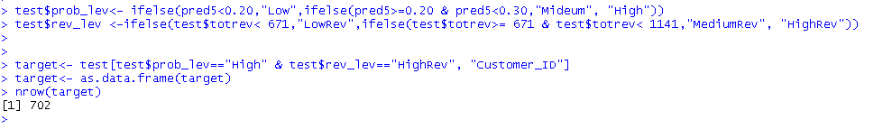
Top Line Questions of Interest to Senior Management
What would be the target segments for proactive retention campaigns? Falling ARPU forecast is also a concern and therefore, Mobicom would like to save their high revenue customers besides managing churn. Given a budget constraint of a contact list of 20% of the subscriber pool, which subscribers should prioritized if “revenue saves” is also a priority besides controlling churn. In other words, controlling churn is the primary objective and revenue saves is the secondary objective

Slide 41
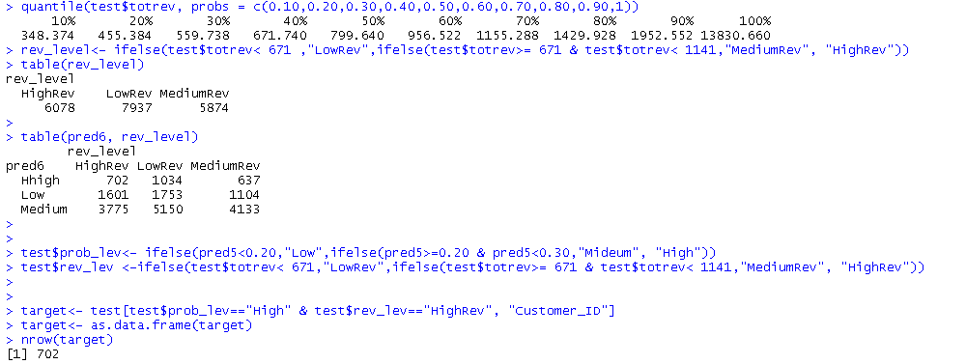
Create customer segments

Slide 42
Thank You

