Slide 1
CS308 Project
Tracktor
Team members
Aditya Kumar Akash (120050046) Team Leader
Nishant Kumar Singh (120050043)
Anurag Shirolkar (120050003)
JVS Shyam (120050053)

Slide 2
INTRODUCTION
System having a holder for objects like mobile and capable of tracking a person
We call it Tracktor as in Tracking Rotor
Suppose you are video calling and you want to move around or do other household work, you need your hands to be free from the mobile/tablet
Tracktor allows people to parallelize their household work with video calls or watching movies etc.

Slide 3
PROBLEM STATEMENT
The aim of the project is to design a system that tracks a user present in its view and orient itself towards them
The user should also be able to mount their own device such as mobile phone tablet on the system

Slide 4
REQUIREMENTS
Functional Requirements
The system should take input in the form of video feed or images at regular intervals
Using the input it should locate the user
It should allow user to mount his own device, such as a phone, on the system
The system should rotate the device towards the user

Slide 5
REQUIREMENTS
Non-functional Requirements
Correctness - The system should correctly track the user and rotate the device
Portability - It should be small and lightweight
Scalability - It should be able to hold any size of the device ranging from phone to tablets
Response time - the system should be quick
Price - it should be affordable

Slide 6
REQUIREMENTS
Hardware Requirements
Raspberry Pi
USB Camera
Servo motor
Power source - 5V adapters for both Rpi and the servo motor

Slide 7
REQUIREMENTS
Software Requirements
Raspbian OS
Python 2.7
OpenCV 2.4.5

Slide 8
SYSTEM DESIGN
Functional components of the system are
RPi - performs face detection and sends the signal to the servo motor
Camera - Sends continuous frames to the RPi
Motor - Rotates the system based on the input from RPi
Holder - Allows keeping mobiles firmly attached to the system

Slide 9
SYSTEM DESIGN
Interaction among components

Slide 10
SYSTEM DESIGN
FSM Representation

Slide 11
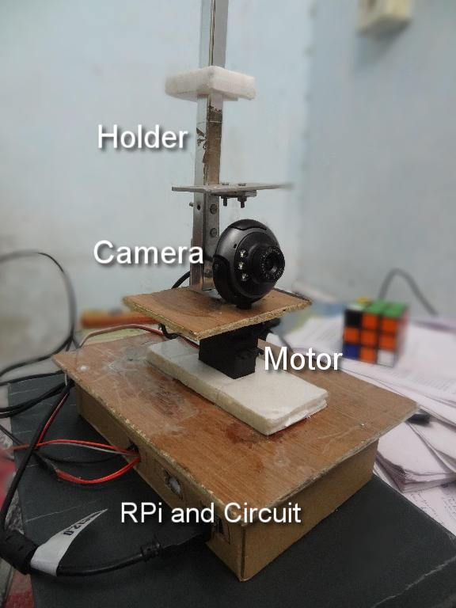
SNAPSHOT

Slide 12
WORKING OF THE SYSTEM
USB camera mounted on the rotating platter captures images and sends them to Raspberry pi for detecting faces
LBP classifier is used for face detection
Using the x-coordinate of the face detected the amount of rotation required for the camera is determined.
PWM signal with the calculated duty cycle is sent to the servo motor which then rotates the stand

Slide 13
TESTING
To test video input, we displayed the video frames on a computer
In the video shown on the computer we highlight the faces detected with a green rectangle, tested with various faces and backgrounds
Tried to mount a number of different sized devices on the system
The system correctly orients the device towards the user without letting the device fall or without having the weight of the device slow it down

Slide 14
DISCUSSION OF THE SYSTEM
What components worked as per plan
Camera
Raspberry Pi
Servo Motor
Nothing more was added to SRS
The motion detector was not used. Camera is used instead for the continuous feed
The system can only cover ~225° due to limited movement of servo motor

Slide 15
FUTURE WORK
Interfacing multiple cameras to cover 360° view, currently 1 camera covers only 53°
Incorporating motion sensor instead of camera if there is no movement, and using the camera only after movement is detected
Using only motion sensor to detect movement and rotating the motor using its data, this would make the system fast

Slide 16
CONCLUSION
Tracktor helps you parallelize household works with video calling or watching movies etc.
It is a system that tracks a user orients itself towards them
It can hold device with varying sizes and rotate them
Working Demo : https://www.youtube.com/watch?v=S-oK19eegDg

Slide 17
REFERENCES
OpenCV
Raspberry Pi

Slide 18
THANK YOU

