Slide 1
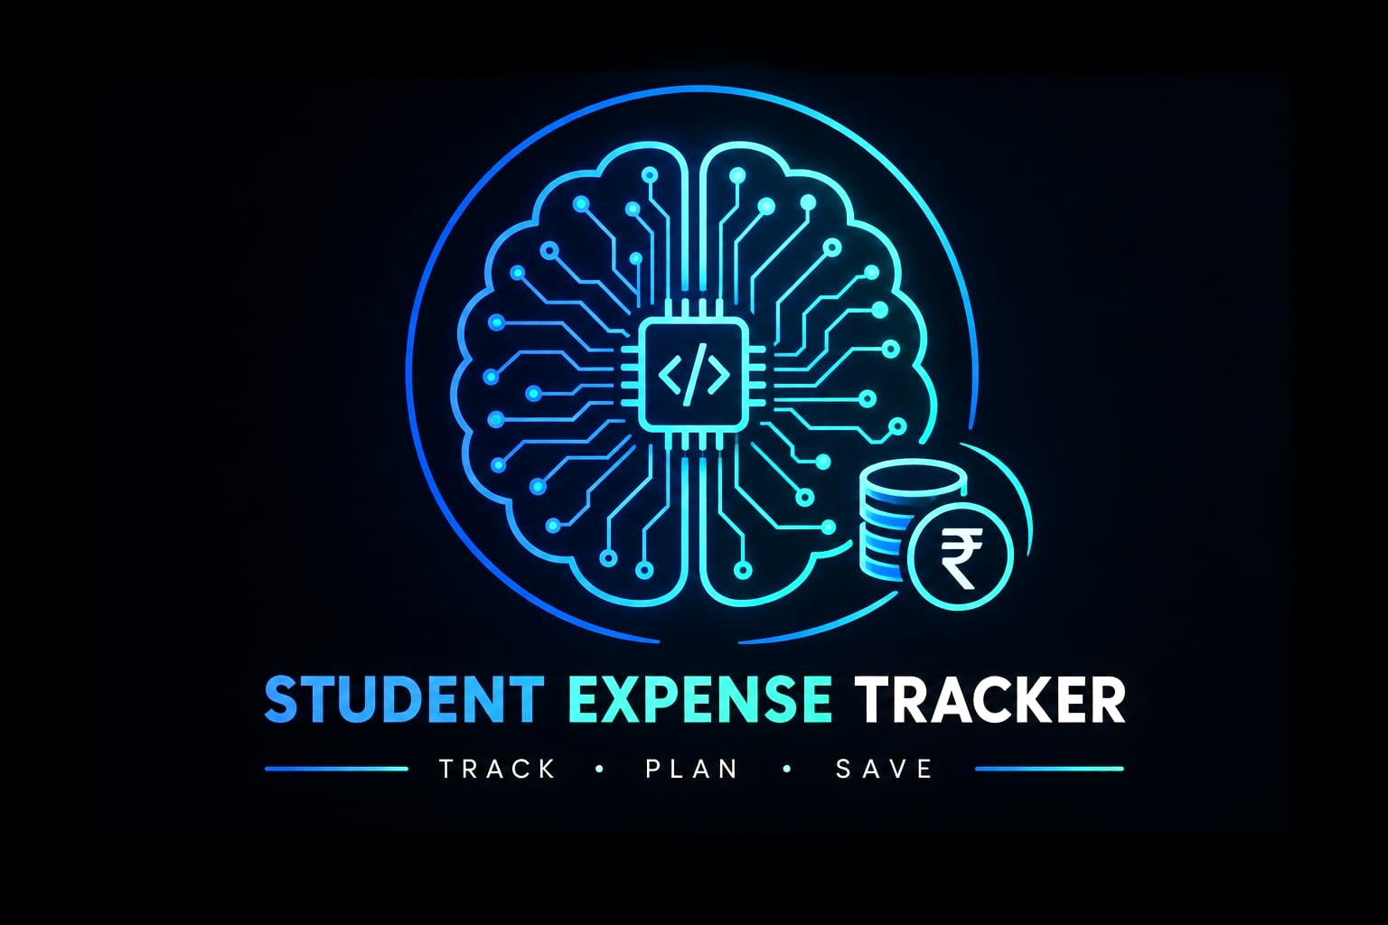
⌁ HACKATHON PROJECT
Student
Expense Tracker
Simple • Efficient • Smart
A C++ based console application to help students
manage their daily expenses easily.
TEAM
MEMBER
COLLEGE
CodeTracker
Aditya Kumar
TIT Bhopal Excellence
Hackathon • Project Presentation
CODETRACKER • STUDENT EXPENSE TRACKER
1/10

Slide 2
02
Problem Statement
◎
Students often find it difficult to track their daily expenses.
Small expenses are easily forgotten, students may not know where their money is being spent, and managing a monthly budget can be difficult.
KEY ISSUES
WHY IT MATTERS
• No proper tracking of daily expenses
• Small expenses are easily forgotten
• Manual tracking can be time-consuming
• Monthly budget management is difficult
A simple tracking system can give students a clearer view of their spending and support better budget awareness.
CODETRACKER • STUDENT EXPENSE TRACKER
2/10

Slide 3
03
Our Solution
✦
Student Expense Tracker
STUDENT EXPENSE
TRACKER
A simple C++ console application for recording and managing student expenses.
01
Record
Record daily expenses in one place.
Daily
₹ 650
Monthly
₹ 2,150
02
Organize
Organize expenses into categories.
Total
₹ 2,800
03
Calculate
Calculate total spending automatically.
04
Manage
Support better budget awareness.
Simple menu-driven workflow
CODETRACKER • STUDENT EXPENSE TRACKER
3/10

Slide 4
04
Main Features
＋
Expense Categories
Σ
Automatic Total Calculation
Organize expenses into different categories.
Calculate total spending automatically.
STUDENT • SIMPLE • PRACTICAL
STUDENT • SIMPLE • PRACTICAL
▤
Monthly Expense Summary
✓
Expense History
See the overall spending picture.
Keep a record of expense activity.
STUDENT • SIMPLE • PRACTICAL
STUDENT • SIMPLE • PRACTICAL
CODETRACKER • STUDENT EXPENSE TRACKER
4/10

Slide 5
05
Technology Used
C
O
D
G
C++
OOP
DSA
Git & GitHub
Programming & project logic
Organizing the project
Data handling
Version control
Core idea: use C++ for speed, efficiency and project logic, with OOP/DSA concepts for structure and data handling.
CODETRACKER • STUDENT EXPENSE TRACKER
5/10

Slide 6
06
How It Works
1
2
3
4
→
→
→
USER
MENU
PROCESS
RESULT
Enter an expense
Choose an option
Perform operation
Show output
Input → Category → Save → Calculate → Summary
CODETRACKER • STUDENT EXPENSE TRACKER
6/10

Slide 7
07
Project Demo
Project Screenshots & Demonstration
SCREENSHOT
SCREENSHOT
SCREENSHOT
ADD EXPENSE
EXPENSE HISTORY
TOTAL / SUMMARY
Add your actual project screenshot here
Add your actual project screenshot here
Add your actual project screenshot here
Use real screenshots from the working project for the final presentation.
CODETRACKER • STUDENT EXPENSE TRACKER
7/10

Slide 8
08
Future Scope
◫
Mobile and Web Application
▥
Expense Graphs and Reports
●
Monthly Budget Alerts
Bring the tracker to modern interfaces.
Visualize spending patterns.
Add budget reminders and alerts.
☁
Cloud Data Storage
✓
User Login and Authentication
Access data from anywhere.
Support account-based access.
CODETRACKER • STUDENT EXPENSE TRACKER
8/10

Slide 9
09
Team Contribution
Aditya Kumar
Team Member 2
01
02
C++ & Project Logic
Frontend / UI
Team Member 3
Team Member 4
03
04
Data / Database
Testing & Presentation
Team • CodeTracker | College • TIT Bhopal Excellence
CODETRACKER • STUDENT EXPENSE TRACKER
9/10

Slide 10
THANK YOU
Student Expense Tracker
Simple • Efficient • Smart
Any Questions?
CodeTracker • Aditya Kumar • TIT Bhopal Excellence
CODETRACKER • STUDENT EXPENSE TRACKER
10/10

